Slide 1
SecureVPN
Post-Quantum WireGuard
Network Security — Project Report
Submitted By
Muhammad Adeel Haider (241541) | Wazeema Eeman (241493)
Ainish Iqbal (241509) | Umar Farooq (241575)
Submitted To Ms. Areeba Fatima | Instructor, Network Security
Department National Cyber Security Academy (NCSA), Air University
May 2026

Slide 2
Presentation Overview
01
Introduction & Motivation
04
Security Architecture
Quantum threat, problem statement, objectives
Defence-in-depth, STRIDE, access controls
02
System Architecture
05
Deployment & Testing
Four-layer design, server components, protocol
Azure deployment, E2E verification, benchmarks
03
Cryptographic Design
06
Conclusion & Future Work
Hybrid PQ key exchange, Kyber-512 KEM
Summary, limitations, technology stack
KEY PROJECT HIGHLIGHTS
Hybrid X25519 + Kyber-512 post-quantum handshake with IND-CCA2
Production deployment on Microsoft Azure with automated installer
Defence-in-depth security with STRIDE threat modeling and rate limiting
~19ms PQ overhead during registration only; zero in-band impact
Windows Python client with CLI, GUI tray, and crypto engine

Slide 3
The Quantum Threat to VPN Security
Classical VPNs Are Vulnerable
Current VPN protocols (OpenVPN, IPsec, WireGuard) rely on ECDH and Diffie-Hellman key exchange — both breakable by Shor's algorithm on a quantum computer.
The Core Problem
"Harvest Now, Decrypt Later"
Quantum computing threatens the foundational cryptography that secures all existing VPN deployments.
Without post-quantum protection, sensitive communications intercepted today will be decryptable in the near future.
Adversaries can capture encrypted VPN traffic today and decrypt it once quantum computers become available. For long-lived sensitive data, this is an immediate risk.
NIST FIPS 203 (2024)
NIST published ML-KEM (Kyber) as the first post-quantum Key Encapsulation Mechanism standard, signalling urgent need for quantum-resistant network security.
Gaps in Current Solutions
Most VPNs lack API-level authentication, automated peer lifecycle management, and transparent post-quantum cryptographic hardening.

Slide 4
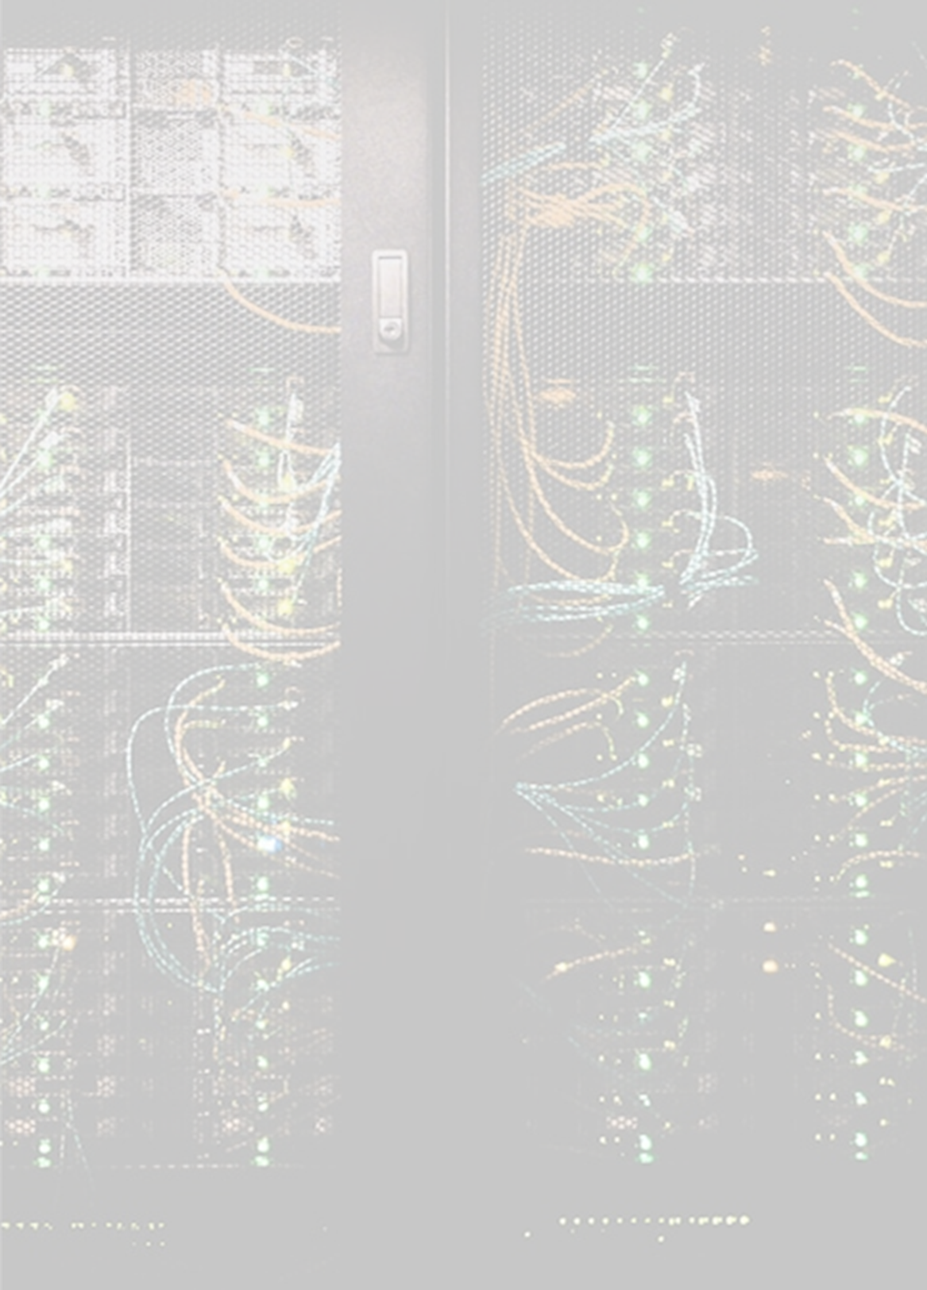
Project Objectives
01
Post-Quantum WireGuard VPN
Design and implement WireGuard with Kyber-512 KEM-derived Pre-Shared Key for quantum-resistant tunnels
02
Secure Authenticated REST API
Build HMAC-SHA256 signed API for peer management with replay prevention and rate limiting
03
Cloud Deployment on Azure
Deploy hardened Linux VPN server on Microsoft Azure with automated single-command installation
04
Defence-in-Depth Security
Implement least-privilege accounts, sudo wrappers, rate limiting, and anomaly detection
05
Cross-Platform Python Client
Provide Windows CLI client with GUI system-tray integration and crypto engine

Slide 5
Four-Layer System Architecture
CLIENT LAYER
Key Components
Python CLI/GUI, Crypto Engine (Kyber-512 + X25519), Tunnel Manager
Flask REST API
7 endpoints: health, status, add-peer, revoke-peer, audit, anomalies, pq-keygen
TRANSPORT LAYER
WireGuard (UDP 51820) + HTTPS API (TCP 443) for dual-channel communication
Nginx + Gunicorn
TLS 1.3 termination, HSTS, security headers, rate limiting at reverse proxy
SERVER API LAYER
Redis Backend
Nginx (TLS 1.3) → Gunicorn → Flask REST API with HMAC authentication
Distributed rate limiting with hardened config — dangerous commands disabled
Azure Deployment
Standard B1s VM, Ubuntu 24.04 LTS, East US (Washington) region
SYSTEM LAYER
WireGuard kernel module, Redis, UFW firewall, systemd services

Slide 6
Server-Side Components
Endpoint | Method | Description
/api/v1/health | GET | Unauthenticated health check — returns API, WireGuard, and system status
/api/v1/status | GET | WireGuard interface status and complete peer list with transfer statistics
/api/v1/add-peer | POST | Register new peer, trigger Kyber-512 KEM encapsulation and PSK derivation
/api/v1/revoke-peer | POST | Remove peer from WireGuard configuration and revoke all access
/api/v1/audit-peers | GET | Peer lifecycle audit — classifies peers as active, expiring, expired, or unknown
/api/v1/anomalies | GET | Handshake timeout and traffic anomaly detection for security monitoring
/api/v1/pq-keygen | POST | Server-side Kyber-512 keypair generation for post-quantum operations
Component Stack
WireGuard Interface
Gunicorn WSGI
Nginx Reverse Proxy
Redis Backend
Kernel-space wg0 on UDP 51820, VPN subnet 10.77.0.1/24, NAT masquerading via iptables
4 worker processes (gthread, 2 threads each) bound to UNIX socket /run/wg-api/wg-api.sock
TLS 1.3 termination on port 443, forwards to Gunicorn UNIX socket, rate limiting 20 req/min
Flask-Limiter distributed rate limiting, localhost-only, dangerous commands disabled
08

Slide 7
Protocol Sequence & Client Design
Hybrid PQ Registration Flow
1
2
3
4
5
Client generates Curve25519 and Kyber-512 keypairs locally
POST /add-peer
with client public keys to API server
Server encapsulates
KEM secret and derives PSK via HKDF-SHA3-256
wg set peer
with client PK and KEM-derived PSK
Client decapsulates
KEM secret, derives matching PSK, establishes UDP tunnel via Noise IKpsk2
Windows Client — CLI Commands
Client Crypto Engine
Command | Description
keygen | Generate keypair and register peer with server
up --profile | Establish WireGuard tunnel with KEM-derived PSK
down --profile | Disconnect and remove tunnel configuration
status | Display tunnel status and transfer statistics
verify | Run DNS/IP leak test to confirm VPN routing
rotate-psk | Rotate post-quantum PSK via re-encapsulation
● X25519 keypair generation (Curve25519)
● Kyber-512 KEM key generation & encapsulation
● HKDF-SHA3-256 PSK derivation from KEM secret
● AES-256-GCM credential encryption via DPAPI
● HMAC-SHA256 API request signing
● TLS 1.3 certificate fingerprint pinning
09

Slide 8
Hybrid Post-Quantum Key Exchange
Classical Layer: X25519 ECDH
PQ Layer: Kyber-512 KEM
Hybrid Security
WireGuard's standard Elliptic Curve Diffie-Hellman handshake using Curve25519.
Security: IND-CCA2 secure against classical adversaries.
Vulnerability: Broken by Shor's algorithm on quantum computers.
Key Encapsulation via Module-LWE with Fujisaki-Okamoto transform.
Security: IND-CCA2 quantum-resistant security.
Output: Shared secret derived as WireGuard PSK via HKDF-SHA3-256.
Adversary must break BOTH X25519 ECDH AND Kyber-512 to compromise the session.
Breaking only one leaves the other layer intact.
"Belts and suspenders" approach to cryptographic security.
+
=
Performance Characteristics
~19 ms
0 ms
Out-of-Band
ChaCha20
PQ overhead for peer registration
In-band traffic routing overhead
PQ operations only during registration
Kernel-space Poly1305 for in-band traffic
The ~19ms overhead occurs exclusively during out-of-band registration via the REST API. In-band WireGuard traffic uses highly optimized kernel-space ChaCha20-Poly1305 with the KEM-derived PSK — zero performance impact.
11

Slide 9
Kyber-512 KEM Implementation
Module-LWE Hardness
Fujisaki-Okamoto Transform
PSK Derivation
Security based on Module Learning With Errors:
R_{q} = Z_{q}[x]/(x^{n}+1)
Parameters: n = 256, q = 3329, k = 2
Ring dimension 512, security level ~AES-128 equivalent
Converts CPA-secure PKE to IND-CCA2 KEM:
● Deterministic randomness: r = SHA3-512(m||H(pk))
● Constant-time comparison via hmac.compare_digest
● Implicit rejection on mismatch
KEM shared secret via HKDF-SHA3-256:
● salt = None | info = "SecureVPN-PQ-PSK-v1"
● length = 32 bytes
Domain separation prevents PSK confusion with other keys.
API Request Authentication & Transport Security
HMAC-SHA256 Request Signing:
● sig = HMAC-SHA256(k, METHOD||":"||path||":"||t||":"||H_{SHA256}(body))
● 300-second replay window: server rejects |t_{server} - t_{client}| > 300s
● Signature in X-Signature header alongside X-API-Key and X-Timestamp
Transport Layer Security:
● TLS 1.3 with 4096-bit RSA server certificate
● Client pins server TLS certificate SHA-256 fingerprint
● Prevents MITM attacks via rogue certificates
● Plain HTTP on port 80 refused — HTTPS-only API
12

Slide 10
Defence-in-Depth Security Controls
Network Security
API Authentication
Access Control
TLS 1.3 with strong cipher suites, certificate fingerprint pinning, HTTPS-only API, UFW default-deny firewall
HMAC-SHA256 request signing, 300-second replay window, API key + timestamp validation on all mutating endpoints
Dedicated wg-api service account with no shell, three sudo wrapper scripts with strict regex argument validation
Rate Limiting
Anomaly Detection
Peer Lifecycle
Two-layer: Nginx (20 req/min per IP) + Redis-backed Flask-Limiter, /pq-keygen capped at 5 req/hour
Background monitoring for handshake timeouts and unusual traffic volumes per peer, exposed via /anomalies endpoint
Automated peer classification (active/expiring/expired) with daily systemd timer for revocation of stale peers
Security Principle: A compromise at any single layer does not grant an attacker control over the system. Each control operates independently.

Slide 11
Access Controls, Rate Limiting & Monitoring
Least Privilege
Rate Limiting
Monitoring & Lifecycle
Dedicated wg-api service account:
● No login shell (/sbin/nologin)
● No home directory
● Write access: /opt/wg-api/logs, /opt/wg api/config, /etc/wireguard
● Read access: /etc/wireguard/server/public.key only
Two-Layer Defence:
● Nginx layer: 20 requests/minute per source IP at HTTP level
● Flask-Limiter: Redis-backed endpoint limits
● /pq-keygen: 5 requests/hour per IP
● Fail-closed: app refuses to start if Redis unreachable
Anomaly Detection (monitor.py):
● Handshake timeout threshold monitoring
● Unusual traffic volume detection per peer
● Structured JSON logging for SIEM
● Exposed via /api/v1/anomalies endpoint
Sudoers Wrapper Scripts
Firewall Configuration (UFW)
Peer Lifecycle Management
wg-set-peer: Base64 PK + IP 10.77.0.x/32 validation
wg-remove-peer: Base64 PK format validation
wg-show: Only wg0, dump, conf subcommands
Zero wildcards — strict regex validation before kernel invocation
Default-deny incoming:
● 22/TCP — SSH | 443/TCP — HTTPS API
● 51820/UDP — WireGuard tunnel
Port 5000 (Flask dev) NOT opened
● Active: Handshake within 90 days
● Expiring: Approaching threshold
● Expired: No handshake > 90 days
● Unknown: Timestamp unavailable
Daily systemd timer auto-revokes expired peers
15

Slide 12
Azure Deployment & Configuration
Infrastructure
Automated Installation (12 Steps)
Systemd Configuration
Parameter | Value
Cloud Provider | Microsoft Azure
Region | East US (Washington)
VM Size | Standard B1s (1 vCPU, 1 GB)
Operating System | Ubuntu Server 24.04 LTS
Public IP | Static, assigned at provisioning
Storage | 30 GB Standard SSD
1. System package update & upgrade
2. Dependency installation (WireGuard, Nginx, Python, Redis)
3. Redis hardening (localhost-only, dangerous commands disabled)
4. Dedicated wg-api service user creation
5. API code deployment with CRLF correction
6. WireGuard server keypair generation
7. Interface configuration with NAT rules
8. Python virtual environment setup
9. API key generation (secrets.token_urlsafe(32))
10. Self-signed TLS cert (4096-bit , 10-year)
11. Sudoers rules and wrapper script
12. Nginx, systemd, UFW, fail2ban configuration
● Type=simple with ExecStartPre directives
● Socket directory created with correct ownership
● tmpfiles.d rule for boot-time socket dir
● wg-api-cleanup.timer runs daily for peer revocation
● fail2ban for SSH brute-force protection
NSG Inbound Rules
Windows Client Setup
Priority | Name | Port | Proto | Action
100 | Allow-SSH | 22 | TCP | Allow
110 | Allow-HTTPS | 443 | TCP | Allow
120 | Allow-WireGuard | 51820 | UDP | Allow
1. Install WireGuard for Windows
2. Create Python venv, install requirements
3. python securevpn_cli.py keygen <name>
4. python securevpn_cli.py up --profile <name>
5. python securevpn_cli.py verify (DNS leak test)
17

Slide 13
Testing Verification & Performance
Security Control Verification
End-to-End Connection Test
Control | Test | Result
Rate Limiting | 25 rapid requests to /health | 429 on req 21+
API Authentication | Request with invalid API key | 403 Forbidden
Replay Prevention | Re-send with old timestamp | 401 Unauthorized
Sudoers Restriction | Direct wg invocation as wg-api | Permission Denied
HMAC Signing | Tampered request body | 401 Unauthorized
TLS Enforcement | Plain HTTP on port 80 | Conn. Refused
Port Isolation | Port scan on 5000, 8000 | All Filtered
● Client generates Curve25519 + Kyber-512 keypairs
● POST /add-peer with public keys
● Server encapsulates KEM, derives PSK via HKDF-SHA3-256
● wg set peer configured with client PK + PSK
● Client decapsulates, derives matching PSK
● UDP handshake confirmed (wg show statistics)
● Internet connectivity verified through USA exit node
Cryptographic Performance Benchmarks
1,000 iterations on Azure Standard B1s server
~19 ms
Total Post-Quantum Overhead
Occurs exclusively during out-of-band registration via REST API. In-band WireGuard traffic routing experiences zero overhead via kernel-space ChaCha20-Poly1305.
18

Slide 14
Project Summary & Key Achievements
Hybrid PQ Handshake
Authenticated Management API
Defence-in-Depth Security
X25519 + Kyber-512 with IND-CCA2 security via Fujisaki-Okamoto transform
HMAC-SHA256 request signing with replay prevention and two-layer rate limiting
Dedicated service user, zero-wildcard sudoers, STRIDE threat modeling
Automated Peer Lifecycle
Single-Command Deployment
Windows Python Client
Anomaly detection with daily systemd timer for automatic stale peer revocation
Complete automated installer deploying full stack on Azure in 12 steps
CLI with GUI system-tray integration, full crypto engine, and DNS leak testing
Verification Result
The system was successfully deployed on Microsoft Azure and tested end-to-end. A Windows client established a post-quantum-protected WireGuard tunnel to the Azure VPN server with a KEM-derived PSK, with internet connectivity confirmed routing through the USA (Washington) exit node. All security controls validated successfully against the STRIDE threat model.
20

Slide 15
Limitations & Future Directions
Current Limitations
Future Work
Custom Kyber-512 implementation is an academic exercise. Production deployment should use an audited library such as liboqs or the NIST FIPS 203 reference implementation.
1
Replace custom Kyber with liboqs ML-KEM (FIPS 203) for production use
2
Implement web dashboard for peer management and traffic visualization
HMAC signing key is the same as the API bearer key. Production use should domain-separate them with HKDF for independent security boundaries.
3
Add multi-server support with anycast routing for geographic load balancing
4
Integrate with a certificate authority for automated TLS certificate management
Self-signed TLS certificate requires manual fingerprint pinning. A Let's Encrypt certificate with a proper domain name would be more user-friendly.
5
Develop mobile clients (Android/iOS) using the WireGuard mobile SDK
6
Implement PSK rotation scheduling with automatic re-encapsulation
Windows client falls back to plaintext master key storage on non-Windows platforms. Cross-platform credential protection needs improvement.
21

Slide 16
Thank You
Building quantum-resistant privacy for the future
SecureVPN - VPN System with Post-Quantum Cryptography
Questions are welcome

