Slide 1
Quickly Build App without Backend
(any)Frontend + Firebase
https://www.firebase.com

Slide 2
About Firebase
Real Time NoSQL Database
JSON Format
Edit data On UI (Dashboard)
Integrated Authentication
Firebase Hosting
Acquired by Google in October 2014
About Firebase

Slide 3
Why I use firebase
FIREBASE is NoSQL DB + WEBSOCKET
Easy to use
Can build an app without backend
Fast to config
Buid in auth
Support multiple paltform
Can manipulate(modifiy) data directly

Slide 4
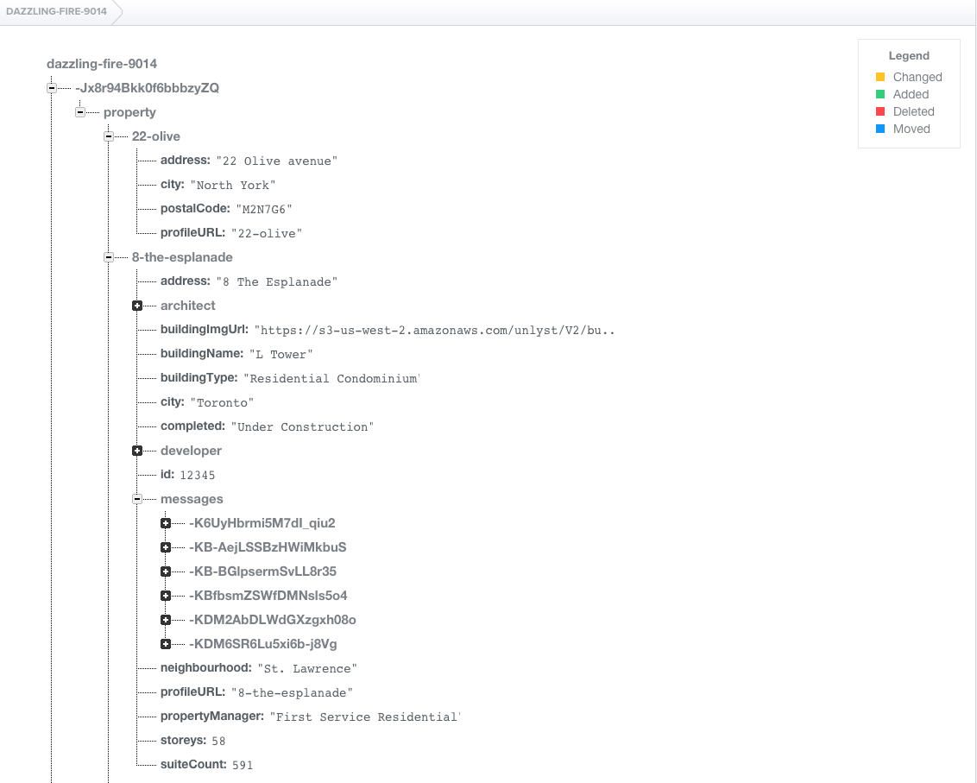
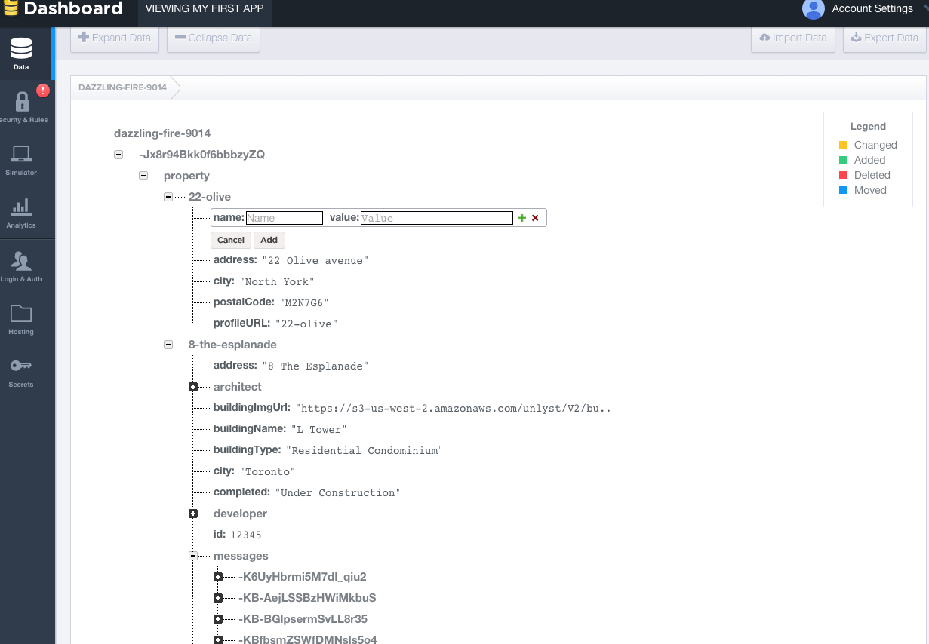

Slide 5
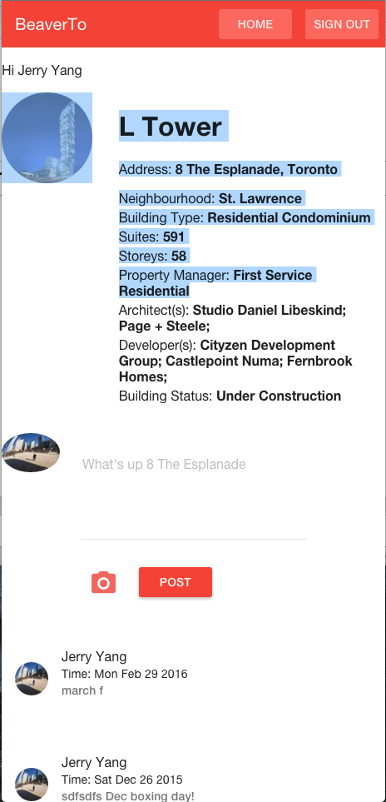
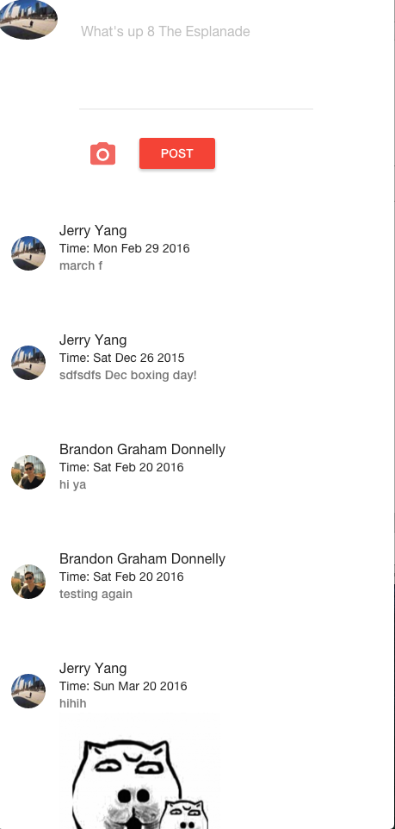
Simple Project
A building message app(from one of my side project
Login
Building portal
Real time message

Slide 6
How to config?
AngularFire
Initialization
var ref = new Firebase('https://dazzling-fire-9014.firebaseio.com/-Jx8r94Bkk0f6bbbzyZQ');
getAllPropertyArray: function() {return $firebaseArray(ref.child("property")); },
getPropertyArray: function(index) { return $firebaseArray(ref.child("property").child(index)); },
getPropertyObject: function(index) {return $firebaseObject(ref.child("property").child(index));},
getMessageArray: function(index) {return $firebaseArray(ref.child("property").child(index).child("messages"));},
getMessageObject: function() {return $firebaseObject(ref.child("property"));},
initAuth: function() {return $firebaseAuth(ref); }

Slide 7
Login && Authintication
$scope.auth=FirebaseService.initAuth();
$scope.auth.$authWithOAuthPopup("facebook")
.then(function(authData) {
console.log("Logged in as:", authData.uid);
$scope.authData = authData;
$scope.userImgUrl = $scope.authData.facebook.profileImageURL;
$scope.userName = $scope.authData.facebook.displayName;
}).catch(function (error) {
console.error("Authentication failed:", error);
});
$scope.auth.$unauth();
$scope.authData = null;

Slide 8
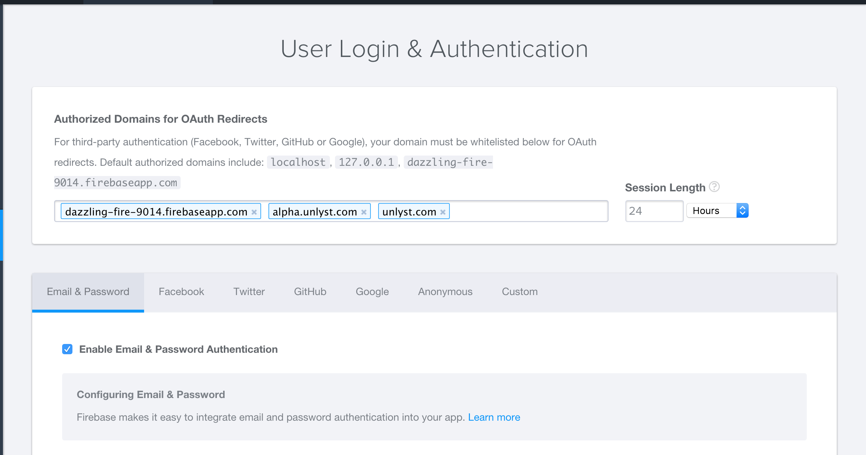
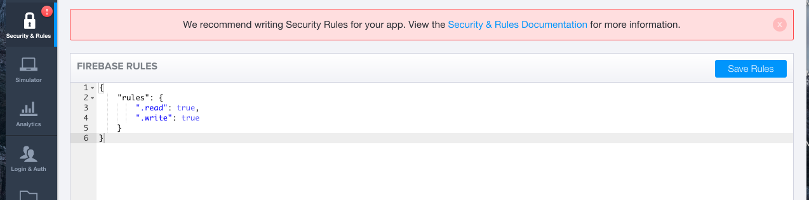
$scope.auth.$unauth(); $scope.authData = null;

Slide 9
Load Data
$scope.messages = FirebaseService.getMessageArray(profileId);
$scope.propertyObject = FirebaseService.getPropertyObject(profileId);
$scope.propertyObject.$loaded()
.then(function (result) {
//do something …..
});
$scope.messages.$add({
userName: $scope.authData.facebook.displayName,
userId: $scope.authData.auth.uid,
userImgUrl: $scope.userImgUrl,
body: $scope.postMessage,
messageImg: “some url”
postTime: postTime.toDateString()
}).then(function(ref) {
console.log("added to message list");
$scope.postMessage = ''; $scope.messageImg = '';
});

Slide 10
More
// Create a connection to your Firebase database
Firebase ref = new Firebase("https://<YOUR-FIREBASE-APP>.firebaseio.com");
// Save data
ref.setValue("Alex Wolfe");
// Listen for realtime changes
ref.addValueEventListener(new ValueEventListener() {
@Override
public void onDataChange(DataSnapshot snap) {
System.out.println(snap.getName() + " -> " + snap.getValue());
}
@Override public void onCancelled(FirebaseError error) { }
});
// Create a connection to your Firebase database
var ref = new Firebase("https://<YOUR-FIREBASE-APP>.firebaseio.com");
// Save data
ref.set({ name: "Alex Wolfe" });
// Listen for realtime changes
ref.on("value", function(data) {
var name = data.val().name;
alert("My name is " + name);
});

Slide 11
Supports:
Web (js)
Ios(objective-c)
Android(java)
Server side API

Slide 12
Resources:
https://www.firebase.com/docs/
https://www.firebase.com/tutorial/#gettingstarted
https://thinkster.io/topics/firebase

Slide 13
Use cases
Chat App
Reviews component…
Traffic app
More….

