Slide 1
BitTrade
04/30/2018
Your personal techno-intelligent bitcoin investment counsellor.
Priyal Lodaria| CEO, BitTrade Inc. Raunak Jodhawat| CEO, BitTrade Inc.
plodaria@andrew.cmu.edu rjodhawa@andrew.cmu.edu
(847)-877-7777 (412)-628-4310

Slide 2
Product Overview
There are many heterogeneous bitcoin networks, currently available in the market. However, there is no consolidated platform that intelligently helps us navigate the bitcoin market with ease.
BitTrade is a platform that allows the customer to enter the amount they want to invest, and based on the current trend of the market the platform recommends the quantity of bitcoins the customer should buy or sell.

Slide 3
Product Features
Continuous data stored and accessed in the database using threads.
Make predictions using TimeSeries forecasting.
Currency conversion.
Recommending the best possible transaction for a given dollar amount.
Market analysis.

Slide 4
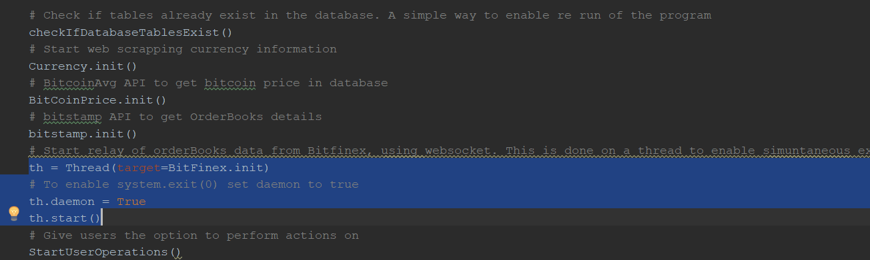
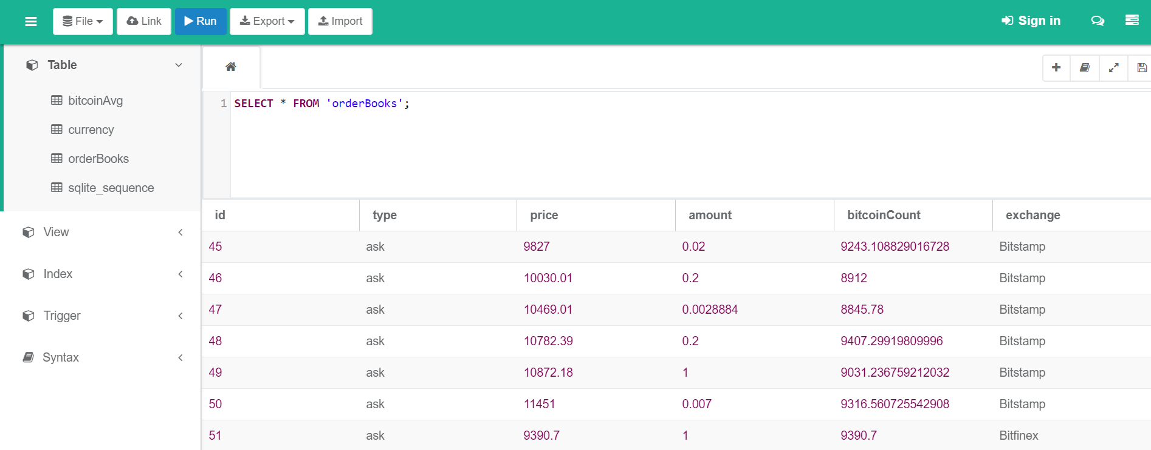
Feature 1 - Continuous data stored and accessed in the database using threads
Description
The data is continuously relayed from BitFinex.com(Web Socket) and BitStamp(API) and stored it in our databse(SQLLite) using one thread, and another thread simultaneously allows our platform to access the data.
Hence, the results change every time the data is accessed.

Slide 5
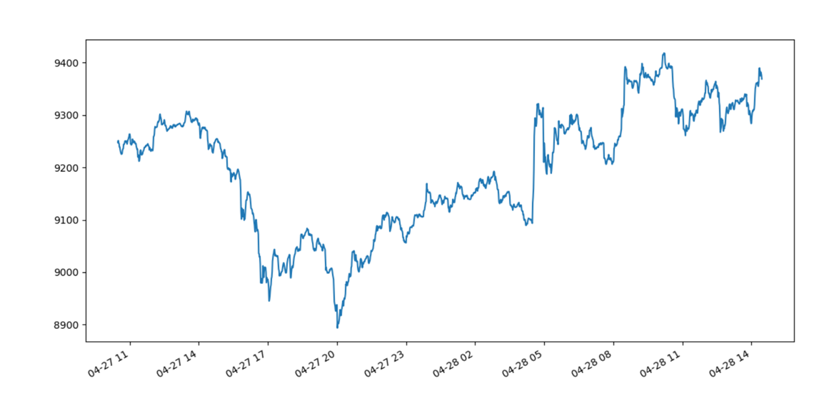
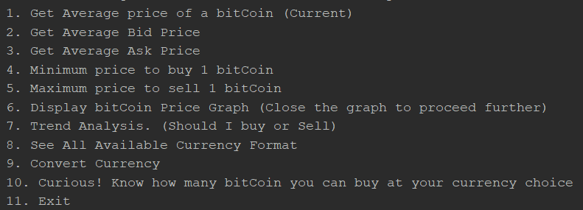
Feature 2- Make predictions using TimeSeries forecasting
Description
The API(Bitcoinaverage) gives us the bitcoin price every minute for the past 1600+minutes.
With this data, using Timeseries forecasting we plot the trend of the price of Bitcoins for over a day as shown.
Based on this trend, we recommend if the Bitcoin price is going to fall or rise and hence if we should buy or sell bitcoins respectively.

Slide 6
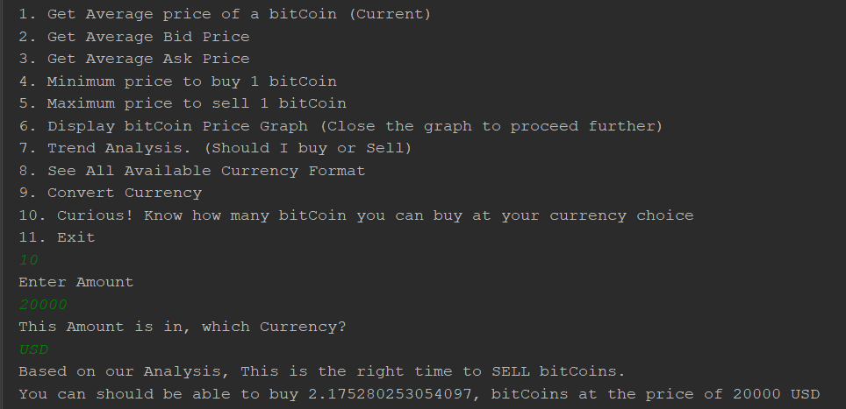
Feature 3 - Recommending the best possible transaction for a given dollar amount
Description
When a user enters a given dollar amount, BitTrade makes a recommendation if the user should bid or ask for bitcoins.
If the recommendation is bid, it gives the maximum number of bitcoins that can be bought at the given amount.
If the recommendation is sell, it gives the minimum number of bitcoins that can be sold at the given amount.

Slide 7
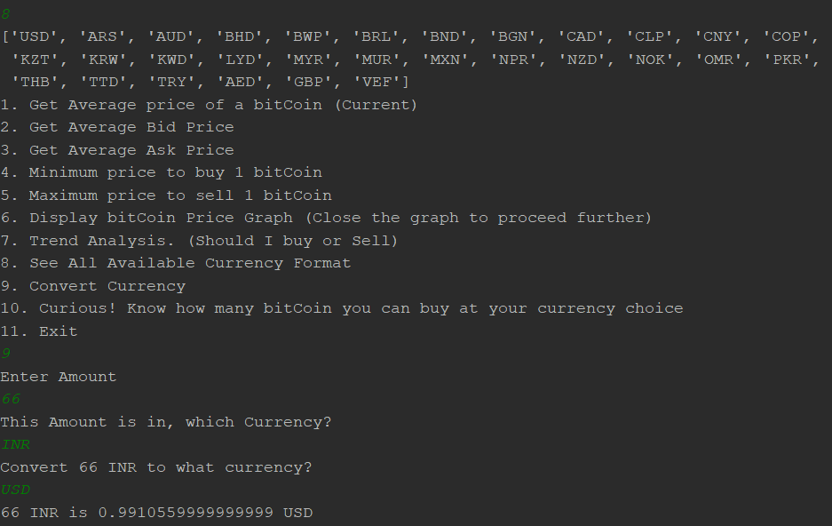
Feature 4 – Currency Conversion
Description
The data is taken by web scraping.
Here we have the country name, the country code and the currency conversion to dollars.
If the user enters a currency and an amount, we can convert it into another currency (default dollars).
This is used so that any currency value entered can be used in our platform.

Slide 8
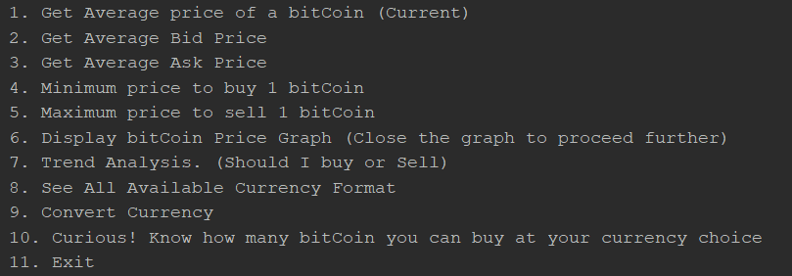
Feature 5 – Market Analysis
Description
BitTrade also has other features such as:
Average bitcoin market price
Average Bid price
Average Sell price
Minimum Price to buy 1 bit coin
Maximum Price to sell 1 bit coin

Slide 9
Deliverables
Git URL : https://github.com/BitTrust-Org/BitTrust
Project Board URL : https://github.com/orgs/BitTrust-Org/projects/1

Slide 10
Additional Enhancements
To add a GUI to the platform
To get continuous data for performing trend analysis
To perform further analysis on the data

Slide 11
Lessons Learned
Learned how to use Threads in python
Learned how to use Timeseries data to plot graphs using matplotlib
Learned how to integrate multiple data sources – Web socket, API, Web scraping and storing it in a database
Learned Tornado framework
Learned how to analyze trends and make forecasts
Learned how to store data in a SQLite database and access it

