Slide 1

0 DAY 2 HERO DAY

Slide 2

ABOUT ME: Cofounder in turansec head of insec uzcard inhanian son husband

Slide 3


Slide 4
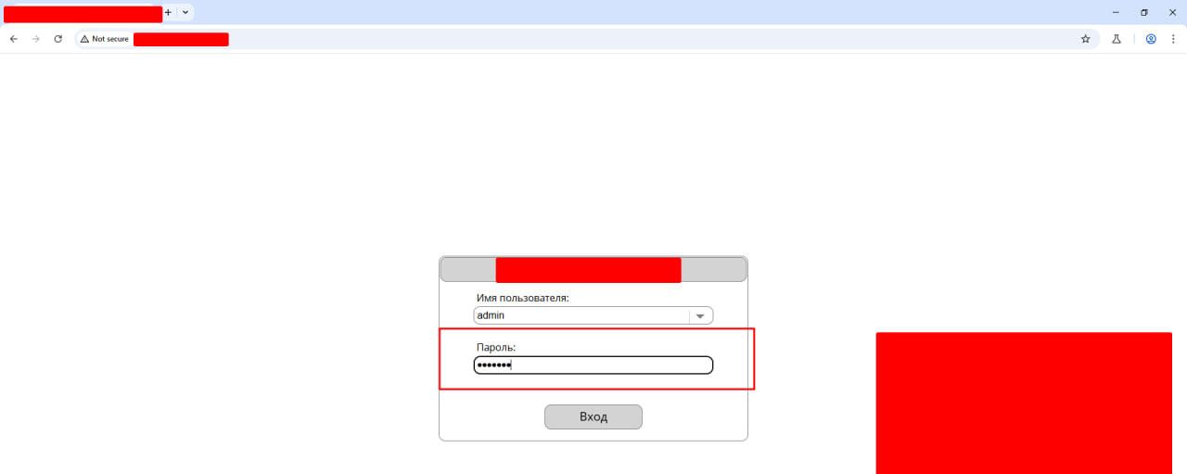

Slide 5
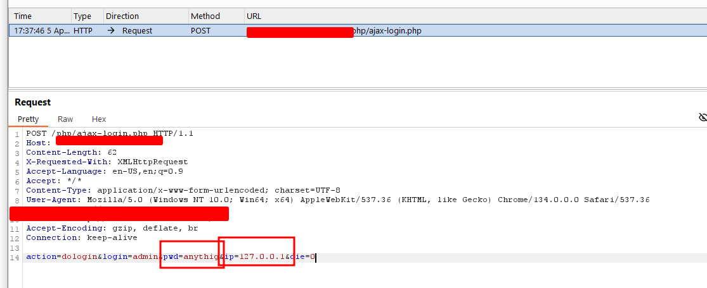

Slide 6
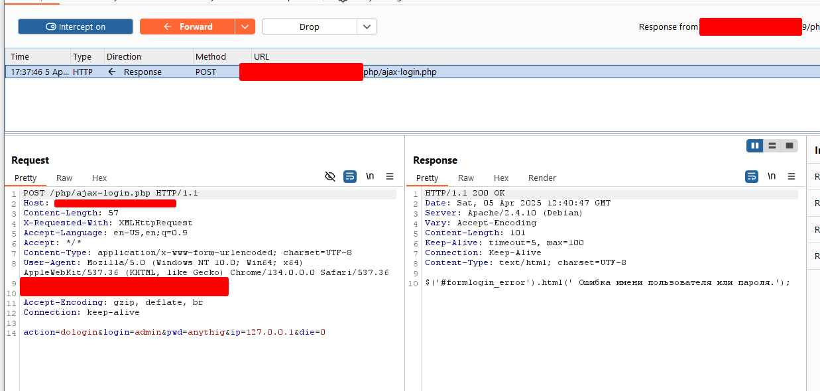

Slide 7


Slide 8


Slide 9
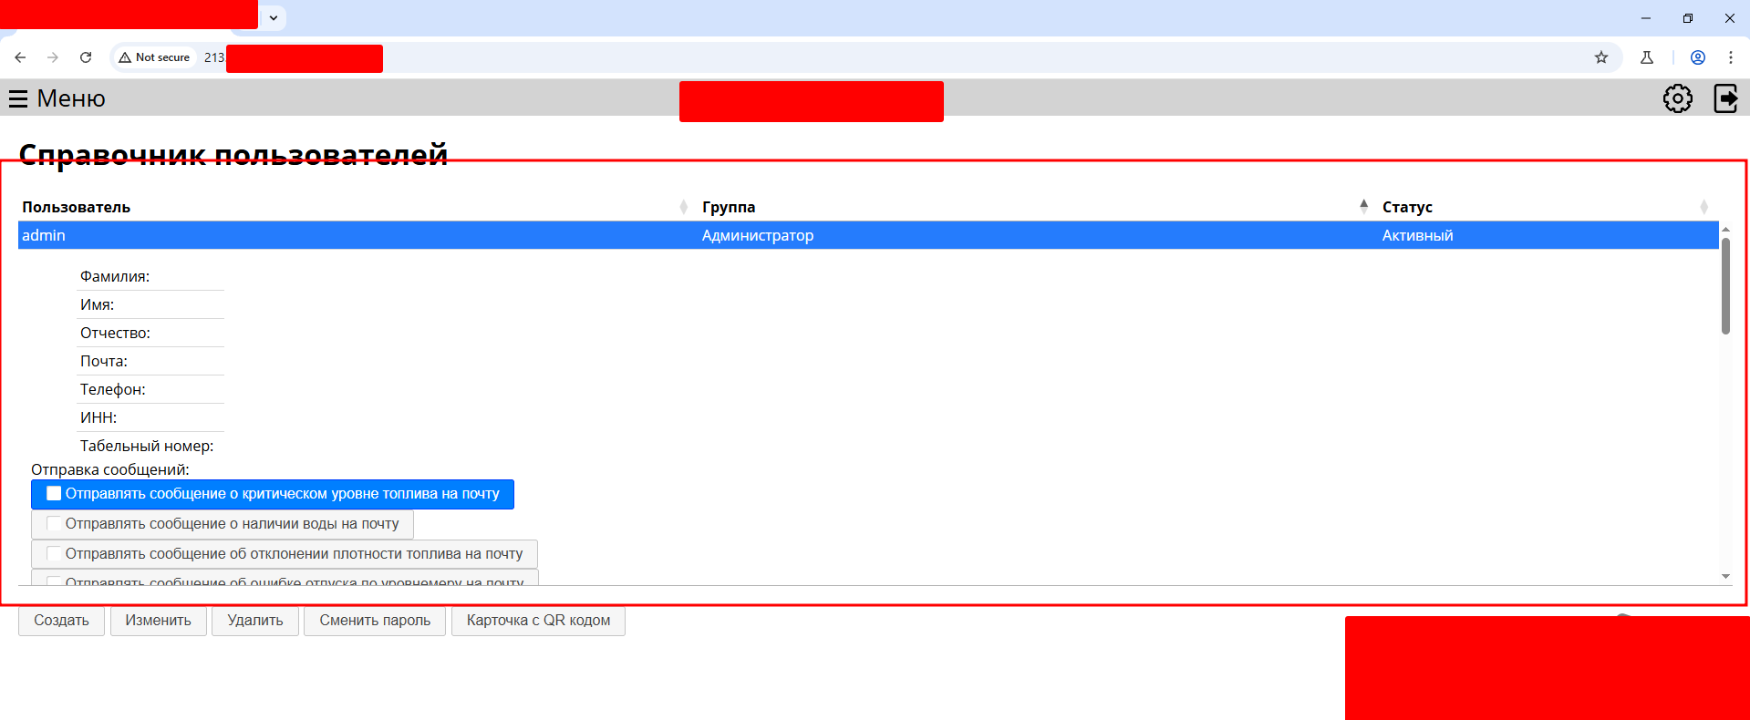

Slide 10
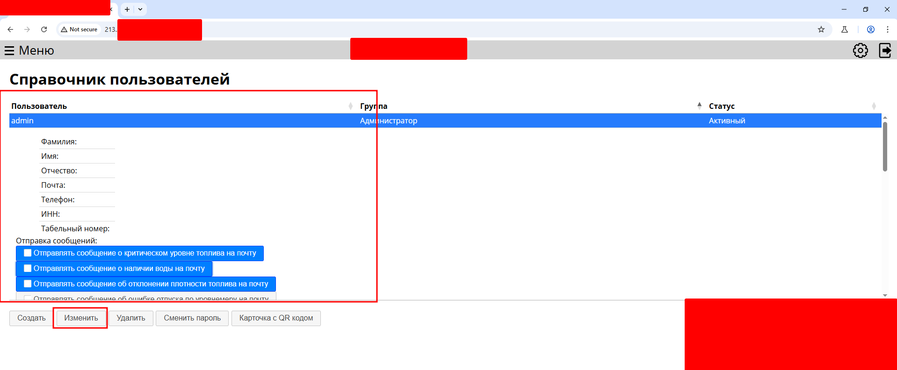

Slide 11


Slide 12
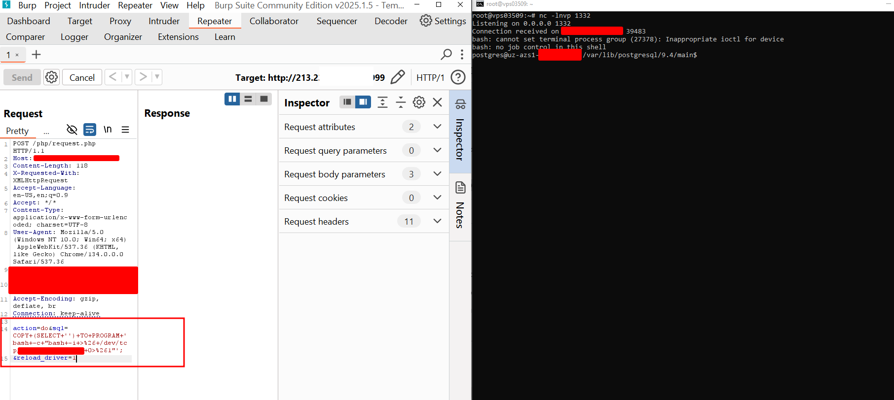

Slide 13
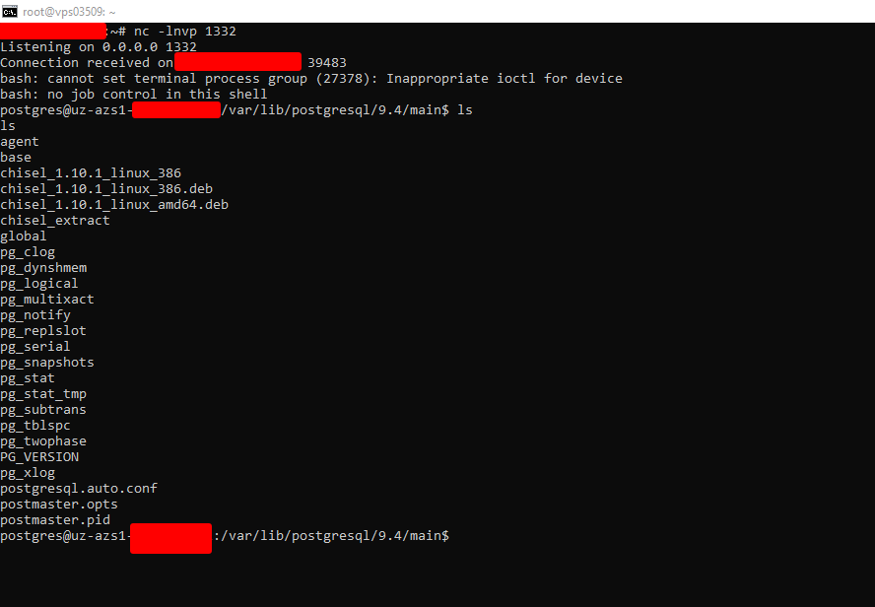

Slide 14
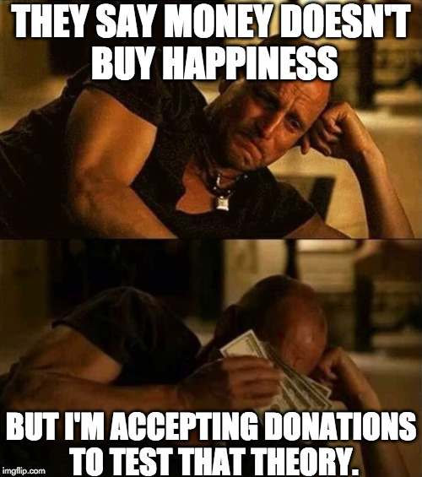

Slide 15




