Slide 1
🛡️ NetGuard-IDS
Network Intrusion Detection & Automated Port Risk Analyzer
A Unified Dual-Engine Defensive Cybersecurity Platform
Author / Presenter: Aditya Yadav (BitWiseAditya27)
Department of Computer Science & Engineering
Academic Year 2026

Slide 2
NETGUARD-IDS DEFENSIVE FRAMEWORK
The Cybersecurity Dilemma in Enterprise Networks
• Explosion of Perimeter Vulnerabilities:
Organizations inadvertently expose dangerous services (SMB 445, Telnet 23, RDP 3389, unauthenticated Redis/Mongo) that serve as primary vectors for ransomware and lateral movement.
• Limitations of Standalone Port Scanners (e.g. Nmap):
Require administrative/root access for SYN scans, CLI-heavy, lack automated CVSS risk scoring, and provide zero intelligence on live traffic intrusions.
• Fragility of Traditional Signature-based NIDS (e.g. Snort):
Rely on rigid, static rules. High false positive rates, resource-heavy, and completely blind to zero-day flow anomalies.
• The Solution -> NetGuard-IDS:
A unified, non-root system bridging socket-level port risk auditing with benchmarked machine learning traffic classification in one real-time dashboard.

Slide 3
NETGUARD-IDS DEFENSIVE FRAMEWORK
Project Objectives & Core Deliverables
✔ 1. Multithreaded Non-Root Port Auditing:
Build asynchronous TCP connect scanner using Python socket + concurrent.futures with application banner grabbing.
✔ 2. Rule-Based CVSS Risk Engine:
Translate discovered ports & banners into risk tiers (Critical, High, Medium, Low) and calculate an aggregate 0–100 risk index.
✔ 3. Machine Learning Intrusion Classifier:
Train, compare, and deploy Random Forest & XGBoost pipelines on the NSL-KDD benchmark across 5 threat taxonomies.
✔ 4. Executive Defensive Dashboard:
Interactive Streamlit interface with Plotly gauges, attack distributions, SQLite audit history, and multi-format exports (PDF, JSON, CSV).
✔ 5. Strict Ethical Guardrails:
Mandatory pre-scan consent, rate-limiting, and restriction to localhost, RFC1918 private subnets, and scanme.nmap.org.

Slide 4
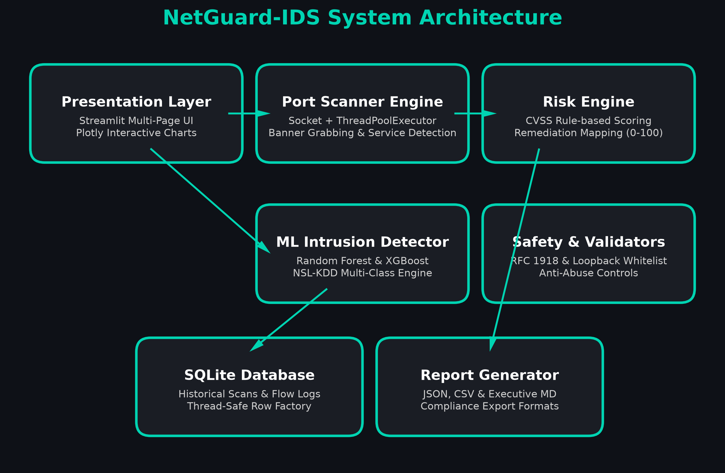
NETGUARD-IDS DEFENSIVE FRAMEWORK
Multi-Tier System Architecture

Slide 5
NETGUARD-IDS DEFENSIVE FRAMEWORK
Defensive Engine 1: Port Scanner & Risk Engine
⚡ 4 Adaptive Scan Modes:
Quick (Top 100), Common (1-1024), Custom Range, and Full (1-65535) with rate limiting.
⚡ Application Banner Grabbing:
Safely queries open TCP sockets for daemon identification (HTTP, OpenSSH, FTP, MySQL, Redis, SMB).
⚡ Heuristic Banner Escalation:
Automatically flags legacy/outdated services (e.g., SMBv1 EternalBlue flags, Anonymous FTP, old OpenSSH).
⚡ CVSS Threat Modeling:
Associates open ports with known exploit vectors: WannaCry (445), BlueKeep (3389), Plaintext sniff (21/23), NoSQL wipes (27017).
⚡ Overarching Verdict (0–100):
Balances maximum CVSS severity with total threat exposure to assign LOW, MEDIUM, HIGH, or CRITICAL verdict.

Slide 6
NETGUARD-IDS DEFENSIVE FRAMEWORK
Defensive Engine 2: ML Intrusion Detection Engine
🧠 Benchmark Dataset:
NSL-KDD benchmark dataset with 41 flow features (connection duration, protocol, service, flags, bytes, host rates).
🧠 Feature Engineering Pipeline:
StandardScaler for numerical flow dynamics + OneHotEncoder for protocol and service categories.
🧠 5 Attack Taxonomies Detected:
Normal (Benign), DoS (Neptune, Smurf), Probe (Nmap, Portsweep), R2L (Guess Password, FTP Write), U2R (Buffer Overflow, Rootkit).
🧠 Dual-Algorithm Comparison:
Benchmarked Random Forest against XGBoost to determine optimal latency-accuracy trade-off.

Slide 7
NETGUARD-IDS DEFENSIVE FRAMEWORK
Model Comparison & Benchmark Results
Classifier | Accuracy | Weighted F1 | Precision | Recall
Random Forest (Selected) | 98.30% | 0.9826 | 0.9838 | 0.9830
XGBoost Classifier | 98.25% | 0.9821 | 0.9830 | 0.9825
Key Observations & Class Breakdown:
• Normal Traffic & R2L Attacks achieved 100% precision and recall.
• DoS attacks achieved 95% precision and 100% recall (zero missed flooding attempts).
• Sub-100ms inference time per batch makes it suitable for real-time flow evaluation.
• Serialization with Joblib allows instantaneous model loading in serverless environments.

Slide 8
NETGUARD-IDS DEFENSIVE FRAMEWORK
Safety Engineering & Ethical Compliance
⚖️ Mandatory Pre-Scan Consent Checkbox:
User must explicitly affirm ownership or written testing authorization before the audit button triggers.
⚖️ Programmatic Target Allowlisting:
Only localhost (127.0.0.1), private RFC1918 subnets (10.x, 172.16-31.x, 192.168.x), and scanme.nmap.org are permitted. Arbitrary public IPs are strictly blocked.
⚖️ Hosted Demo Mode:
Generates authentic simulated scan results in cloud environments where raw socket outbound traffic is blocked by cloud provider firewalls.
⚖️ Zero Command Injection Surface:
Built strictly with Python native sockets; no subprocess execution with shell=True.
⚖️ Regulatory Compliance:
Designed in adherence with CFAA (US), Computer Misuse Act (UK), and IT Act 2000 (India).

Slide 9
NETGUARD-IDS DEFENSIVE FRAMEWORK
Deployment, Testing & Live Demonstration
🌐 Public GitHub Repository:
https://github.com/BitWiseAditya27/netguard-ids
🌐 Live Streamlit Cloud Deployment:
https://netguard-ids.streamlit.app/
🌐 Automated Testing Suite:
10/10 Pytest tests passing covering validators, CVSS math, socket handlers, and ML inference.
🌐 Multi-Version CI/CD:
GitHub Actions workflow running linting and tests across Python 3.10, 3.11, and 3.12 on every push.
🌐 Export Capabilities:
Instant export of security findings to JSON, CSV, and Markdown executive summaries.

Slide 10
NETGUARD-IDS DEFENSIVE FRAMEWORK
Conclusion & Future Enhancements
📌 Conclusion:
NetGuard-IDS provides a comprehensive, production-grade cybersecurity tool combining lightweight host scanning, actionable CVSS-style risk scoring, and 98.3% accurate ML flow classification in an intuitive dashboard.
📌 Future Scope 1: Live Packet Sniffing:
Incorporate eBPF / Scapy for real-time promiscuous interface packet capture on hardware taps.
📌 Future Scope 2: Deep Learning Autoencoders:
Deploy unsupervised LSTM Autoencoders to detect zero-day evasion techniques.
📌 Future Scope 3: Enterprise SIEM Integration:
Integrate automated webhooks and alerts into Splunk, Elastic SIEM, and Discord/Slack SOC channels.
📌 Thank You!:
Questions & Answers are welcome.

