Slide 1
NetGuard-IDS
Complete Architectural Workflow & Data Pipeline
Deep-Dive into Ingestion, Ethical Gates, Dual Scanning Engines, and Report Synthesis
Presentation by-
Aditya Yadav
Ashutosh Mehta
Atishay Jain

Slide 2
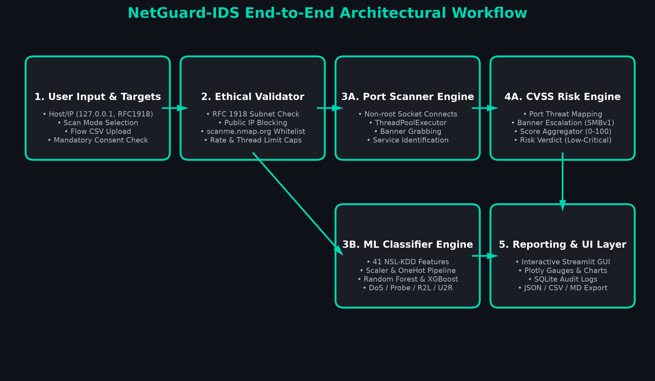
End-to-End Architectural Workflow Blueprint
2

Slide 3
Workflow Step 1: Target Ingestion & Consent
Stage 1: User Parameters & Mandatory Consent Policy
User supplies target identifier: IP Address (127.0.0.1, 192.168.1.1) or Hostname (scanme.nmap.org).
Scan mode parameter configured: Quick (Top 100), Common (1-1024), Custom Range, or Full (1-65535).
Mandatory Pre-Scan Verification Checkbox: Programmatically blocks scan initiation until ownership or written authorization is confirmed.
Network flow CSV ingestion for intrusion detection module.
3

Slide 4
Workflow Step 2: Ethical Whitelisting & Safety
Stage 2: Programmatic Enforcement & Anti-Abuse Rules
Target resolution through socket.gethostbyname with regex sanitization to block command injection.
RFC 1918 Private Subnet Verification: Verifies target belongs to 10.0.0.0/8, 172.16.0.0/12, or 192.168.0.0/16.
Public IP Quarantine: Any unapproved public internet IP is immediately halted with a policy violation notice.
Official research target exception: Specifically permits authorized host scanme.nmap.org.
Rate-limiting and thread capping (10-100 max) to prevent denial of service.
4

Slide 5
Workflow Step 3: Non-Root Multithreaded Scanner
Stage 3A: Socket-Level Reconnaissance & Banner Grabbing
ThreadPoolExecutor dispatches asynchronous non-root socket.connect_ex probes.
Operates without sudo/root or raw packet privileges across Windows and Linux.
Active Banner Grabbing: Queries open sockets for software version strings (HTTP, SSH, ProFTPD, MySQL, SMB).
Heuristic Banner Analysis: Detects obsolete services, anonymous FTP permits, and legacy SMBv1 headers.
Cloud Fallback (Hosted Demo Mode): Simulates enterprise host telemetry when serverless outbound sockets are blocked.
5

Slide 6
Workflow Step 4: Rule-Based CVSS Risk Engine
Stage 4A: Vulnerability Mapping & Aggregated Verdicts
Maps discovered ports to CVSS v3.1 base metrics and severity categories (Critical, High, Medium, Low).
Associates findings with known exploit vectors (WannaCry on 445, BlueKeep on 3389, cleartext sniff on 21/23).
Mathematical Score Aggregation: Score = min(100, (raw_score * 0.8) + (max_cvss * 3.5)).
Issues overarching security verdict: LOW, MEDIUM, HIGH, or CRITICAL.
Generates concrete, actionable remediation steps for system administrators.
6

Slide 7
Workflow Step 5: Machine Learning Flow Classifier
Stage 3B: Dual-Model Intrusion Detection Pipeline
Input: Network flow telemetry comprising 41 NSL-KDD attributes (duration, bytes, flags, rates).
Preprocessing: StandardScaler for continuous dynamics + OneHotEncoder for categorical services/protocols.
Inference Pipeline: Evaluates flows using trained Random Forest & XGBoost classifiers.
5 Attack Taxonomies Classified: Normal, DoS (flooding), Probe (recon), R2L (unauthorized access), U2R (privilege escalation).
Achieves 98.30% Accuracy and 0.9826 Weighted F1-Score in sub-100ms batch execution.
7

Slide 8
Workflow Step 6: Telemetry Dashboard & Reporting
Stage 5: Visualization, Persistence & Export Artifacts
Streamlit Reactive Interface: Visualizes risk with Plotly gauge meters, severity donuts, and attack bar charts.
Embedded Relational Persistence: Automatically stores scan sessions and ML metrics in SQLite 3.
Multi-Format Artifact Export: Exports audit records to JSON, CSV, and Markdown executive summaries.
Live SOC Feed: Real-time tracking of historical scans, malicious flow rates, and host threat status.
8

Slide 9
Thank You!
NetGuard-IDS Workflow Architecture

