Slide 1
NetGuard-IDS
Network Intrusion Detection & Port Risk Analyzer
An AI-Driven Dual-Engine Defensive Cybersecurity Platform
Presentation by:
Aditya Yadav
Ashutosh Mehta
Atishay Jain

Slide 2
NETGUARD-IDS | DEFENSIVE CYBERSECURITY & ML
2
Introduction
• Rapid expansion of digital infrastructure and remote networks has created widespread perimeter visibility gaps.
• Manual tracking of open network ports, services, and unauthorized access attempts is impractical at enterprise scale.
• Need for an automated, unified defensive system to support network engineers, security auditors, and SOC analysts.
• Proposed Solution: NetGuard-IDS — A Machine Learning & socket-based platform to discover exposed services, calculate automated CVSS risk verdicts, and detect network intrusions in real time.

Slide 3
NETGUARD-IDS | DEFENSIVE CYBERSECURITY & ML
3
Problem Statement
• Enterprise environments process millions of network flows daily, making manual threat triage impossible.
• Traditional scanners (e.g. Nmap) require root privileges, manual CLI flags, and lack built-in CVSS risk scoring.
• Classic signature-based NIDS (e.g. Snort) fail to identify novel attack variations and zero-day traffic anomalies.
• Lack of unified coordination between port vulnerability discovery and real-time flow intrusion detection.
• Results in critical missed opportunities to isolate exposed vectors (SMB 445, RDP 3389, Telnet 23) before ransomware compromise occurs.

Slide 4
NETGUARD-IDS | DEFENSIVE CYBERSECURITY & ML
4
Objectives
• Develop an automated, non-root multithreaded TCP port scanner with application banner grabbing.
• Construct an automated CVSS-style risk engine that scores vulnerabilities from 0–100 with concrete remediation steps.
• Preprocess flow telemetry and train benchmark ML models (Random Forest & XGBoost) on the NSL-KDD dataset.
• Detect and classify 5 attack taxonomies: Normal, DoS, Probe, R2L (Remote-to-Local), and U2R (User-to-Root).
• Provide real-time interactive telemetry through a modern, responsive Streamlit dashboard.
• Enforce strict ethical guardrails and target whitelisting (RFC 1918 & scanme.nmap.org) to prevent malicious use.

Slide 5
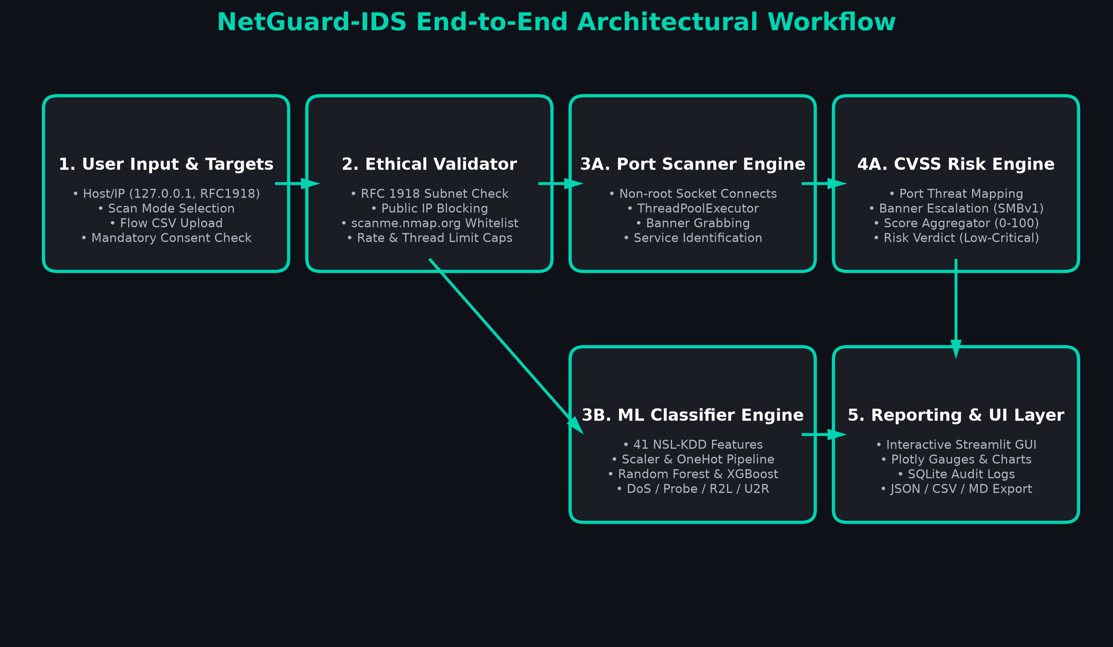
NETGUARD-IDS | DEFENSIVE CYBERSECURITY & ML
5
System Methodology & End-to-End Workflow
1. Data Collection & Target Ingestion -> 2. Safety Whitelist -> 3. Dual Engine (Port Scanner & ML Flow Classifier) -> 4. CVSS Scoring -> 5. Streamlit Dashboard & Report Export

Slide 6
NETGUARD-IDS | DEFENSIVE CYBERSECURITY & ML
6
Operating Environment
• Core Language & Runtime:
Python 3.10+ (Cross-platform compatibility across Windows, Linux, macOS).
• Data Processing & Machine Learning:
Pandas, NumPy, Scikit-learn, XGBoost, Joblib.
• Networking & Concurrency:
Python standard socket library, concurrent.futures.ThreadPoolExecutor.
• Presentation & Visualization:
Streamlit 1.35+, Plotly interactive charts.
• Persistence & Database:
Embedded SQLite 3 (Thread-safe connection pool, zero configuration).
• Deployment & Cloud Hosting:
Streamlit Community Cloud (Hosted serverless persistent container).
• Browser Support:
Google Chrome, Microsoft Edge, Mozilla Firefox, Apple Safari.

Slide 7
NETGUARD-IDS | DEFENSIVE CYBERSECURITY & ML
7
Non-Functional Requirements
✔ High-Speed Performance:
Sub-second port discovery for top ports; sub-100ms ML batch inference latency.
✔ Zero Root Privilege Dependency:
Operates entirely within user space via unprivileged TCP connect sockets.
✔ Strict Target Authorization & Safety:
Programmatic allowlisting blocking arbitrary public IPs; mandatory consent checkbox.
✔ High Reliability & Fault Tolerance:
Graceful timeout handling for firewalled/dropped packets without app crashes.
✔ Multi-Format Exportability:
One-click generation of audit records in JSON, CSV, and Markdown formats.
✔ Scalability:
Thread-pool architecture capable of scaling across subnets and cloud demo environments.

Slide 8
NETGUARD-IDS | DEFENSIVE CYBERSECURITY & ML
8
User Classes
👤 Security Engineers & SOC Analysts:
Conduct host posture audits, upload live flow captures, inspect intrusion breakdowns, and monitor perimeter health.
👤 System & Network Administrators:
Identify exposed internal services (e.g. unauthenticated Redis, SMBv1), review CVSS severity scores, and apply hardening advice.
👤 Penetration Testers & Auditors:
Perform authorized vulnerability assessments with exportable compliance logs and evidence artifacts.
👤 Academic Evaluators & Students:
Study defensive cybersecurity architectures, port risk mechanics, and ML-based flow threat detection.

Slide 9
NETGUARD-IDS | DEFENSIVE CYBERSECURITY & ML
9
Advantages
• Automated Identification: Seamlessly bridges port scanning and flow classification in one platform.
• Non-Root Portability: Unlike Nmap SYN scans, requires zero sudo or root administrative privileges.
• High Predictive Accuracy: 98.30% accuracy and 0.9826 F1-score achieved on NSL-KDD benchmark.
• Actionable Remediation: Explains exact real-world exploit vectors (WannaCry, BlueKeep) and hardening steps.
• Embedded Persistence: Zero-setup SQLite tracking for historical trend comparisons.
• Ethical Guardrails: Native controls prevent abuse against unauthorized external targets.

Slide 10
NETGUARD-IDS | DEFENSIVE CYBERSECURITY & ML
10
Limitations
• Predictive Accuracy Depends on Flow Features: Model relies on 41 NSL-KDD attributes; unformatted raw PCAPs require conversion.
• Cloud Hosting Socket Restrictions: Outbound TCP connects may be blocked by serverless cloud providers (mitigated via Hosted Demo Mode).
• Passive vs. Active Interception: Currently performs detection and classification rather than inline packet dropping (IPS).
• Firewall SYN Drops: Scanning heavily firewalled hosts can increase duration if connect timeouts are set high.

Slide 11
NETGUARD-IDS | DEFENSIVE CYBERSECURITY & ML
11
Future Scope
• Live Packet Sniffing Integration: Implement eBPF or Scapy promiscuous capture directly from hardware interfaces.
• Deep Learning Zero-Day Detection: Incorporate unsupervised LSTM Autoencoders to detect uncataloged attack variants.
• Active Intrusion Prevention (IPS): Add automated iptables/Windows Firewall rule injection to drop attacking IPs in real time.
• Enterprise SIEM Webhooks: Export alerts directly into Splunk, Elastic SIEM, and SOC messaging channels (Slack/Discord).

Slide 12
NETGUARD-IDS | DEFENSIVE CYBERSECURITY & ML
12
Conclusion
• Proactive perimeter auditing and continuous traffic inspection are essential for modern cybersecurity defense.
• NetGuard-IDS successfully demonstrates that non-root socket auditing and machine learning can be unified into an efficient, lightweight solution.
• Achieves 98.30% threat classification accuracy with actionable CVSS remediation advice and interactive SOC telemetry.
• Provides educational and industrial organizations with an accessible, production-ready cyber defense environment.

Slide 13
Thank You!
Questions & Feedback are Welcome
GitHub: github.com/BitWiseAditya27/netguard-ids
Live Demo: netguard-ids.streamlit.app

