Slide 1
Title: Car Blackbox Project
Sub - Title: Embedded System Project
Presented by:
Veerabhadreshwar Guggari
Project Guides
1.Sabari 2.Poovarsaan Raj

Slide 2
Project Overview
Introduction to Car Blackbox
Objective
Features
System Architecture
Block diagram and Workflow
Functionality
Result
Applications and Conclusion

Slide 3
Introduction
The Car Black Box is a device similar to the flight data recorder used in airplanes. Its main purpose is to record crucial data related to the vehicle's operation and conditions, which can be useful for accident analysis, monitoring driving behavior, and improving safety.
Key Features:
Event Recording: Logs important events like speed, gear position, and time.
Real-Time Clock (RTC): Provides accurate timestamps for events.
Data Storage: Maintains logs that can be reviewed later.
UART Communication: Allows downloading of logs to a computer for analysis.
User Interface: Enables viewing logs, clearing data, setting time, and downloading logs.
Purpose and Importance:
Accident Investigation: Helps in reconstructing the sequence of events leading up to a crash.
Driver Monitoring: Enables the assessment of driving habits and compliance with safety norms.
Insurance Claims: Provides evidence that can support or refute claims.

Slide 4
Objectives:
Accident data recording
Vehicle performance monitoring
Driver behavior analysis
Safety improvements
Post-accident analysis
Real-time alerts and notifications
Insurance and claims support
Legal and forensic evidence
Enhance navigation and route planning
Data for vehicle research and development

Slide 5
Features:
Dashboard:
Time: Displays the current time.
Event: Shows specific events such as accidents or abnormal driving behavior.
Speed: Displays the current speed of the vehicle.
Event Logging:
Logs events (accidents, critical driving conditions) and stores them in external EEPROM after every event is logged.
Menu Navigation:
View Log: Allows access to the recorded logs and event data.
Clear Log: Option to delete or clear the recorded logs.
Set Time: Allows the user to set or adjust the system time.
Download Log: Enables downloading of the recorded data logs for further analysis.
Download Log from External EEPROM:
Retrieves the event logs stored in the external EEPROM.
Display on Slave (Tera Term):
Displays the downloaded log data on a terminal (e.g., Tera Term) for viewing and analysis.

Slide 6
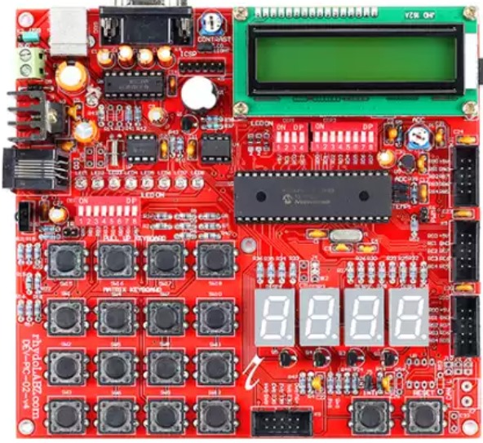
System Architecture
PIC18F4580 Microcontroller Integration
DS1307 RTC Module
External EEPROM
16x2 Character LCD
Keypad (push button)
Power Supply Options
Seven segment display(SSD)
UART Protocol
ADC

Slide 7
Block diagram
POTENTIOMETER
POWER SUPPLY
ADC
PIC MC 18F4580
MATRIX KEYPAD
I2C
CLCD
EEPROM
RTC

Slide 8
FLOW CHART
Start
1.Fetch time from RTC 2.Determine the gear position 3.Read the speed
* STORE IN EEPROM
DASHBOARD
Display Time , Gear and Speed (up-to 10 logs)
MAIN MENU 1.View logs 2.Clear logs 3.Set time 4.Download logs
Switch 12 back to dashboard/mainmenu
View logs
Display stored logs(10)
Key11: Update and main menu
Clear logs
Clear logs
Alter time
Set time
Back to main menu
Send logs to PC via UART
Download logs

Slide 9
Functionality - Fetching Time from RTC
How RTC is integrated
Time synchronization process
Displaying time on the dashboard

Slide 10
Functionality - Displaying Dashboard Content
Monitoring and displaying speed
Recording gear shifts
Capturing events with timestamps

Slide 11
Main Menu Options
View Log
Clear Log
Set Time
Download Log via UART to Tera Term

Slide 12
View Log Functionality
Displaying recorded logs
Navigation through logs

Slide 13
Clear Log Functionality
Process to clear the stored logs
Confirmation messages

Slide 14
Set Time Functionality
User interface for setting RTC time
Steps to update time

Slide 15
Download Log via UART
UART setup with Tera Term
Steps to download logs
Example output in Tera Term

Slide 16
Software Implementation
Code overview
Key functions for each feature

Slide 17
Testing and Results
Test cases and scenarios
Observed results and performance

Slide 18
APPLICATIONS AND Conclusion
Applications:
Accident analysis
Vehicle Performance
Real time driver behaviour tracking
Conclusion: The car black box project effectively records and stores critical driving data, such as speed, events, and time, in external EEPROM for post-accident analysis. Its intuitive menu navigation allows users to manage logs and download data for further examination. Displaying the logs on a terminal like Tera Term enhances accessibility and analysis. Overall, the system contributes to vehicle safety, maintenance improvements, and accident investigation support.

Slide 19
THANK YOU

