Slide 1
Robust Algorithm for Identifying Bot Authors on Social Media

Slide 2
Research Background

Slide 3
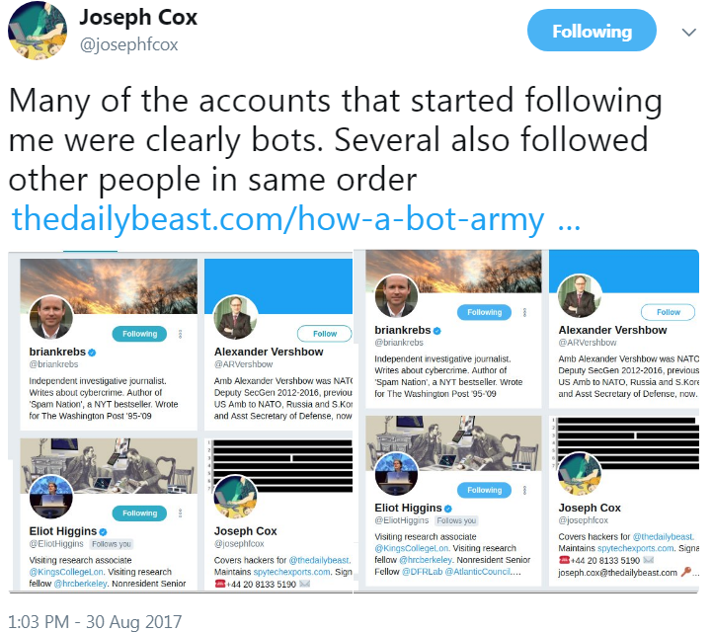
Bot Accounts on Social Media

Slide 4
Data Introduction

Slide 5
Data Description
Data Address: https://github.com/rrsr28/Twitter-Bot-Detection/tree/main/Datasets
Basic Information:
Total Account Count | Total Tweet Count | Bot Account Count | Human Account Count | Average Tweet Count | Time Span
92 | 155758 | 47 | 45 | 1673 | 2011 - 2018
References:
Alarfaj F K, Ahmad H, Khan H U, et al. Twitter bot detection using diverse content features and applying machine learning algorithms[J]. Sustainability, 2023, 15(8): 6662.

Slide 6
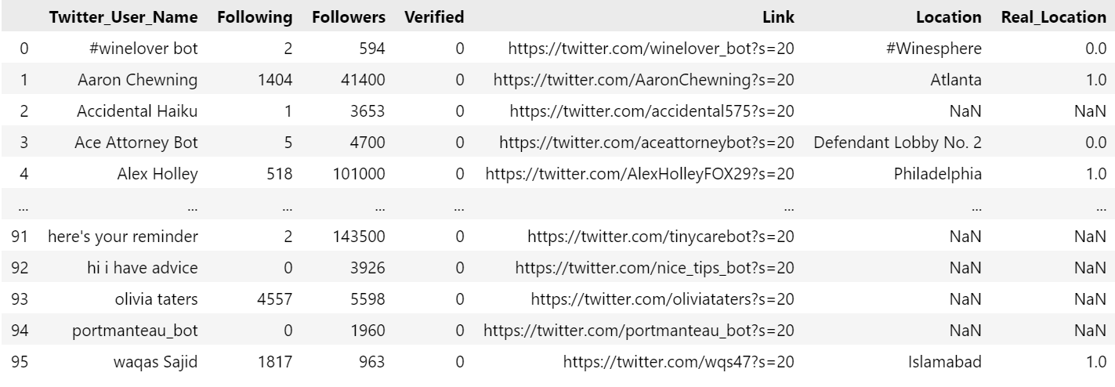
Data Sample

Slide 7
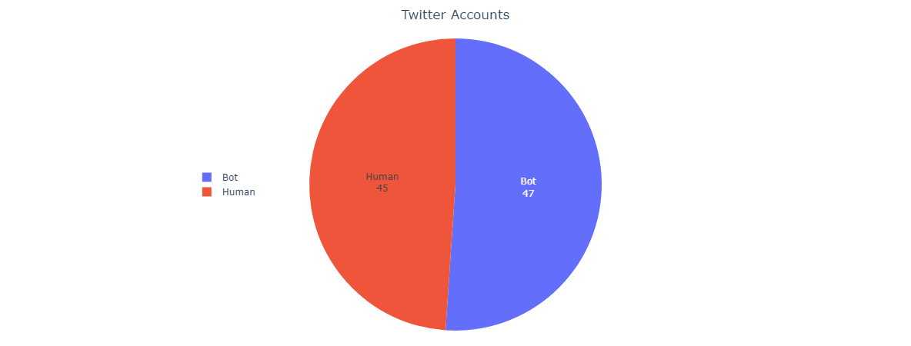
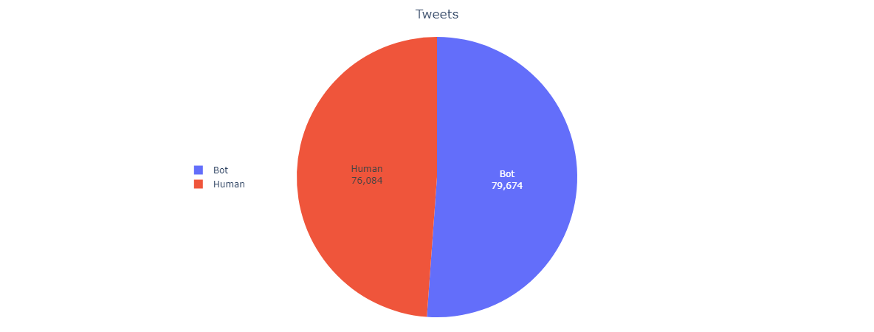
Data Analysis

Slide 8
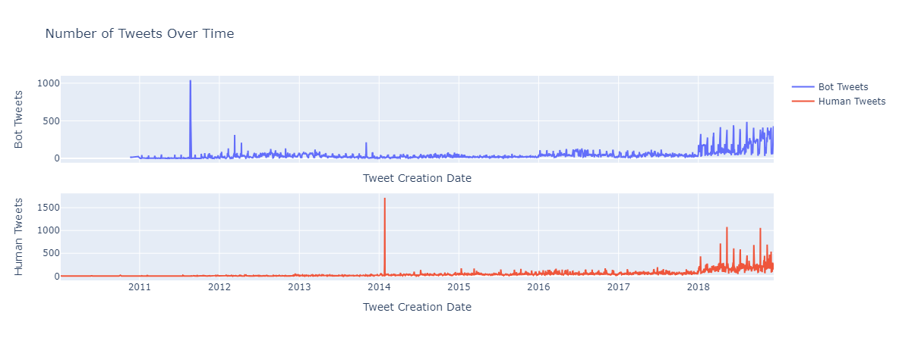
Data Analysis

Slide 9
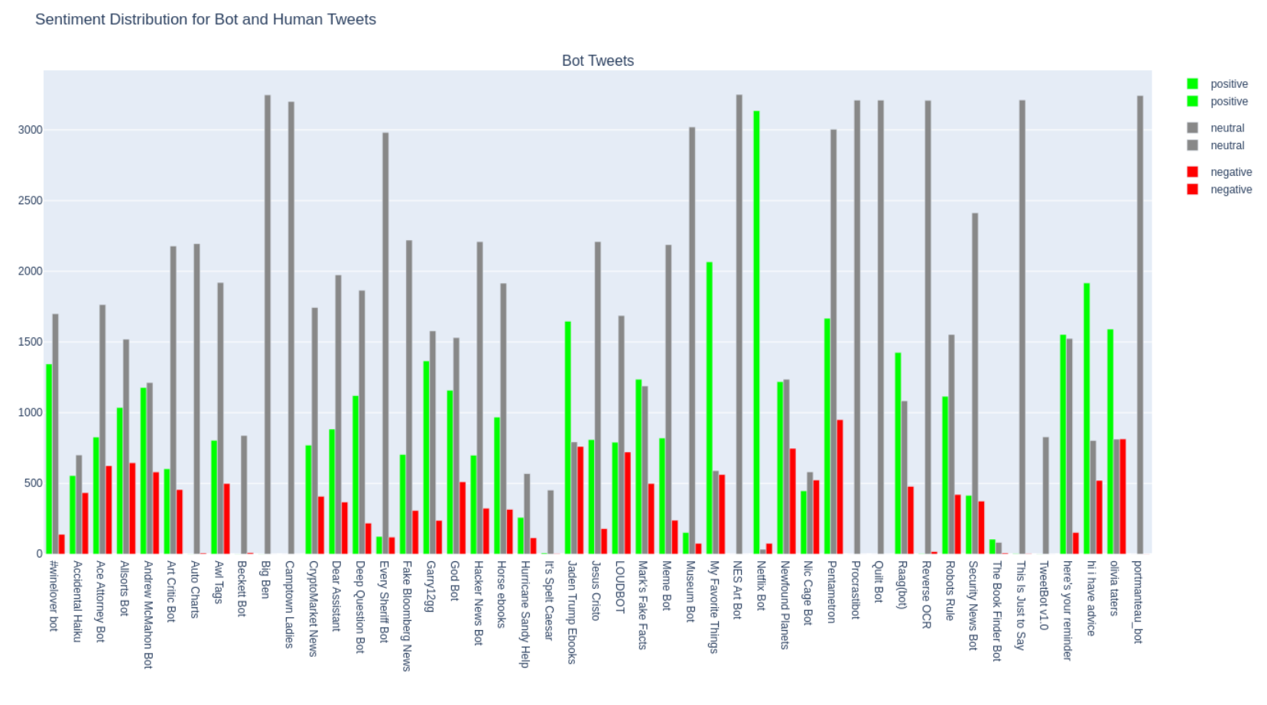
Data Analysis - Sentiment Distribution

Slide 10
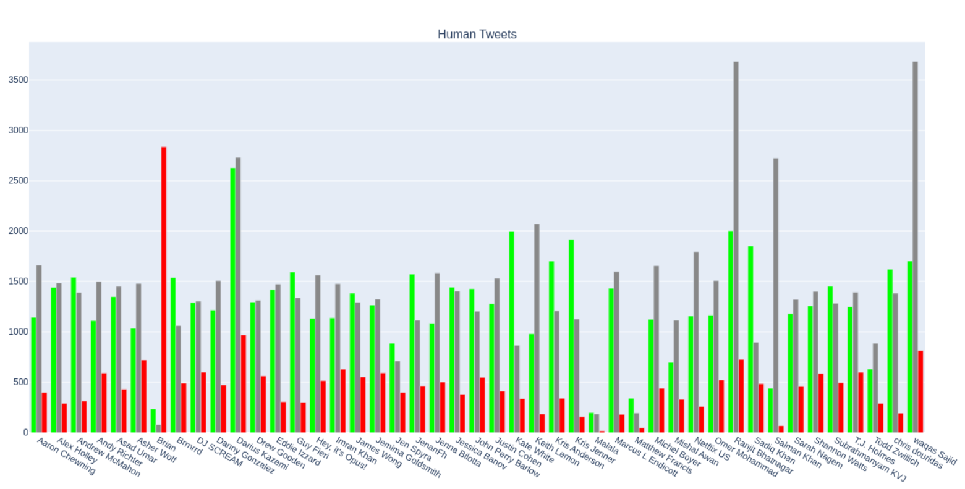
Data Analysis - Sentiment Distribution

Slide 11
Research Methodology

Slide 12
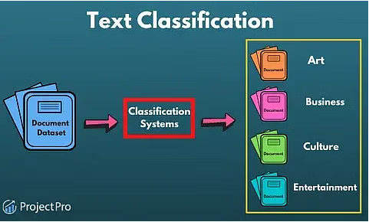
Text Classification Task
https://www.projectpro.io/article/machine-learning-nlp-text-classification-algorithms-and-models/523

Slide 13



TF-IDF Features
1
2
3

Slide 14
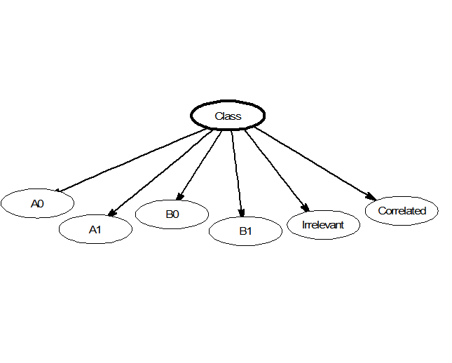
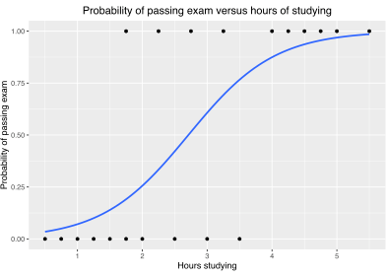
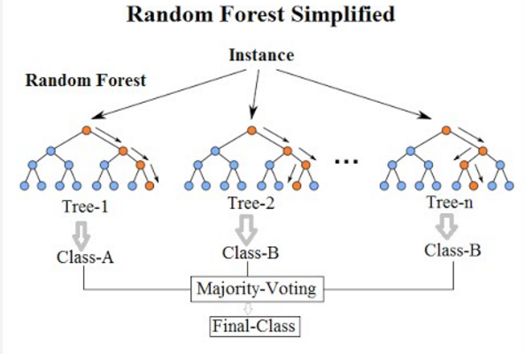
Classification Models
Naive Bayes
Logistic Regression
Random Forest

Slide 15
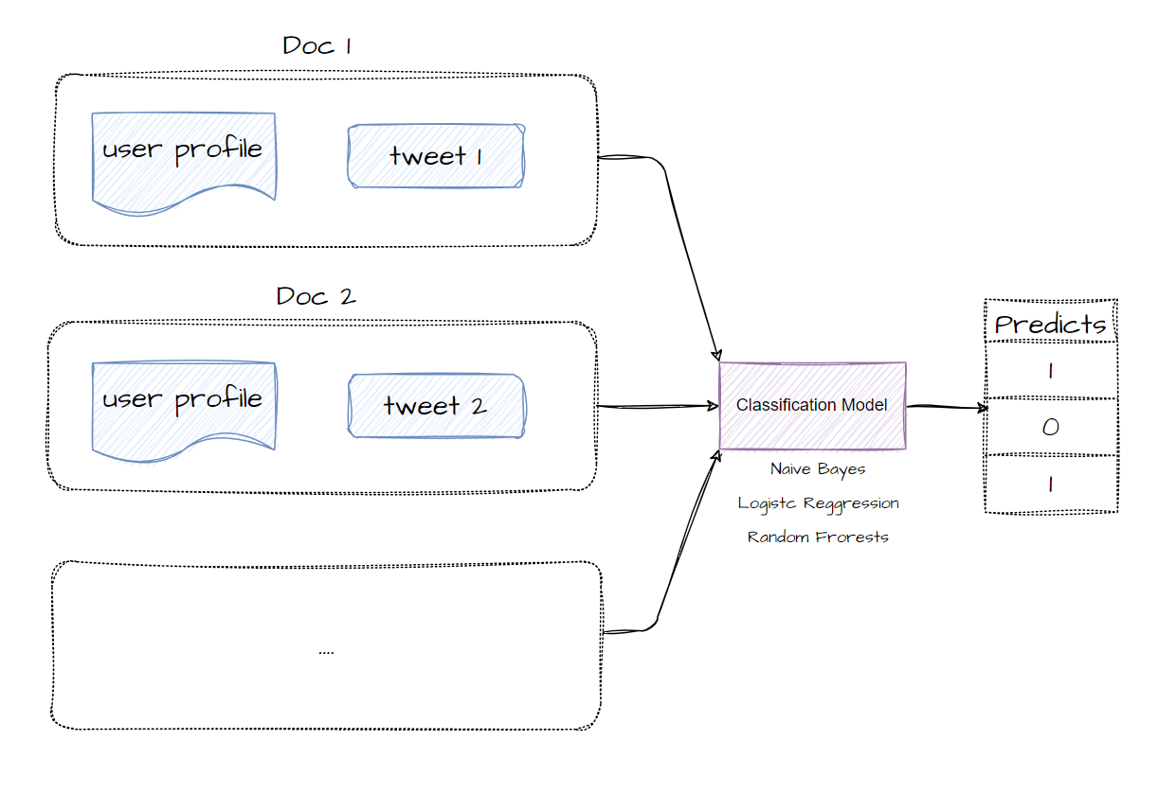
Bot Detection Process Based on Tweet

Slide 16
The Disadvantages of Tweet-based Classification Models
For bot users, not every tweet exhibits bot characteristics, which leads to the possibility of misjudgment.
Assessing each tweet individually does not adequately consider the user's behavior from a holistic perspective and does not allow for an evaluation of the user based on these behaviors.

Slide 17
Construction of Robust Algorithm Based on User Dimensions
The overall behavior of a user needs to be considered comprehensively.
A Twitter user may exhibit the following behaviors:
1. Posting tweets
2. Engaging in actions such as liking, retweeting, and saving posts.

Slide 18
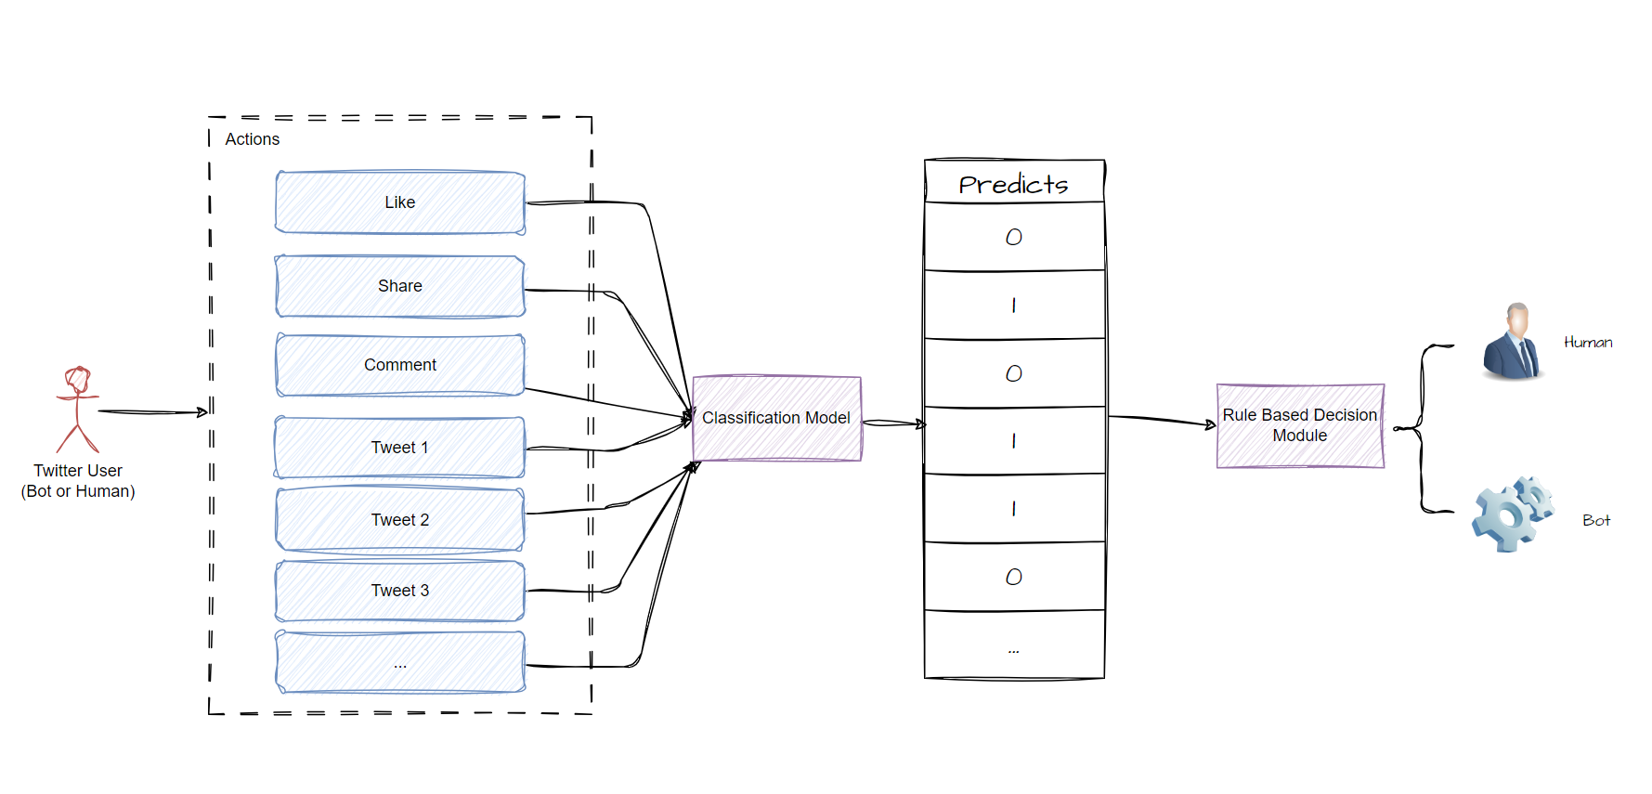
User Behavior-Based Bot Identification System Workflow

Slide 19
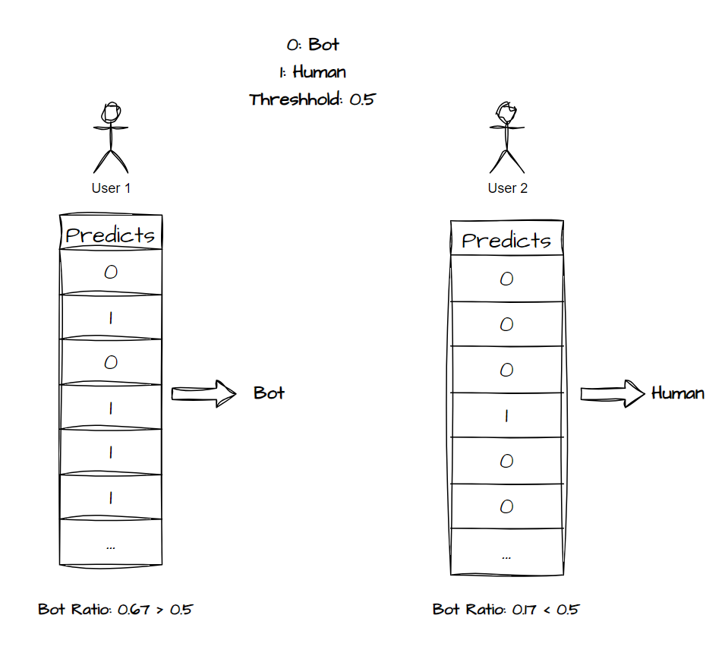
Decision Module Design

Slide 20
Disguise Technologies
Mimicking Normal Posting Behavior: Bot accounts typically simulate the posting style and frequency of ordinary users. For example, they may regularly publish relatively normal content and maintain reasonable time intervals between posts in order to avoid being identified as exhibiting abnormal activity. This content may mimic trending topics or popular trends, further helping them blend into the community.
Acquiring Inactive Real Accounts Through Purchase or Hacking: Some creators resort to purchasing forgotten or inactive real accounts from the black market, which they then utilize for Bot operations. This method effectively reduces the risk of detection since such accounts usually possess a certain history and follower base, making them less likely to be immediately identified.
Social Engineering: By masquerading as ordinary users and interacting with others, Bots can gradually establish trust. This includes actions such as liking, commenting, and sharing, thereby pretending to be an active community member, which makes it more challenging to uncover their Bot identity.
Others

Slide 21
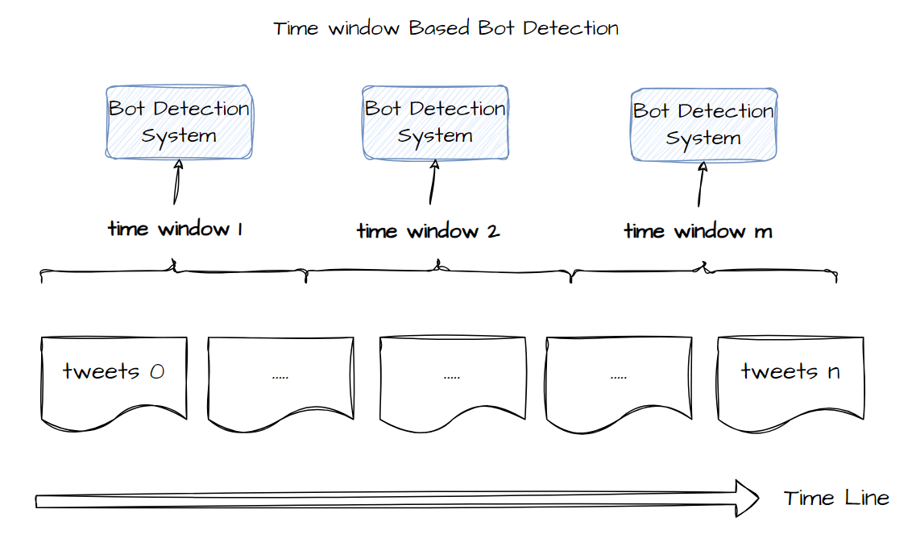
Optimization Strategies
For Disguise Technology 1: attempt to explore different decision thresholds within the user behavior-based Bot detection process, seeking a balance between recognition and misjudgment.
For Disguise Technology 2: attempt to determine Bot accounts using a time period as a window; if an account exhibits a high proportion of Bot-like behaviors within a specific time period, it will be classified as a Bot account.

Slide 22
Experimental Results

Slide 23
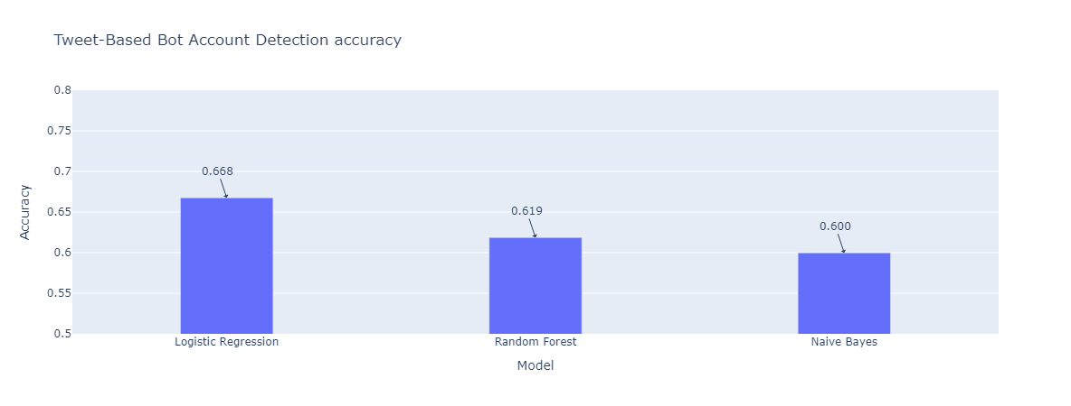
Effects Statistics of Different Classification Models

Slide 24
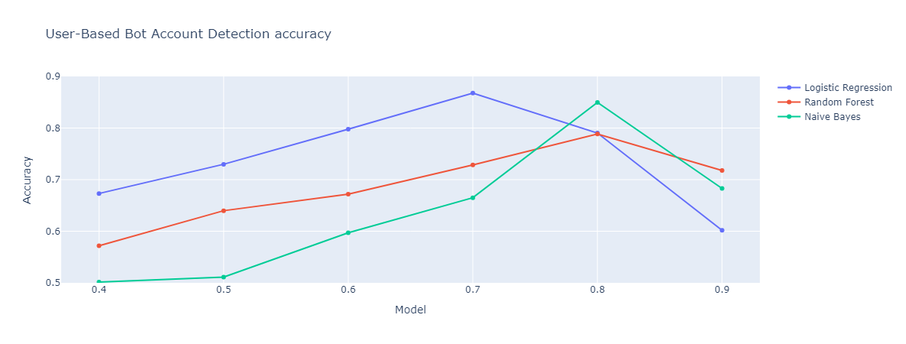
Statistics on Bot Recognition Effectiveness Based on User Dimension

Slide 25
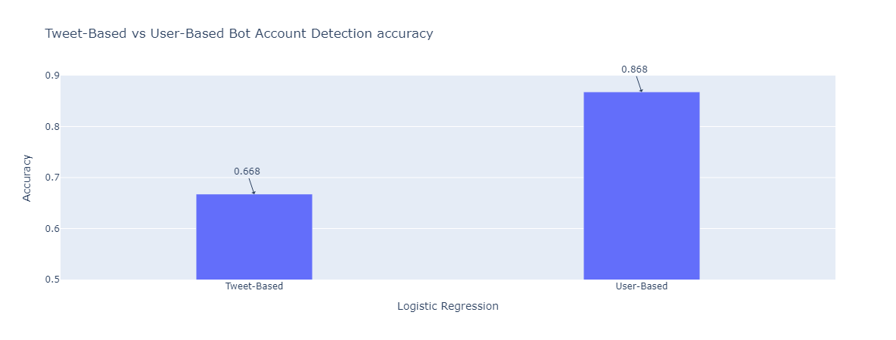
Tweet-Base Process VS User-Based Process

Slide 26
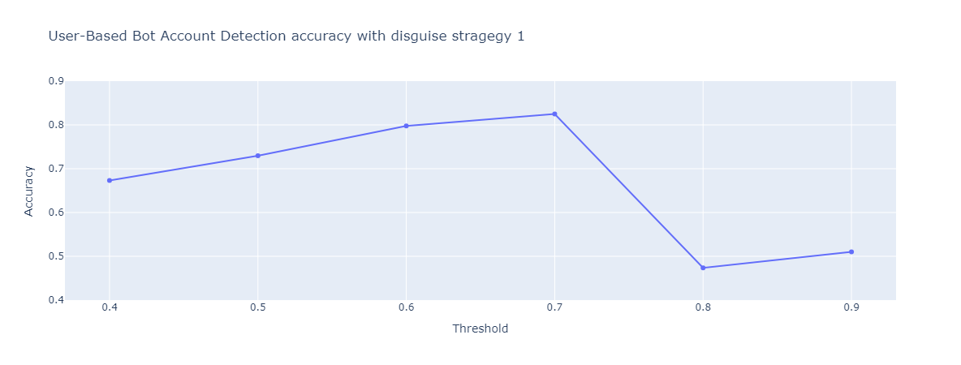
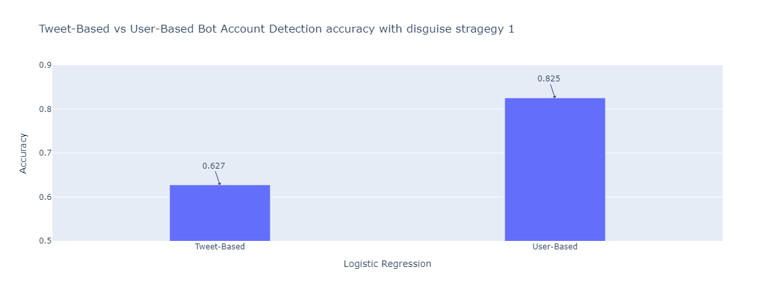
Tweet-Base Process VS User-Based Process" on Disguise Technology 1

Slide 27
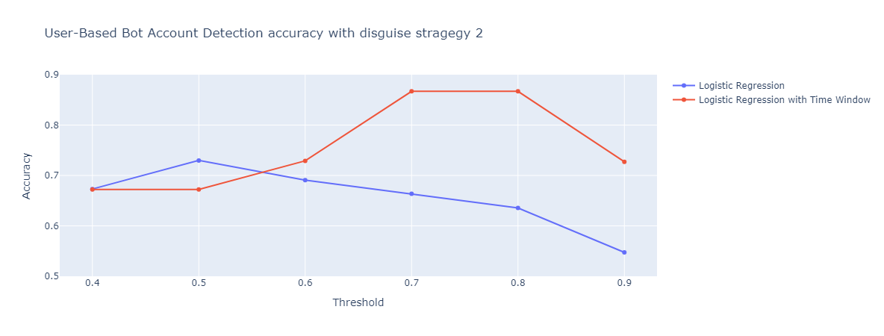
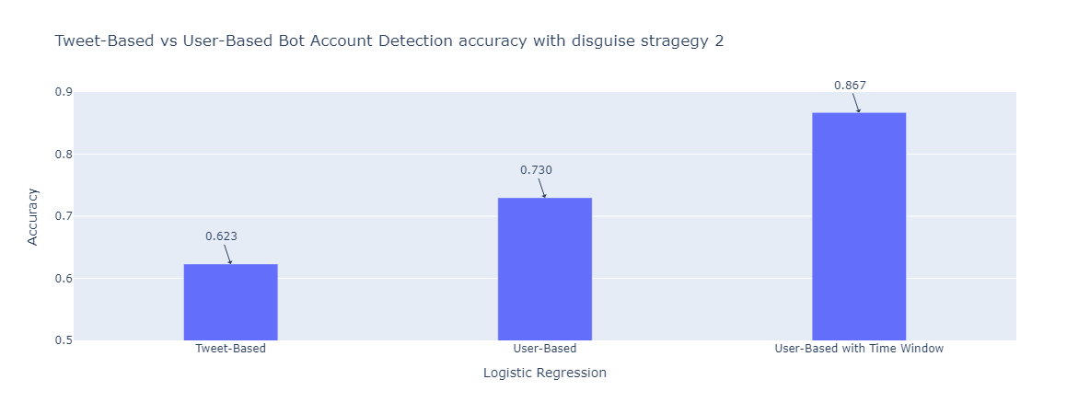
“Tweet-Base Process VS User-Based Process VS User-Based With Time-Window Process” on Disguise Technology 2

Slide 28
Conclusion

Slide 29
Summary and Future Research Directions
The study compares the performance of different machine learning models on a Twitter dataset and analyzes the account identification effectiveness based on user dimensions and tweet dimensions.
The study investigates common bot disguise techniques and their impact on the robustness of detection systems, finding that user-based detection methods exhibit relatively stable performance under various disguise strategies.
In future research, in-depth analysis of user behavior could be pursued. Moreover, integrating various link information from social networks and attempting to further optimize Bot account detection performance and robustness based on graph results could be beneficial.

Slide 30
References
Alarfaj, Fawaz Khaled, Hassaan Ahmad, Hikmat Ullah Khan, Abdullah Mohammaed Alomair, Naif Almusallam, and Muzamil Ahmed. 2023. Twitter bot detection using diverse content features and applying machine learning algorithms. Sustainability 15 (8):6662.
Aljabri, Malak, Rachid Zagrouba, Afrah Shaahid, Fatima Alnasser, Asalah Saleh, and Dorieh M Alomari. 2023. Machine learning-based social media bot detection: a comprehensive literature review. Social Network Analysis and Mining 13 (1):20.
Bayes, Thomas. 1968. Naive bayes classifier. Article Sources and Contributors, 1–9.
Breiman, Leo. 2001. Random forests. Machine learning 45:5–32.
Ferrara, Emilio. 2018. Measuring social spam and the effect of bots on information diffusion in social media. Complex spreading phenomena in social systems: Influence and contagion in real-world social networks, 229–255.
LaValley, Michael P. 2008. Logistic regression. Circulation 117 (18):2395–2399.

