Slide 1
Bitaqat Hifd Qor’an
Learning the Qur’an, step by step
The recitation card system
1
2
3
4
5
6
Free work — Non-commercial — bitaqat-hifd-quran.com
1

Slide 2
Methodology
1
2
3
Objective-based teaching
Stakeholders and allocation of roles
Requirements
Individualised learning programme
Personalised monitoring
Strong involvement from parents
Learning at home / recitation in class
Free work — Non-commercial — bitaqat-hifd-quran.com
2

Slide 3
Methodology
(continued)
Stated objectives
Materials
Setting up a Qur’an learning pathway
Learn ¼ of the Qur’an in 6 years (“Sabbih” “Yâsîn”)
Course materials (Qur’an, photocopies, display folders)
Card system
Free work — Non-commercial — bitaqat-hifd-quran.com
3

Slide 4
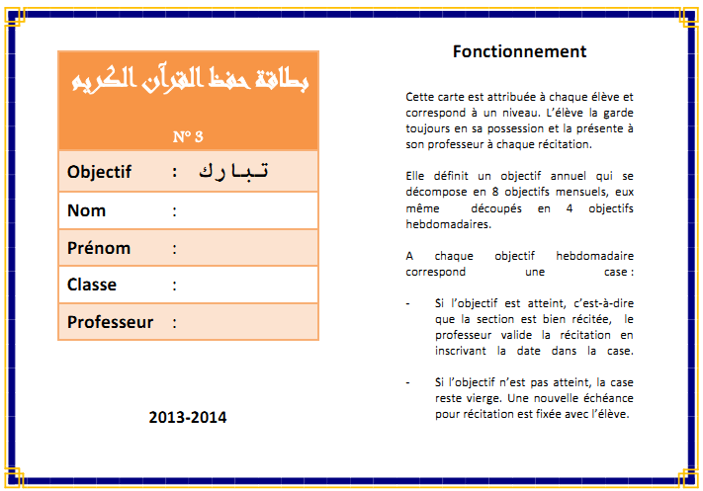
Recitation card
Principle and operation
Individual card kept by the student
Student details and rules of use
Learning schedule with annual, medium- and short-term objectives
Progress tracking
Validation / monitoring by the teacher
Monitoring by the parents
Numbering and colour code
Duplicate held by the teacher
Card no. 3 — front
Free work — Non-commercial — bitaqat-hifd-quran.com
4
Notes:
8 monthly objectives (or one objective per surah for the beginner level) Each objective is broken down into weekly deadlines Each weekly objective corresponds to one box If the recitation is correct, the teacher validates the box by writing the date in it If the objective is not met, the box stays empty - the objective is carried over to the following week If 2 consecutive objectives are missed, a meeting is arranged with the parents Intermediate validations (monthly, bi-monthly and four-monthly)

Slide 5
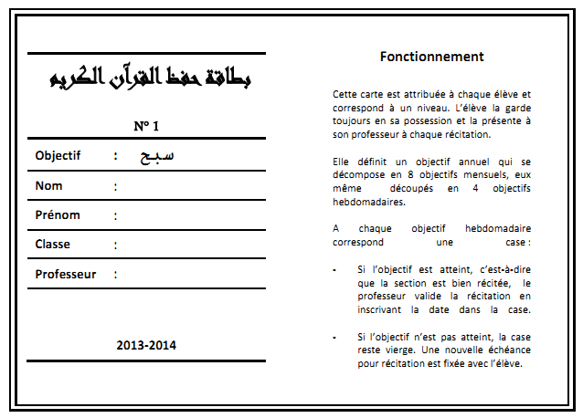
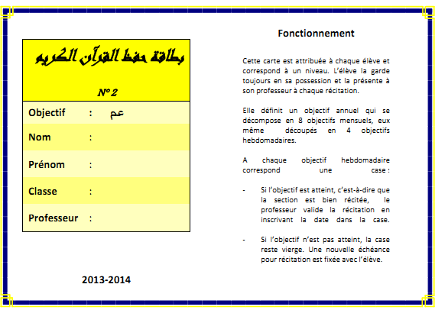
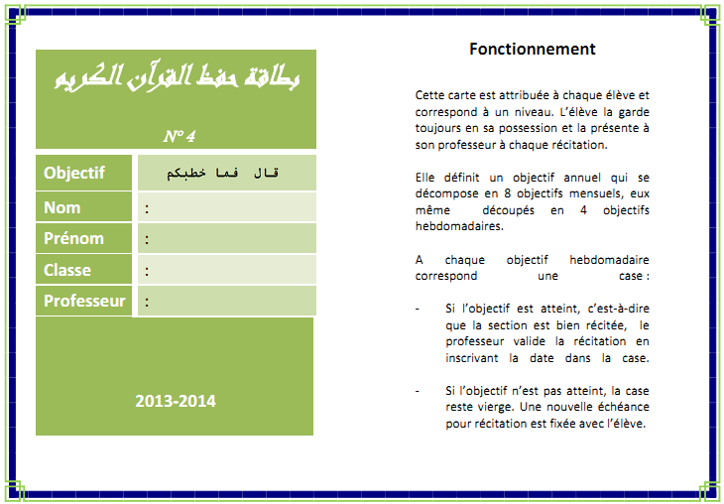
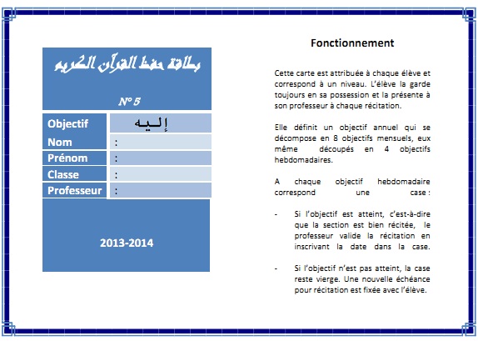
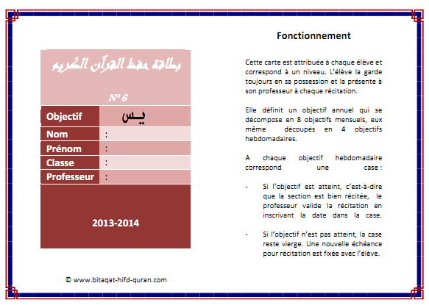
Recitation card
Principle and operation
#1
#2
#3
#4
#5
#6
Free work — Non-commercial — bitaqat-hifd-quran.com
5

Slide 6
Recitation card
Progression and levels
Divided into 3 levels
Six cards with different numbers and colours
Six distinct objectives (annual and weekly) and prerequisites
Progressively increasing learning volume
From hizb 60 (“Sabbih”) to hizb 45 inclusive (Surah “Yâsîn”)
Beginner
no. 1
Intermediate
no. 2 and 3
Advanced
no. 4, 5 and 6
Cards independent of the student’s class and years of attendance
If the annual objective is met, the student receives a higher-numbered card (even mid-year)
A reward at every change of card
Free work — Non-commercial — bitaqat-hifd-quran.com
6
Notes:
A student’s category is determined by the following criteria: Reading proficiency Degree of learning autonomy Learning capacity by volume (minimum threshold: 1/8 hizb per week) To belong to the “Advanced” category, all 3 criteria must be met. To belong to the “Intermediate” category, the first 2 criteria must be met.

Slide 7
Progression and levels
Level | Card no. | Prerequisite (no. of “hizb”) | Objective |  |  |  | Learning
 |  |  | Year (no. of “hizb”) | Cumulative (no. of “hizb”) | Week (no. of lines) | Day (no. of lines)
Beginner | 1 | Alphabet reading | 1 (no. 60) | 1 (Sabbih) | 3-5 | - | In class (group repetition)
Intermediate | 2 | 1 (Sabbih) | 1 (no. 59) | 2 (Amma) | 3-5 | < 1 | At home (semi-autonomous)
 | 3 | 2 (Amma) | 2 (no. 58 + 57) | 4 (Tabâraka) | 7-10 | < 2 | At home (autonomous)
Advanced | 4 | 4 (Tabâraka) | 4 (no. 56 - 52) | 8 (Addhariyât) | 15-20 | < 3 | At home
 | 5 | 8 (Addhariyât) | 4 (no. 51 - 48) | 12 (Ashoûrâ) | 15-20 | < 3 | At home
 | 6 | 12 (Ashoûrâ) | 4 (no. 47 - 44) | 16 (Yâsîn) | 15-20 | < 3 | At home
Free work — Non-commercial — bitaqat-hifd-quran.com
7

Slide 8
Recitation card
Implementation
1
2
3
4
Record each student’s current progress (already done)
Assign cards according to “hifdh” levels
Set up an individualised revision / catch-up programme
Tailor-made card for atypical students
Free work — Non-commercial — bitaqat-hifd-quran.com
8

Slide 9
Course organisation
Recitation (40%)
Sunday
Revision (30%)
Wednesday
Reading improvement / tajwîd (20%)
Wednesday
Islamic education and Qur’anic sciences (10%)
Wednesday
Beginner: Names of Allah / Invocations
Intermediate: Context of the revelation / Value and merits of the Qur’an
Advanced: Context of the revelation / Qur’anic ethics and morality
Free work — Non-commercial — bitaqat-hifd-quran.com
9

Slide 10
Course organisation
“Beginner” level
Objectives
Learning mode (1st term)
Qur’an
Learn hizb “Sabbih” (no. 60)
Method
Acquiring reading (syllabic method “An-Nourâniyyâ”)
Gradual acquisition of learning autonomy
In class and in groups
Short surahs (“Wad-Douhâ” to “An-Nâss”)
Learning mode (2nd term)
Revision
In class and at home with parental help
Photocopy of the section to learn in a suitable format (display folder)
Weekly objective: 3 to 5 lines
In class
In groups
Free work — Non-commercial — bitaqat-hifd-quran.com
10

Slide 11
Course organisation
“Intermediate” level
Objectives
Learning mode
Revision
Qur’an
Reach the annual objective of the recitation card (no. 2 or 3)
Know the “hizb” from previous years
Method
Reading proficiency and knowledge of basic tajwîd rules
Achieving full autonomy in learning
At home
Photocopy of the section to learn (display folder) and “Mushaf”
Weekly objective: 3 to 5 lines or 7-10 lines depending on card no.
In class
In groups, individually or in pairs
Free work — Non-commercial — bitaqat-hifd-quran.com
11

Slide 12
Course organisation
“Advanced” level
Objectives
Learning mode
Revision
Qur’an
Reach the annual objective of the recitation card (depending on no.)
Know the “hizb” from previous years
Method
Mastery of tajwîd rules
Increase learning / revision volume
Independently at home
“Mushaf”
Weekly objective: 15 to 20 lines (1/2 hizb per month)
In class
Individually, in pairs or in groups
Free work — Non-commercial — bitaqat-hifd-quran.com
12

Slide 13
Course schedule
LEVEL | CARD NO. | HIZB | LEARNING /MONTH (HIZB) | WEDNESDAY |  | SUNDAY
BEGINNER | 1 | 60 | 1/8 | Du‘a (5 min) | Revision / learning + reading (1h15) | Du‘a (5 min)
 |  |  |  | Islamic education (15 min) | Names of ALLAH (15 min) | Group learning / Recitation (2h)
INTERMEDIATE | 2 | 59 | 1/8 | Du‘a (5 min) | Reading (45 min) | Du‘a (5 min)
 |  |  |  | Qur’anic sciences (15 min) | Revision (30 min) | Recitation (2h)
 | Reading proficiency + 2 hizbs acquired = AUTONOMY
 | 3 | 57-58 | 1/4 | Du‘a (5 min) | Tajwîd (15 min) | Du‘a (5 min)
 |  |  |  | Qur’anic sciences (15 min) | Revision (1h) | Recitation (2h)
ADVANCED | 4 | 53-54-55-56 | 1/2 | Du‘a (5 min) | Tajwîd (15 min) | Du‘a (5 min)
 |  |  |  | Qur’anic sciences (15 min) | Revision (1h) | Recitation (2h)
 | 5 | 49-50-51-52 | 1/2 | Du‘a (5 min) | Tajwîd (15 min) | Du‘a (5 min)
 |  |  |  | Qur’anic sciences (15 min) | Revision (1h) | Recitation (2h)
 | 6 | 45-46-47-48 | 1/2 | Du‘a (5 min) | Tajwîd (15 min) | Du‘a (5 min)
 |  |  |  | Qur’anic sciences (15 min) | Revision (1h) | Recitation (2h)
Free work — Non-commercial — bitaqat-hifd-quran.com
13

Slide 14
Reminder
Learning at home / Recitation in class
Parental involvement
Monitoring
Help
Consistency
Recitation card / home-school notebook
At home (beginners), 15 min./day, no pressure
Getting used to daily homework
Free work — Non-commercial — bitaqat-hifd-quran.com
14

Slide 15
Bitaqat Hifd Qor’an
Questions & Answers
The recitation card system
1
2
3
4
5
6
Free work — Non-commercial — bitaqat-hifd-quran.com
15

Slide 16
Licence
Free work — Creative Commons BY-NC 4.0
This licence covers the pedagogical resources of the Bitaqat Hifd Qor’an project: recitation cards, tracking tools and methodology documents.
You are free to
Provided that you
Share — copy and distribute the content, in any medium or format
Adapt — remix, transform and build upon the content
Credit “Bitaqat Hifd Qor’an — bitaqat-hifd-quran.com” and indicate any changes
Make no commercial use of it, and do not sell it in any form
Full text: creativecommons.org/licenses/by-nc/4.0/legalcode
Free work — Non-commercial — bitaqat-hifd-quran.com
16

