Slide 1


Implementing covenants and Circle STARK verifier with OP_CAT
Weikeng Chen and Pingzhou Yuan
through a grant from its LP

Slide 2
Covenants

Slide 3
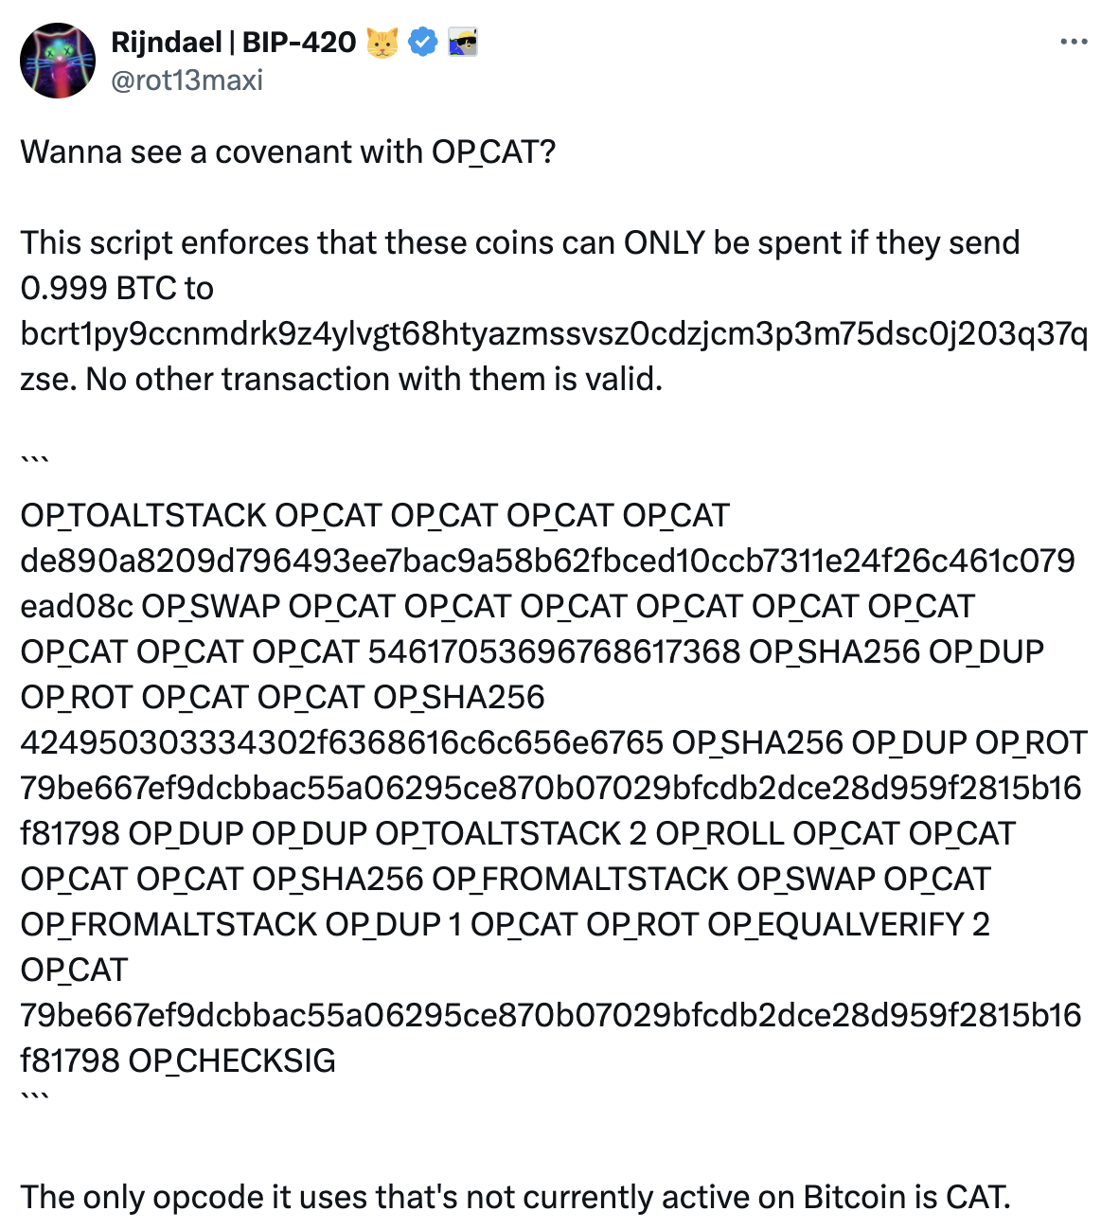
Covenants
Andrew Poelstra showed that with OP_CAT, the Bitcoin script can obtain a hash of the CheckSigVerify preimage, through a Schnorr signature over a dummy public key.
This allows us to:
build covenants
reflect previous outputs

Slide 4
Two steps of building a covenant
Epoch
Annex
Hash Type
This Output
Version
Ext
LockTime
TapSighash
TxData Part 1
TxData Part 2
Following BIP-341
Spend Type
This Input
Input Index
Assemble CheckSigVerify preimage

Slide 5
Two steps of building a covenant
Standard Schnorr trick requires e to be ending with 0x01
(use grinding)
TapSighash
Schnorr’s e element
s = e+1
CheckSigVerify

Slide 6
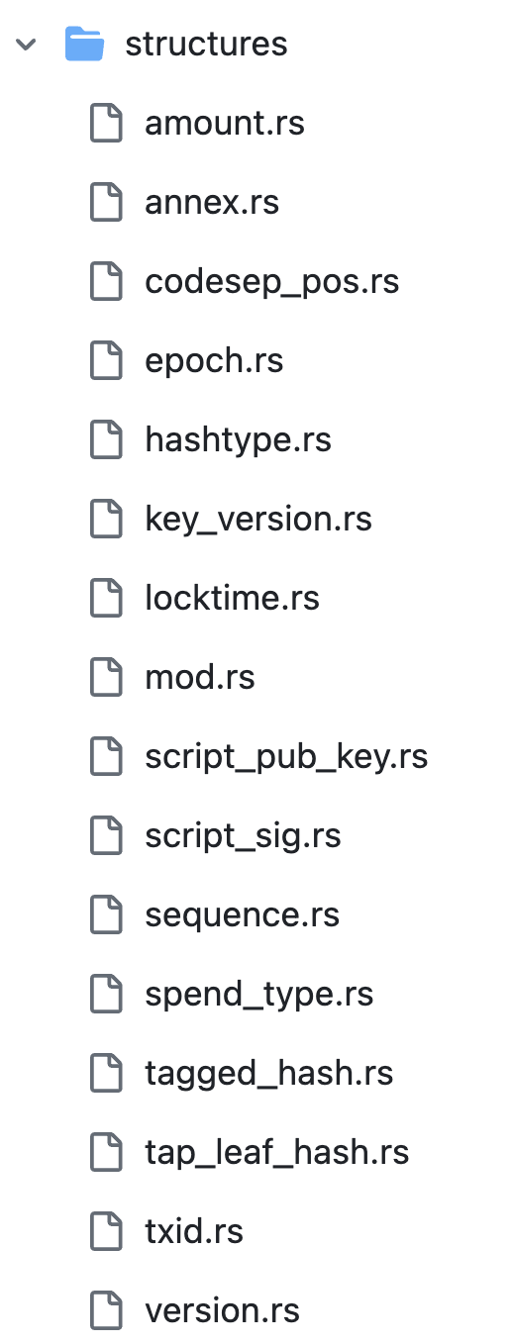
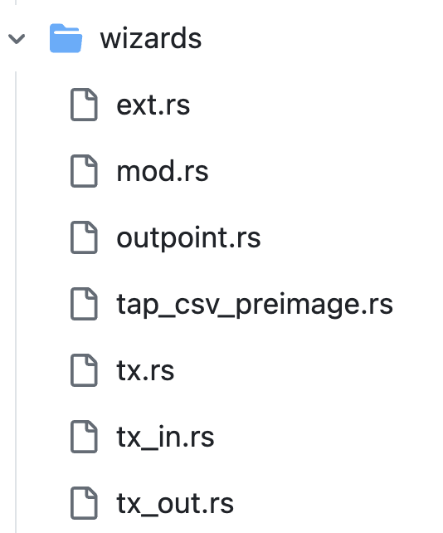
Implementation
https://github.com/Bitcoin-Wildlife-Sanctuary/covenants-gadgets
All the Bitcoin scripts needed for CheckSigVerify

Slide 7
Two steps of reflecting a previous transaction
Through the TXID obtained from covenants

Slide 8
Two steps of reflecting a previous transaction
Version
Out counter
In counter
Output amount
Input outpoint
Output scriptPK
Txid
Input scriptSig
LockTime
Input sequence
Different from Wtxid
Assemble Txid preimage

Slide 9
Two steps of reflecting a previous transaction
Epoch
Annex
Hash Type
This Output
Outpoint
Version
Ext
Txid
Amount
LockTime
Output index
ScriptPubKey
TxData Part 1
Sequence
TxData Part 2
Spend Type
Compare Txid with the one obtained from the Schnorr trick
This Input
Input Index

Slide 10
Implementation
https://github.com/Bitcoin-Wildlife-Sanctuary/covenants-gadgets
All the Bitcoin scripts needed for opening up txid

Slide 11
State-carrying UTXOs

Slide 12
Passing data to the next program
To construct smart contracts on chain, we need to be able to carry data.
Vault Script
$500
[$300 from A,
$150 from B,
$40 from C]
Vault Script
$290
[$150 from B,
$130 from C]
Vault Script
$590
[$300 from A,
$150 from B,
$130 from C]
$300 from A
$90 from C
The naïve solution is to embed the state data in the new UTXO’s vault script.

Slide 13
Naïve solution doesn’t work well
Vault Script
$500
[$300 from A,
$150 from B,
$40 from C]
Vault Script
$290
[$150 from B,
$130 from C]
Vault Script
$590
[$300 from A,
$150 from B,
$130 from C]
$300 from A
$90 from C
For P2TR, the scriptPubKey is an elliptic curve point tweaked by the script hash. Computing the new vault’s scriptPubKey will be expensive, especially when the script exceeds the OP_CAT output limit (520 bytes).

Slide 14
Solution: state caboose
Read new state
using covenant
Vault Script
$590
Vault Script
$290
Vault Script
$500
Vault Script
$590
State caboose
[$300 from A,
$150 from B,
$130 from C]
State caboose
[$150 from B,
$130 from C]
$90 from C
Read previous state using txid reflection
$300 from A
2nd output
2nd output

Slide 15
State caboose only stores a hash of the state
State caboose
[$300 from A,
$150 from B,
$130 from C]
P2WSH
OP_RETURN OP_PUSHBYTES_32
[0x….]
State caboose
0x….
Vault script can ask the caller to include the state preimage in the unlocking script (scriptSig), so the state caboose can just keep a hash of the state for binding.

Slide 16
Solution: state caboose
Vault Script
P2TR
Vault Script
P2TR
Vault Script
P2TR
Vault Script
P2TR
State caboose
P2WSH
Other input
P2?H/P2TR
State caboose P2WSH
Other output
P2?H/P2TR

Slide 17
Example: a counter-carrying program
https://github.com/Bitcoin-Wildlife-Sanctuary/covenants-examples
Count-update script
Three functions:
Increase by 1
Increase by 2
Increase by a caller-provided number if it is <100
State
1
State
2
State
4
State
103
State
104

Slide 18
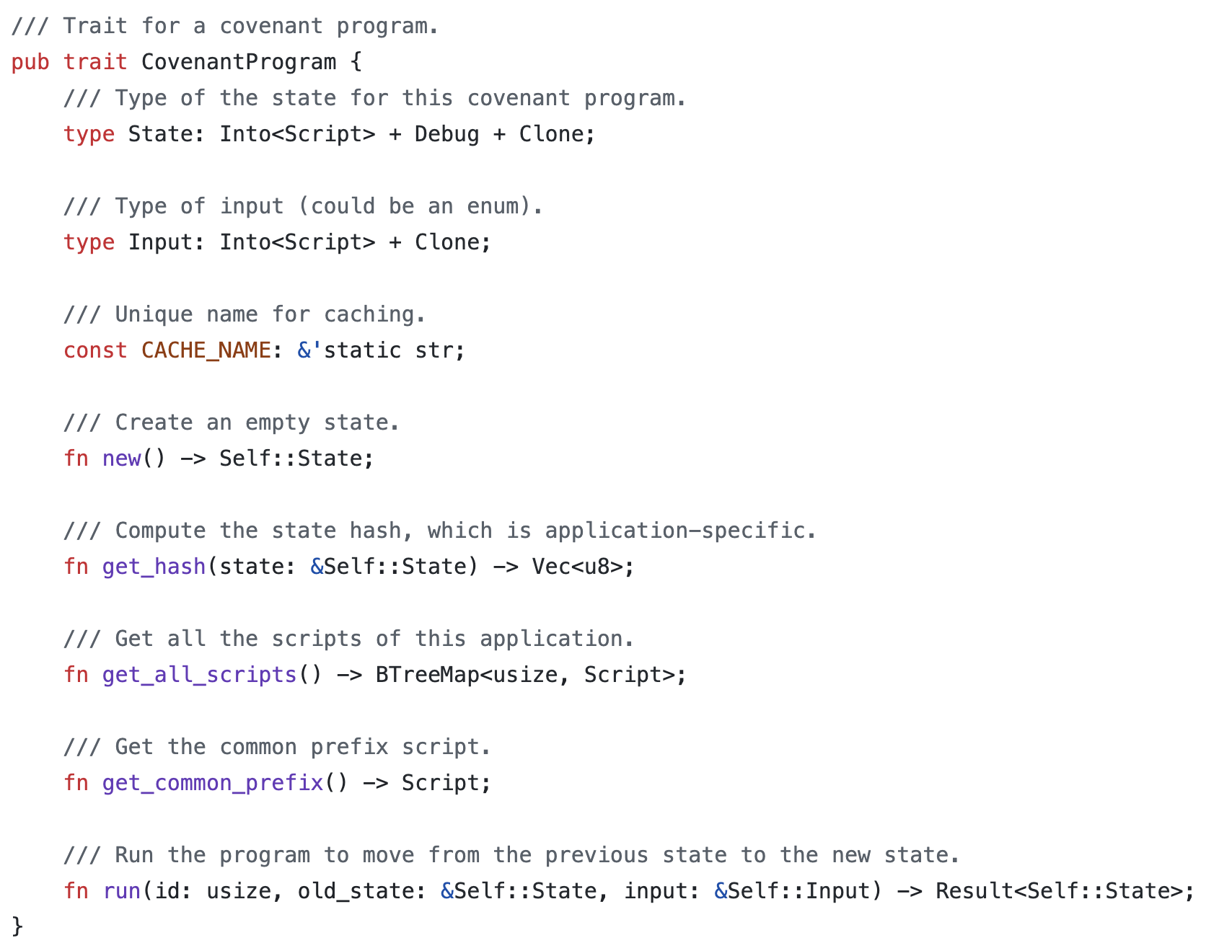
Implementation

Slide 19
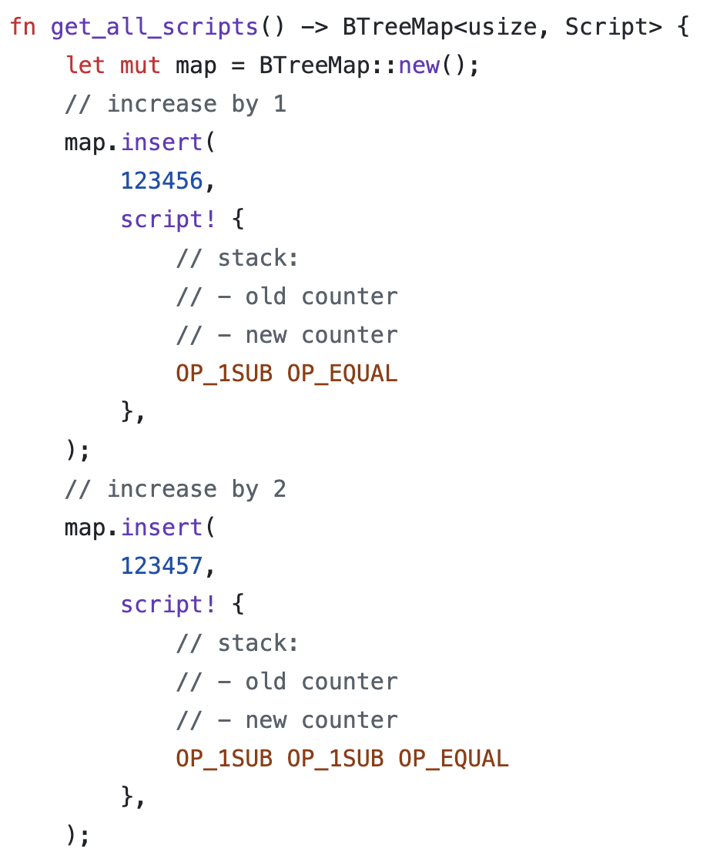
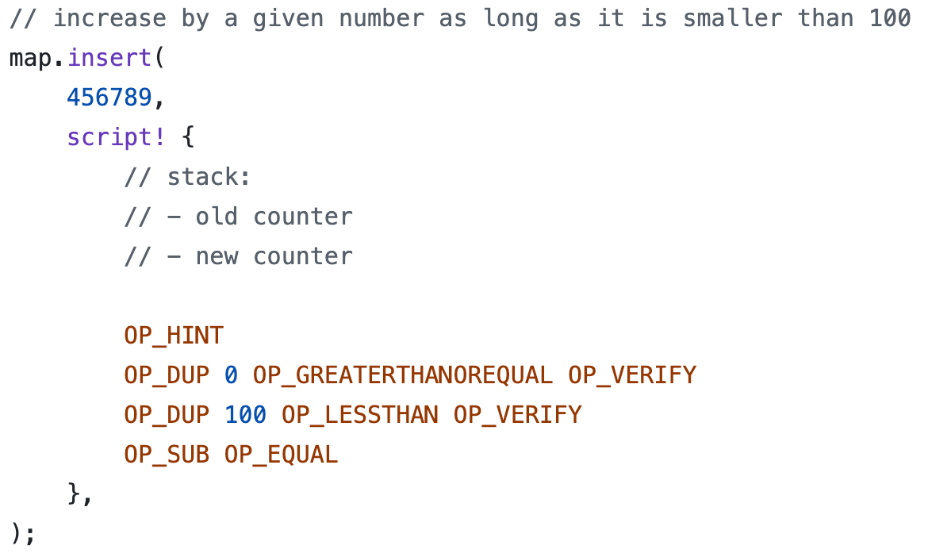
Implementation
OP_DEPTH OP_1SUB OP_ROLL

Slide 20
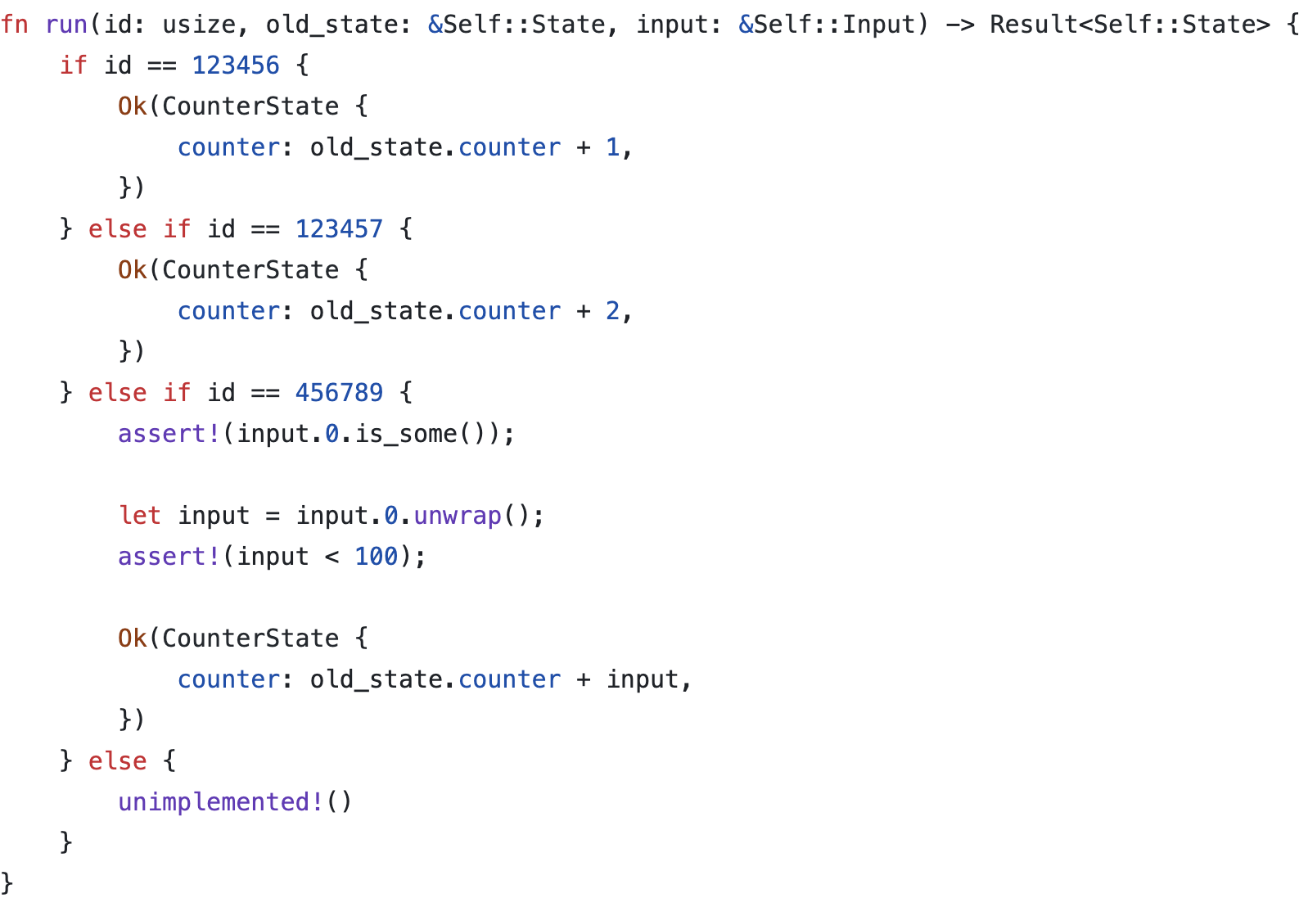
Implementation

Slide 21
Toy circle STARK verifier

Slide 22
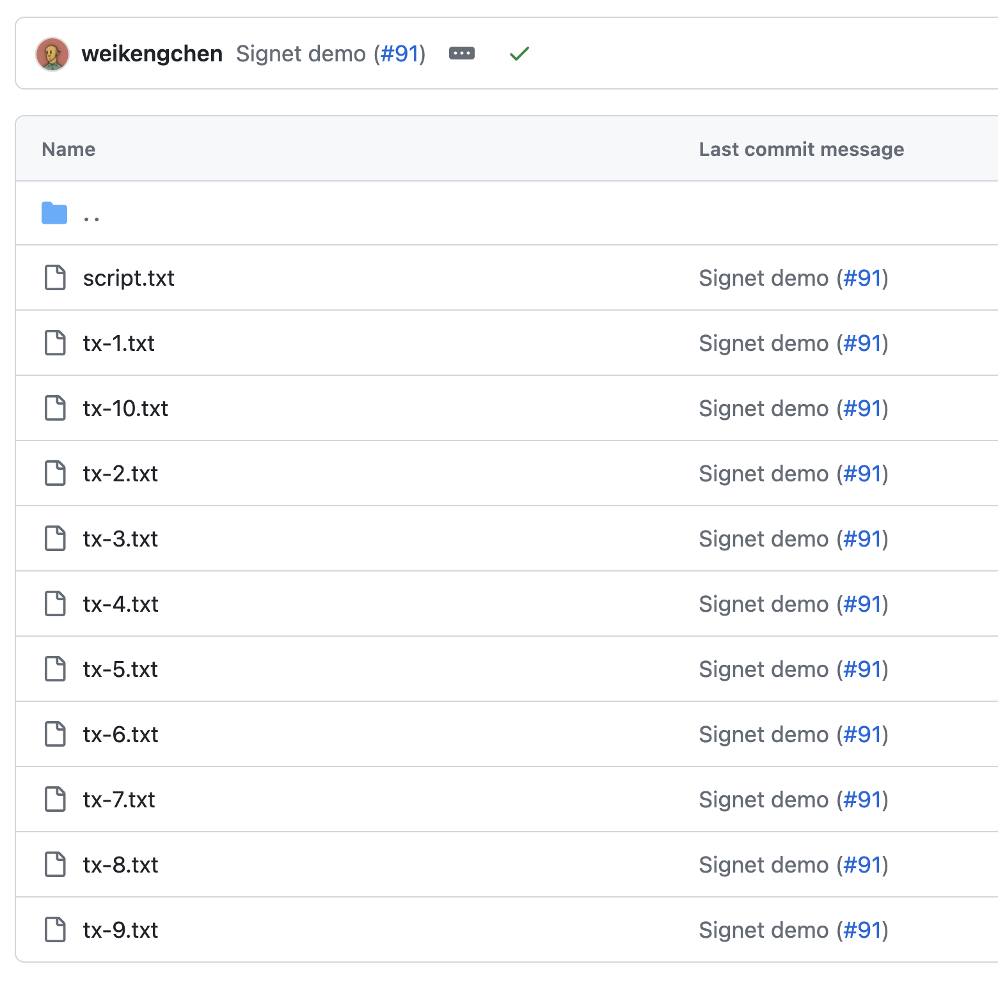
Script layout
We split the verifier into 10 transactions.
One handling Fiat-Shamir transformation.
One handling common computation.
8 more transactions, each handling one of the 8 FRI queries

Slide 23
Chaining them together
State
[1, Fiat-Shamir output]
Toy STARK verifier script
Ten functions:
Fiat-Shamir transform
Common computation
Checking query 1
Checking query 2
…
Checking query 8
State
[0]
State
[2, Fiat-Shamir output
Common computation results]
State
[9, Fiat-Shamir output
Common computation results]
State
[3, Fiat-Shamir output
Common computation results]
State
[4, Fiat-Shamir output
Common computation results]
……

Slide 24
Dynamic control flow: RESET as an example
State
[1, Fiat-Shamir output]
State
[0]
State
[2, Fiat-Shamir output
Common computation results]
State
[9, Fiat-Shamir output
Common computation results]
State
[3, Fiat-Shamir output
Common computation results]
State
[4, Fiat-Shamir output
Common computation results]
……

Slide 25
Next steps

Slide 26
Mempool-friendly transaction flow
Although the ten transactions can, in theory, be submitted together and settled in 1 block, in our experiment, we can only push one transaction per block.
Due to default mempool limits on limitancestorsize, limitdescendantsize.
Solution: we are planning on a new transaction flow design that bypasses limitancestorsize and limitdescendantsize.

Slide 27
Mempool-friendly transaction flow
Verifier script
1/10
State 0 / State 1
Joint caboose
State 0 / State 1
Joint caboose
Verifier script
2/10
State 1 / State 2
Joint caboose
State 1 / State 2
Joint caboose
Vault script
……
……
……
Some output
Verifier script
10/10
State 9 / State 10
Joint caboose
State 9 / State 10
Joint caboose
Vault script
Some input

Slide 28
STARK for General Computation: mini-Plonk
Mini-Plonk (from Starkware) is a simplified Plonk proof system that, compared with the toy example, provides general computation.
Circom script
R1CS
Mini-Plonk
https://github.com/Bitcoin-Wildlife-Sanctuary/circle-plonk
https://github.com/Bitcoin-Wildlife-Sanctuary/r1cs-to-circle-plonk

Slide 29
Thank you

