Slide 1

Covenants and STARK proof verification with OP_CAT
Weikeng Chen

Slide 2
Bitcoin Programmability
Bitcoin script and EVM are both stack-based virtual machines.
EVM is more powerful than Bitcoin:
State
Function calls
Concurrency
Crypto accelerators
Send and receive money

Slide 3
Bitcoin script

Slide 4
Stack machine and opcode
Bitcoin has a lot of opcodes.
If-else
OP_IF OP_ELSE OP_ENDIF …
32-bit integer math
OP_ADD OP_SUB …
Hash
OP_SHA256 …
Signature verification
OP_CHECKSIGVERIFY …
bottom
bottom
OP_ADD
1
3
2
top
top
Stack
Stack

Slide 5
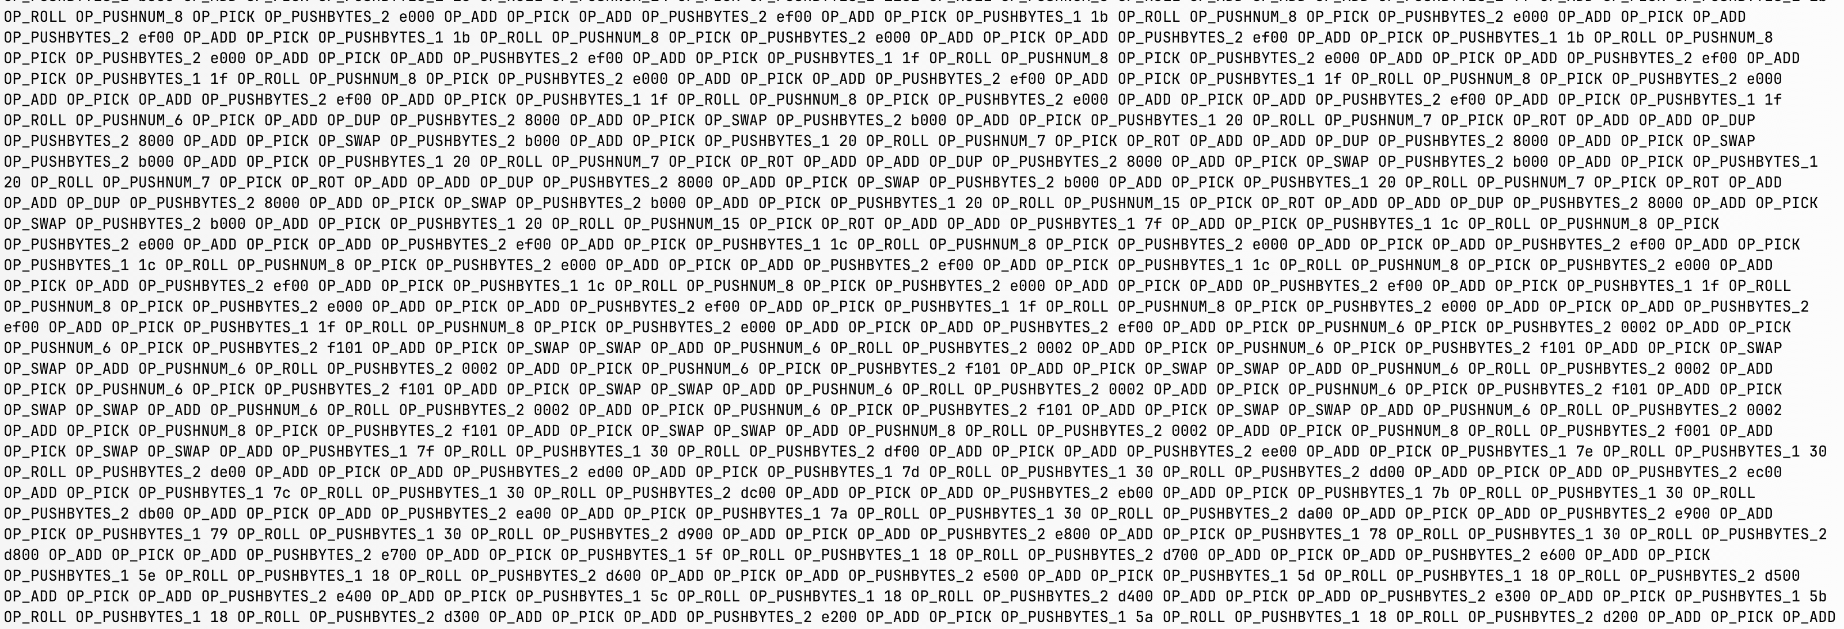
Example of Bitcoin script

Slide 6
Bitcoin lacks certain opcodes
No OP_MUL OP_DIV
Multiplication and division can be emulated using OP_ADD and others
No OP_XOR
XOR can be emulated by lookup table

Slide 7
Bitcoin lacks certain opcodes
No OP_SEND_BTC OP_GET_INPUT OP_GET_OUTPUT
The only opcodes that involve the transaction is signature verification.
Covenant is [provably] not possible.
No OP_CAT
There is [provably] no way to concatenate two strings that are longer than 4 bytes.
“aaaaa”
“aaaaabbbbb”
“bbbbb”

Slide 8
Consequences
Some operations are possible but slow
Some operations are [provably] impossible

Slide 9
Merkle tree is possible, but…
Without OP_CAT, one needs to implement a hash function in Bitcoin script (and cannot use the OP_SHA256 opcode)
Best result: Blake3, 46k script per 512 bits
Simulate 32-bit additions using OP_ADD OP_SUB OP_GREATERTHAN
Simulate XOR using a lookup table
USD $14.95 per layer in the Merkle tree, assuming 2sat/vByte
If we use Merkle tree for a 4GB memory (each leaf is 32-bit), writing a leaf costs USD $600.
Wasting blockspace: doing the script 100 times needs to repeat the script 100 times

Slide 10
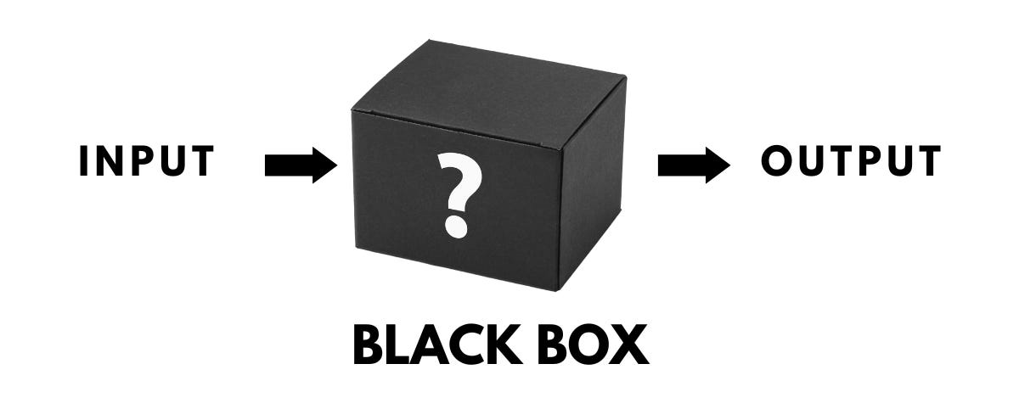
Covenant is impossible
A transaction has inputs and outputs.
There is [provably] no way for a script to constrain outputs other than going through signature verification.
Signatures are “black-box” to the script.

Slide 11

Covenant with OP_CAT

Slide 12
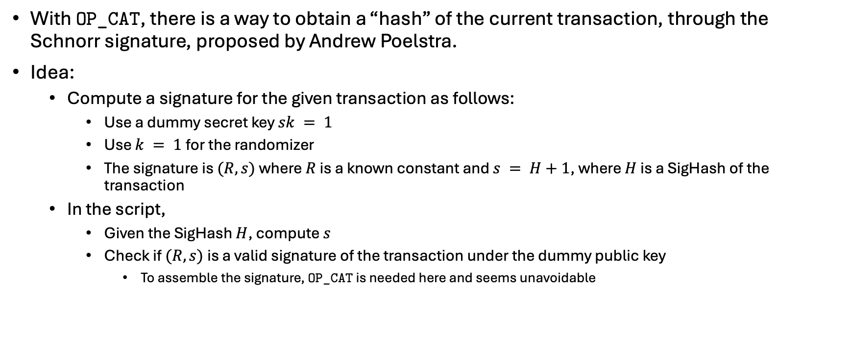
Schnorr trick
With OP_CAT, there is a way to obtain a “hash” of the current transaction, through the Schnorr signature, proposed by Andrew Poelstra.
Idea:
Compute a signature for the given transaction as follows:
Use a dummy secret key $sk = 1$
Use $k = 1$for the randomizer
The signature is $(R, s)$where $R$ is a known constant and $s = H+1$, where $H$ is a SigHash of the transaction
In the script,
Given the SigHash $H$, compute $s$
Check if $(R, s)$is a valid signature of the transaction under the dummy public key
To assemble the signature, OP_CAT is needed here and seems unavoidable

Slide 13
Open up SigHash with OP_CAT
SigHash in Taproot is the hash of several components of the transaction.
Given the transaction information, the script can reconstruct the transaction, compute its SigHash, and check if it is the same SigHash from the Schnorr trick.
The reconstruction requires OP_CAT and it seems impossible to bypass.
This allows the script to constrain inputs and outputs.
Epoch
This Input
Hash Type
Input Index
Version
Annex
LockTime
This Output
TxData Part1
Ext
TxData Part2
Spend Type

Slide 14
Txid reflection with OP_CAT
SigHash can provide the txid of input UTXOs
Txid is a hash of the transaction (with certain information removed)
Given a transaction, the script can compute its txid and compare if it matches the txid of a certain input.
This allows the script to “reflect” on the previous transaction.
Version
Out counter
In counter
Output amount
Input outpoint
Output scriptPK
Input scriptSig
LockTime
Input sequence

Slide 15
Covenant with OP_CAT

Slide 16
Covenant with OP_CAT

Slide 17
New tools from OP_CAT

Slide 18
State
Problem: how to pass the memory data, as a state, to the next execution?

Slide 19

State caboose
A design called “state caboose” or “state caboose hash” is a way to commit the state in the transaction.
OP_RETURN $H(state_{1})$

Slide 20


State caboose
The next computation can use txid reflection to read the state commitment and commit its new state similarly.
OP_RETURN $H(state_{1})$
OP_RETURN $H(state_{2})$

Slide 21
State enables ERC20
With Merkle trees and state, one can implement ERC20.
Token transfer:
Check the sender has provided authorization (e.g., CheckSigVerify)
Subtract the number of tokens by N of the sender
Increase the number of tokens by N for the receiver

Slide 22
Function calls
Example: A contract invoking ERC20 contract to send K tokens to a user
Contract
Contract caboose
Contract new UTXO
Inter-contract communication
ERC20 caboose
ERC20
ERC20 new UTXO
input
output

Slide 23
Function calls
1. Read previous state from the old caboose.
Contract old caboose
Contract old UTXO
Contract
Contract caboose
Contract new UTXO
Inter-contract communication
ERC20 caboose
ERC20
ERC20 new UTXO
input
output

Slide 24
Function calls
2. Check the new state from the new caboose.
Contract old caboose
Contract old UTXO
Contract
Contract caboose
Contract new UTXO
Inter-contract communication
ERC20 caboose
ERC20
ERC20 new UTXO
input
output

Slide 25
Function calls
3. Check that the new contract UTXO is correctly present.
Contract old caboose
Contract old UTXO
Contract
Contract caboose
Contract new UTXO
Inter-contract communication
ERC20 caboose
ERC20
ERC20 new UTXO
input
output

Slide 26
Function calls
Contract old caboose
Contract old UTXO
Contract
Contract caboose
Contract new UTXO
4. Check that the ERC20 token transfer request is correctly placed in the inter-contract communication.
Inter-contract communication
ERC20 caboose
ERC20
ERC20 new UTXO
input
output

Slide 27
Function calls
Contract old caboose
Contract old UTXO
Contract
Contract caboose
Contract new UTXO
(use a technique called “account emulation” from the CAT20 protocol)
Inter-contract communication
ERC20 caboose
5. Check that the ERC20 contract is present.
ERC20
ERC20 new UTXO
input
output

Slide 28
Function calls
Contract
Contract caboose
Contract new UTXO
6. Read previous ERC20 state from the old caboose.
Inter-contract communication
ERC20 old caboose
ERC20 caboose
ERC20 old UTXO
ERC20
ERC20 new UTXO
input
output

Slide 29
Function calls
7. Read the inter-contract communication.
Contract
Contract caboose
Contract new UTXO
Inter-contract communication
ERC20 old caboose
ERC20 caboose
ERC20 old UTXO
ERC20
ERC20 new UTXO
input
output

Slide 30
Function calls
Contract
Contract caboose
Contract new UTXO
8. Check that the contract (who is the sender) is present
Inter-contract communication
ERC20 old caboose
ERC20 caboose
ERC20 old UTXO
ERC20
ERC20 new UTXO
input
output

Slide 31
Function calls
9. Check the new ERC20 state in the new state caboose
Contract
Contract caboose
Contract new UTXO
Inter-contract communication
ERC20 old caboose
ERC20 caboose
ERC20 old UTXO
ERC20
ERC20 new UTXO
input
output

Slide 32
Function calls
10. Check that the new ERC20 contract UTXO is correctly present.
Contract
Contract caboose
Contract new UTXO
Inter-contract communication
ERC20 old caboose
ERC20 caboose
ERC20 old UTXO
ERC20
ERC20 new UTXO
input
output

Slide 33
Function calls
The example is a special case for two contracts to interact with each other.
Needs standardization for such inter-contract communication that is simple, safe, scalable, and flexible.

Slide 34
Concurrency
A fundamental issue with function calls is that users may need to work together to schedule the transaction flow, to allow the same contract being invoked multiple times in the same block.
ERC20 caboose
ERC20 caboose
ERC20
ERC20 new UTXO
ERC20
ERC20 new UTXO
input
output
input
output
Alice
Bob

Slide 35
Concurrency
Miner-helped sequencing (sCrypt uses this idea in CAT-based StarkNet bridge)
Instruction
Alice
Submission UTXO
Miner, sequencer,
or bundler
Hashes of instructions
Instruction
Aggregated UTXO
Bob
Submission UTXO
ERC20 caboose
Instruction
Used to collect a signature from Bob
ERC20
ERC20 new UTXO
Carol
Submission UTXO

Slide 36
Concurrency
Function calls would make it more complicated
Miner, sequencer,
or bundler

Slide 37
Concurrency
Miners can decide the order and even change the order to reduce the overhead of aggregation -> MEV from miners or from submitters
Solution:
Decentralize the MEV: Currently miners are the only one who decides the order, and miners will change. It is possible to create a role of “bundler” and rotate who is the bundler that is authorized to sort the transactions.
Discourage MEV by PoW: Complicated but useful in some use cases that are highly MEV sensitive. Could be application-specific.
Block n: build a list of submission, sort them by the txid, commit the sorted list
Block n+1: use a valid block header, shuffle the sorted list with the block header hash, execute the list exactly following the order in the lsit

Slide 38
Crypto accelerators
Bitcoin has OP_SHA256, but without OP_CAT it can only do two things:
Hash a non-hash element and make it a hash
Hash a hash element again
Enough for Lamport and Winternitz signatures, but not for Merkle trees
With OP_CAT, the opcode OP_SHA256 becomes a general-purpose crypto accelerator for hashing up to 520 bytes at once.
Merkle trees

Slide 39
Send and receive money
Contract
Contract caboose
Incoming money
Contract new UTXO
Receive money
Contract caboose
Contract
Contract new UTXO
Outgoing money
Send money

Slide 40
Status of OP_CAT

Slide 41
Using OP_CAT today
Liquid Network (TVL: USD $251m)
Native token is L-BTC, 1-1 peg with BTC
Deviates from Bitcoin by having more opcodes and protocol changes
Bitcoin SV (TVL: USD $977m)
Native token is BSC, a separate token
Deviates from Bitcoin by having larger blocks and script support
Fractal Mainnet (TVL: USD $25m)
Native token is FB, a separate token
Deviates from Bitcoin only in having OP_CAT
Bitcoin Signet (no TVL, testnet)
Native token is Signet BTC, a testnet token that is rendered no value
Deviates from Bitcoin only in having OP_CTV, OP_CAT, ANYPREVOUT

Slide 42
OP_CAT covenant is highly efficient
Example: counter
At a fee rate 2 sat/vByte, every transaction costs USD $0.55
Count-update script
Three functions:
Increase by 1
Increase by 2
Increase by a caller-provided number if it is <100
State
1
State
2
State
4
State
103
State
104

Slide 43
BitVM benefits from OP_CAT
BitVM requires a per-instance trusted setup ceremony
MultiSig that depends on the programs but does not depend on proofs or data
Purpose: do covenants without OP_CAT
OP_CAT removes this setup
Script can directly enforce covenants.
No need for Lamport or Winternitz signatures.
Low challenging deposit

Slide 44
OP_CAT subsumes OP_CTV
OP_CTV can be implemented with OP_CAT
OP_CAT can pull the information of the entire transaction and compute OP_CTV template hash.
OP_CTV is weaker than OP_CAT.
OP_CTV does not enable recursive covenants.

Slide 45
OP_CAT can (somewhat) do ANYPREVOUT
ANYPREVOUT standard refers to a Schnorr signature over a hash that does not commit “previous outputs” data.
OP_CAT can compute the message to be signed by the Schnorr but verifying this Schnorr signature cannot be done by OP_CHECKSIG.
One must emulate Schnorr signature verification (which involves elliptic curve and finite field) in the Bitcoin script.
Without ANYPREVOUT, signatures for OP_CHECKSIG are not directly reusable.
Some use cases may have an easier implementation directly via OP_CAT.

Slide 46
L2 and Bitcoin ZK verifier

Slide 47
Reasons for L2
Scalability, latency, fee
Sequencing, account abstraction
Computation model (account vs UTXO)
Programming language (EVM/WASM vs Bitcoin script)
Even if some of the features could be emulated within Bitcoin script, but Bitcoin has a limited processing capacity that cannot afford the virtualization overhead.

Slide 48
BitVM is an option, but not ideal for a layer-2
For liveness, needs to trust at least one of the designated operators
Otherwise, operators can lock all users’ assets
No unilateral exit
Peg-in needs to be a fixed amount during the setup
Operator needs to front BTC during peg-out, and operator will need to wait for a period to get the money back (for security against forking attacks)
Many other issues have solutions.

Slide 49
STARK vs SNARK
Hash-based ZK, commonly known as STARK, can be made Bitcoin-friendly so a single proof verification takes about 6MB of script.
Elliptic curve-based ZK, commonly known as SNARK, is known to require at least 2GB of script.
The cost of both can be dramatically lowered down if we do optimistic ZK proof verification (if someone will challenge if the proof is wrong)

Slide 50
Our work: Circle Plonk verifier
Circle Plonk is a proof system that replaces a few components from the Plonk protocol:
Use Circle M31 for field and FRI for polynomial commitment
Further simplify the circuit representation, reduce the number of columns
Support R1CS. Developers can use circuits from existing DSLs, such as Arkworks-rs or Circom.
Verifying a small Circle Plonk proof takes about 3.6MB of script (which would cost $1162 to verify one proof with a fee rate of 2sat/vByte). We can optimize it to $660 by reusing Bitcoin PoW. This number can go up for larger proofs.
Optimistic ZK verifier would be very cheap.

Slide 51

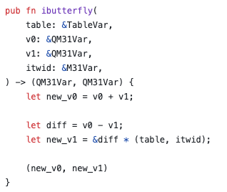
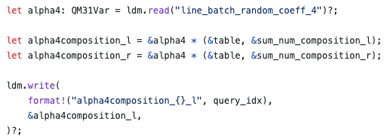
Writing the Bitcoin script for the verifier
We currently use an embedded DSL in Rust (based on the design of Arkworks-rs) to write Bitcoin script.
Hashing
Field arithmetic
Memory

Slide 52
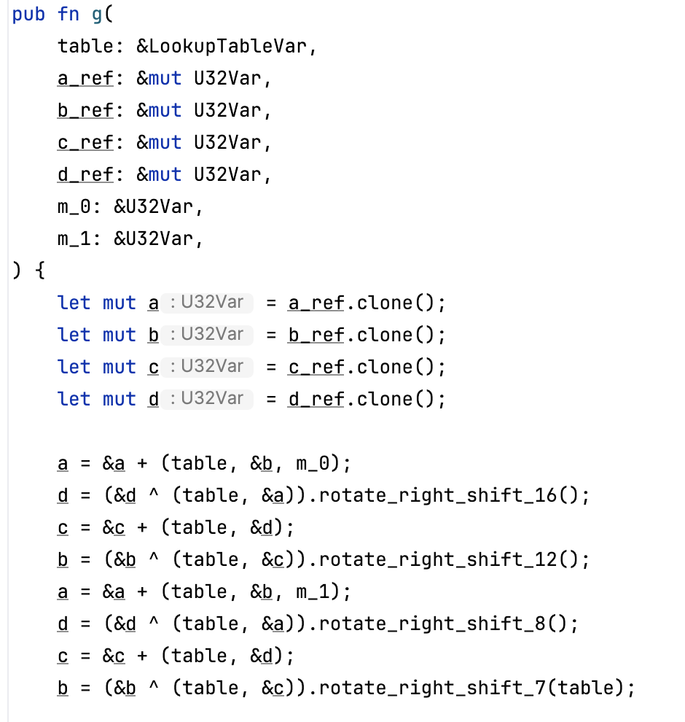
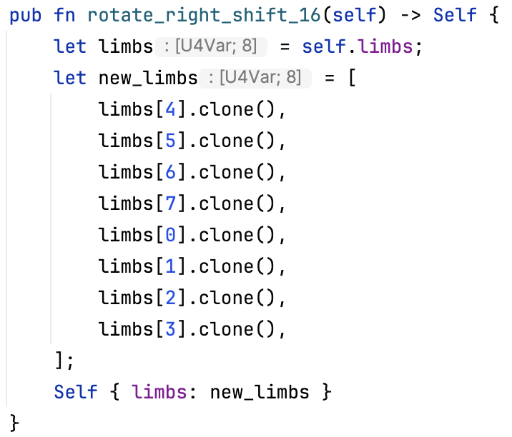
Writing the Bitcoin script for the verifier
Blake3 g function
Recently we attempted using it to implement Blake3.
Blake3 rotate right shift by 16

Slide 53
Next steps
Reusing Bitcoin PoW
Decorrelated transaction flow
Fraud proof version
Recursive verifier: verifying Circle Plonk in Circle Plonk
Exploring STARK verifier in BitVM

Slide 54
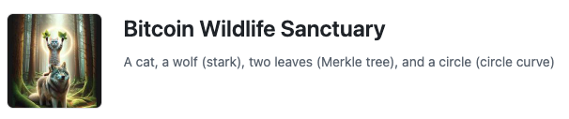


Thank you
https://github.com/Bitcoin-Wildlife-Sanctuary

