Slide 1
The Ice Breaker App
Technology as a wingman

Slide 2

Pivotal Social Experiences
Technology and human engagement
Catalyzing social growth
Exiting the “Comfort Zone”
De-strangerization

Slide 3
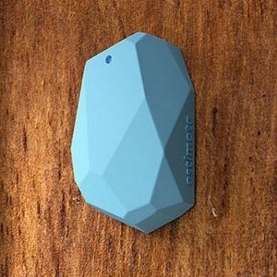
Blue-tooth technology
Ubiquitous blue-tooth emitters
Social-context-aware environment
Human engagement through localization

Slide 4


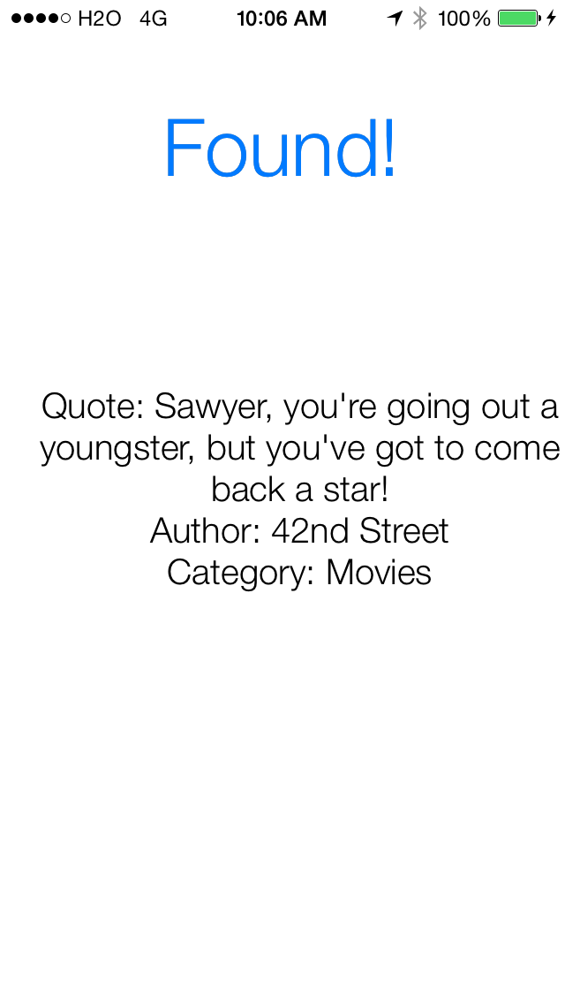
The pitch

Slide 5
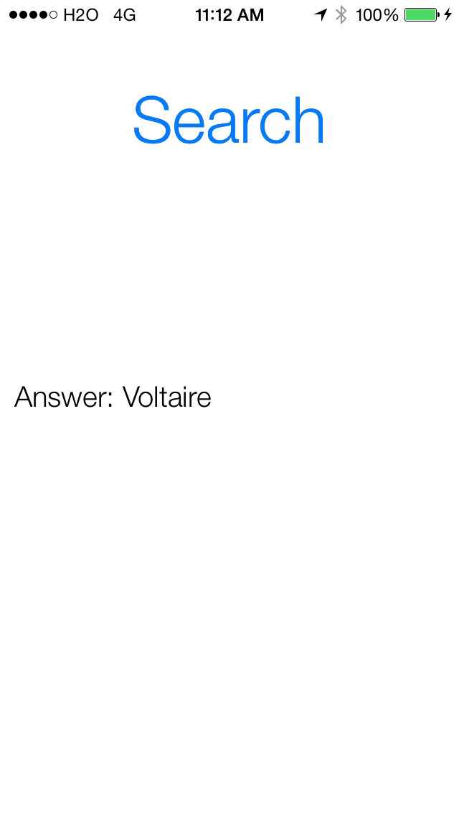
The catch

