Slide 1

FIWARE ChanChan
https://github.com/Bitergia/fiware-chanchan
Sample application using Authentication and Authorization
for publish CKAN contents using Orion Context Broker
Bitergia Team: fiware-testing@bitergia.com
FIWARE Friendly Testing

Slide 2
Goals
Create a sample application integrating FIWARE GEs for publish Internet of Things (IoT) content in CKAN.
Use Authentication (IDM Key Rock) and Authorization (Thales Access Control) for user permissions management using organizations.
Use Orion Context Broker (through Cygnus CKAN) to publish content in CKAN.

Slide 3
Results
Web based (SPA) application with two panels:
  Manual publishing of data in CKAN.
  Santander Sound Level Meters sensors publishing in CKAN.
Provision system for deploying automatically all platform using VAGRANT or a FIWARE Image based in Ubuntu 14.04.

Slide 4
User
FIWARE ChanChan
GLOBAL ARCHITECTURE
Admin
http://chanchan.server
https://idm.server
ChanChan VAGRANT
IMAGE
CKAN
orion.lab.fi-ware.org
http://demo.ckan.org
Orion Context Broker
OpenData
FIWARE Lab
Santander Sound Level Sensors

Slide 5
FIWARE ChanChan
COMPLETE ARCHITECTURE
User
http://chanchan.server
https://idm.server
Admin
Web Client
ChanChan
IDM KeyRock
Server
Access Control
(KeyPass)
Orion PEP
Orion Context
Broker
Cygnus CKAN
ChanChan
Vagrant
Image
CKAN
orion.lab.fi-ware.org
http://demo.ckan.org
Orion Context Broker
OpenData
FIWARE Lab
Santander Sound Level Sensors

Slide 6
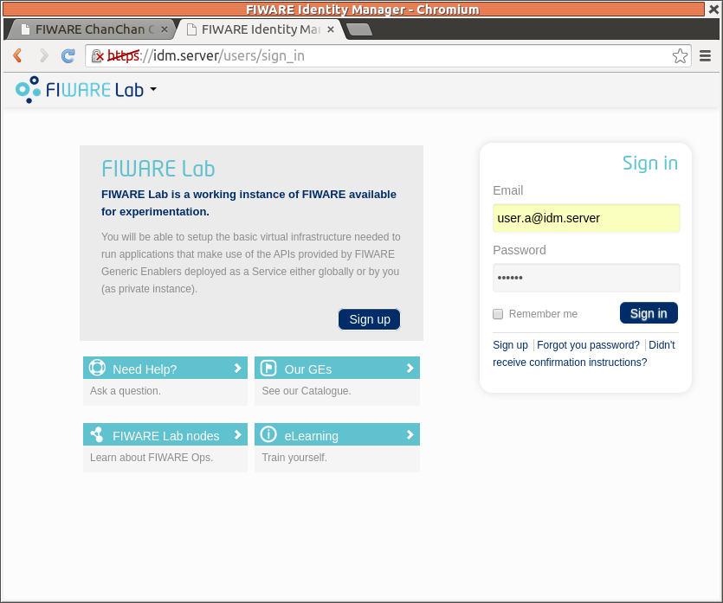
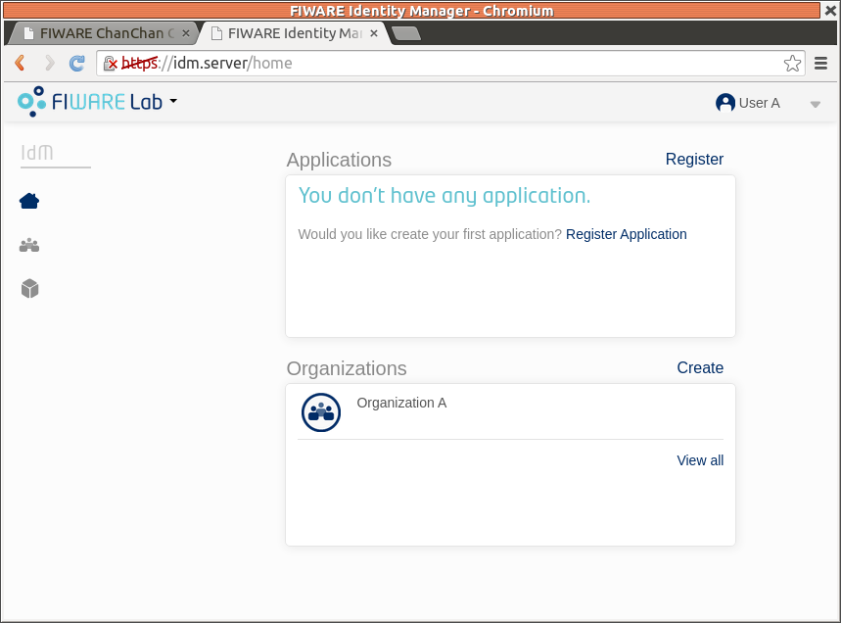
Authentication (I)

Slide 7
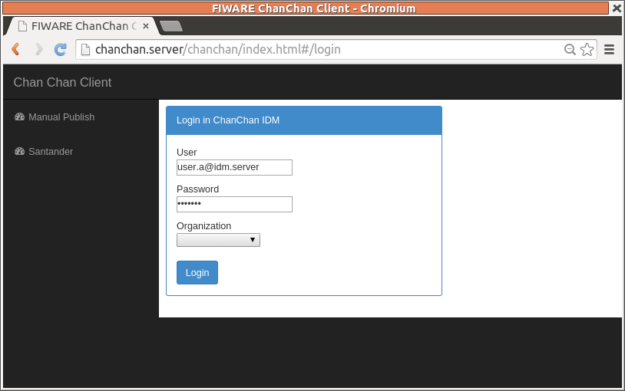
Authentication (II)
Web Client
ChanChan
IDM KeyRock
Server

Slide 8
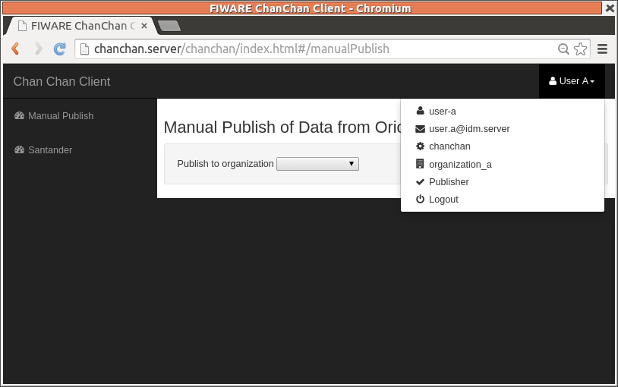
Authentication (II)
Web Client
ChanChan
IDM KeyRock
Server

Slide 9
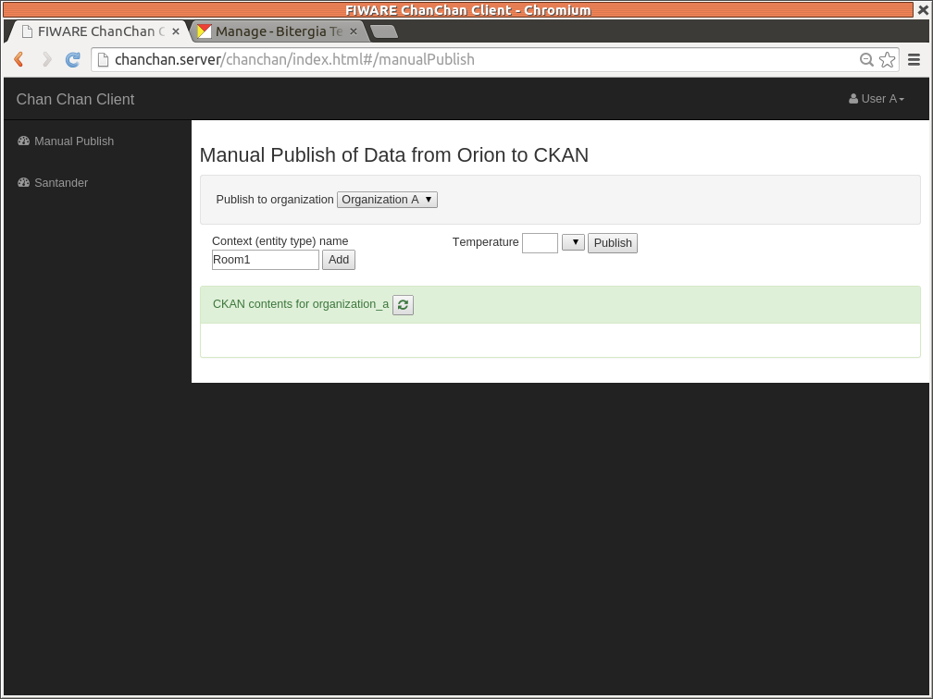
Manual Publish (Data from CKAN)
CKAN
Web Client
ChanChan
OpenData
Server

Slide 10
Manual Publish (Data to CKAN)
Web Client
ChanChan
Orion PEP
Cygnus CKAN
OpenData
Server
Subscription
Orion Context
Broker
CKAN

Slide 11
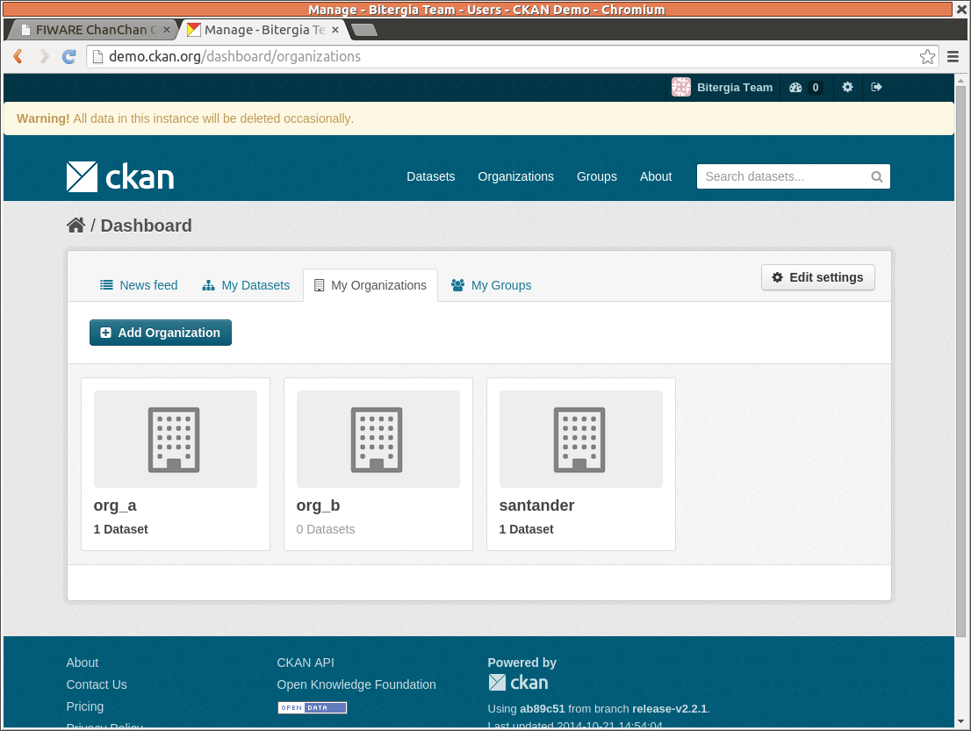
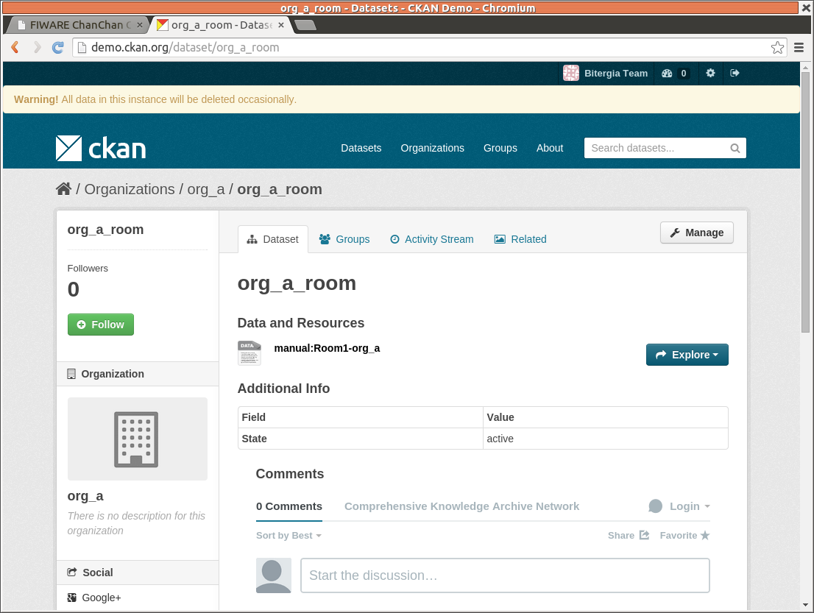
Manual Publish (Data in CKAN)

Slide 12
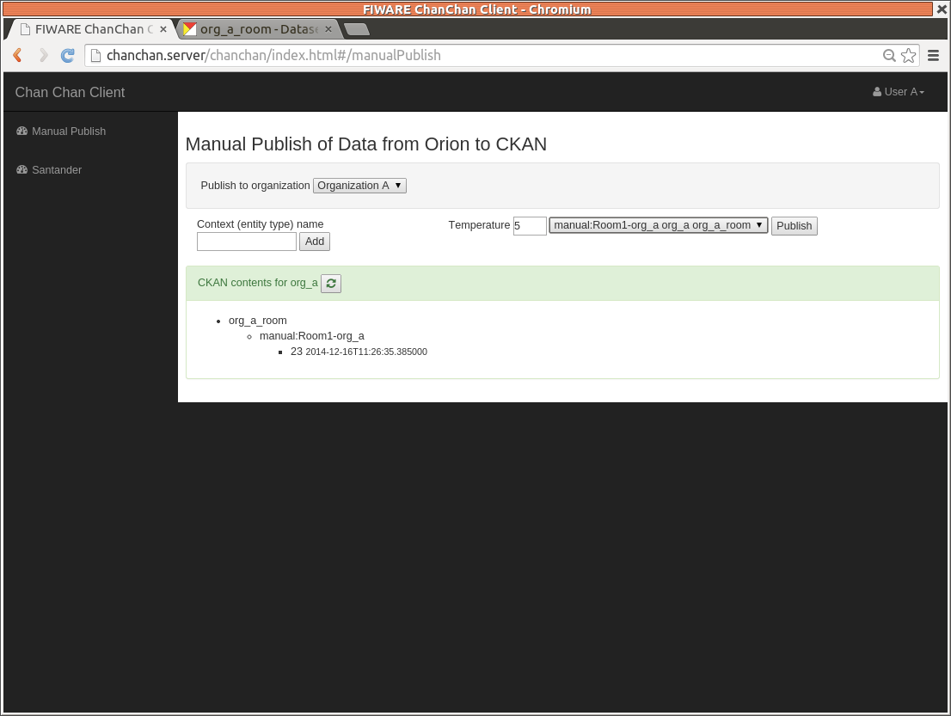
Manual Publish (Data to CKAN)
Web Client
ChanChan
Orion PEP
Cygnus CKAN
OpenData
Server
Subscription
Orion Context
Broker
CKAN

Slide 13
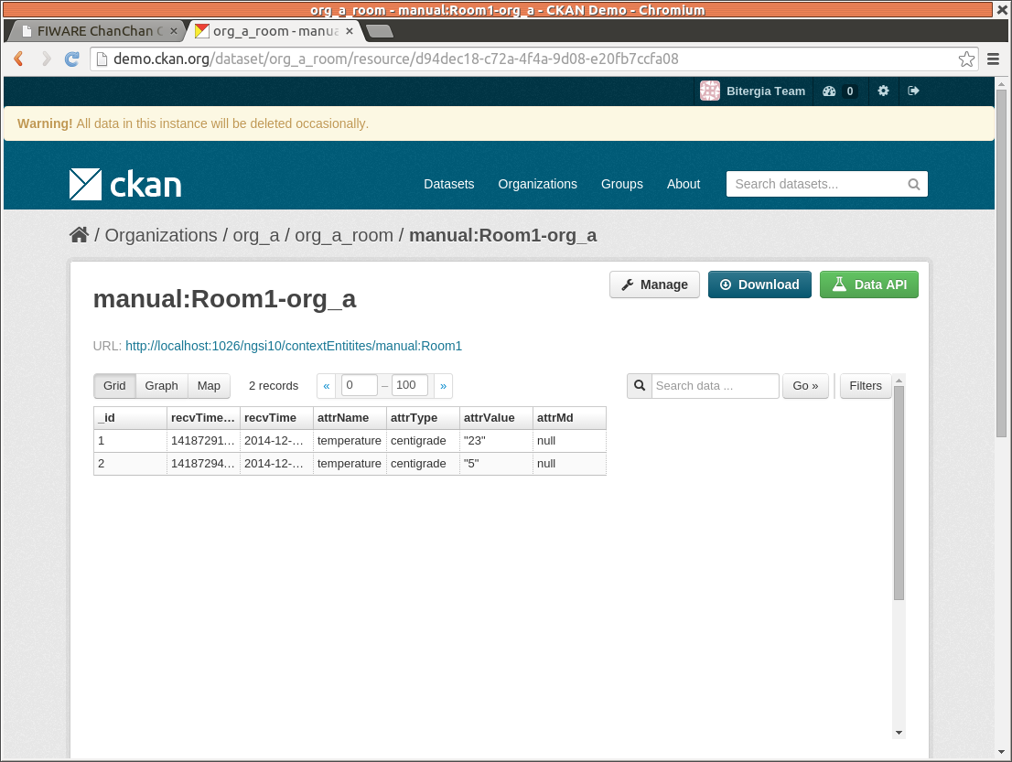
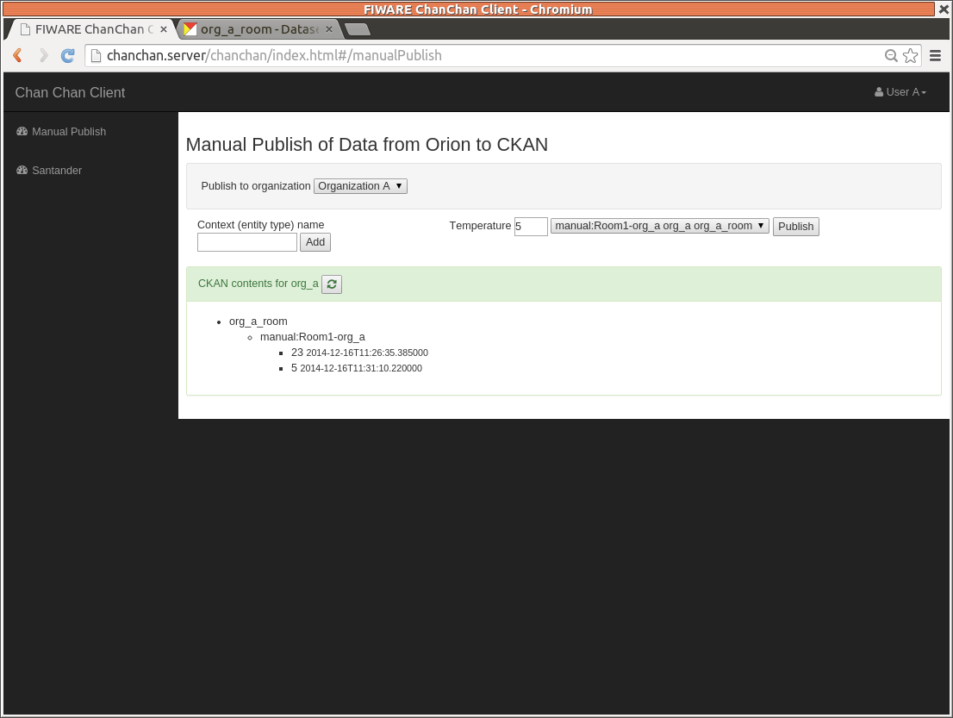
Manual Publish (Data in CKAN)

Slide 14
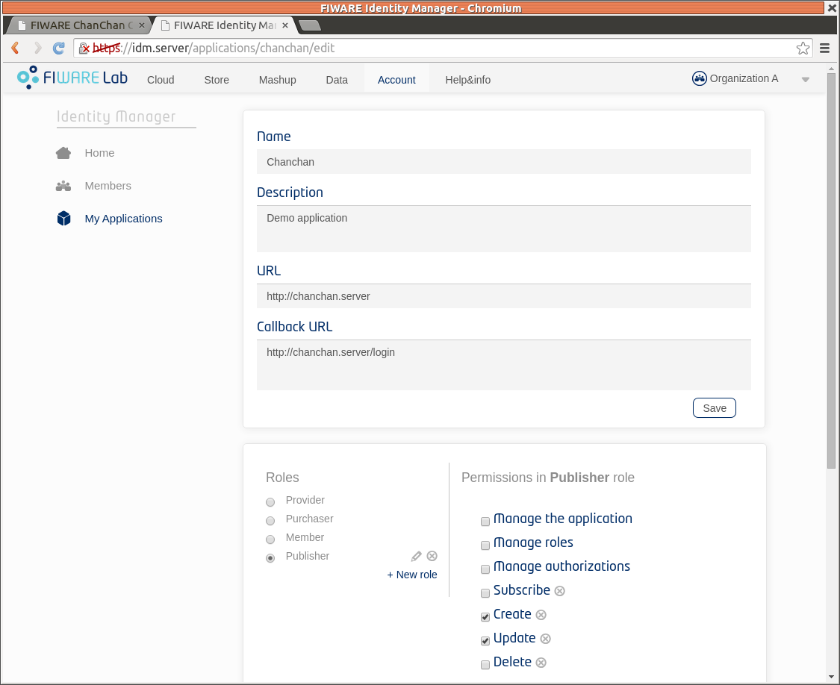

Manual Publish (Access Control)

Slide 15
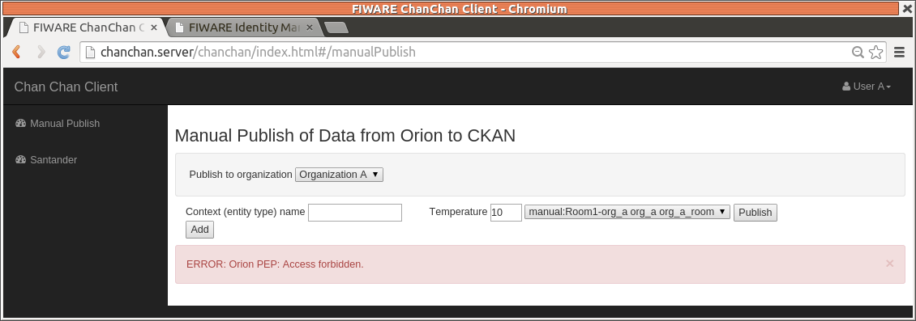
Manual Publish (Access Control)
Web Client
ChanChan
Orion PEP
Access Control
(KeyPass or Thales)
Server
Not Authorized

Slide 16
Work Done: Provision
All ChanChan platform is installed automatically using VAGRANT or an Ubuntu 14.04 image. All components are Open Source (KeyPass substitutes Access Control).
Provision (download, compile, install, configure, integration and initial deploy) has been done for:
  ChanChan client and server
  KeyRock IDM
  Orion PEP
  Cygnus CKAN
  KeyPass
https://github.com/Bitergia/fiware-chanchan/tree/master/vagrant/scripts

Slide 17
Work Done: ChanChan
ChanChan client is a Single Page Application Web using AngularJS. It uses the REST interfaces offered by ChanChan server.
ChanChan server is a Node.js based gateway that offers a REST interface for access CKAN, IDM Key Rock, Orion and Orion PEP REST interfaces.

Slide 18
Work Done: Santander Sensors
Access to Santander Sensors for Sound Level Meter is done using Orion in FIWARE Labs.
Current approach is “pull” in order ChanChan app does not need a public end point for “push”.
Adding new sensors should be pretty easy.

Slide 19
Work Done: IDM KeyRock and KeyPass
IDM KeyRock does not support KeyPass. This support has been developed and contributed upstream.

Slide 20
Conclusions
ChanChan platform could be used to bootstrap systems than needs authentication, authorization and context broker, the basic FIWARE GEs. So it could be seen as a FIWARE SDK.
ChanChan platform could be used to track the development of KeyRock, Orion, Orion PEP, Cygnus and KeyPass and test quickly all of them and its integration. It is an efficient testbed that is “cheap” to maintain.
ChanChan platform shows a complete platform and a SPA web app that uses them, lowering the entry barrier for new developers to FIWARE.

Slide 21
https://github.com/Bitergia/fiware-chanchan
fiware-testing@bitergia.com
Project funded by FICORE friendly testing program

