Slide 1
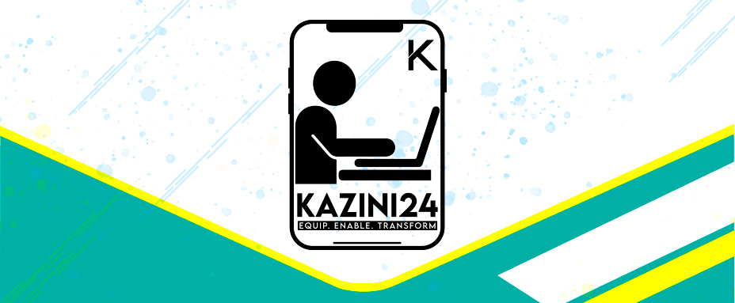

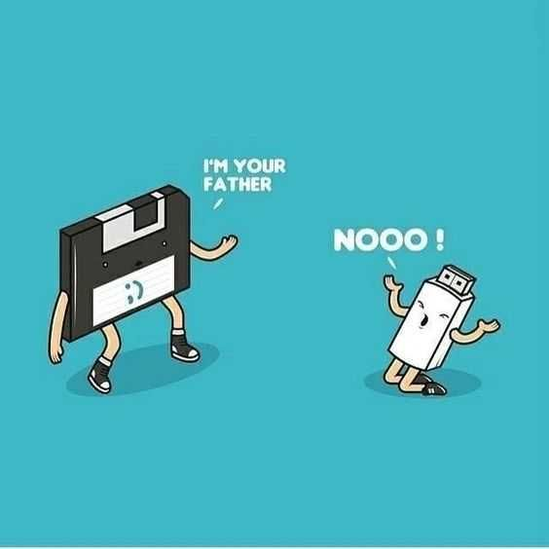

Introduction to Kazini24 SAAS and Possible benefit to KRA
Presented By:
John Kiama

Slide 2
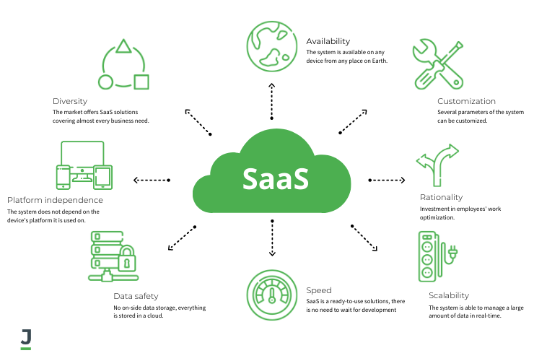
Who are we?
We are a software company that designs, builds and deploy Software as service (SAAS) platform for businesses

Slide 3


What we do
We are in the business of Digitizing millions of micro and small businesses and democratizing entrepreneurship
We do this through Retail Micro Technology(RMT) SAAS platform called KAZINI24.

Slide 4
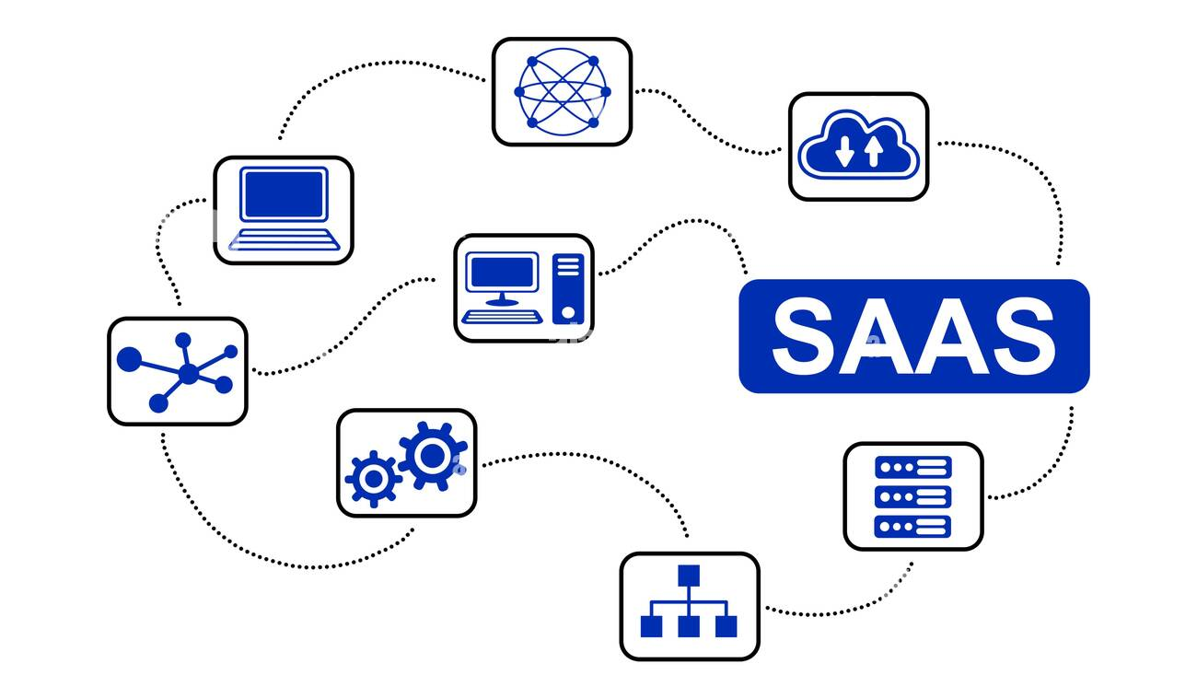

What is Kazini24 Platform
Kazini24 is Retail Micro Technology(RMT) SAAS platform which is designed for SMEs to help them cut costs , increase efficiency , streamline processes ,access financial credit , engage with their customers on a more personal level and generally increase productivity of a business through digital mobile platform with complex data collection, organization , clustering ,reporting and prediction algorithms.
Retail Micro Technology(RMT) SAAS this is a branch of technology that deals with democratizing professionalism in micro and small enterprises

Slide 5

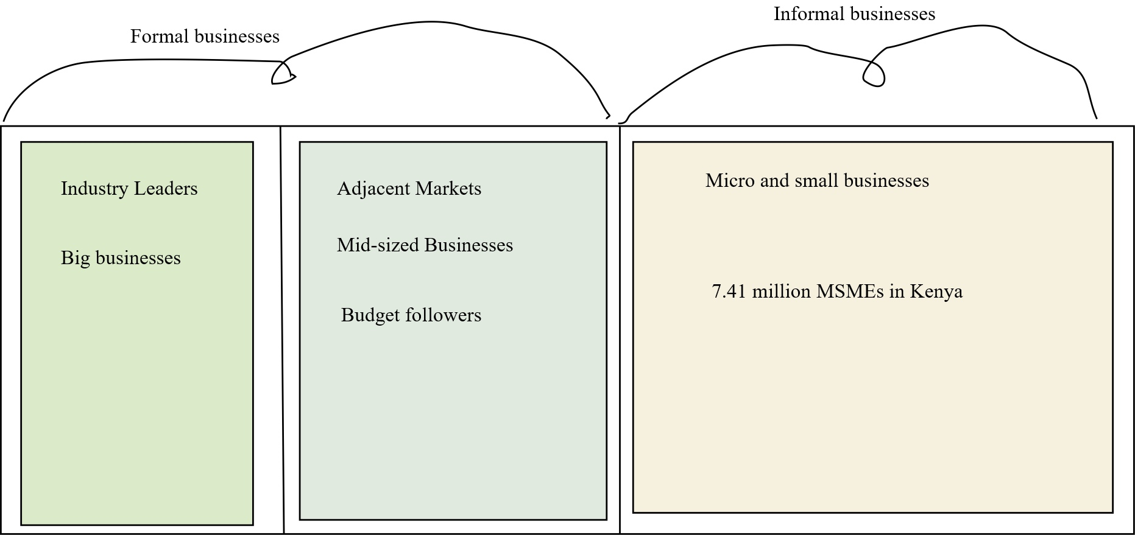
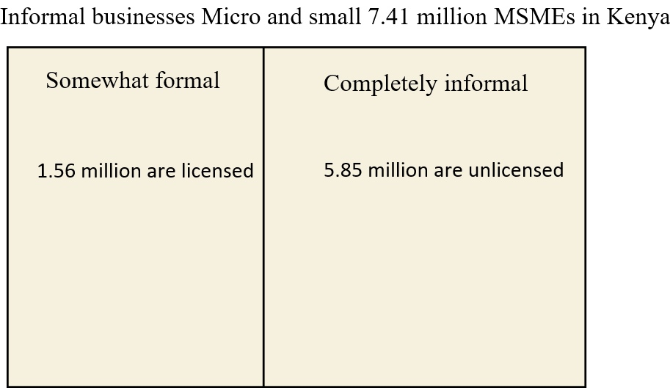
Markets

Slide 6

THE END
Thank you

