Slide 1

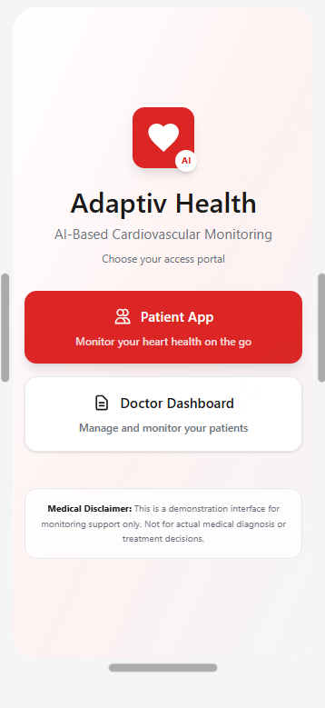
AI-POWERED CARDIOVASCULAR MONITORING SYSTEM
ADAPTIV
HEALTH
ADAPTIV HEALTH — SMARTER MOVEMENT, SAFER HEARTS.
PRESENTED BY
PULSE.

Slide 2

PRESENTED BY
TEAM PULSE
TEAM PULSE
— BRINGS TOGETHER DIFFERENT SKILLS, ONE MISSION, AND A SHARED HEARTBEAT FOR INNOVATION.
ABDALLA HEGGY #8457785
OMAR MASSOUD #7858681
GHINA ISHAQ #871179
KARYLLE OCHAVE #7669057
BITHIN RADHAKRISHNAN #8910881
HAMZA AL RAJABY #7322586
(02)
Team Pulse is a diverse group of innovators combining AI, cybersecurity, and business insight to build heart-safe digital health solutions.

Slide 3
THE PROBLEM
17.9 MILLION PEOPLE DIE FROM CARDIOVASCULAR DISEASE EVERY YEAR — THE WORLD'S #1 KILLER
YET THE CRITICAL GAP BETWEEN HOSPITAL DISCHARGE AND DAILY LIFE REMAINS UNSOLVED.
No Real-Time Monitoring
Blind Spots for Doctors
Patients leave hospital with zero continuous oversight between appointments.
Clinicians cannot see what happens to patients outside the clinic walls.
Fitness Apps Fall Short
Generic apps ignore cardiac safety entirely — one wrong workout can be fatal.
ADAPTIV HEALTH — SMARTER MOVEMENT, SAFER HEARTS.

Slide 4
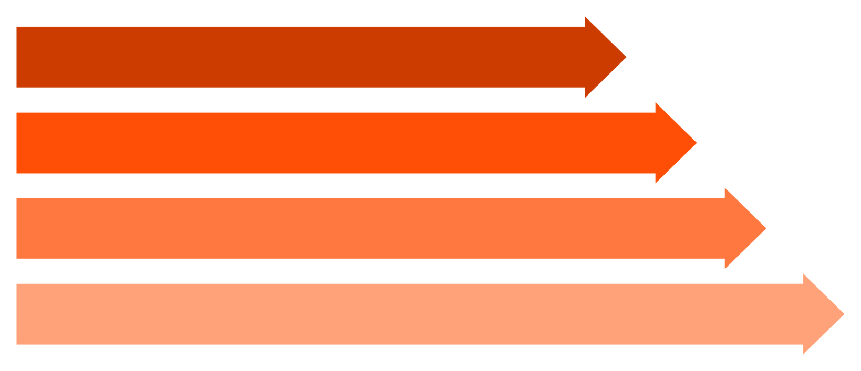




OUR SOLUTION
BRIDGING THE GAP BETWEEN CLINIC AND DAILY LIFE
NOT A FITNESS APP. NOT A DIAGNOSTIC TOOL. A SAFETY NET FOR CARDIAC PATIENTS.
REAL-TIME RISK CLASSIFICATION
COLLECT VITALS
CONTINUOUS CARDIOVASCULAR RISK SCORING, COLOUR-CODED FOR INSTANT CLARITY.
GENERATE AI SCORE
PERSONALISED AI EXERCISE GUIDANCE
SAFE, TAILORED WORKOUT PLANS GENERATED FROM LIVE CARDIAC DATA.
DELIVER EXERCISE PLAN
INSTANT DANGER ALERTS
AUTOMATIC ALERTS TO CLINICIANS THE MOMENT READINGS BECOME DANGEROUS.
TRIGGER DOCTOR ALERT
WORKS COMPLETELY OFFLINE
ON-DEVICE EDGE AI ENSURES PROTECTION EVEN WITHOUT INTERNET CONNECTIVITY.
ADAPTIV HEALTH — SMARTER MOVEMENT, SAFER HEARTS.

Slide 5
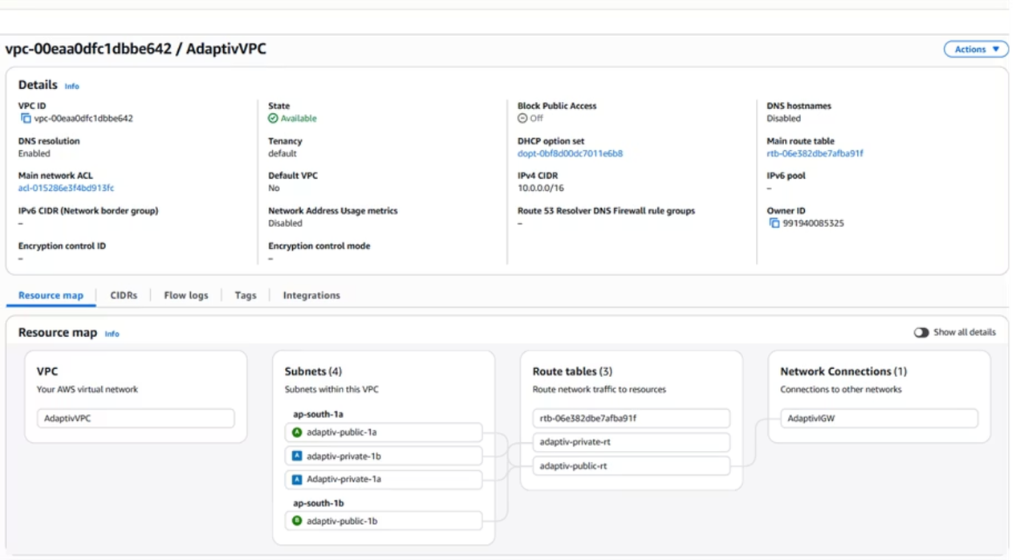
SYSTEM ARCHITECTURE
FOUR LAYERS. ONE SEAMLESS SYSTEM.
FULLY DEPLOYED AT API.BACK-ADAPTIVEHEALTHUOWD.XYZ — AWS EC2 MUMBAI, PRIVATE VPC, POSTGRESQL RDS.
STACK OVERVIEW
01
FLUTTER APP (EDGE AI)
PATIENT-FACING MOBILE APP WITH ON-DEVICE INFERENCE.
02
AWS API GATEWAY + FASTAPI
ASYNC PRODUCTION-GRADE BACKEND ON EC2, MUMBAI REGION.
03
POSTGRESQL RDS (PRIVATE VPC)
ZERO PUBLIC INTERNET ACCESS — ALL PHI ENCRYPTED AT REST.
04
REACT CLINICIAN DASHBOARD
REAL-TIME OVERSIGHT FOR DOCTORS FROM ANY BROWSER.
Notes:
Our machine learning model is the brain of the system. We chose Random Forest because it's the gold standard for medical AI applications - it handles structured health data exceptionally well.
The model was trained on workout and user data stored in our AWS RDS database. It analyzes 16 features that capture heart rate behavior, exercise intensity, recovery patterns, and age-related risk factors.
Initially, we achieved 100% accuracy - which seemed great, but actually indicated a problem called data leakage. The model was simply learning the mathematical threshold we used to create the labels: risk_score = peak_HR divided by max_safe_HR.
*To simulate real-world medical complexity, we added:
Protective factors like fast recovery and high oxygen saturation
Risk factors like slow recovery, low oxygen, and elderly patients
Medication effects - beta-blockers that reduce heart rate response*
This reduced our accuracy to 95.9%, which is actually more realistic and aligns with published clinical AI systems that report 92-97% accuracy.
Critically, we maintained 98% recall - meaning we catch 98 out of 100 high-risk cases. In cardiac monitoring, missing a dangerous case is far worse than a false alarm, so high recall is our top priority.

Slide 6
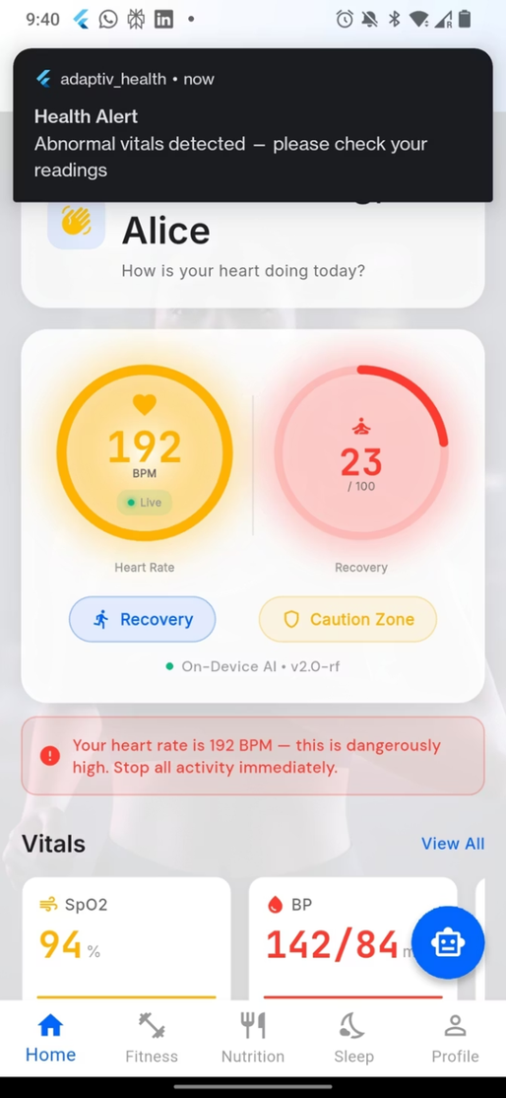
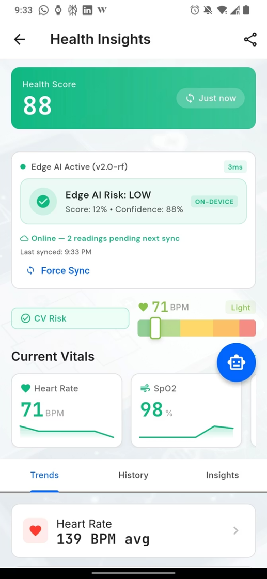
PATIENT APP
THE PATIENT'S SAFETY COMPANION
→ LIVE VITALS DISPLAY
REAL-TIME HR, SPO2, AND BLOOD PRESSURE WITH COLOUR-CODED SAFETY ZONES (GREEN / AMBER / RED).
→ ON-DEVICE EDGE AI
PURE-DART RANDOM FOREST MODEL — WORKS COMPLETELY OFFLINE, <160MS INFERENCE.
→ BLE WEARABLE + GEMINI COACH
BLUETOOTH WEARABLE CONNECTIVITY AND AI HEALTH COACH POWERED BY GEMINI FOR NARRATIVE GUIDANCE.
→ OFFLINE SYNC + SECURITY
AUTOMATIC SYNC ON RECONNECTION; BRUTE FORCE PROTECTION LOCKS ACCOUNT AFTER FAILED ATTEMPTS.

Slide 7
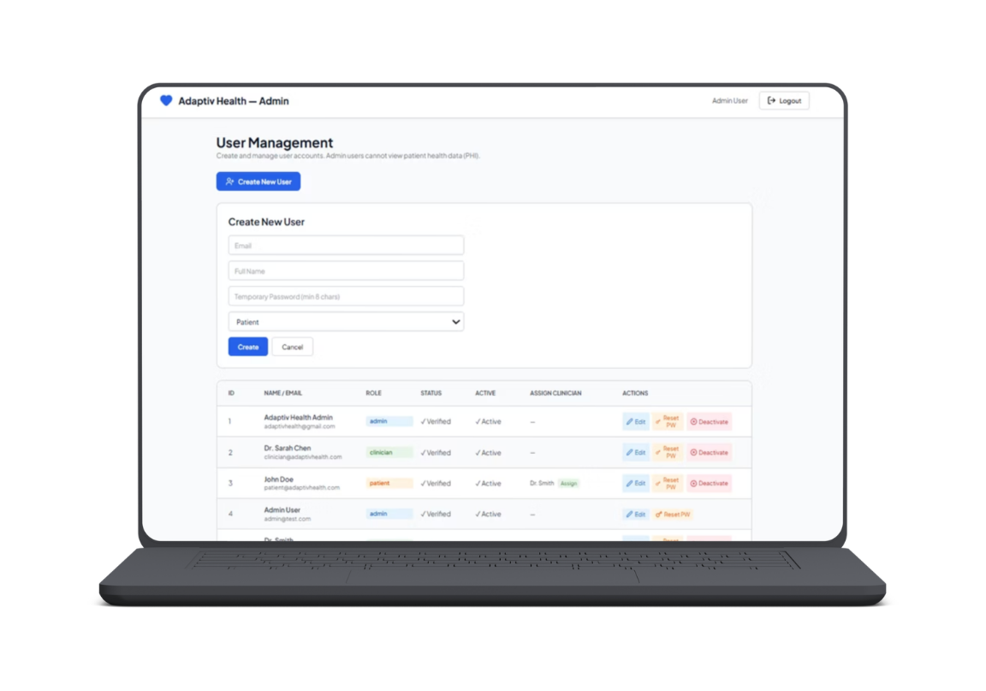
CLINICIAN DASHBOARD
CLINICAL OVERSIGHT, ANYWHERE, ANYTIME
LIVE PATIENT LIST
AI RISK SUMMARIES
AI-GENERATED NARRATIVE SUMMARIES AND INTERACTIVE CARDIOVASCULAR TREND GRAPHS.
REAL-TIME HEALTH SCORES AND RISK LEVELS ACROSS ALL ASSIGNED PATIENTS.
CRITICAL ALERT PANEL
ROLE-BASED ACCESS
COLOUR-CODED SEVERITY ALERTS AND POPULATION-LEVEL ANALYTICS AT A GLANCE.
SECURE MESSAGING AND STRICTLY ENFORCED DOCTOR / ADMIN / PATIENT ACCESS TIERS.

Slide 8
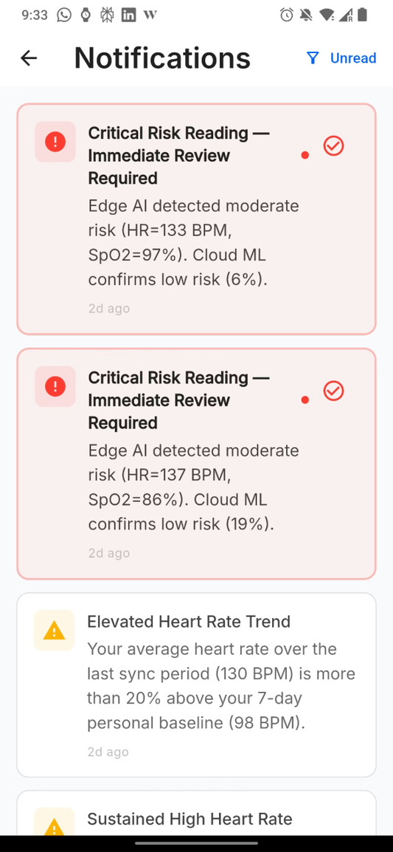
AI & MACHINE LEARNING
THREE LAYERS OF INTELLIGENCE
LAYER 1 — EDGE AI (ON-DEVICE)
LAYER 2 — CLOUD ML (AWS EC2)
LAYER 3 — GEMINI AI COACH
RANDOM FOREST · SCIKIT-LEARN · 96.9% ACCURACY · HIGH RISK RECALL OPTIMISED
NARRATIVE RECOMMENDATIONS · TEMPERATURE 0.4 · DUAL-PATH FALLBACK — NEVER OFFLINE
RANDOM FOREST · PURE DART · <160MS · FULLY OFFLINE
RISK CLASSIFICATION: LOW (0.0–0.49) → CONTINUE SAFELY · MODERATE (0.50–0.79) → SLOW DOWN · HIGH (0.80–1.0) → STOP IMMEDIATELY + ALERT DOCTOR
Notes:
We didn't just pick Random Forest arbitrarily - we tested 6 different machine learning algorithms to find the best cardiovascular risk predictor.
As you can see in the terminal output, we compared Random Forest, Gradient Boosting, Logistic Regression, Support Vector Machine, K-Nearest Neighbors, and Decision Tree.
Random Forest won for three critical reasons:
First, accuracy - it achieved 96.9% overall correctness, tied with Gradient Boosting at the top.
Second, and most importantly, 100% recall - it caught every single high-risk case in our test set. Look at KNN by comparison - only 76.5% recall, meaning it would miss nearly 1 in 4 dangerous cardiac events. That's unacceptable for patient safety.
Third, speed - 0.07 milliseconds per prediction. This enables real-time safety alerts during exercise. KNN was 173 times slower at 12.15 milliseconds, which would create noticeable lag during a workout.
Random Forest also matches clinical AI standards - published cardiac monitoring systems report 92-97% accuracy, so we're right in that validated range.

Slide 9






SECURITY
HEALTHCARE-GRADE SECURITY. NO COMPROMISES.
ARGON2ID PASSWORD HASHING
AES-256-GCM ENCRYPTION
OWASP & NIST SP 800-63B RECOMMENDED STANDARD.
EVERY PHI FIELD ENCRYPTED BEFORE DATABASE STORAGE.
JWT WITH JTI BLOCKLIST
AWS PRIVATE VPC
IMMEDIATE TOKEN REVOCATION ON LOGOUT — STATEFUL SESSION CONTROL.
DATABASE HAS ZERO PUBLIC INTERNET ACCESS.
HIPAA & UAE DHA COMPLIANT
ROLE-BASED ACCESS CONTROL
CLOUDTRAIL AUDIT LOGS WITH 6-YEAR RETENTION.
PATIENT · DOCTOR · ADMIN — STRICTLY ENFORCED ACROSS ALL ENDPOINTS.
Notes:
For our database layer, we used AWS RDS PostgreSQL hosted in the cloud. This stores all our patient data, workout sessions, and AI-generated safety alerts.
PostgreSQL was chosen because it's highly reliable, can handle complex relational queries needed for clinical analytics, and scales to support thousands of concurrent users.
As you can see in the pgAdmin screenshot, our database currently contains 973 cardiac patients with complete medical histories, 973 workout sessions with heart rate data, and 432 safety alerts that were automatically generated when the ML model detected risk scores above 0.85.
This cloud-based setup allows our machine learning model to pull data directly from AWS rather than relying on local files, which is essential for a production healthcare system. It also enables real-time access for both the mobile app and the doctor dashboard.

Slide 10
TEST RESULTS
46 TEST CASES. 100% PASS RATE.
TESTED AGAINST THE LIVE PRODUCTION SYSTEM AT API.BACK-ADAPTIVHEALTHUOWD.XYZ
Category | Tests | Result
Functionality | 12 | PASS
Database | 8 | PASS
UX / UI | 10 | PASS
Security | 9 | PASS
Machine Learning | 7 | PASS
TOTAL | 46 | 100% ✓
46
TOTAL TESTS
ACROSS 5 CATEGORIES
100%
PASS RATE
ZERO FAILURES ON LIVE SYSTEM
Notes:
We didn't just pick Random Forest arbitrarily - we tested 6 different machine learning algorithms to find the best cardiovascular risk predictor.
As you can see in the terminal output, we compared Random Forest, Gradient Boosting, Logistic Regression, Support Vector Machine, K-Nearest Neighbors, and Decision Tree.
Random Forest won for three critical reasons:
First, accuracy - it achieved 96.9% overall correctness, tied with Gradient Boosting at the top.
Second, and most importantly, 100% recall - it caught every single high-risk case in our test set. Look at KNN by comparison - only 76.5% recall, meaning it would miss nearly 1 in 4 dangerous cardiac events. That's unacceptable for patient safety.
Third, speed - 0.07 milliseconds per prediction. This enables real-time safety alerts during exercise. KNN was 173 times slower at 12.15 milliseconds, which would create noticeable lag during a workout.
Random Forest also matches clinical AI standards - published cardiac monitoring systems report 92-97% accuracy, so we're right in that validated range.

Slide 11
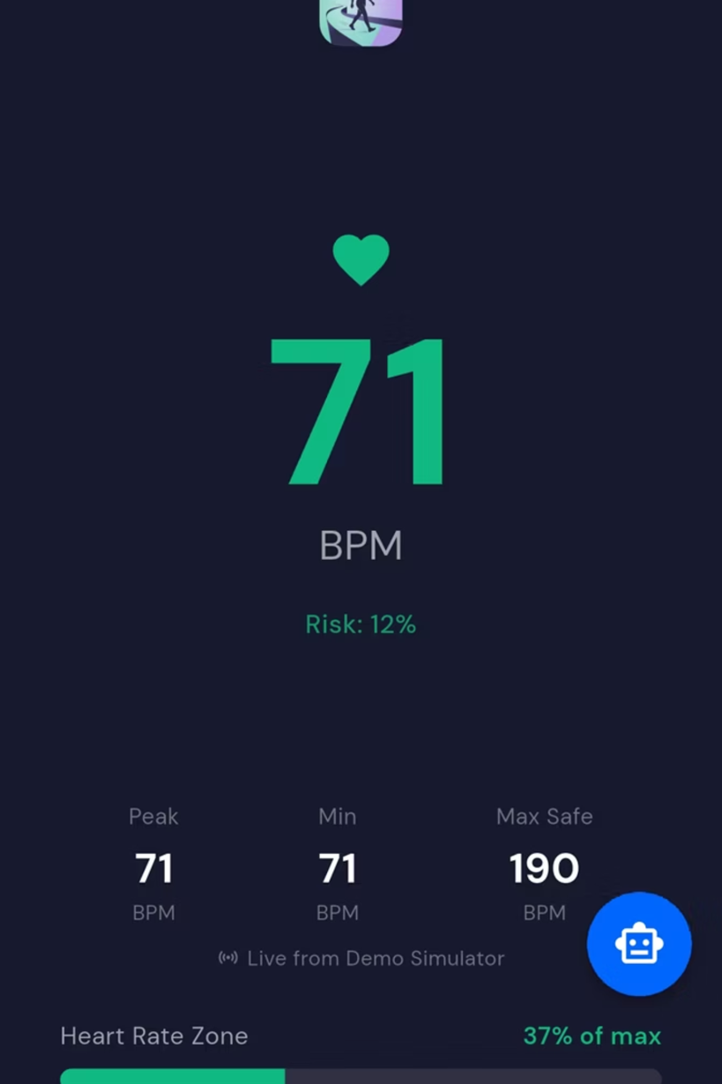
EVOLUTION
WHAT WE BUILT VS. WHAT WE PLANNED
WE DIDN'T JUST PLAN IT — WE CHANGED AND IMPROVED IT AT EVERY STAGE.
PLANNED → DELIVERED
FLASK → FASTAPI (ASYNC, PRODUCTION-GRADE) TENSORFLOW/LSTM → RANDOM FOREST (MEDICALLY VALIDATED) FIREBASE + AWS → AWS RDS ONLY (HIPAA COMPLIANT) BCRYPT → ARGON2ID (OWASP GOLD STANDARD) BASIC JWT → JWT + JTI BLOCKLIST TFLITE → PURE-DART (TRULY OFFLINE, ZERO DEPENDENCIES)
ADDED IN SEMESTER 2
✦ GEMINI AI HEALTH COACH ✦ ADMIN DASHBOARD ✦ OFFLINE SYNC QUEUE ✦ CLOUDTRAIL HIPAA AUDIT LOGGING

Slide 12

FUTURE WORK
THE FOUNDATION IS BUILT. HERE'S WHAT COMES NEXT.
NEAR-TERM ROADMAP
LONG-TERM VISION
ECG SENSOR INTEGRATION
REAL BLE PAIRING
FEDERATED LEARNING
HOSPITAL EMR INTEGRATION
NATIVE APPLE WATCH & FITBIT CONNECTIVITY.
TRAIN ON-DEVICE — PROTECT PATIENT PRIVACY AT SCALE.
ARRHYTHMIA DETECTION VIA HARDWARE ECG SENSORS.
SEAMLESS CONNECTION WITH ELECTRONIC MEDICAL RECORDS.
WEBSOCKET STREAMING
FDA / CE MARK + UAE PILOT
REAL-TIME LIVE DASHBOARD DATA STREAMING.
CLINICAL VALIDATION AND UAE HOSPITAL PILOT PROGRAMME.

Slide 13

ADAPTIV HEALTH
KEEPING CARDIAC PATIENTS SAFE — EVERY HEARTBEAT.
LIVE SYSTEM
TEAM
DASHBOARD-ADAPTIVHEALTHUOWD.XYZ
TEAM PULSE · CSIT321 · UOWD 2026
QUESTIONS
WE'D LOVE TO WALK YOU THROUGH THE LIVE SYSTEM.

Slide 14
ADAPTIV
HEALTH
ADAPTIV HEALTH — SMARTER MOVEMENT, SAFER HEARTS.
PRESENTED BY
PULSE.

