Slide 1
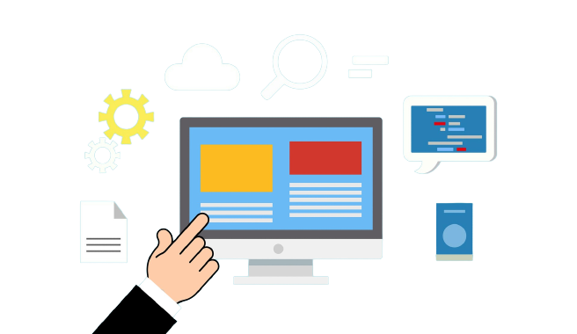

INVENTORY
MANAGEMENT SYSTEM

Slide 2
Submitted By:
Mst. Bithy ID: 193015065
Kallan Chandra Roy ID: 193015057
Course Title: Software Engineering Lab Course Code : CSE 314

Slide 3
Overview
Introduction of Inventory Management System.
Objective
Use-case Diagram
Data Flow Diagram
Sequence Diagram
Design
Conclusion

Slide 4
INTRODUCTION
Inventory management refers to the process of ordering, storing, using, and selling a company's inventory. This includes the management of raw materials, components, and finished products, as well as warehousing and processing of such items.
The Application is Web-based application, that will provide sourcing, storing, and managing inventory.
This system is designed for the particular need of the company to carry out operations in a smooth and effective manner.

Slide 5
OBJECTIVES/AIMS
Main features of this project is product manage, stock manage, supplier and customer manage, invoice, purchase and inventory reporting.
The project is totally built at administrative end and thus only administrator is guaranteed the access.
The purpose of the project is to built an application program to reduce the manual work for managing the inventory, vendor, delivery, product.

Slide 6
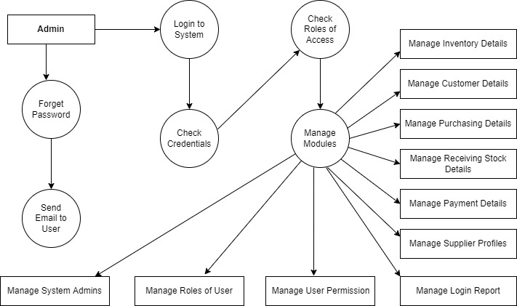
Data flow diagram

Slide 7
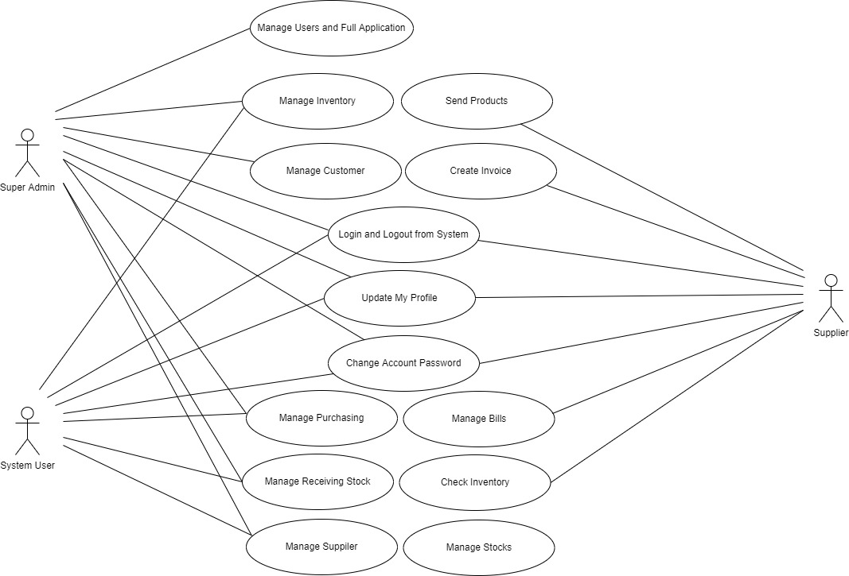
Use case Diagram

Slide 8
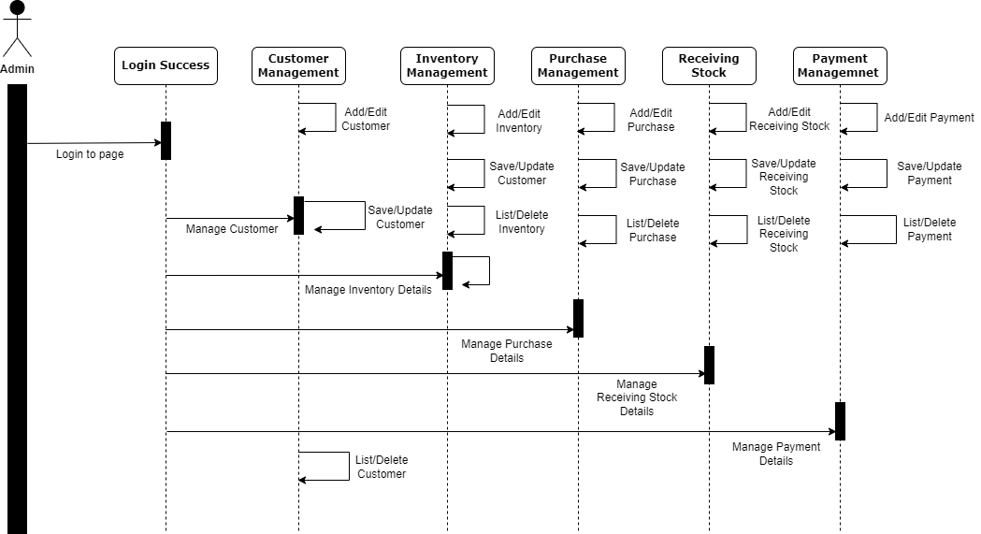
Sequence Diagram

Slide 9
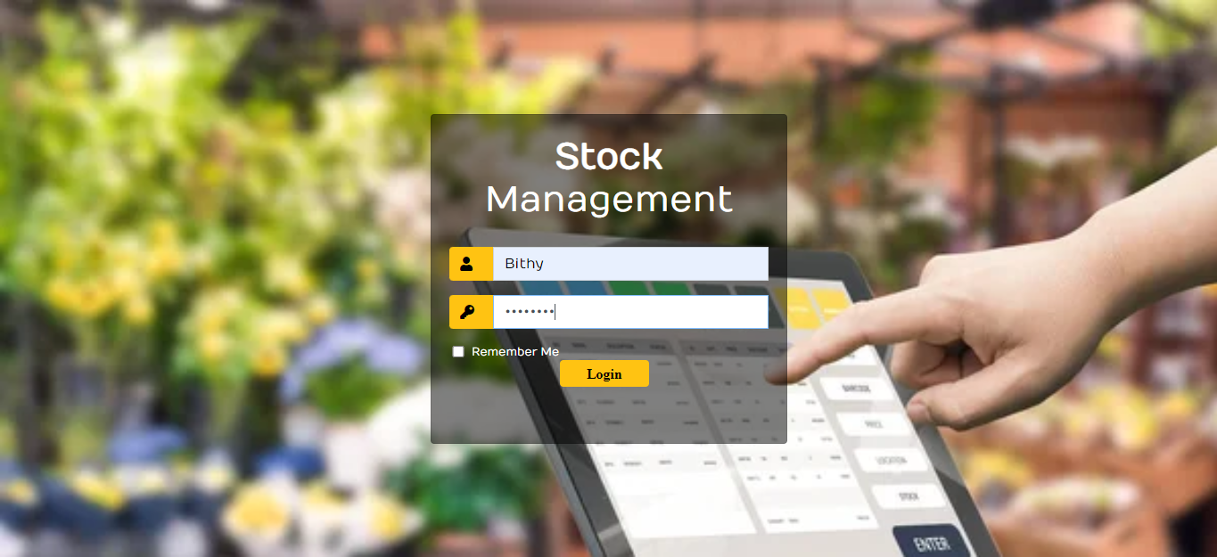

Let's see how this application Looks Like……
Login page of
Project

Slide 10
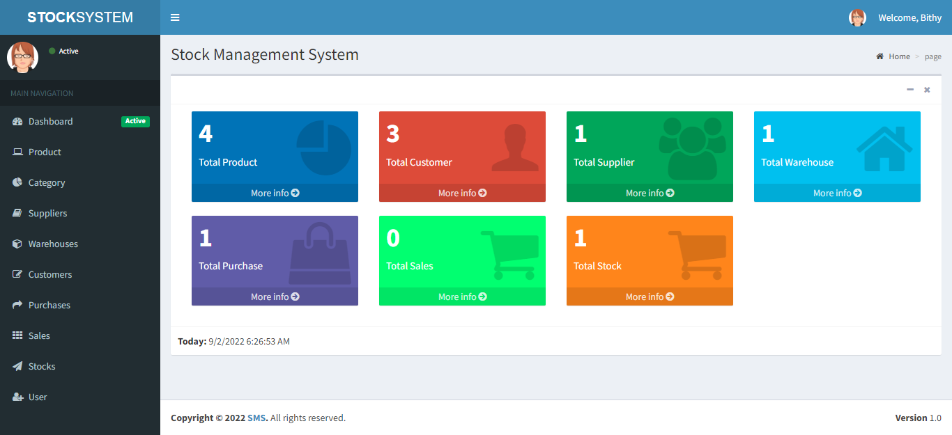
Let's see how this application Looks Like……
Dashboard of
Project

Slide 11
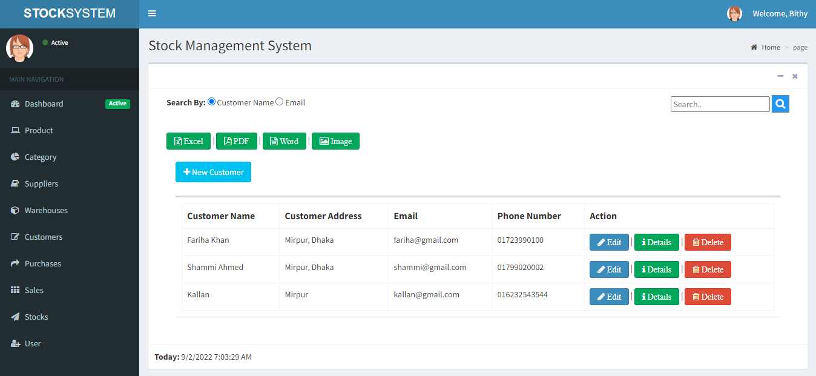
Let's see how this application Looks Like……
Customer interface of
Project

Slide 12
FUTURE SCOPE
We can give more advance software for Inventory Management System including more facilities.
We will host the platform on online servers to make it accessible worldwide.
Create the master and slave database structure to reduce the overload of the database queries.

Slide 13
CONCLUSION
The Inventory Management System is developed and designed for recording and managing the inventory of an organization.
While making the system, an eye has been kept on making it as user-friendly, as cost-effective and as flexible as possible. As such one may hope that the system will be acceptable to any user and will adequately meet his/her needs.

Slide 14
Thank You

