Slide 1
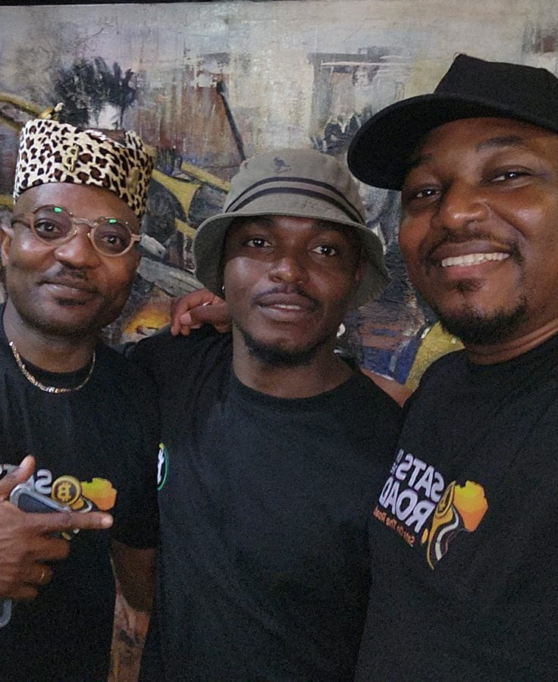

DAY 1 · SESSION 1 · 45 MIN
Money, and why ours fails
What money is, and why the money we use lets us down.
satsontheroad.africa · Driving Bitcoin across the African continent

Slide 2
DAY 1 · SESSION 1 · 45 MIN
What is money?
● A way to trade goods and services
● A shared agreement: it works because everyone accepts it
● Not valuable in itself, it is a tool
satsontheroad.africa
02
Notes:
Money is like a common language for trade. Chocolate could be money if everyone accepted it, but it would melt, so it would be bad money.

Slide 3
DAY 1 · SESSION 1 · 45 MIN
The three jobs of money
● Store of value: hold worth to save for later
● Medium of exchange: trade it for anything
● Unit of account: one way to price and compare
satsontheroad.africa
03
Notes:
Without a unit of account you would price a car in cows or in hours of work. Money gives one shared measure.

Slide 4
DAY 1 · SESSION 1 · 45 MIN
Good money has six properties
● Durable
● Divisible
● Portable
● Acceptable
● Scarce
● Fungible (one unit equals another)
satsontheroad.africa
04
Notes:
Pass objects around. Ask which properties each one has. Cowry shells: scarce and portable. Gold: durable and scarce.

Slide 5
DAY 1 · SESSION 1 · 45 MIN
Step 1: Barter
● Swap goods directly, no money
● Needs a "double coincidence of wants"
● Slow and clumsy
satsontheroad.africa
05
Notes:
You have bananas, you want a coconut, but the coconut owner wants a mango. Everyone gets stuck.

Slide 6
DAY 1 · SESSION 1 · 45 MIN
Step 2: Commodity money
● One good thing everyone accepts
● Cowry shells, gold, silver
● Scarce and hard to fake
satsontheroad.africa
06
Notes:
Cowry shells were accepted across parts of Africa for a very long time. These were real money because they were scarce and recognisable.

Slide 7
DAY 1 · SESSION 1 · 45 MIN
Step 3: Fiat money
● Today's notes and coins
● "Fiat" means "by decree"
● Money because the state says so, not backed by gold
satsontheroad.africa
07
Notes:
Over the last century the link between paper money and gold was ended. Now value rests on trust in those who issue it.

Slide 8
DAY 1 · SESSION 1 · 45 MIN
The inflation auction
● Round 1: everyone gets the same play money
● We auction one small prize
● Round 2: everyone gets much more play money
● We auction the same prize again
satsontheroad.africa
08
Notes:
Run the activity now. Do not explain the lesson yet. Write both winning prices on the board.

Slide 9
DAY 1 · SESSION 1 · 45 MIN
What just happened
● Nobody got richer in round 2
● More money chased the same prize
● The price went up
● That is inflation
satsontheroad.africa
09
Notes:
Let them feel it before you name it. The extra money did not create more prizes.

Slide 10
DAY 1 · SESSION 1 · 45 MIN
Inflation and your [local currency]
● When more [local currency] is created, each note buys less
● Prices rise, savings shrink
● Ask: what did bread or transport cost years ago?
satsontheroad.africa
10
Notes:
[CONFIRM: a local price example the country lead fills in]. Keep it honest, no predictions.

Slide 11
DAY 1 · SESSION 1 · 45 MIN
Fiat is convenient, but
● Easy to use, cheap to carry
● A small group can create more of it
● Ordinary savers carry the cost
satsontheroad.africa
11
Notes:
Be balanced. The problem is not paper itself, it is who can make more of it and who pays.

Slide 12
DAY 1 · SESSION 1 · 45 MIN
The search for better money
● People long wanted money no small group can print
● That search led to Bitcoin
● Fixed limit, no one in charge
satsontheroad.africa
12
Notes:
Bridge to Session 2. Keep it plain. No hype, no advice.

Slide 13
DAY 1 · SESSION 1 · 45 MIN
Next: What Bitcoin is, in plain words
● Session 2
● Glossary: ../../../translations/GLOSSARY.md
satsontheroad.africa
13
Notes:
Take one or two questions. Hand out the quiz if tracking the ambassador badge.

