Slide 1
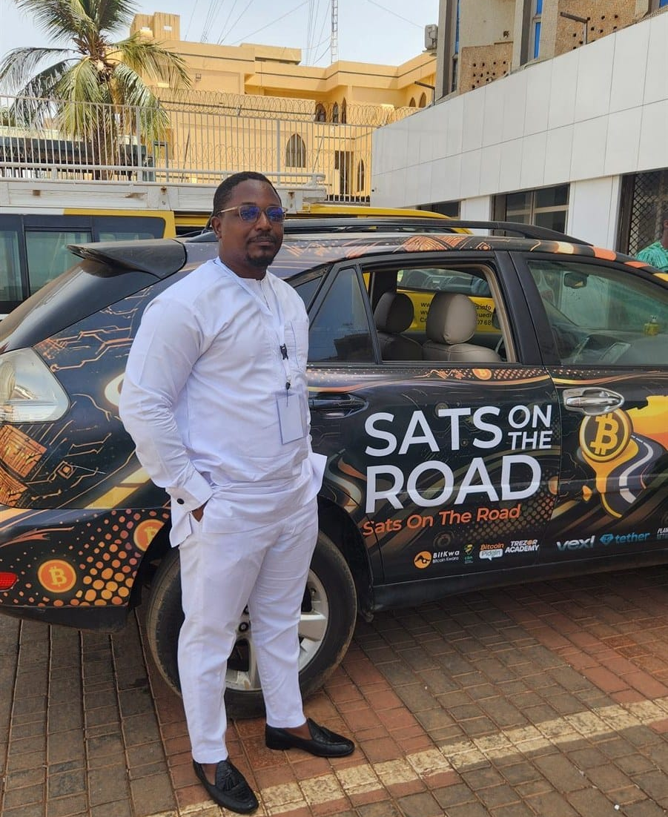

DAY 1 · SESSION 2 · 45 MIN
What Bitcoin is, in plain words
Digital money no one can print, sent person to person.
satsontheroad.africa · Driving Bitcoin across the African continent

Slide 2
DAY 1 · SESSION 2 · 45 MIN
A quick recap
● Money is a shared tool for trade
● Fiat money can be created at will
● When supply grows, each note buys less
satsontheroad.africa
02
Notes:
Ask: if you could design money no small group could print more of, what would you want it to do?

Slide 3
DAY 1 · SESSION 2 · 45 MIN
The problem to solve
● People wanted digital cash, person to person
● Earlier attempts needed a central office
● Shut the office, and the money stops
satsontheroad.africa
03
Notes:
If one company runs the money, it can block you or be shut down.

Slide 4
DAY 1 · SESSION 2 · 45 MIN
A different design
● 2008: a short paper by "Satoshi Nakamoto"
● January 2009: the network started running
● Money with no single company or government in charge
satsontheroad.africa
04
Notes:
Satoshi may be a person or a group. The identity is unknown, the goal was clear.

Slide 5
DAY 1 · SESSION 2 · 45 MIN
Bitcoin is money
● Digital money
● Lives on computers all over the world
● Not in one building
satsontheroad.africa
05
Notes:
Most money today is already digital. The difference is no single company controls Bitcoin.

Slide 6
DAY 1 · SESSION 2 · 45 MIN
Peer-to-peer
● Send it straight to another person
● Like handing over cash
● No bank needs to approve it
satsontheroad.africa
06
Notes:
You do not wait for permission. You send directly.

Slide 7
DAY 1 · SESSION 2 · 45 MIN
No one is in charge
● No boss, no head office
● No one can switch it off
● No one can change the rules for themselves
satsontheroad.africa
07
Notes:
This is its strength. It also means no hotline to call, which we address in Session 3.

Slide 8
DAY 1 · SESSION 2 · 45 MIN
An agreement among people
● Like a board game with shared rules
● Everyone follows the same rules
● Cheat, and the others reject you
satsontheroad.africa
08
Notes:
If a player tries to pay with the wrong thing, others simply stop playing with them. The game continues.

Slide 9
DAY 1 · SESSION 2 · 45 MIN
A fixed limit: 21 million
● There will only ever be 21 million bitcoins
● No one can make extra for themselves
● The network rejects any attempt
satsontheroad.africa
09
Notes:
Compare to fiat, which can be created at will. Fixed supply means no small group can dilute it.

Slide 10
DAY 1 · SESSION 2 · 45 MIN
Sats: the everyday unit
● 1 bitcoin = 100,000,000 satoshis
● We call them "sats"
● You do not need a whole bitcoin to use it
satsontheroad.africa
10
Notes:
Most people deal in sats day to day. A coffee is a few hundred or thousand sats.

Slide 11
DAY 1 · SESSION 2 · 45 MIN
Sound digital money
● Scarce, with a fixed limit
● Hard to counterfeit
● Open to anyone with a phone and internet
satsontheroad.africa
11
Notes:
This is what "sound digital money" means. Keep it plain.

Slide 12
DAY 1 · SESSION 2 · 45 MIN
An honest note
● Bitcoin is young, like the internet in the 1990s
● Its price in [local currency] can rise and fall
● A tool to learn and use, not a promise of profit
satsontheroad.africa
12
Notes:
No financial advice, no predictions. Be balanced.

Slide 13
DAY 1 · SESSION 2 · 45 MIN
Exercise: rules of the game
● Small groups act out a shared rule
● See why a cheater is rejected
● See why no one can invent extra tokens
satsontheroad.africa
13
Notes:
Run the activity in exercise.md. Keep it light and quick.

Slide 14
DAY 1 · SESSION 2 · 45 MIN
Next: set up your own wallet
● Session 3, hands-on
● Glossary: ../../../translations/GLOSSARY.md
satsontheroad.africa
14
Notes:
Take one or two questions. Next session everyone gets their own wallet and first sats.

