Slide 1
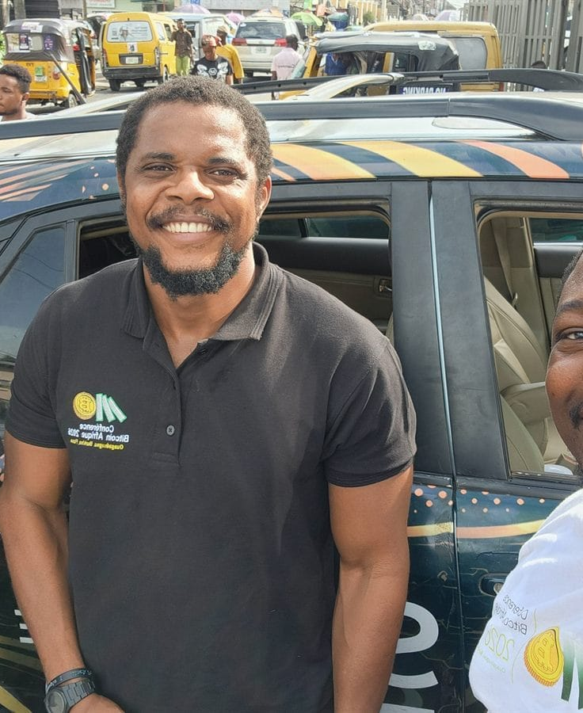

DAY 1 · SESSION 3 · 90 MIN
Set up your wallet, write your seed
The core of day one: your own wallet and your first sats.
satsontheroad.africa · Driving Bitcoin across the African continent

Slide 2
DAY 1 · SESSION 3 · 90 MIN
A wallet holds keys, not coins
● Your sats live on the network
● The wallet holds your keys
● Keys prove the sats are yours
satsontheroad.africa
02
Notes:
Receive address is like your email. Private key and seed phrase are like your password.

Slide 3
DAY 1 · SESSION 3 · 90 MIN
Not your keys, not your coins
● Receive address: share it, like an email address
● Private key and seed phrase: never share, like a password
● Whoever holds the keys holds the money
satsontheroad.africa
03
Notes:
Repeat this saying through the whole session.

Slide 4
DAY 1 · SESSION 3 · 90 MIN
Custodial wallet
● A company holds your keys
● Easy to start, they can help you recover
● But they can freeze your money, and if they fail your sats are at risk
satsontheroad.africa
04
Notes:
Fine for small amounts and first steps. Like money in someone else's safe.

Slide 5
DAY 1 · SESSION 3 · 90 MIN
Self-custodial wallet
● You hold your own keys
● No one can freeze or confiscate your sats
● You carry full responsibility
satsontheroad.africa
05
Notes:
This is the goal for savings. If you lose your seed phrase, no one can recover it.

Slide 6
DAY 1 · SESSION 3 · 90 MIN
Real options (neutral)
● Blink: easy start with Lightning
● Phoenix: self-custodial Lightning
● Machankura: Lightning over USSD, no smartphone needed
● Hardware wallets: for savings
satsontheroad.africa
06
Notes:
[CONFIRM availability per country]. Today we all use [primary wallet].

Slide 7
DAY 1 · SESSION 3 · 90 MIN
Install and create
● Open the official app store
● Search [primary wallet], check the publisher
● Install, open, choose "Create a new wallet"
● Set a PIN if offered
satsontheroad.africa
07
Notes:
Never install from a link someone sent you. Check the maker's name.

Slide 8
DAY 1 · SESSION 3 · 90 MIN
Your seed phrase (the big one)
● The app shows 12 or 24 words
● This is the master key to all your sats
● Anyone who gets it can take everything
satsontheroad.africa
08
Notes:
Slow right down here. This is the most important skill of the day.

Slide 9
DAY 1 · SESSION 3 · 90 MIN
Write it down, by hand
● On paper, in the exact order, numbered
● Keep it somewhere safe and dry
● Lose phone AND paper, and the sats are gone forever
satsontheroad.africa
09
Notes:
Walk the room. Check everyone has actually written it before moving on.

Slide 10
DAY 1 · SESSION 3 · 90 MIN
Never do these
● Never take a photo of your seed phrase
● Never type it into any website
● Never put it in notes, messages, or email
● No real support will ever ask for it
satsontheroad.africa
10
Notes:
Anyone who asks for your seed phrase is trying to rob you. Say this clearly.

Slide 11
DAY 1 · SESSION 3 · 90 MIN
Receive your first sats
● Tap "Receive"
● Show the QR code or address
● Your address is safe to share
● Watch the balance update
satsontheroad.africa
11
Notes:
Send each learner a small amount. [CONFIRM amount and funding source].

Slide 12
DAY 1 · SESSION 3 · 90 MIN
Send sats
● Tap "Send"
● Scan the QR code or paste the address
● Enter the amount in sats
● Double-check, then confirm
satsontheroad.africa
12
Notes:
Pair learners. Payments cannot be reversed. Always check amount and recipient first.

Slide 13
DAY 1 · SESSION 3 · 90 MIN
Three things to remember
● You hold your own keys
● Your seed phrase is on paper, never photographed
● Always check before you confirm
satsontheroad.africa
13
Notes:
Recap. These three are the whole session.

Slide 14
DAY 1 · SESSION 3 · 90 MIN
Next: Lightning
● Session 4, fast and cheap payments
● Glossary: ../../../translations/GLOSSARY.md
satsontheroad.africa
14
Notes:
Take questions. Next we go deeper into Lightning.

