Slide 1
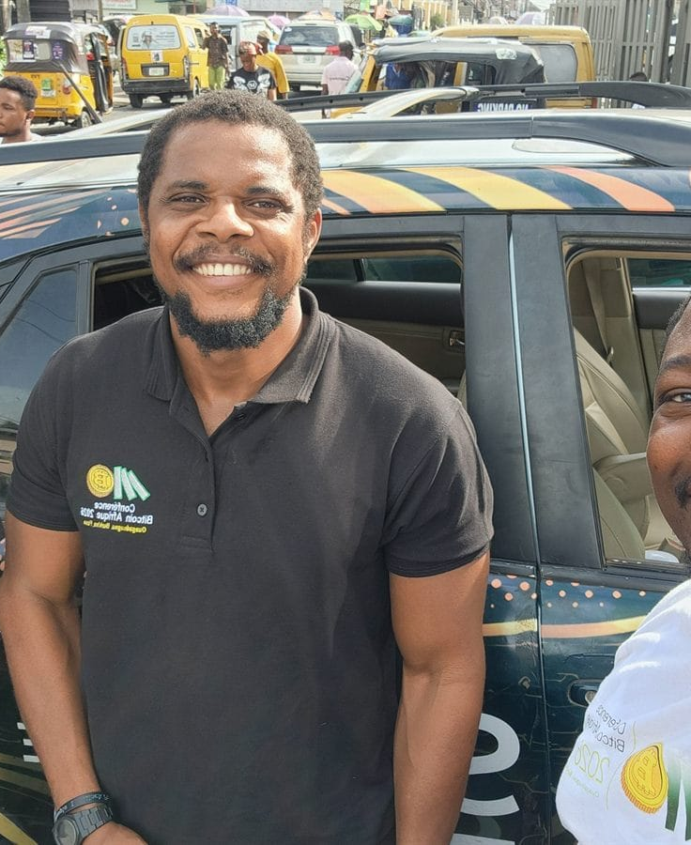

DAY 1 · SESSION 4 · 60 MIN
Lightning: paying and getting paid
Fast, cheap Bitcoin payments, person to person.
satsontheroad.africa · Driving Bitcoin across the African continent

Slide 2
DAY 1 · SESSION 4 · 60 MIN
The problem
● On-chain payments are very secure
● But they take about ten minutes
● And can cost more in fees
satsontheroad.africa
02
Notes:
For a coffee or a taxi fare, we want faster and cheaper.

Slide 3
DAY 1 · SESSION 4 · 60 MIN
What Lightning is
● A fast layer built on top of Bitcoin
● A quick lane for small payments
● Instant, and very cheap
satsontheroad.africa
03
Notes:
Bitcoin is the strong base. Lightning is the fast layer on top. Same sats.

Slide 4
DAY 1 · SESSION 4 · 60 MIN
The café tab
● Open a tab for the day
● Pay as you go
● Settle the final total at the end
satsontheroad.africa
04
Notes:
Lightning works in a similar way. Payments are instant and cheap.

Slide 5
DAY 1 · SESSION 4 · 60 MIN
On-chain vs Lightning
● On-chain: very secure, about 10 minutes, best for larger amounts
● Lightning: instant, very low fees, best for everyday spending
satsontheroad.africa
05
Notes:
Use the right tool for the job. Large savings: on-chain. Daily spend: Lightning.

Slide 6
DAY 1 · SESSION 4 · 60 MIN
A Lightning invoice
● A request for a payment
● The receiver creates it, often a QR code
● Can include a set amount
● Used up once it is paid
satsontheroad.africa
06
Notes:
To get paid: tap Receive, choose Lightning, enter amount, show the QR code.

Slide 7
DAY 1 · SESSION 4 · 60 MIN
To pay an invoice
● Tap "Send"
● Scan the invoice or QR code
● Check the amount
● Confirm
satsontheroad.africa
07
Notes:
Same careful habit as Session 3. Check before you confirm.

Slide 8
DAY 1 · SESSION 4 · 60 MIN
A Lightning address
● Looks like an email address
● name@example.com
● Reusable: people can pay you again and again
satsontheroad.africa
08
Notes:
[CONFIRM whether your wallet gives each learner a Lightning address].

Slide 9
DAY 1 · SESSION 4 · 60 MIN
A real example
● The Sats On The Road fundraiser receives Lightning
● Address: satsontheroadafrica@geyser.fund
● A Lightning address in real use
satsontheroad.africa
09
Notes:
Shows learners a real, reusable Lightning address.

Slide 10
DAY 1 · SESSION 4 · 60 MIN
Live demonstration
● Sats relay across the room
● Then pay the facilitator
● Watch it arrive in seconds
satsontheroad.africa
10
Notes:
Run the activity in exercise.md. Keep it lively and hands-on.

Slide 11
DAY 1 · SESSION 4 · 60 MIN
When to use which
● Lightning: small daily payments
● On-chain: larger amounts and savings
● Keep only spending money on your phone
satsontheroad.africa
11
Notes:
Repeat Session 3 safety. Seed phrase on paper, never photographed.

Slide 12
DAY 1 · SESSION 4 · 60 MIN
An honest note
● Payments can sometimes fail; the sats stay with the sender
● Just try again
● No financial advice, no predictions
satsontheroad.africa
12
Notes:
Balanced and calm. Lightning is young but works well for daily spending.

Slide 13
DAY 1 · SESSION 4 · 60 MIN
Next: Market practice
● Session 5, buy something real in sats
● Glossary: ../../../translations/GLOSSARY.md
satsontheroad.africa
13
Notes:
Take a few questions. Next we go to a real merchant.

