Slide 1
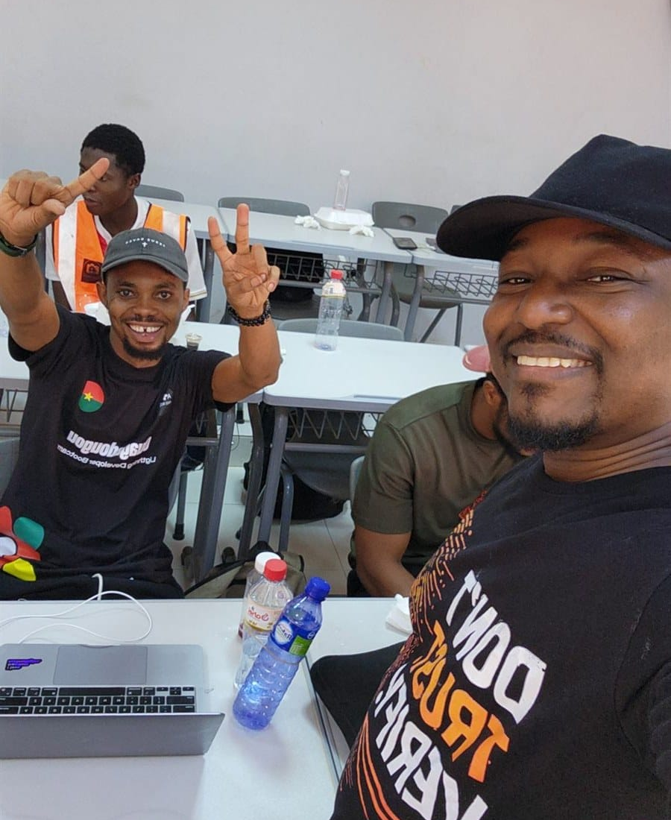

DAY 1 · SESSION 5 · 60 MIN
Market practice
Buy something real from a merchant, in sats.
satsontheroad.africa · Driving Bitcoin across the African continent

Slide 2
DAY 1 · SESSION 5 · 60 MIN
Today's goal
● Buy a real item from a merchant
● Pay in sats over Lightning
● Handle any problems calmly
satsontheroad.africa
02
Notes:
This is the real test of the day. Everyone makes one real payment.

Slide 3
DAY 1 · SESSION 5 · 60 MIN
The steps
● Agree the price
● Merchant shows a QR code or invoice
● Scan it, check the amount
● Confirm, and both see it arrive
satsontheroad.africa
03
Notes:
Walk through once before leaving. Same careful habit: check before you confirm.

Slide 4
DAY 1 · SESSION 5 · 60 MIN
Be a good guest
● Be patient and polite
● Some merchants are new to this too
● Keep your phone secure
● Thank them
satsontheroad.africa
04
Notes:
We are guests in their shop. Do not block other customers.

Slide 5
DAY 1 · SESSION 5 · 60 MIN
Finding merchants
● Many show a QR code at the till
● BTCMap.org lists shops that accept Bitcoin
● A pilot session was run in Lomé, Togo
satsontheroad.africa
05
Notes:
[CONFIRM what is listed near you]. Partners work with a growing merchant network.

Slide 6
DAY 1 · SESSION 5 · 60 MIN
If there is no signal
● Move to better signal
● Switch wifi and mobile data
● Wait and retry
● Use the stand-in merchant if needed
satsontheroad.africa
06
Notes:
USSD options like Machankura exist where there is no smartphone data. [CONFIRM].

Slide 7
DAY 1 · SESSION 5 · 60 MIN
If the amount is wrong
● Stop before confirming
● Ask for a fresh invoice
● Never confirm an amount you are unsure of
satsontheroad.africa
07
Notes:
Checking the amount is the single most important habit.

Slide 8
DAY 1 · SESSION 5 · 60 MIN
If a payment fails
● The sats stay with you
● Try again, or ask for a new invoice
● A failed payment is not a lost payment
satsontheroad.africa
08
Notes:
Reassure learners. Failures happen and are easy to recover from.

Slide 9
DAY 1 · SESSION 5 · 60 MIN
The market run
● Go in pairs
● Use your checklist
● Facilitators are here to help
satsontheroad.africa
09
Notes:
Keep the queue orderly. Help with scanning, amounts, confirming.

Slide 10
DAY 1 · SESSION 5 · 60 MIN
Reflection
● What did you buy, and how did it feel?
● What was smooth? What was tricky?
● Would you use this again? Where?
satsontheroad.africa
10
Notes:
Go round the circle. Celebrate that everyone made a real payment.

Slide 11
DAY 1 · SESSION 5 · 60 MIN
You did the full journey
● You understand money and Bitcoin
● You have a wallet
● You have spent sats in the real world
satsontheroad.africa
11
Notes:
Bridge to Day 2 for those who want to teach and onboard merchants.

Slide 12
DAY 1 · SESSION 5 · 60 MIN
Next: Day 2 (ambassadors)
● Teach this, onboard merchants, go deeper on safety
● Glossary: ../../../translations/GLOSSARY.md
satsontheroad.africa
12
Notes:
Thank the merchant and the group.

