Slide 1
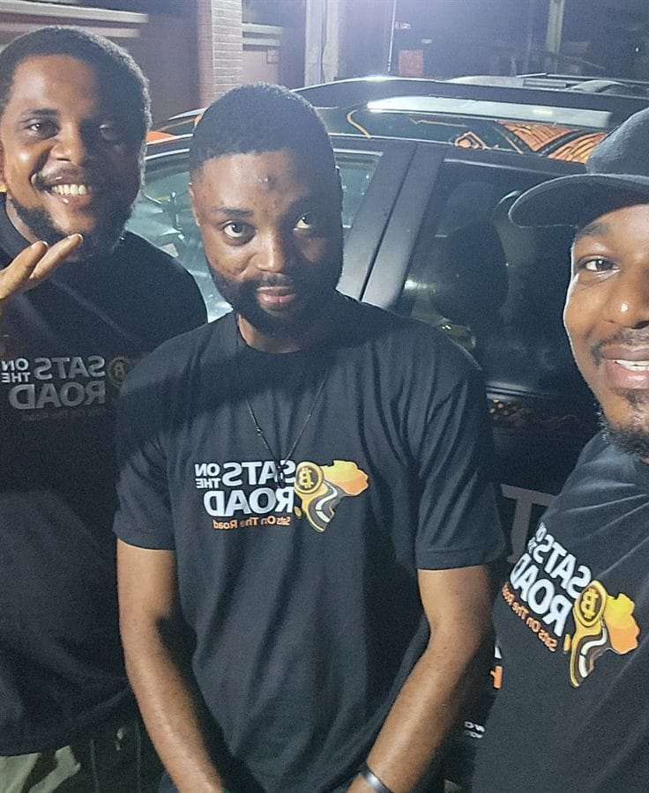

DAY 2 · SESSION 10 · 45 MIN
The ambassador commitment
Targets, reporting, and keeping the work going.
satsontheroad.africa · Driving Bitcoin across the African continent

Slide 2
DAY 2 · SESSION 10 · 45 MIN
What an ambassador is
The person who keeps the work going after the vehicle leaves.
Teaching, onboarding merchants, supporting your community.
A role of trust, not a job title.
satsontheroad.africa
02
Notes:
Set the honest frame for the next 40 minutes.

Slide 3
DAY 2 · SESSION 10 · 45 MIN
Targets
A shared promise, so the whole trip can see progress.
[CONFIRM: targets per month]
● Sessions run
● People onboarded
● Merchants signed up
satsontheroad.africa
03
Notes:
Targets guide support, they are not a trap. Point to the playbook for exact numbers.

Slide 4
DAY 2 · SESSION 10 · 45 MIN
The monthly report
What you did, how many people and merchants, what worked, what was hard, what you need.
Due [CONFIRM: monthly report due date].
satsontheroad.africa
04
Notes:
Walk the template field by field. This is how the network learns.

Slide 5
DAY 2 · SESSION 10 · 45 MIN
The monthly call
A short group call.
[CONFIRM: monthly call day and time]
Share wins, problems, and questions. Ask for help here.
satsontheroad.africa
05
Notes:
Support reaches you through the call and the report.

Slide 6
DAY 2 · SESSION 10 · 45 MIN
Stipend, in brief
A support for costs, not a salary.
● Possible stipend: [CONFIRM: amount and currency]
● Paid: [CONFIRM: schedule]
● It follows the work: reporting and real activity required
satsontheroad.africa
06
Notes:
Do not invent any amount. The full rules and verification are in the playbook.

Slide 7
DAY 2 · SESSION 10 · 45 MIN
What gets you removed
● Asking for or taking a seed phrase or funds
● Promising profits or predicting prices
● Running or covering scams
● Harassment, discrimination, or dishonest reporting
satsontheroad.africa
07
Notes:
Be direct. These lines are not negotiable.

Slide 8
DAY 2 · SESSION 10 · 45 MIN
The code of conduct
Including activists and journalists.
● Honesty
● Respect
● Safety
● Protect the people you teach
satsontheroad.africa
08
Notes:
The code exists to protect learners. Full text in the playbook.

Slide 9
DAY 2 · SESSION 10 · 45 MIN
Taking the commitment
Ready? Sign [CONFIRM: commitment form location].
Not yet? That is honourable too.
satsontheroad.africa
09
Notes:
Give real space to decide. A thoughtful "not yet" is welcome.

Slide 10
DAY 2 · SESSION 10 · 45 MIN
What next
Keep learning and keep teaching.
● BitKwa Bitcoin Diploma
● PlanB Network (planb.network)
● My First Bitcoin (myfirstbitcoin.io)
satsontheroad.africa
10
Notes:
Hand out the "What next" note. See handout.md.

Slide 11
DAY 2 · SESSION 10 · 45 MIN
Thank you
Two days of real work.
The first monthly call: [CONFIRM: first monthly call date]
satsontheroad.africa
11
Notes:
Point to the quiz for the badge. Close warmly.

