Slide 1
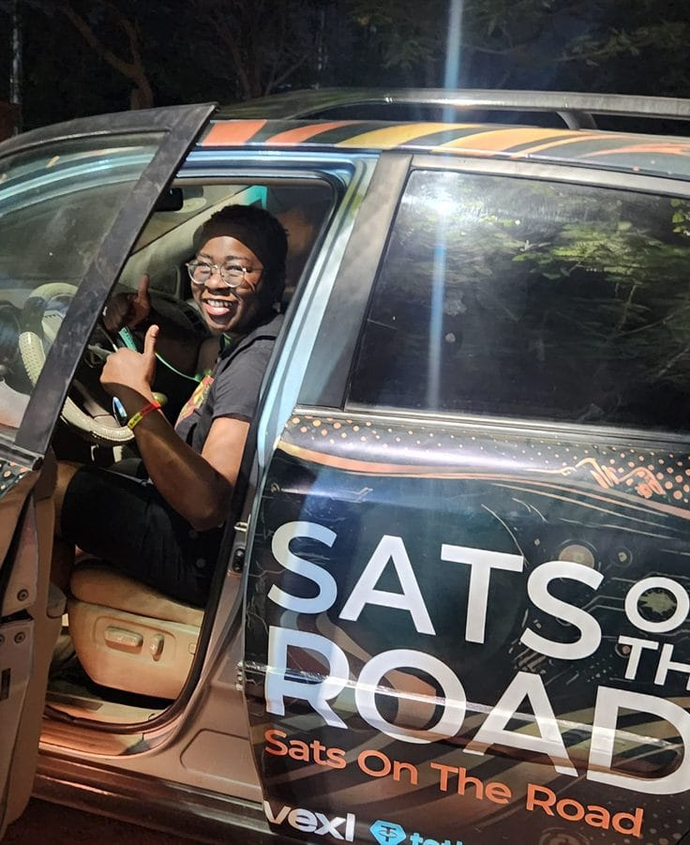

DAY 2 · SESSION 6 · 60 MIN
Self-custody, deeper
Backups, recovery, and what not to do.
satsontheroad.africa · Driving Bitcoin across the African continent

Slide 2
DAY 2 · SESSION 6 · 60 MIN
Not your keys, not your coins
If you do not hold the keys, you do not truly own the coins.
Someone else can freeze, lose, or block them.
satsontheroad.africa
02
Notes:
The core saying from Chapter 3. Say it, write it, repeat it.

Slide 3
DAY 2 · SESSION 6 · 60 MIN
Custodial vs self-custody
| | Custodial | Self-custody |
|---|---|---|
| Who holds the keys | The provider | You |
satsontheroad.africa
03
Notes:
Both halves of the deal. Do not oversell self-custody as risk-free.

Slide 4
DAY 2 · SESSION 6 · 60 MIN
Your seed phrase IS your wallet
12 or 24 words, in order.
Anyone with the words controls the coins.
Lose the words with no backup, and the coins are gone forever.
satsontheroad.africa
04
Notes:
The coins are not in the phone. The phrase is the proof of ownership.

Slide 5
DAY 2 · SESSION 6 · 60 MIN
Safe ways to back up
● Write it by hand, in order, on paper or card
● Keep a second copy in a different safe place
● For savings, a metal backup survives fire and water
satsontheroad.africa
05
Notes:
Have each person hand-write a practice phrase now.

Slide 6
DAY 2 · SESSION 6 · 60 MIN
Never safe
● A screenshot or photo
● The cloud, email, or a note app that syncs
● A message to yourself in any chat app
● Reading the words aloud to anyone
satsontheroad.africa
06
Notes:
Convenience is the enemy of key safety.

Slide 7
DAY 2 · SESSION 6 · 60 MIN
Test your recovery
A backup you have never tested is a guess.
Restore the practice wallet on a second phone.
Watch the sats come back.
satsontheroad.africa
07
Notes:
This is the exercise. The coins live on the network, not the phone.

Slide 8
DAY 2 · SESSION 6 · 60 MIN
How people lose their coins
● Screenshots and cloud backups
● Sharing the seed phrase with "support"
● Typing the phrase into a website or pop-up
● Fake-wallet apps that steal the phrase
satsontheroad.africa
08
Notes:
Ask ambassadors to add scams they have seen locally.

Slide 9
DAY 2 · SESSION 6 · 60 MIN
No real support ever needs your seed phrase
Anyone who asks for it is stealing from you.
As an ambassador, never ask a learner to show theirs.
satsontheroad.africa
09
Notes:
Model the behaviour you want them to teach.

Slide 10
DAY 2 · SESSION 6 · 60 MIN
Scams to name out loud
Don't trust, verify.
● "Send 1, get 2 back"
● Giveaways and airdrops that ask you to send first
● "The next Bitcoin" and quick-profit promises
satsontheroad.africa
10
Notes:
Chapter 3 mantra. Applies to every claim.

Slide 11
DAY 2 · SESSION 6 · 60 MIN
Cold storage for savings
Separate spending from savings.
Same rules: back up the seed, test the recovery.
● Mobile wallet: daily spending
● Hardware (cold) wallet: long-term savings, keys offline
satsontheroad.africa
11
Notes:
[CONFIRM: whether a specific hardware wallet is recommended per country]

Slide 12
DAY 2 · SESSION 6 · 60 MIN
Remember
● The coins live on the network, not in the phone
● The seed phrase is the only proof they are yours
● A backup you have not tested is not a backup
satsontheroad.africa
12
Notes:
Close with each person finishing: "My seed phrase is safe when ___." Point to the quiz and to Session 7.

