Slide 1
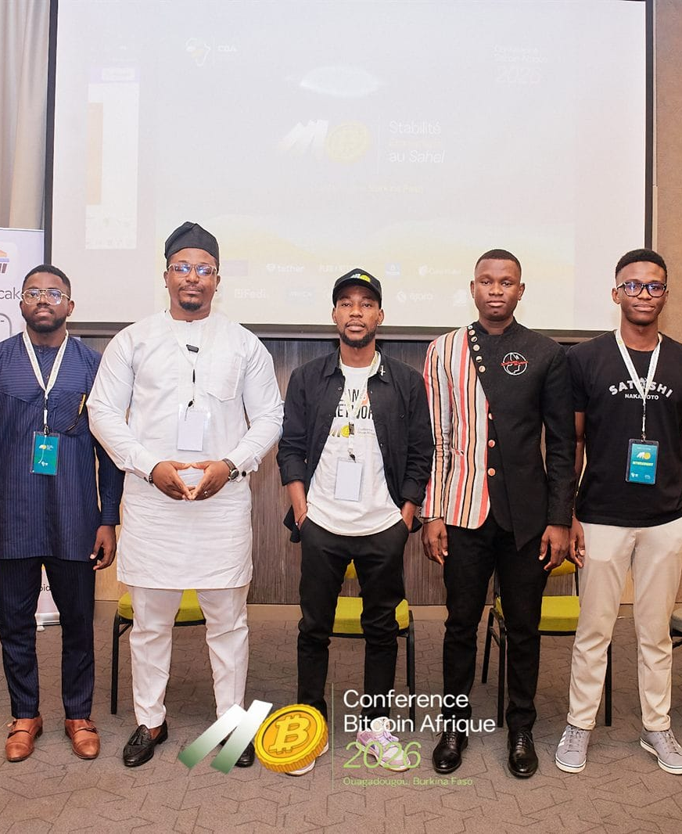

DAY 2 · SESSION 7 · 90 MIN
Privacy and opsec
Bitcoin for activists and journalists, used safely.
satsontheroad.africa · Driving Bitcoin across the African continent

Slide 2
DAY 2 · SESSION 7 · 90 MIN
Money can be switched off
● Nigeria, 2020: organisers' bank accounts frozen; Bitcoin kept the movement funded
● Kenya, 2024: fundraisers delayed, mobile-money transfers blocked
● Zimbabwe, Sudan: inflation, blocked remittances, audits used against civil society
satsontheroad.africa
02
Notes:
Keep it concrete and local. The point: hold value that cannot be turned off.

Slide 3
DAY 2 · SESSION 7 · 90 MIN
Money, power and rights
● Control money, and you control movement, speech and assembly
● Tactics: account freezes, de-banking, transaction censorship, surveillance
● Financial privacy is a safety issue, not a way to hide wrongdoing
satsontheroad.africa
03

Slide 4
DAY 2 · SESSION 7 · 90 MIN
The one idea to remember
Bitcoin is pseudonymous, not anonymous.
● Every on-chain payment is public and permanent
● Your name is not on it, but patterns can reveal you
● So privacy must be *practised*, not assumed
satsontheroad.africa
04
Notes:
Contrast anonymity (no one knows you) vs pseudonymity (traceable, no name).

Slide 5
DAY 2 · SESSION 7 · 90 MIN
Seven habits (1-4)
● Never reuse an address
● Never share a screenshot, balance or xpub
● Separate wallets: donations / spending / savings
● Prefer Lightning for small, frequent payments
satsontheroad.africa
05
Notes:
Demonstrate a fresh address on a real wallet here.

Slide 6
DAY 2 · SESSION 7 · 90 MIN
Seven habits (5-7)
● Protect the device: lock, PIN, updates, clean phone for sensitive work
● Pseudonyms and a Lightning address for public fundraising; no live balances
● Sane custody: paper or metal seed, two locations, multisig for group funds
satsontheroad.africa
06

Slide 7
DAY 2 · SESSION 7 · 90 MIN
The golden rule
● Fake wallet links on WhatsApp or Telegram
● "Your wallet is locked, click to restore"
● "Double your Bitcoin", guaranteed returns
satsontheroad.africa
07

Slide 8
DAY 2 · SESSION 7 · 90 MIN
Group funds and seized devices
● One person should not hold a group's keys
● Multisig: several people must agree to move money
● One arrest or one seized phone cannot drain the fund
● Plan the response *before* you need it (see team safety protocol)
satsontheroad.africa
08

Slide 9
DAY 2 · SESSION 7 · 90 MIN
The boundary
● This is not about evading legitimate law or hiding a crime
● It is about ordinary people keeping the ability to organise, report and survive
● Teach the law where you are; never advise breaking it
satsontheroad.africa
09

Slide 10
DAY 2 · SESSION 7 · 90 MIN
Hand out and practise
● Opsec handout (one page, translated)
● Exercise: coach a journalist through safe receiving
● Short quiz for the ambassador badge
satsontheroad.africa
10
Notes:
Point to safety/opsec-for-activists-and-journalists.md for the full version.

