Slide 1
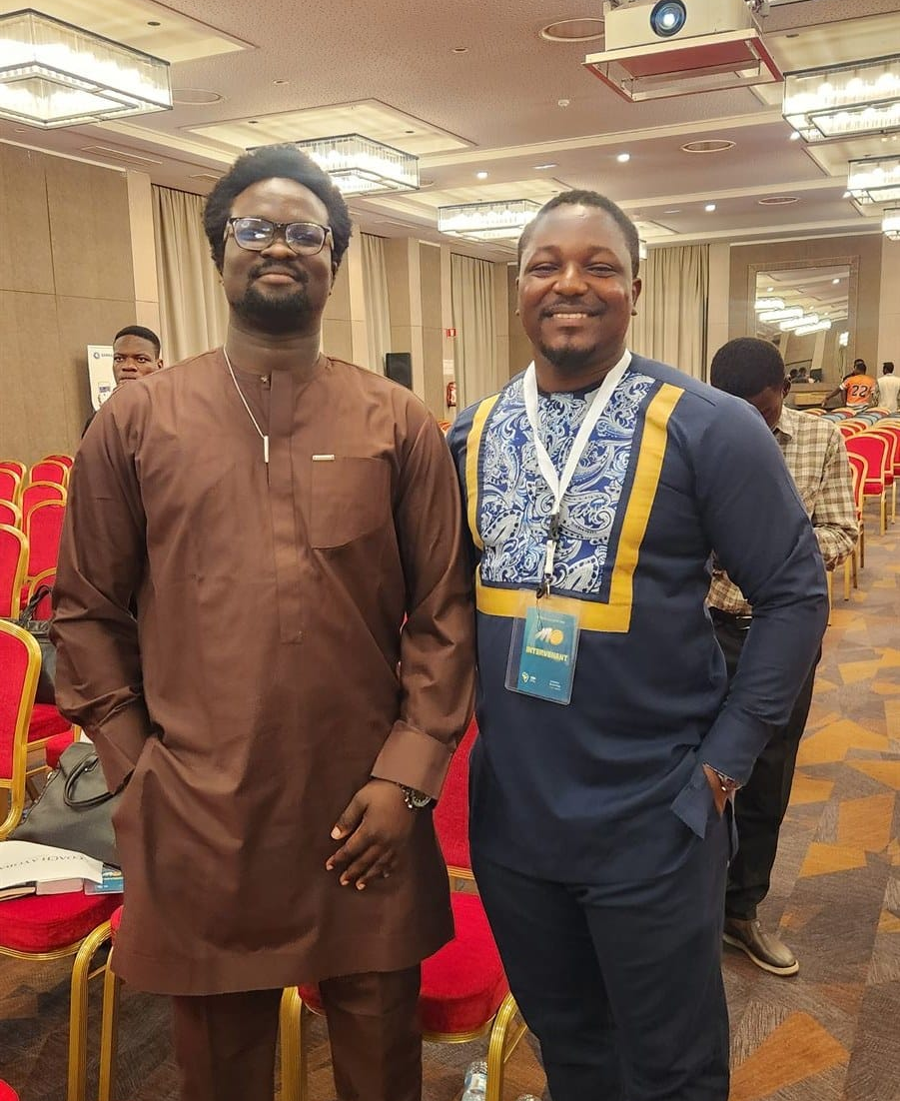

DAY 2 · SESSION 8 · 60 MIN
How to teach this
Run a session, handle questions, keep a room.
satsontheroad.africa · Driving Bitcoin across the African continent

Slide 2
DAY 2 · SESSION 8 · 60 MIN
You are ready sooner than you think
You do not need to be an expert.
You need to be one step ahead, and honest about the rest.
satsontheroad.africa
02
Notes:
The main message. Say it plainly and mean it.

Slide 3
DAY 2 · SESSION 8 · 60 MIN
How adults learn
● By doing first, understanding second
● When it solves a real money problem they have
● When they are respected, not talked down to
● They remember what they did, not what they heard
satsontheroad.africa
03
Notes:
Hands on the phone early. Connect every idea to money they use.

Slide 4
DAY 2 · SESSION 8 · 60 MIN
Say it, show it, let them do it
One idea, three ways.
Repetition in different forms beats saying it louder.
satsontheroad.africa
04
Notes:
People remember little from a lecture and a lot from one thing they did.

Slide 5
DAY 2 · SESSION 8 · 60 MIN
Shape of a two-hour session
● Open (10 min): welcome, why money matters, what they leave with
● Teach and do (85 min): money, what Bitcoin is, set up a wallet, one real payment
● Close (15 min): questions, where to get help, how to keep going
● Buffer (10 min): it always runs long
satsontheroad.africa
05
Notes:
This is the one-session plan from Day 1. Keep the real payment sacred.

Slide 6
DAY 2 · SESSION 8 · 60 MIN
Managing time
● Start on time, even with a small crowd
● Keep one eye on the clock
● Cut depth, not the hands-on part
● Always protect the real payment at the end
satsontheroad.africa
06
Notes:
Running long is the number one new-facilitator problem.

Slide 7
DAY 2 · SESSION 8 · 60 MIN
Keep the room awake
● Ask questions, then wait for answers
● Use local prices, local names, local examples
● Get phones in hands early and often
● Pair people so neighbours help each other
satsontheroad.africa
07
Notes:
Move around. Use names. Celebrate the first payment out loud.

Slide 8
DAY 2 · SESSION 8 · 60 MIN
Practice-teach
Five minutes each, in pairs.
Partner plays an unsure beginner.
Then swap, and give one kind, specific note.
satsontheroad.africa
08
Notes:
This is the exercise and the heart of the session. Circulate and collect good moments.

Slide 9
DAY 2 · SESSION 8 · 60 MIN
Mistakes to avoid
● Talking too long
● Using jargon
● Skipping the hands-on part
● Pretending to know an answer
● Running out of time before the real payment
satsontheroad.africa
09
Notes:
Use the debrief to surface these gently from the pairs' own experience.

Slide 10
DAY 2 · SESSION 8 · 60 MIN
When you do not know
"I don't know. Let's find out together."
Honesty builds more trust than a confident wrong answer.
satsontheroad.africa
10
Notes:
Write the question down and bring the answer next time.

Slide 11
DAY 2 · SESSION 8 · 60 MIN
A session succeeds when
People leave having done something,
not having heard something.
satsontheroad.africa
11
Notes:
Close here. This is the measure of good teaching.

