Slide 1
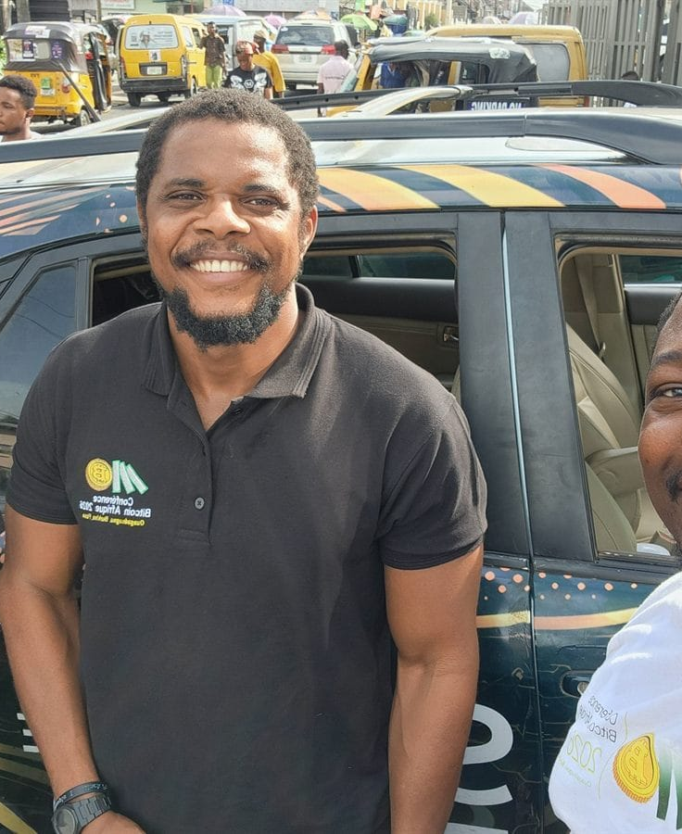

DAY 2 · SESSION 9 · 60 MIN
Onboarding a merchant
Step by step, in the stall.
satsontheroad.africa · Driving Bitcoin across the African continent

Slide 2
DAY 2 · SESSION 9 · 60 MIN
Why merchants matter
No merchants, no circular economy.
A learner who can spend needs someone who can receive.
satsontheroad.africa
02
Notes:
Set the tone: quick, respectful, never pushy.

Slide 3
DAY 2 · SESSION 9 · 60 MIN
The value, in under a minute
● Get paid directly, no chargebacks once confirmed
● Low fees on Lightning ⚡
● Reach customers who hold Bitcoin
● Cash out to [local currency] when you want
satsontheroad.africa
03
Notes:
Sell the problem you solve, not the technology. Practise saying it in one breath.

Slide 4
DAY 2 · SESSION 9 · 60 MIN
The flow
● Explain the value
● Set up receiving
● Do a test payment
● Check it arrived
● Show cash-out
● Leave the signage
satsontheroad.africa
04
Notes:
This is the whole session on one slide. Everything else fills it in.

Slide 5
DAY 2 · SESSION 9 · 60 MIN
Set up receiving
● Install from the official source only
● Create and back up a seed phrase (they keep it)
● Find the Lightning address or Receive QR
● Show the QR on the phone or a printed stand
satsontheroad.africa
05
Notes:
Never touch their seed phrase. Be clear about custodial vs self-custody.

Slide 6
DAY 2 · SESSION 9 · 60 MIN
Do a test payment
Send a small, real payment.
Let the merchant watch their own screen.
The moment it lands is the moment they believe.
satsontheroad.africa
06
Notes:
Talk less, show the sats landing. Then read the amount in [local currency].

Slide 7
DAY 2 · SESSION 9 · 60 MIN
Check it arrived
Show them the wallet history.
A confirmed payment shows there.
Now they can check any sale without you.
satsontheroad.africa
07
Notes:
This is what lets them run it alone after you leave.

Slide 8
DAY 2 · SESSION 9 · 60 MIN
Show cash-out, honestly
Options where they work locally:
[CONFIRM per country: e.g. Vexl, Banxaas, BitSpenda, Machankura]
Never promise a rate.
satsontheroad.africa
08
Notes:
Only name options that actually work in this country. Walk one end to end if time allows.

Slide 9
DAY 2 · SESSION 9 · 60 MIN
Leave the signage
Place the "Bitcoin accepted here" sign and QR stand.
Add the merchant to the stop's record.
Agree a simple follow-up.
satsontheroad.africa
09
Notes:
See the merchant kit for printable materials.

Slide 10
DAY 2 · SESSION 9 · 60 MIN
Role-play
One plays a busy merchant.
One plays the ambassador.
Work straight down the checklist, then swap.
satsontheroad.africa
10
Notes:
This is the exercise. Use the printed onboarding checklist.

Slide 11
DAY 2 · SESSION 9 · 60 MIN
Remember
● Respect their time
● Show, do not just tell
● Never promise a price
● Leave them able to do it alone
satsontheroad.africa
11
Notes:
Close here. Point to the quiz and the merchant kit.

