Slide 1
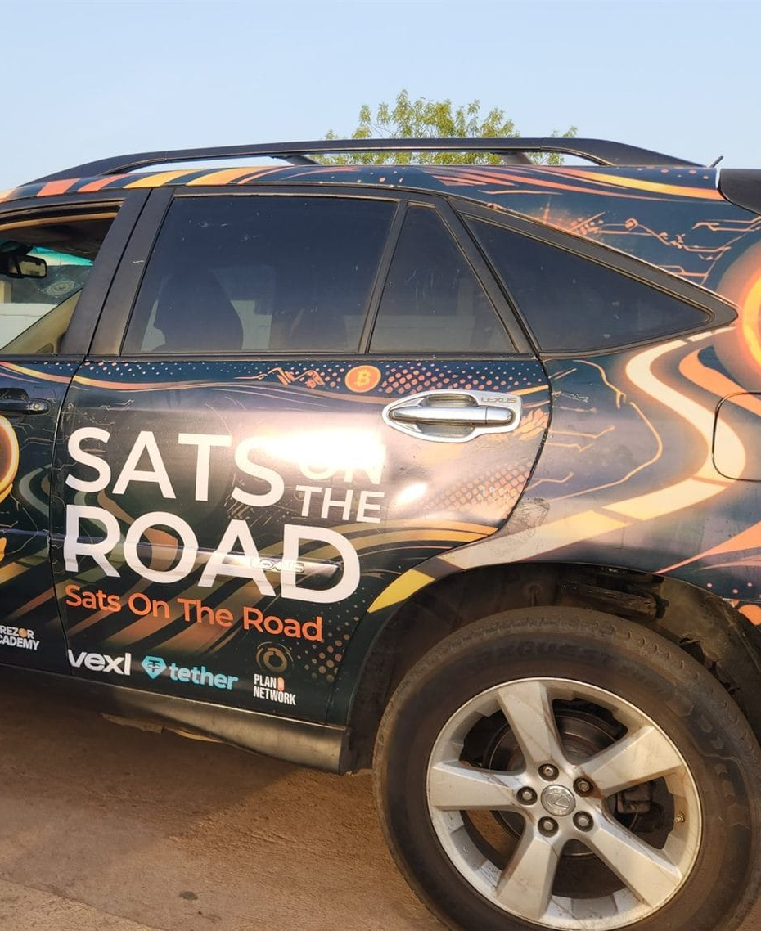

ONE SESSION · 2 HOURS
Bitcoin in two hours
The market or school session, from money to one real payment.
satsontheroad.africa · Driving Bitcoin across the African continent

Slide 2
ONE SESSION · 2 HOURS
Money and why ours fails
● What did [local currency] buy 5 years ago versus today?
● Money we do not control can be frozen, printed, or lose value
● There is another option
satsontheroad.africa
02

Slide 3
ONE SESSION · 2 HOURS
What Bitcoin is, in plain words
● Digital money, fixed supply (21 million, no one can print more)
● Sent person to person, no one in charge
● Not a getrich scheme. The price moves, that is normal
satsontheroad.africa
03

Slide 4
ONE SESSION · 2 HOURS
Your own wallet (the core)
● Install the wallet
● Create it
● Write your seed phrase on paper
● Receive a few sats
● Send a few to your neighbour
satsontheroad.africa
04
Notes:
Helpers move through the room. Never photograph the seed, never type it on a website.

Slide 5
ONE SESSION · 2 HOURS
One real payment ⚡
● Buy something small and real, in sats
● The merchant checks it arrived
● That is Lightning: fast, cheap, person to person
satsontheroad.africa
05

Slide 6
ONE SESSION · 2 HOURS
Stay safe
● Never share your seed phrase
● If someone asks for it, it is a scam
● Keep savings separate from spending
● Back up your seed in two safe places
satsontheroad.africa
06

Slide 7
ONE SESSION · 2 HOURS
Want to go further?
● Join the full two-day training and become an ambassador
● satsontheroad.africa
● Take the handout home
satsontheroad.africa
07
Notes:
Note the keen ones for Day 2.

