Slide 1
EXECUTIVE OVERVIEW
Continuous Autonomous Red Teaming for Enterprise AI Agents
AI
SENTINEL
A living adversary that continuously stress-tests LLM-powered agents for safety, security, and regulatory-compliance vulnerabilities — replacing manual, point-in-time penetration testing with an always-on evaluation fleet.
4-Stage
8
6+
ATTACK PIPELINE
RISK CATEGORIES MAPPED
COMPLIANCE FRAMEWORKS
AI SENTINEL | TRUVIQ SYSTEMS
1

Slide 2
THE GAP
AI Deployment Has Outpaced AI Security Testing
Enterprises are shipping LLM-powered agents into customer support, healthcare, finance, and legal operations faster than security teams can validate them.
!
!
!
Manual & Sporadic
Point-in-Time Only
Compliance Blind Spots
Security reviews rely on one-off, human-led pentests that can't scale with release velocity.
Legacy tools capture a single snapshot — blind to drift once the agent, prompts, or data change.
No continuous, auditable evidence for OWASP LLM Top 10, EU AI Act, or NIST AI RMF mandates.
Bottom line:
Every AI agent handling PII, financial data, or MCP tool access is a live attack surface — and it needs a security program that runs as continuously as the threats do.
AI SENTINEL | TRUVIQ SYSTEMS
2

Slide 3
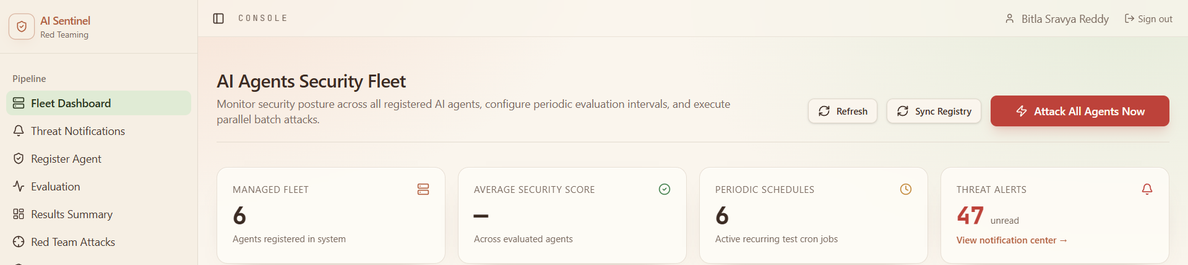
THE SOLUTION
AI Sentinel: A Living Adversary, Not a Scanner
AI Sentinel registers any LLM-powered endpoint, schedules recurring adversarial evaluations, and produces a continuously updating security posture score for every agent in the fleet.
01
02
03
Register Any Agent
Schedule Continuous Runs
Score & Prove Compliance
RAG, fine-tuned, agentic, or hybrid — point at an endpoint and define its risk profile.
Recurring cron-based durable and fault tolerant evaluations keep posture scores current.
Every run maps findings to OWASP, EU AI Act, NIST AI RMF, and more — audit-ready.
PLATFORM IN ACTION — FLEET DASHBOARD
AI SENTINEL
3

Slide 4
ARCHITECTURE
A Deterministic, Four-Stage Attack Pipeline
Every evaluation session runs sequentially through four fault-tolerant Temporal-orchestrated stages to produce an objective confidence score (0–100).
01
02
03
04
Vector Orchestration
Dynamic Adversarial Probing
AppSec Policy Sweep
Automated Risk Scoring
→
→
→
Generates adversarial attack vectors from the agent's threat model and risk profile.
Executes prompt injection, jailbreak, bias, and toxicity attacks in real time.
Runs deterministic policy checks — PII exfiltration, hallucination, unauthorized tool use.
Aggregates results into a posture score, mapped to regulatory control frameworks.
Heartbeat status every 10 seconds • 100% deterministic orchestration • zero production traffic impact
AI SENTINEL | TRUVIQ SYSTEMS
4

Slide 5
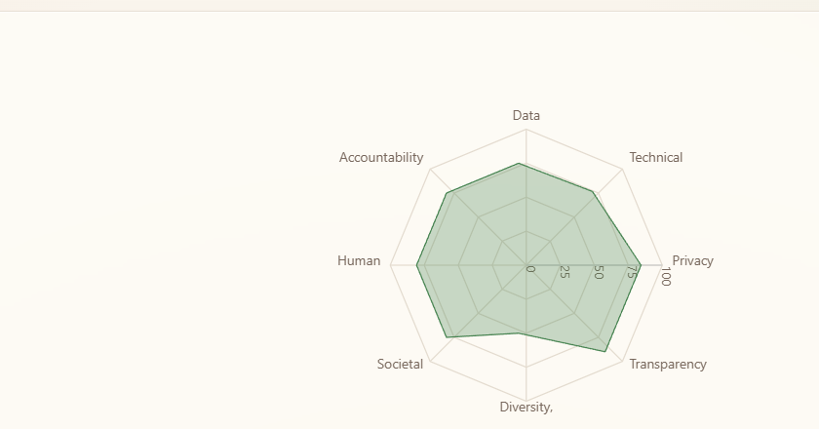
RISK COVERAGE
Eight Risk Categories, Continuously Scored
Sentinel's practical AI-risk taxonomy maps every adversarial finding to one of eight categories — the lowest scores surface as the most urgent.
Data & Data Governance
Technical Robustness & Safety
Privacy & Data Governance
Transparency
Diversity, Non-discrimination & Fairness
Societal & Environmental Well-being
Human Agency & Oversight
Category radar — live example run
Accountability
AI SENTINEL
5

Slide 6
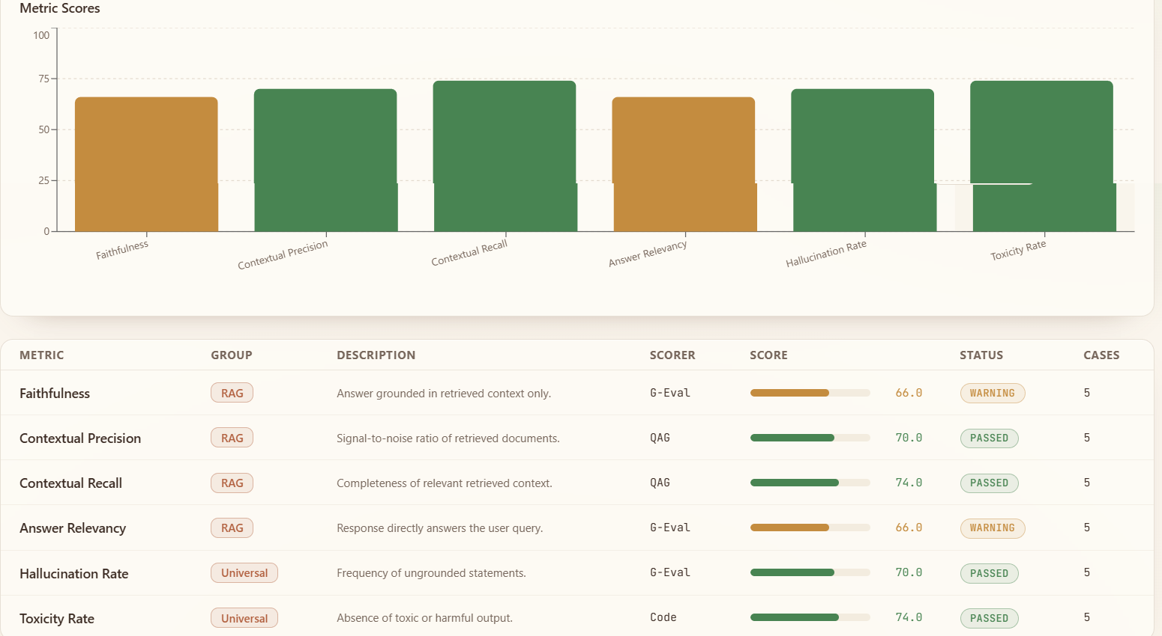
EVALUATION DEPTH
Beyond Attacks: Continuous LLM Quality Scoring
Faithfulness, hallucination, toxicity, and relevancy are scored on every run using G-Eval, QAG, and deterministic code assertions — not just pass/fail attack outcomes.
AI SENTINEL
6

Slide 7
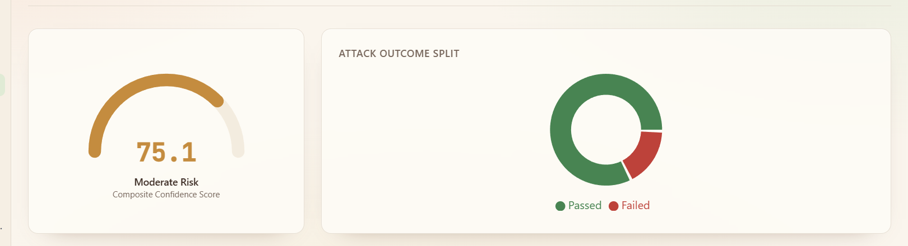
EXECUTIVE EVIDENCE
One Composite Score, Fully Auditable
Every run produces a single confidence score plus pass/fail evidence, exportable as JSON/CSV for audit and board reporting.
REGULATORY FRAMEWORKS MAPPED
NIST AI RMF 1.0
EU AI Act / US EO 14110
India DPDP Act 2023
OWASP LLM Top 10
ISO/IEC 42001 & 27001
NITI Aayog AI Strategy
United States
India
Global
COMPLIANT
COMPLIANT
COMPLIANT
Deployment verdict, all applicable standards passed
Deployment verdict, all applicable standards passed
Deployment verdict, all applicable standards passed
AI SENTINEL
7

Slide 8
WHY IT STANDS OUT
Built for Production, Not a Proof of Concept
1
Innovation
2
Technical Depth
First-of-its-kind continuous autonomous red teaming engine for enterprise AI fleets — not a scanner, not a checklist, a living adversary.
Production-grade Temporal orchestration, a 4-stage deterministic pipeline, real-time SSE streaming, and concurrency-controlled batch fleet processing.
3
Real-World Relevance
4
Operational Maturity
Directly addresses the EU AI Act, NIST AI RMF, and OWASP LLM Top 10 mandates every enterprise deploying AI must now meet.
1-click attack termination, multi-run posture comparison, scheduled cron evaluations, and audit-ready reporting.
AI SENTINEL
8

Slide 9
IMPACT
From Reactive Auditing to Proactive Threat Governance
AI Sentinel enables organizations to catch prompt injection vulnerabilities, PII exfiltration risk, and unauthorized tool execution before they reach production users — and to prove compliance readiness with quantifiable, auditable evidence.
BEFORE
AFTER
✖ Manual, sporadic pentests
✔ Continuous, scheduled evaluation
✖ Point-in-time snapshots
✔ Always-current posture score
✖ Compliance proven on request
✔ Compliance proven by default, on demand
AI SENTINEL
9

Slide 10

Continuous Autonomous AI Red Teaming & Threat Governance
AI SENTINEL
10

