Slide 1

PintOS project
GROUP 11
22027036 Farhan Zakir
21065719 Bit Na Yoon
21003020 Eyad Alshehri

Slide 2
File systems
Functional file systems are included in PintOS enabling operations by creating, opening, reading and closing files. It uses inodes to represent files and directories, also includes buffer cache which improves performance.

Slide 3
Memory Management
PintOS memory management: Efficient allocation via demand paging, two-level web page table hierarchy, minimizes memory usage, handles page faults, individual thread stacks for local variables and function returns.

Slide 4
Kernal and userspace
PintOS follows a rigid kernel architecture with a single address space for code, granting direct access to hardware resources and critical operations. The kernel serves as the backbone of the OS, providing essential functions and management of hardware resources. Developers work in an isolated user space, ensuring security and preventing unauthorized access to hardware, thus maintaining system stability.

Slide 5
Threads and process management
PintOS employs threads as basic units of execution for concurrent tasks within a process's shared memory space. The priority-based scheduler ensures fair CPU time distribution, and synchronization methods like locks, semaphores, and condition variables maintain data integrity. It supports pre-emption and offers efficient thread management through kernel-level APIs and user-level threads via libraries.

Slide 6
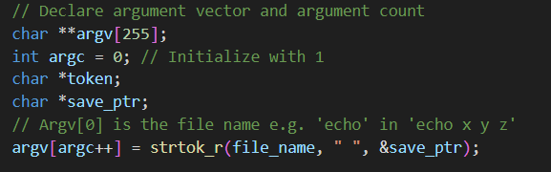
Explanation of tokenisation and argument passing
Before we start tokenisation, we declare few arguments like arg vector and arg c

Slide 7
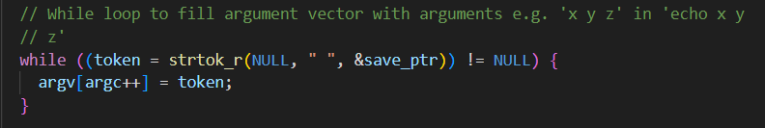
Explanation of tokenisation and argument passing
Tokenisation starts from here

Slide 8
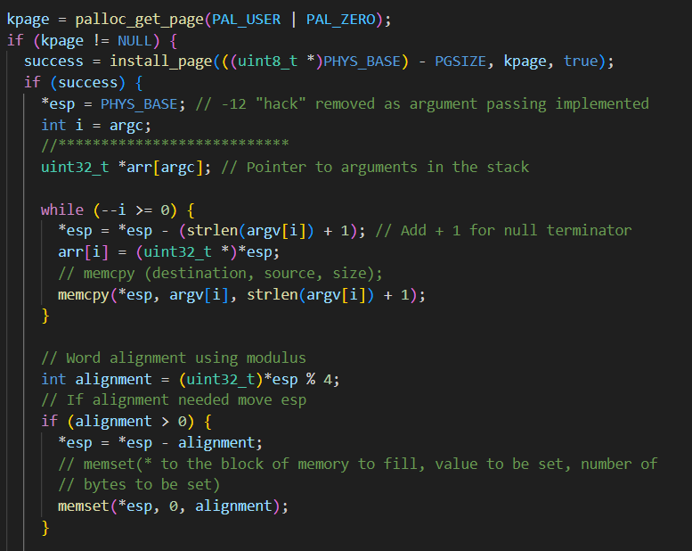
Explanation of tokenisation and argument passing
How parsed strings gets added and addresses

Slide 9
SYSTEM CALL DEVELOPMENT

Slide 10
What is a system call?
In PintOS, system calls are interfaces that enable user-level programs to request essential services from the operating system kernel. They provide access to functionalities such as file operations, process management, memory management, and synchronization. By using system calls, user programs can delegate tasks to the kernel, allowing them to access restricted functionalities and perform complex operations efficiently.

Slide 11
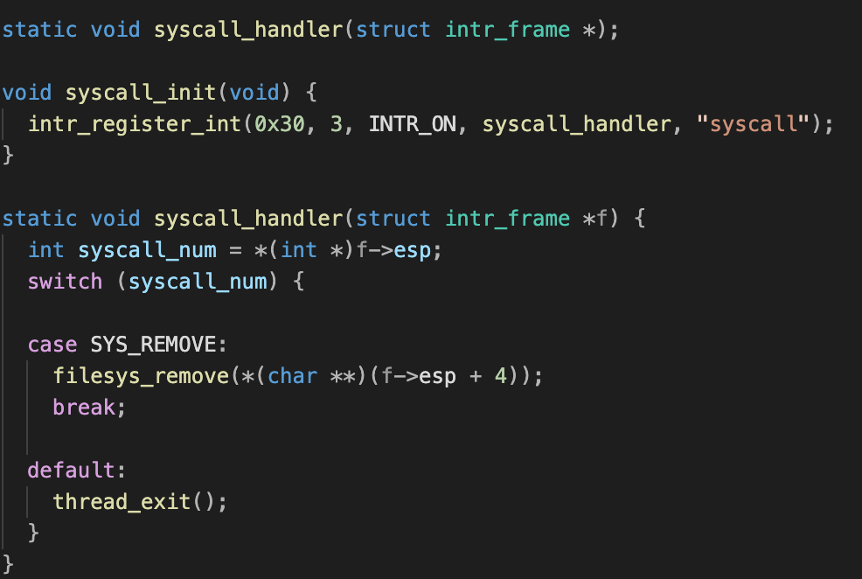
SYS_REMOVE
System call implementation
Deletes file from system, utilizes filesys_remove() within syscall_handler

Slide 12
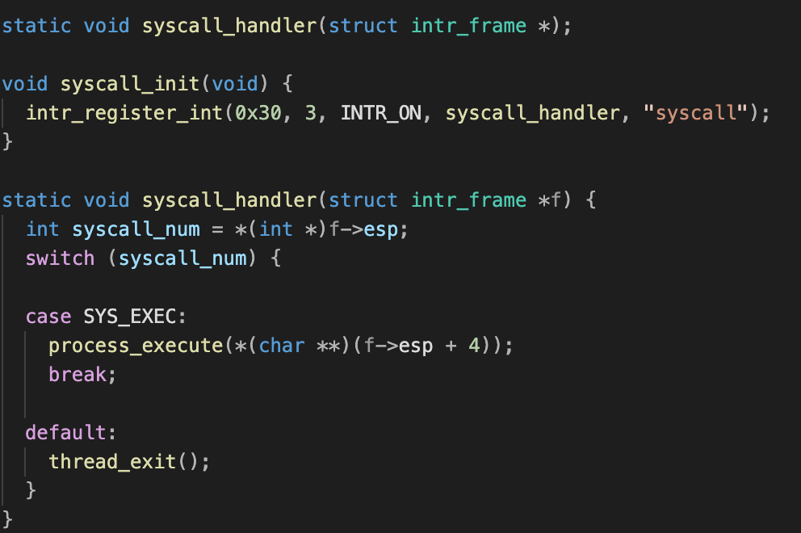
SYS_EXEC
System call implementation
Takes command line input, interfaces with sys_exec, passes input to process_execute

Slide 13
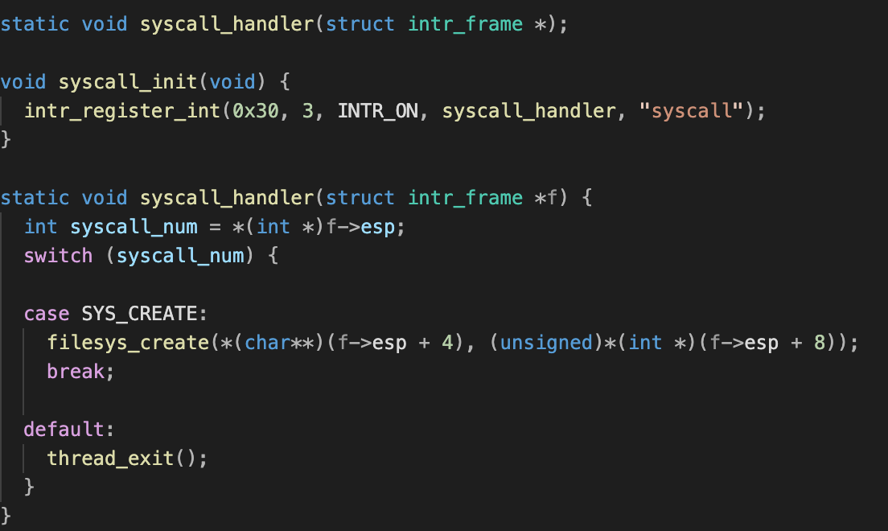
SYS_CREATE
System call implementation
Takes file name, interfaces with sys_create, uses filesys_create for new file creation

Slide 14
System call exploitation

Slide 15
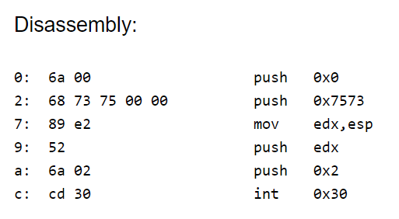
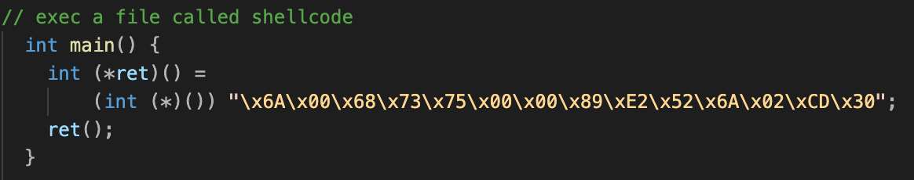
SYS-EXEC exploit

Slide 16
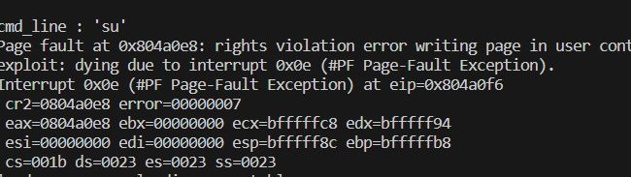
SYS_EXEC

Slide 17
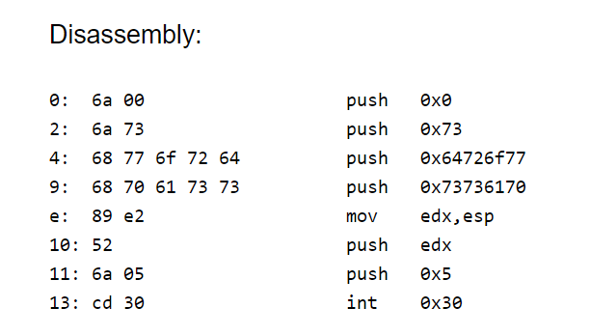
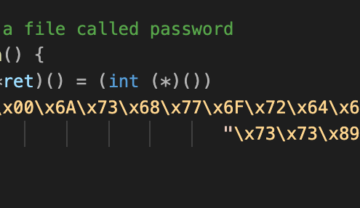
SYS_REMOVE exploitation code

Slide 18
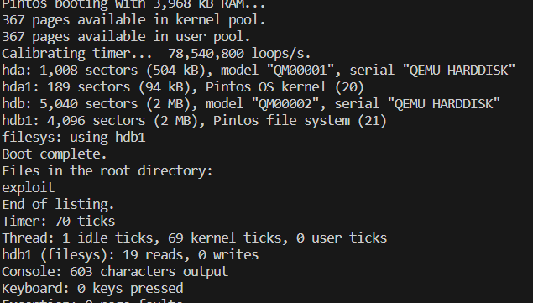
SYS_REMOVE

Slide 19
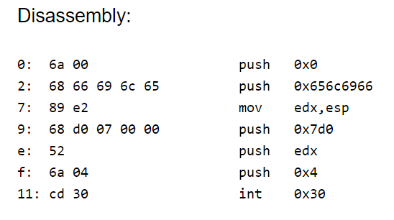
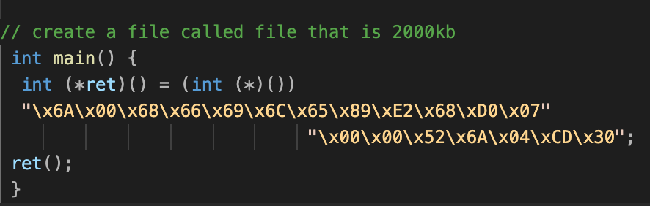
Exploit of sys_create

Slide 20
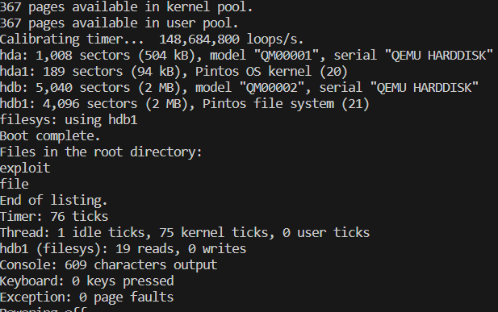
SYS_CREATE

Slide 21
Countermeasures
Sandboxing: Running your software in a sandbox or a similar isolated environment can prevent an exploit from affecting other parts of the system. If an exploit attempts to create, execute, or remove files, it will be confined to the sandbox.
Authentication and Access Control: Ensure that only authenticated users can make these system calls. Use role-based access control to restrict who can perform certain operations.
Input Validation: Always validate the input given to these system calls. Ensure that the paths, commands, or file names passed to them are within expected parameters. Look for invalid characters, or paths that lead outside of allowed directories.

