Slide 1

PintOS project
GROUP 11
22027036 Farhan Zakir
21065719 Bit Na Yoon
21003020 Eyad Alshehri

Slide 3
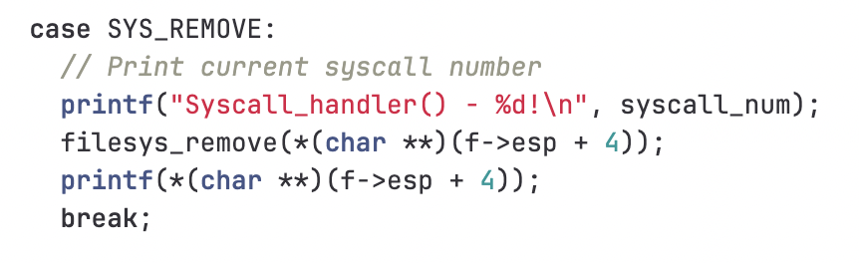
SYS_REMOVE
System call implementation

Slide 4
System call implementation

Slide 5
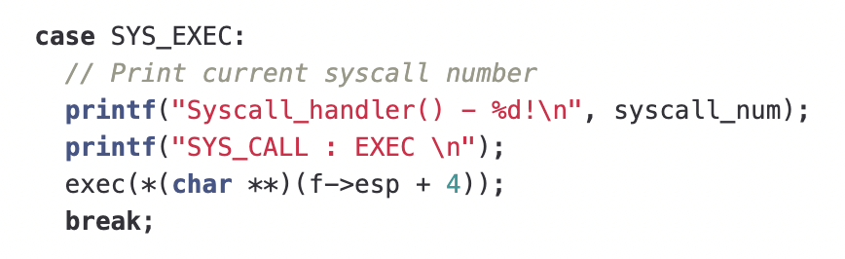
SYS_EXEC
System call implementation

Slide 6
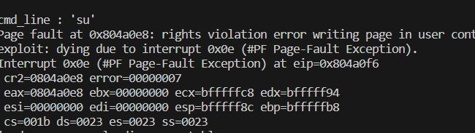
Execution result
System call implementation

Slide 7
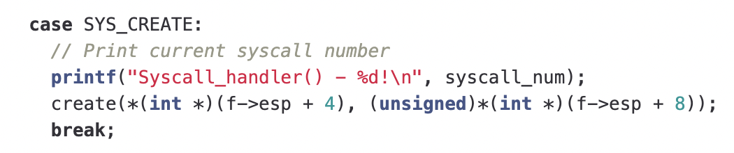
SYS_CREATE
System call implementation

Slide 8
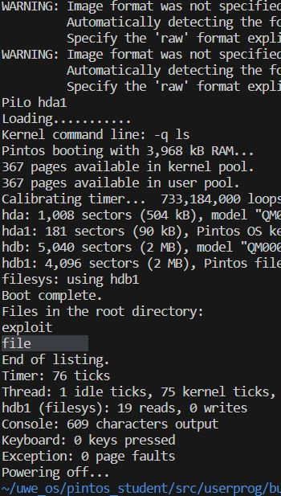
Execution result
System call implementation

