Slide 1

PintOS project
GROUP 11
22027036 Farhan Zakir
21065719 Bit Na Yoon
21003020 Eyad Alshehri

Slide 2
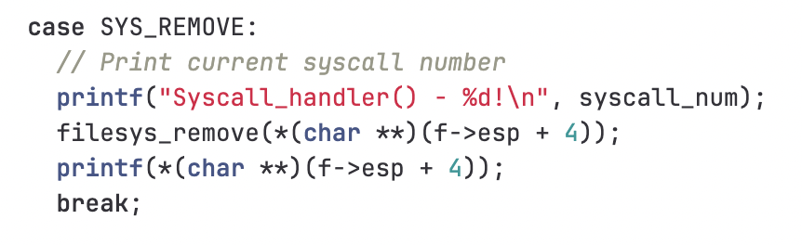
SYS_REMOVE
System call implementation
Deletes file from system, utilizes filesys_remove() within syscall_handler

Slide 3
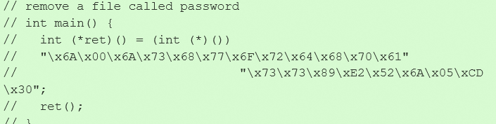
System call implementation
SYS_REMOVE exploitation code

Slide 4
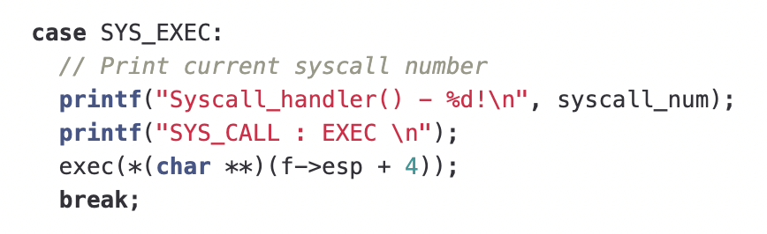
SYS_EXEC
System call implementation
Takes command line input, interfaces with sys_exec, passes input to process_execute

Slide 5
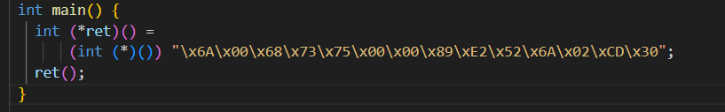
SYS-EXEC exploit

Slide 6
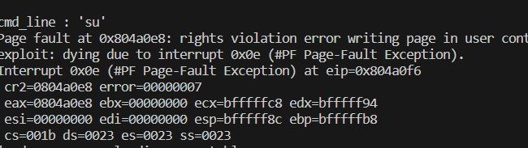
Execution result
System call implementation

Slide 7
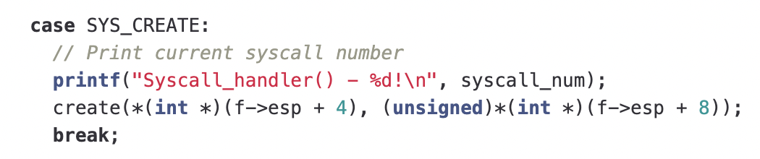
SYS_CREATE
System call implementation
Takes file name, interfaces with sys_create, uses filesys_create for new file creation

Slide 8
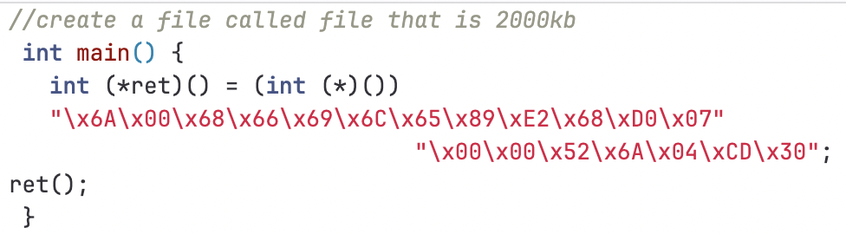
Exploit of sys_create
\x6A\x00 – push 0x00
\x68\x66\x69\x6C\x65 - Push the string 'file' onto the stack
\x89\xE2 – Copy the value of the esp register into the edx register
\x68\xD0\x07\x00\x00 – push 2000kb
\x52 – Push the pointer pointing to the file name onto the stack
\x6A\x04 – Push the system call number of sys_creat, which is 4, onto the stack
\xCD\x30 - Trigger an 0x30 interrupt to perform the system call

Slide 9
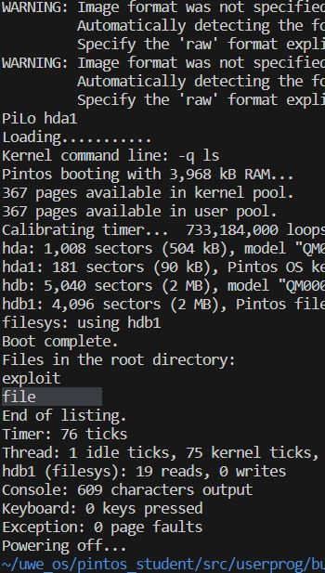
Execution result
System call implementation

