Slide 1
Deal AI — Functional Documentation
Three-tier AI-driven real-estate marketing platform
Frontend (Next.js) ▸ Backend (Express) ▸ AI Service (Flask)
April 2026

Slide 2
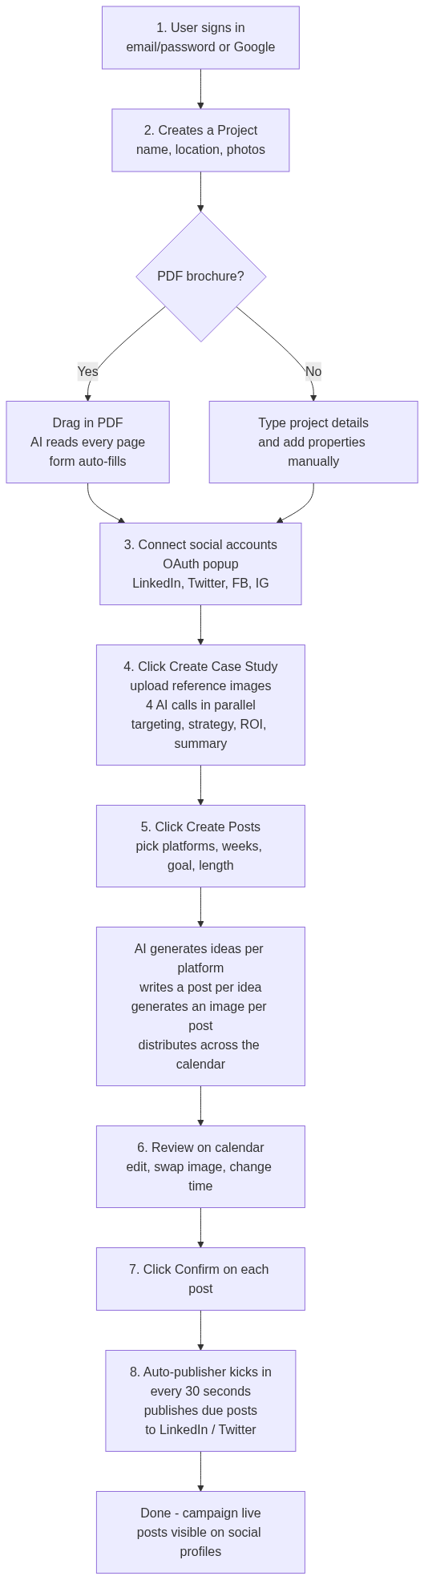
0. What is Deal AI? — diagram

Slide 3
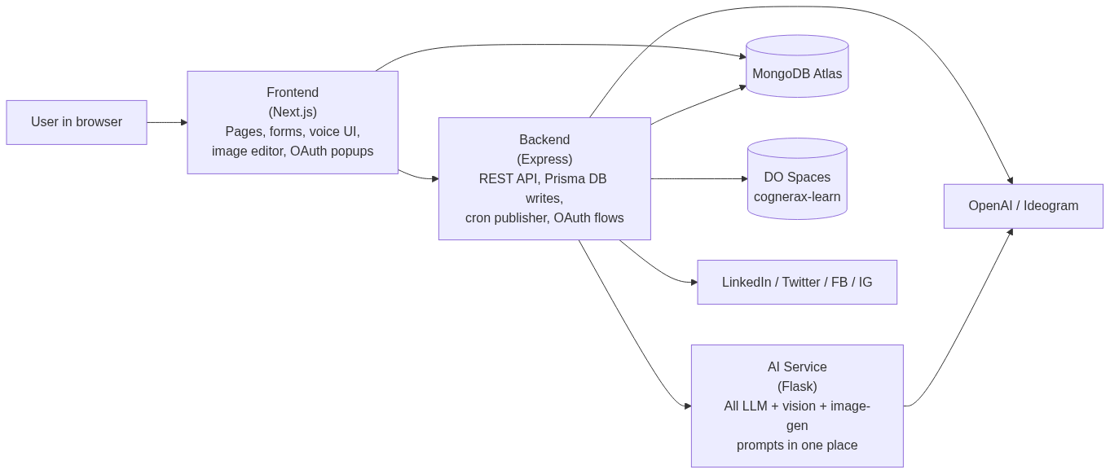
0. What is Deal AI? — diagram

Slide 4
0. What is Deal AI?
❝ Comprehensive documentation of the Deal AI platform: every feature, every flow, every endpoint. Read once, build twice.
Three repositories make up the system:
- **`deal-ai`** —... ❞
▸ In one paragraph
Deal AI is an AI-powered marketing co-pilot for real-estate developers. Drop in a project brochure (PDF, photos, basic info) and the platform turns it into a complete, weeks-long social-media campa...
▸ Core skills & services (what the user gets)
Table: Service / What it does for the user
• **AI brochure ingestion** | Upload a PDF brochure → AI reads every page, extracts project name, location, land area, every unit type with rooms / baths / spaces / finishing, and...
• **AI case study generation** | One click produces a complete marketing case study: who to target on each platform, recommended marketing strategy, performance metrics, ROI proje...

Slide 5
0. What is Deal AI? (cont.)
• **AI content campaigns** | Pick the platforms you want, the campaign goal (Branding / Engagement / Sales), the content length (Short / Medium / Long), and how many weeks. The pl...
• **AI image generation per post** | Every generated post gets a unique on-brand image rendered by DALL-E 3 from a prompt the system writes for it. Images are stored in your cloud...
• ... +7 more rows
▸ How it works — a typical user journey
▸ Under the hood (technical summary)
The platform is split across three services, each with one job:
• Frontend handles all UI, form validation, voice capture, image editing, and OAuth popups. Authenticates users with Lucia + Google OAuth.

Slide 6
0. What is Deal AI? (cont.)
• Backend is the orchestrator: receives every request, fans out to the AI service for LLM work, writes results to MongoDB via Prisma, uploads media to DigitalOcean Spaces, and pub...
• AI service is a stateless prompt library: every endpoint is a wrapper around an OpenAI or Ideogram call with a carefully tuned system prompt. Keeping prompts in one place means ...
▸ What's special about it (vs. generic AI writers like Buffer, Hootsuite, Jasper)
• Real-estate verticalized: data model speaks "Project", "Apartment", "Villa", "ROI", "marketing strategy" — not generic "campaigns".
• PDF brochure ingestion: nobody else turns a developer's brochure into a structured project in one drop.
• Arabic-first: prompts, dictionaries, RTL layout, dialect-aware copy.
• Voice control: hands-free project + content management is a novelty in the AI-marketing space.

Slide 7
0. What is Deal AI? (cont.)
• End-to-end: from raw brochure → published content, all in one tool.

Slide 8
Table of Contents
• [What is Deal AI?](#0-what-is-deal-ai) *(plain-language overview)*
• [Executive Summary](#1-executive-summary) *(technical)*
• [System Architecture](#2-system-architecture)
• [Tech Stack](#3-tech-stack)
• [Data Model](#4-data-model)
• [State Machines](#5-state-machines)
• [Authentication](#6-authentication)

Slide 9
Table of Contents (cont.)
• [Project Management](#7-project-management)

Slide 10
1. Executive Summary
Deal AI is an AI-driven social-media marketing platform for real-estate developers. It generates marketing case studies, plans content campaigns, drafts posts, generates images, and publishes them ...
▸ Headline capabilities
• Authentication: Email/password with Argon2 + Google OAuth via Lucia (frontend Next.js Server Actions).
• Project management: Real-estate projects, properties (apartments / villas), connected social platforms, soft-delete + restore.
• PDF brochure → structured data: Upload a PDF; gpt-4o-mini vision extracts title/location/units/floor-plans into form fields.
• AI case study: Four parallel calls to the Python AI service produce target-audience segmentation, marketing strategy, ROI projections, and project summary in one shot.
• Multi-platform post campaigns: AI-generated ideas + post content per platform across N weeks; dall-e-3 image per post; auto-distributed to days of the week.

Slide 11
1. Executive Summary (cont.)
• Image editor: Konva canvas with frame templates, RTL-aware text overlays, crop, export.
• Voice assistant ("Siri"): GPT-4o function-calling for hands-free project / property / case-study / post management. Web Speech API.
• Cron publisher: Every 30 s, publishes confirmed posts to LinkedIn (/v2/ugcPosts) and Twitter/X (/2/tweets) with token-refresh.
▸ Design tenets
• Three-tier separation: UI (Next.js) ↔ orchestration (Express) ↔ inference (Flask).
• Python service is the single source of LLM/Image/Vision calls so prompts stay in one place.
• Backend is Prisma-only DB writer; frontend never touches the DB directly.

Slide 12
1. Executive Summary (cont.)
• Cron publisher in the Express backend is the single fan-out to social APIs.

Slide 13
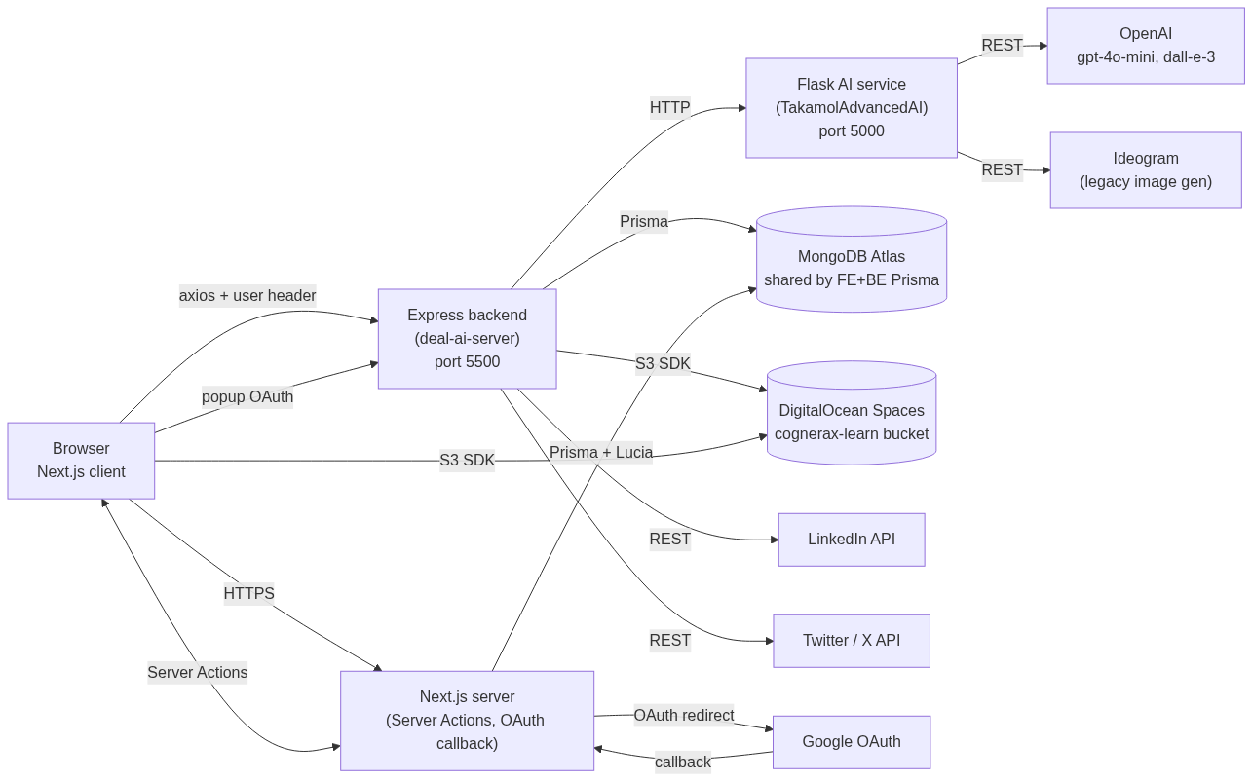
2. System Architecture — diagram

Slide 14
2. System Architecture
▸ High-level
▸ Inter-service dependencies
Table: From / To / Protocol / Purpose
• Browser | Next.js | HTTPS
• Browser | Express | HTTPS + base64 `user` header
• Browser | DigitalOcean Spaces | HTTPS (CDN)
• Browser | Express OAuth popup | HTTPS

Slide 15
2. System Architecture (cont.)
• ... +7 more rows
Service-port discovery (local dev):
Table: Service / Port / Notes
• Next.js | 3000 | `yarn dev`
• Express | 5500 | `yarn dev` (nodemon)
• Flask Python | 5000 | `python app.py`
• Ollama (optional) | 11434 | Not used currently

Slide 16
3. Tech Stack
▸ Frontend (`deal-ai`)
Table: Layer / Library
• Framework | Next.js 14.2.5 (App Router)
• Language | TypeScript 5
• Auth | Lucia 3.2 + Arctic 1.9 + @node-rs/argon2
• ORM | Prisma 5.17 (MongoDB)
• ... +10 more rows

Slide 17
3. Tech Stack (cont.)
▸ Backend (`deal-ai-server`)
Table: Layer / Library
• Runtime | Node.js ≥ 16, ESM
• Framework | Express 4.18
• ORM | Prisma 5 (MongoDB, **same schema as frontend**)
• Cron | `node-cron` 3.0
• ... +5 more rows

Slide 18
3. Tech Stack (cont.)
▸ Python AI service (`TakamolAdvancedAI`)
Table: Layer / Library
• Runtime | Python 3.12
• Framework | Flask 3 + flask-cors + flask-socketio
• LLM | `openai` 1.35 (gpt-4o-mini, gpt-4o, dall-e-3)
• Vision | OpenAI gpt-4o-mini (image_url content blocks)
• ... +4 more rows

Slide 19
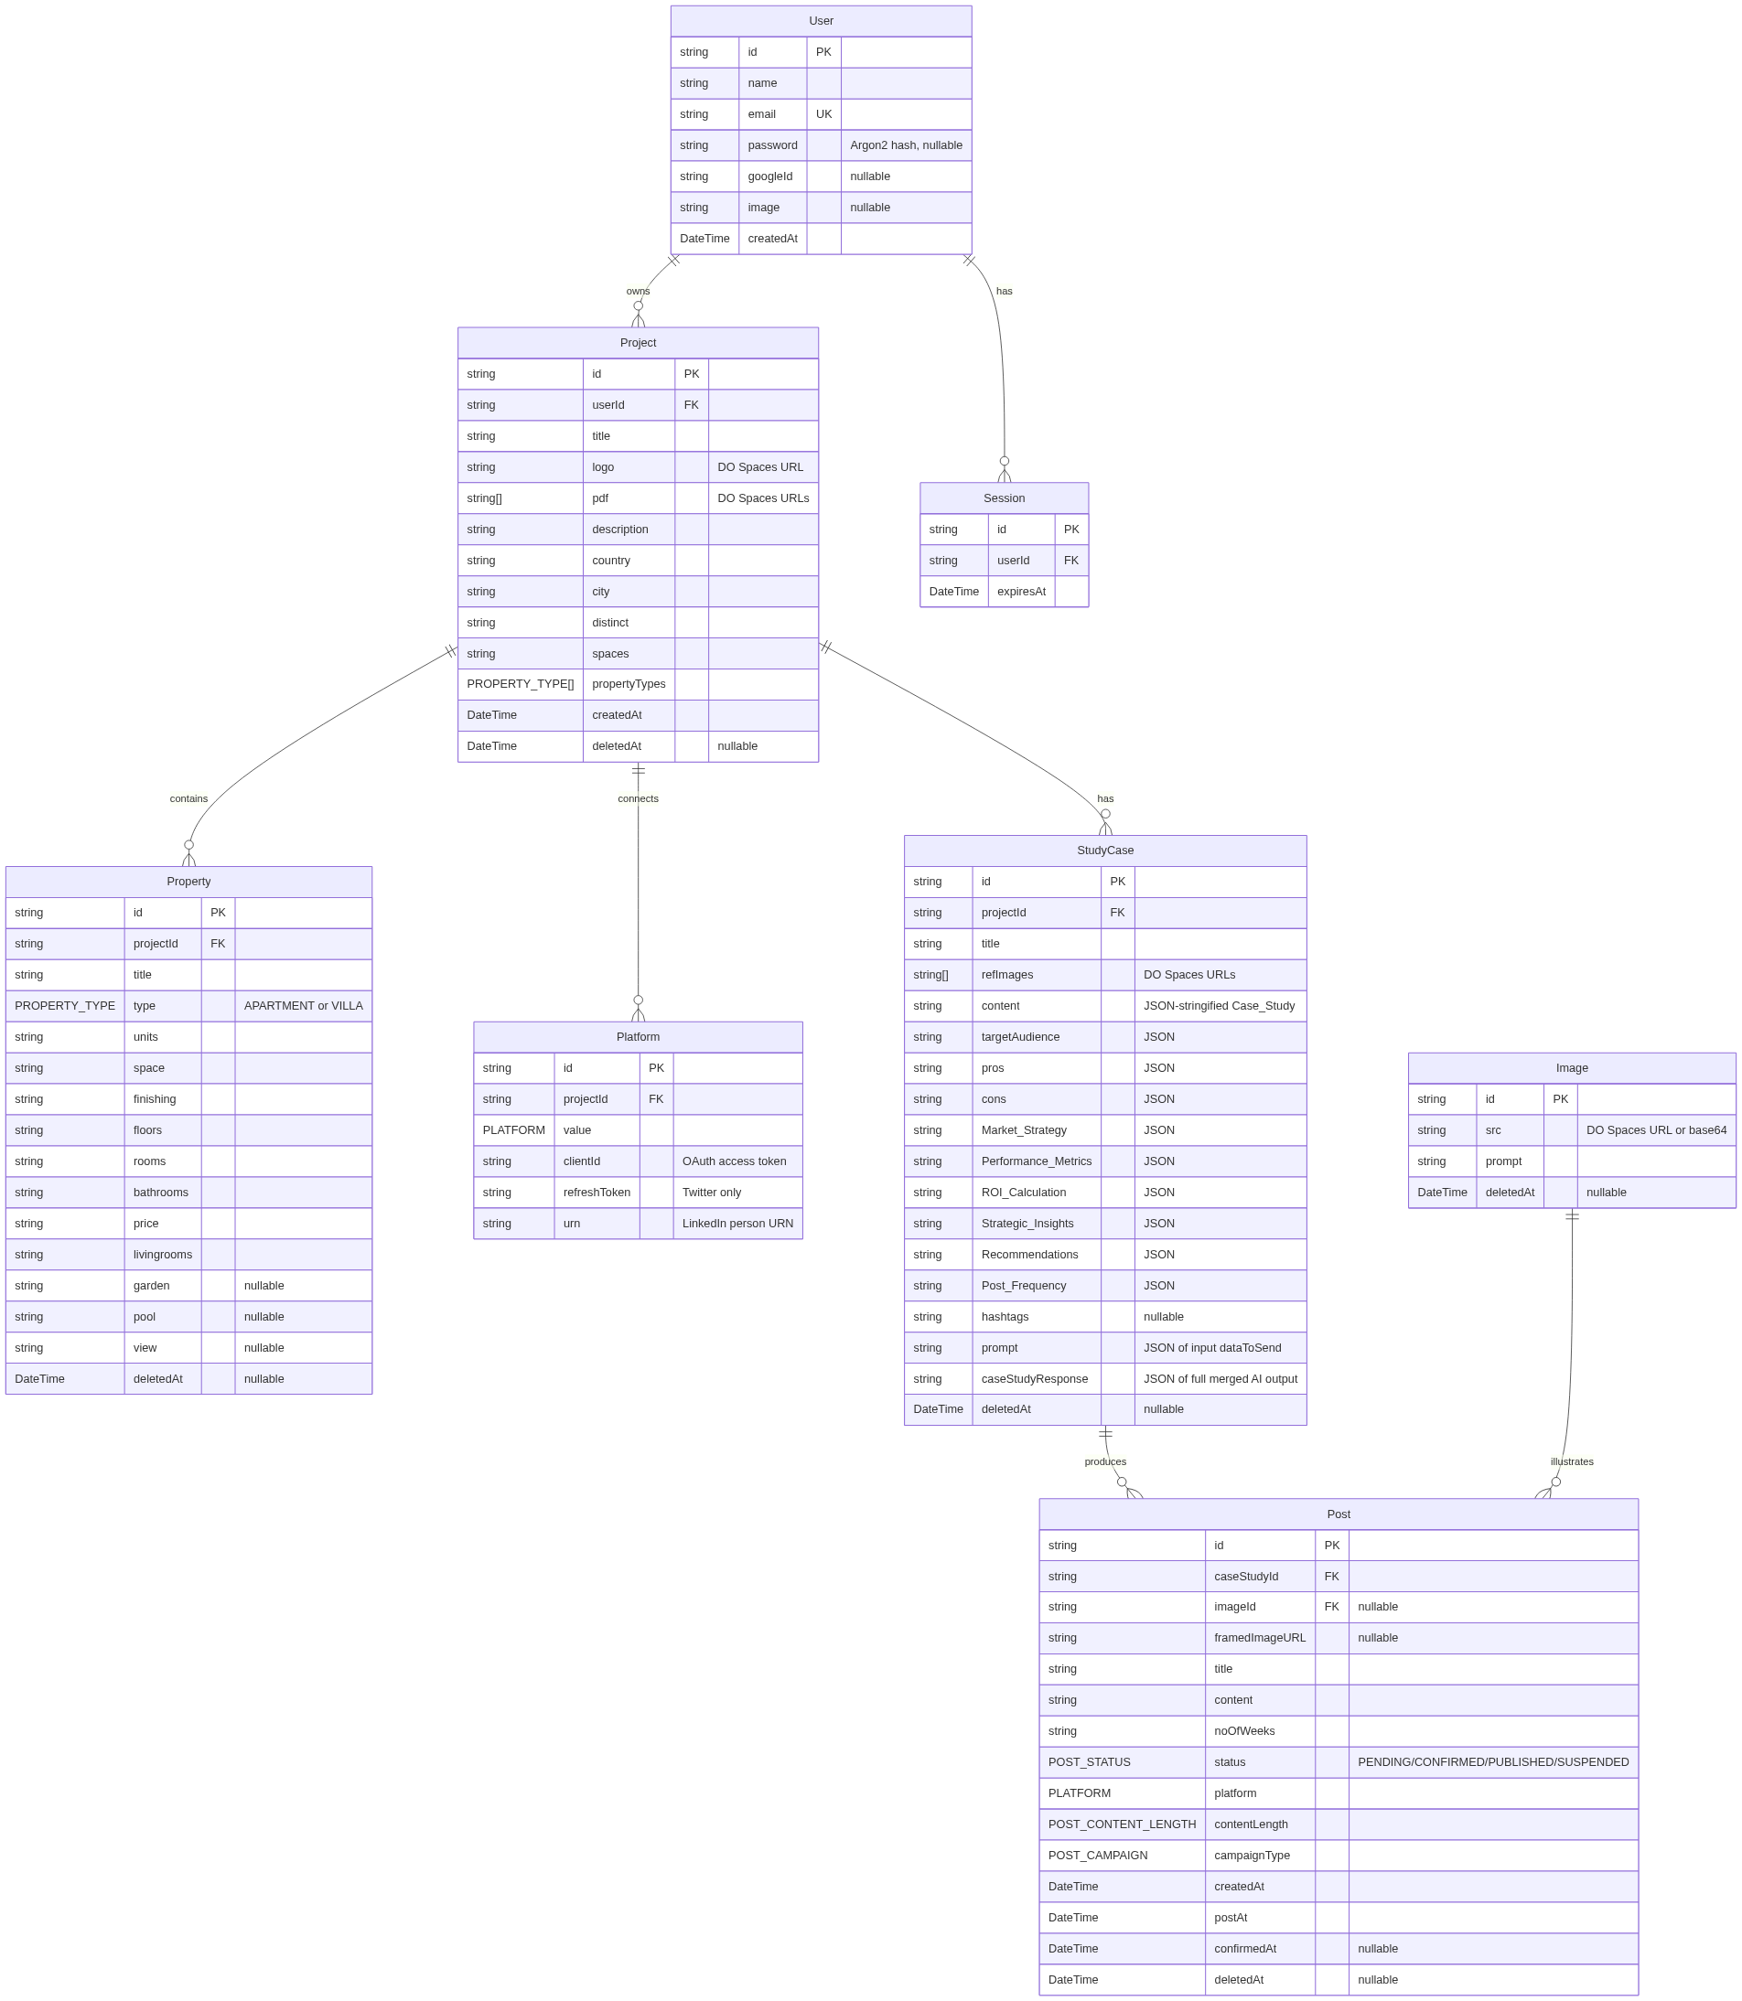
4. Data Model — diagram

Slide 20
4. Data Model
▸ ER diagram
▸ Enums
Table: Enum / Values
• `PLATFORM` | `FACEBOOK`, `LINKEDIN`, `INSTAGRAM`, `TWITTER`
• `PROPERTY_TYPE` | `APARTMENT`, `VILLA`
• `POST_CAMPAIGN` | `BRANDING_AWARENESS`, `ENGAGEMENT`, `SALES_CONVERSION`
• `POST_CONTENT_LENGTH` | `SHORT`, `MEDIUM`, `LONG`

Slide 21
4. Data Model (cont.)
• ... +1 more rows
▸ Soft-delete
• Project, Property, StudyCase, Image, Post carry deletedAt: DateTime?.
• User, Session, Platform are hard-deleted only.
▸ Schema source
Both deal-ai/prisma/schema.prisma and deal-ai-server/prisma/schema.prisma are byte-identical. Drift is a future hazard.

Slide 22
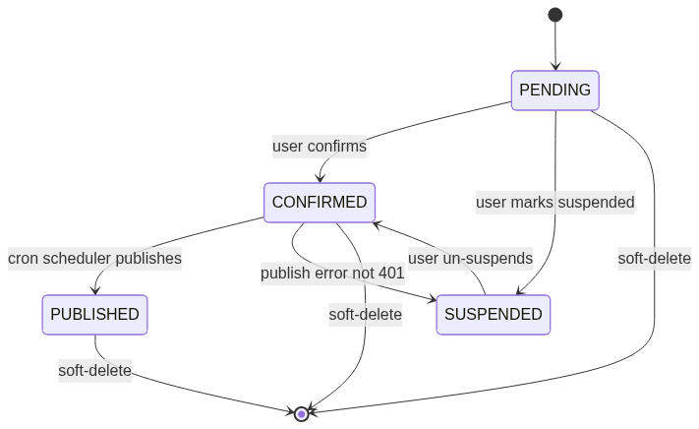
5. State Machines — diagram

Slide 23
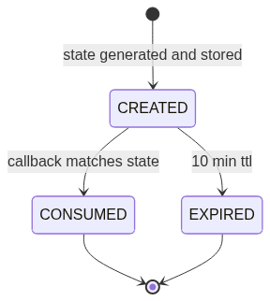
5. State Machines — diagram

Slide 24
5. State Machines
▸ Post lifecycle
▸ OAuth state lifecycle (LinkedIn / Twitter)

Slide 25
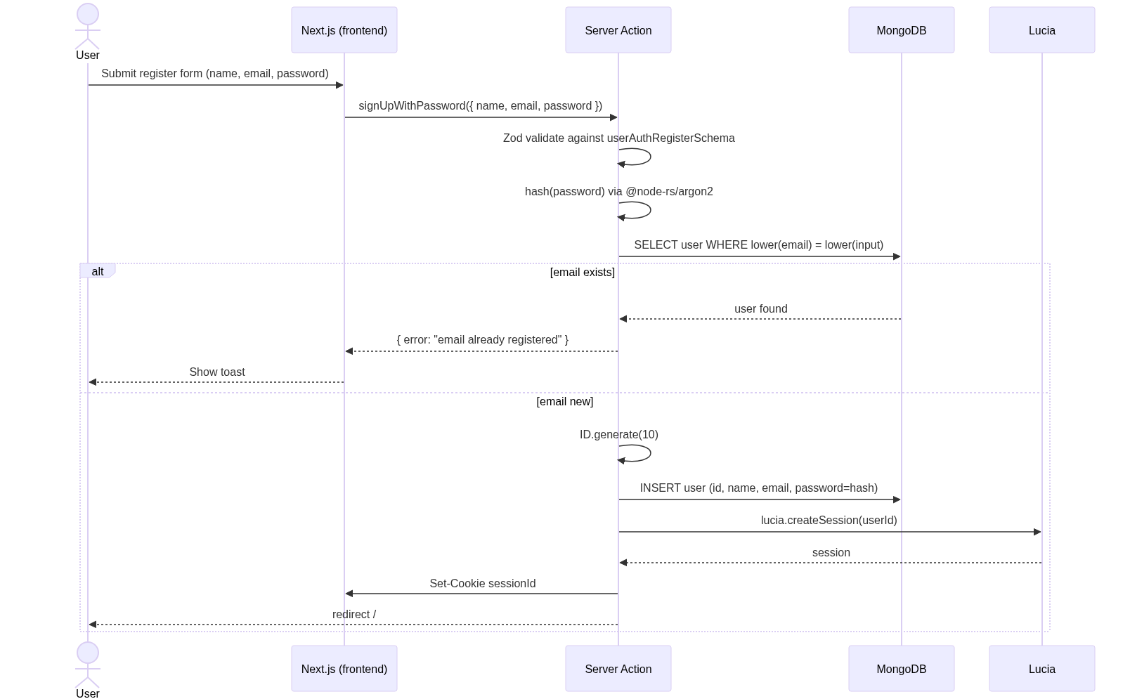
6. Authentication — diagram

Slide 26
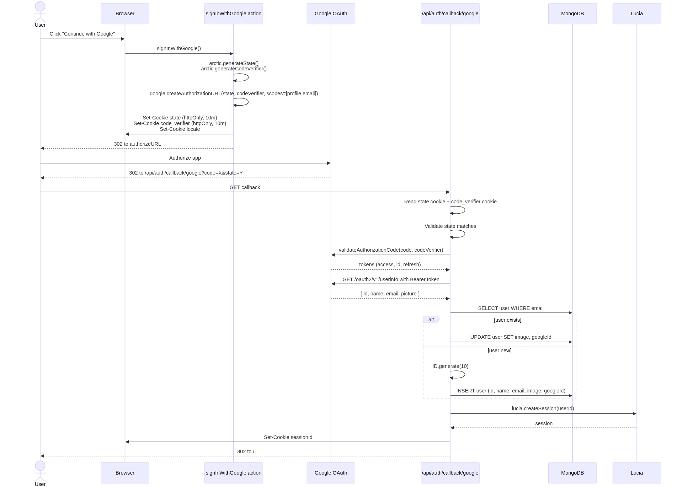
6. Authentication — diagram

Slide 27
6. Authentication
▸ 6.1 Email/password sign-up
Code refs:
• deal-ai/src/actions/users.ts:21-65
• deal-ai/src/actions/helpers.ts:39-46 — hash()
• deal-ai/src/validations/users.ts:24-28 — schema
▸ 6.2 Google OAuth sign-in
Code refs:

Slide 28
6. Authentication (cont.)
• deal-ai/src/actions/users.ts:107-148
• deal-ai/src/app/api/auth/callback/google/route.ts:1-100
▸ 6.3 Logout & profile updates
Table: Action / File / Effect
• Logout | `actions/users.ts:150-168` | `lucia.invalidateSession()`, clear cookie, redirect to login
• Update name/email | `actions/users.ts:170-209` | Auth-checked DB update; revalidate layout cache
• Update password | `actions/users.ts:211-256` | Argon2 re-hash; new session created (forces re-login on other tabs)

Slide 29
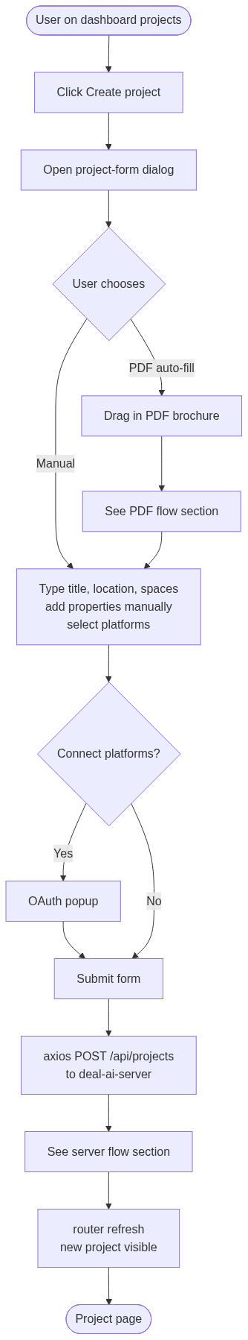
7. Project Management — diagram

Slide 30
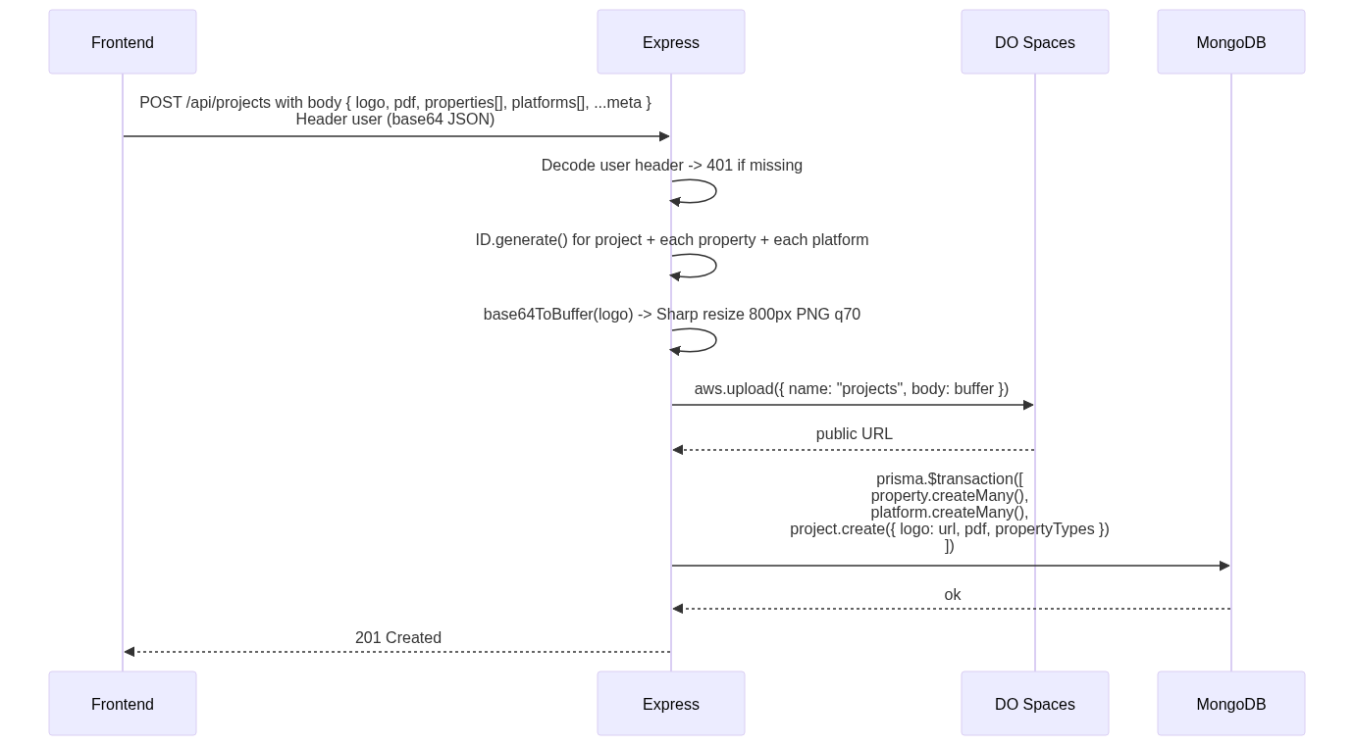
7. Project Management — diagram

Slide 31
7. Project Management
▸ Server-side project creation
Refs: deal-ai-server/src/routes/projects.js:52-145, deal-ai/src/components/project-form.tsx.
▸ Edit / soft-delete / restore
• Edit: PATCH /api/projects/:id with body fields.
• Soft-delete: PATCH deletedAt = now. Item moves to /dashboard/bin.
• Restore: PATCH deletedAt = null. Listed in /dashboard/projects again.

Slide 32
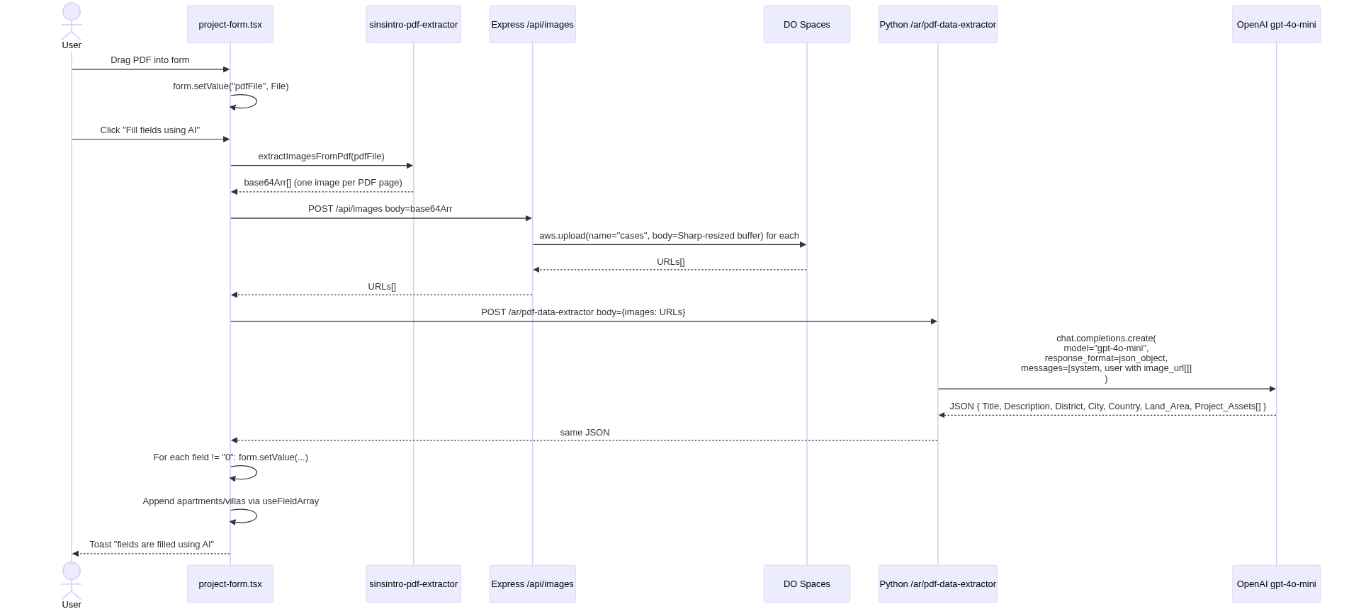
8. PDF Brochure Auto-fill — diagram

Slide 33
8. PDF Brochure Auto-fill
This is the killer onboarding feature: drag a PDF, get the form filled in.
Refs: deal-ai/src/components/project-form.tsx:140-278; TakamolAdvancedAI/app.py:113-171.
System prompt is reproduced in Appendix A.

Slide 34
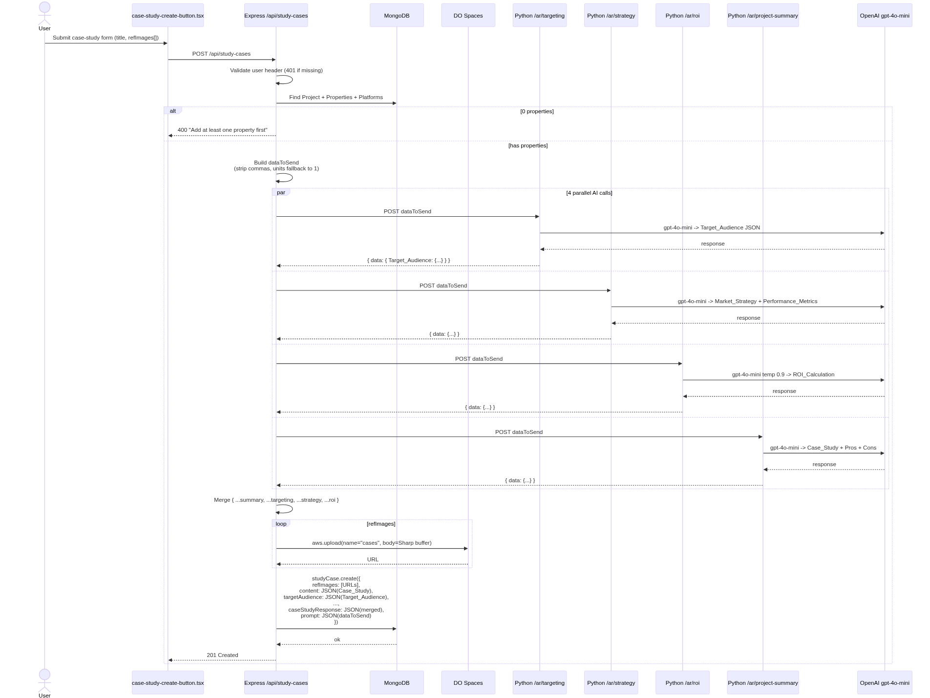
9. Case Study Generation — diagram

Slide 35
9. Case Study Generation
The most prompt-heavy flow. One client request fans out to four parallel AI calls.
▸ Asset normalization (the comma + units fix)
study-cases.js runs every property through:
Reason: /ar/roi does float(price) * int(units); commas in "2,000,000" blow up float(), and units: "0" silently produces zero ROI. The frontend sometimes stores numeric fields as comma-formatted str...
Refs: deal-ai-server/src/routes/study-cases.js:43-185; TakamolAdvancedAI/app.py:1486-1634.
const stripCommas = v => typeof v === "string" ? v.replace(/,/g, "") : v;
const atLeastOne = v => {
const cleaned = stripCommas(v);
const n = parseFloat(cleaned);
return !isFinite(n) || n < 1 ? "1" : cleaned;
};

Slide 36
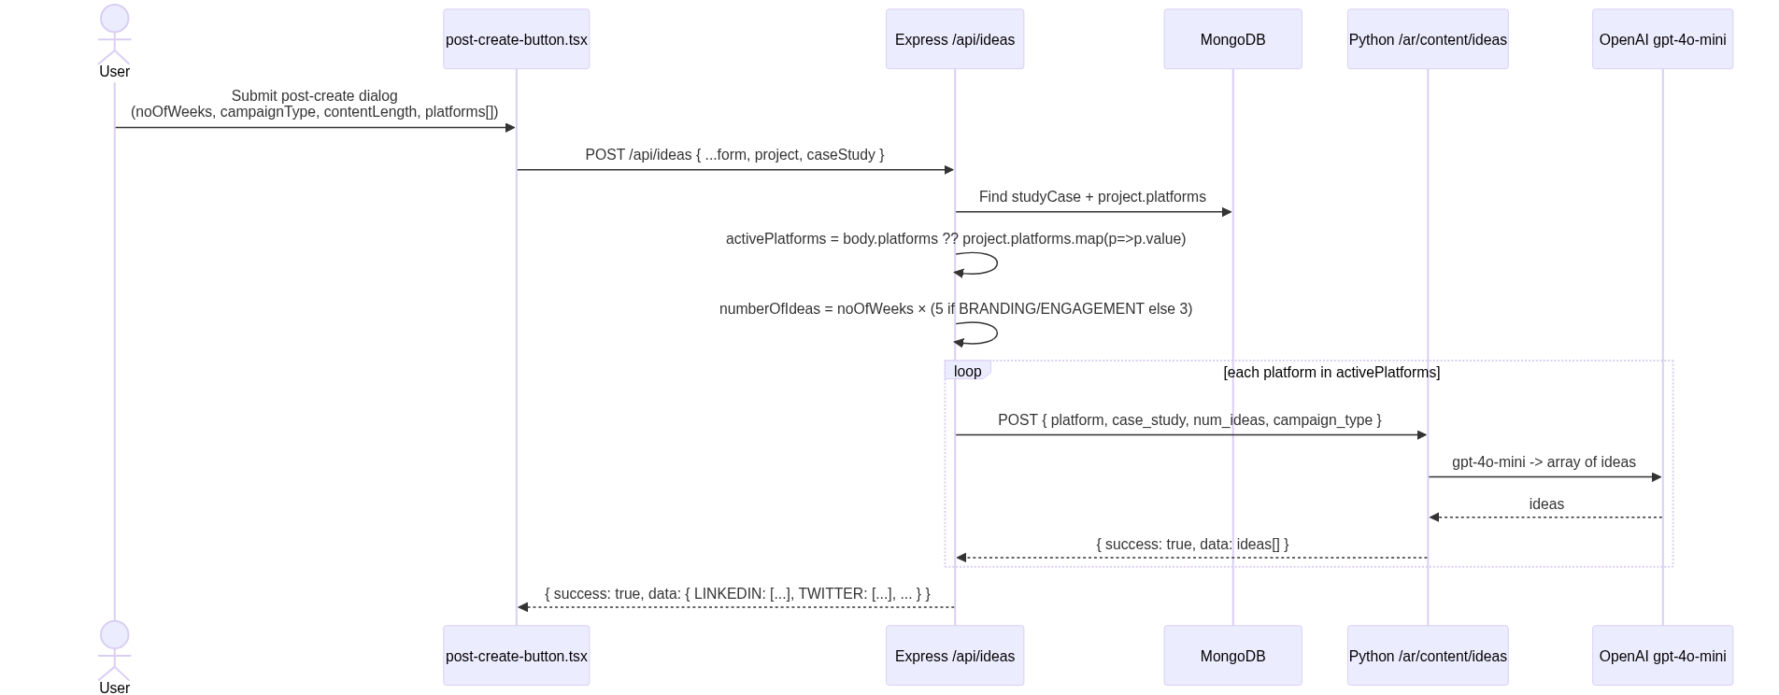
10. Post Generation Pipeline — diagram

Slide 37
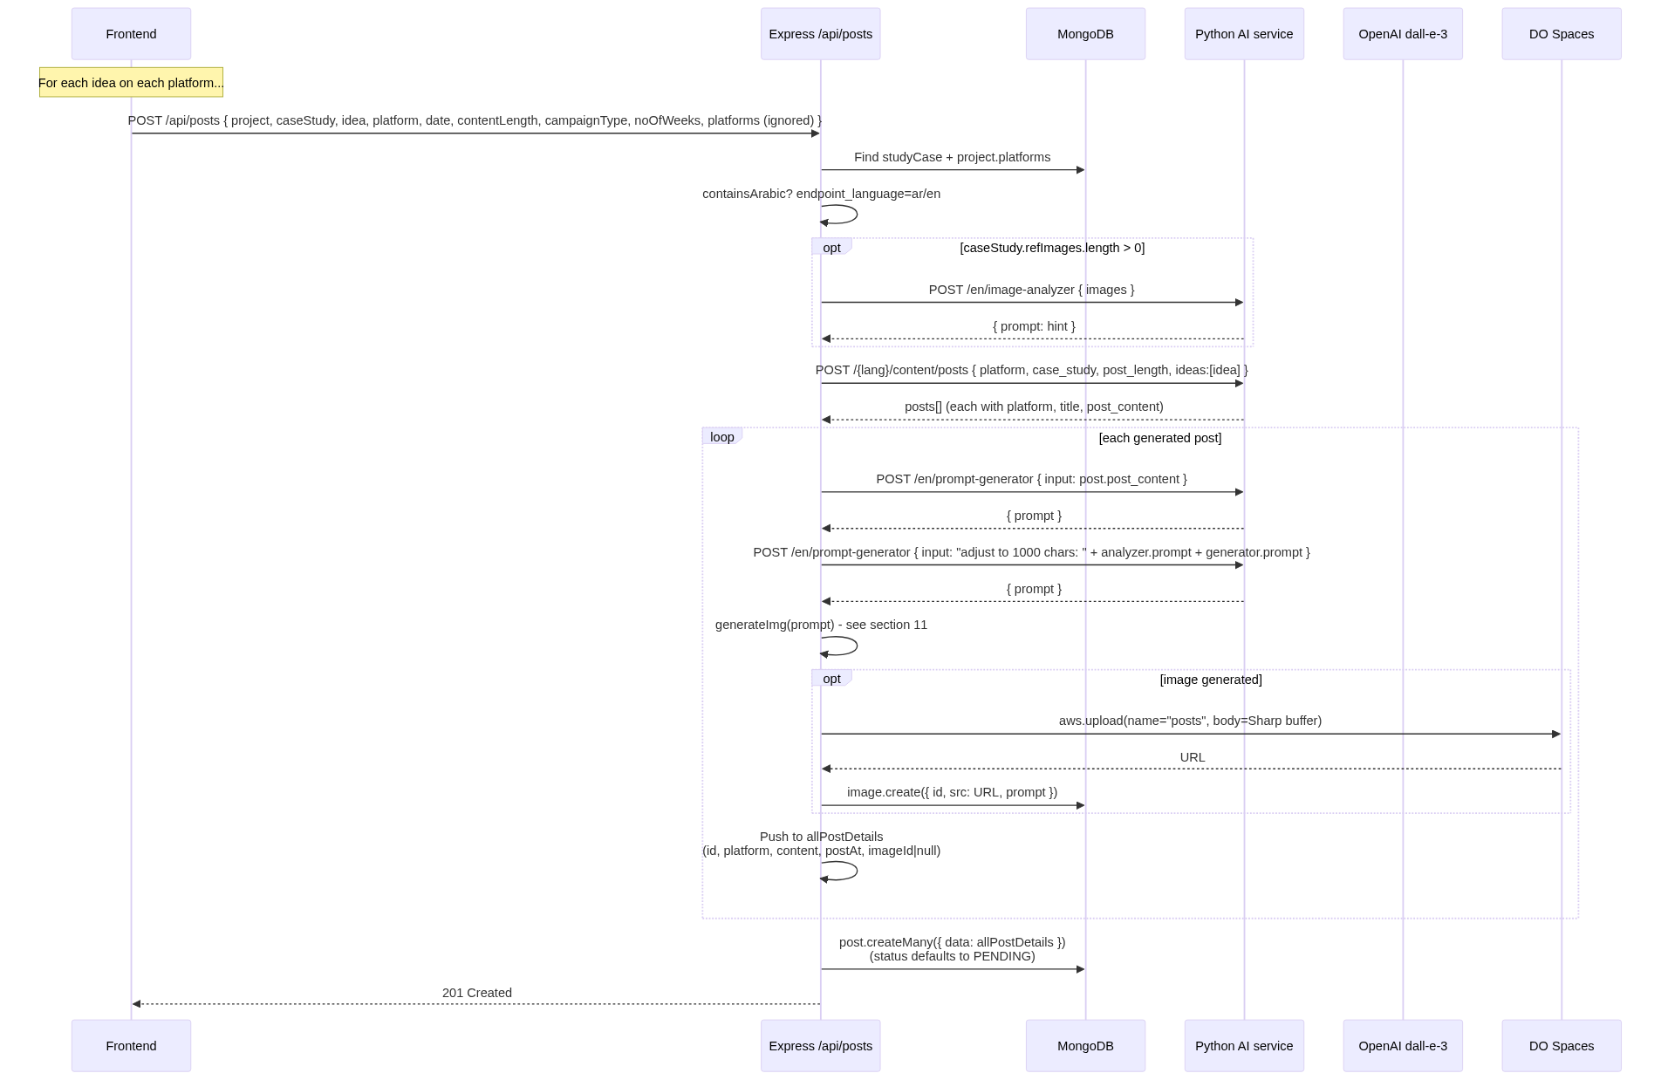
10. Post Generation Pipeline — diagram

Slide 38
10. Post Generation Pipeline
The biggest pipeline in the system. Two-stage: generate ideas, then generate posts (one per idea).
▸ Stage 1: ideas
▸ Stage 2: posts (per idea)
▸ Day-of-week distribution (frontend logic)
So a 5-week BRANDING_AWARENESS campaign with 4 platforms = 5 × 5 × 4 = 100 posts. Each calls /api/posts separately.
Refs:
• deal-ai/src/components/post-create-button.tsx:74-186
// post-create-button.tsx:104-150
const noOfPostsPerWeek =
data.campaignType === "BRANDING_AWARENESS" || data.campaignType === "ENGAGEMENT"
? 5 : 3;
const daysToPost = noOfPostsPerWeek === 3 ? [0, 2, 4] : [0, 1, 2, 3, 4];
// Each idea gets postAt incremented day by day, skipping non-daysToPost,
// random hour 11-20 local.

Slide 39
10. Post Generation Pipeline (cont.)
• deal-ai-server/src/routes/posts.js:71-400
• deal-ai-server/src/routes/ideas.js:71-205

Slide 40
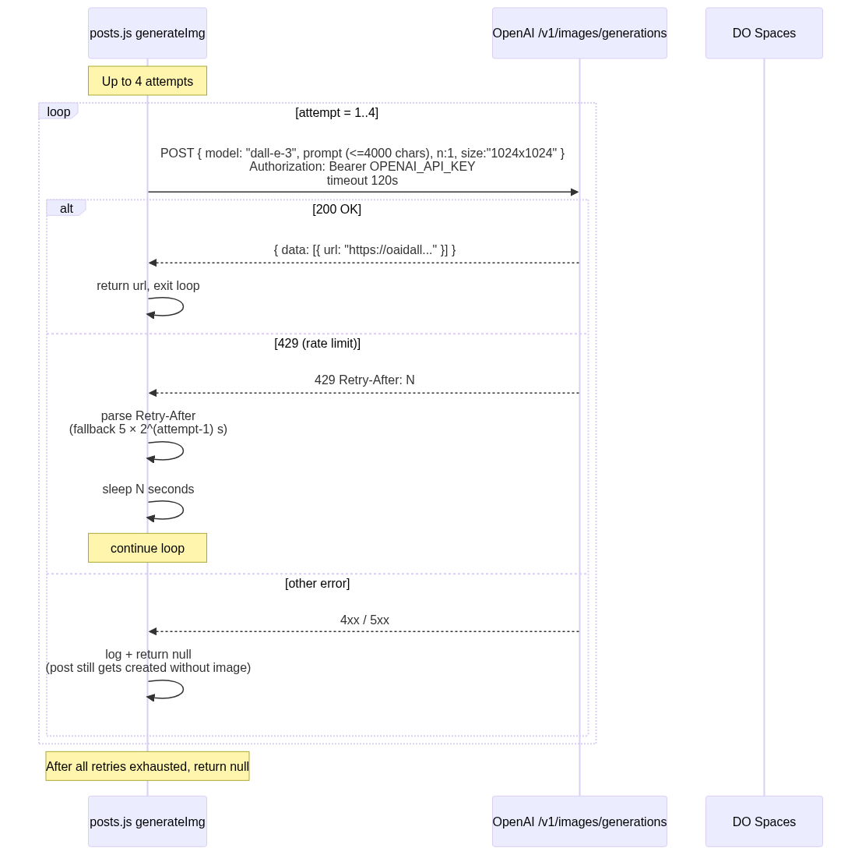
11. Image Generation — diagram

Slide 41
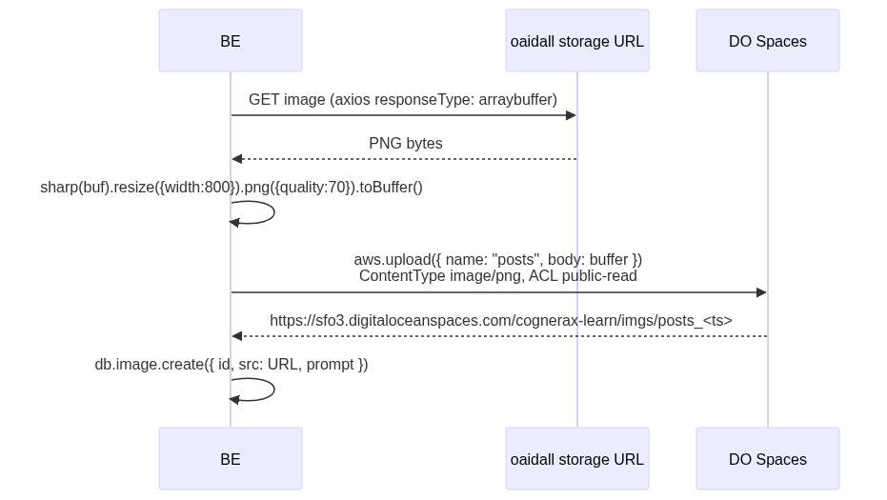
11. Image Generation — diagram

Slide 42
11. Image Generation
The image-gen path went through three iterations:
• Original: Python /image-model-2 → Ideogram (out of credit).
• Local fallback: Skip image, post text-only.
• Current (this codebase): Express calls OpenAI dall-e-3 directly with retry-on-429.
▸ Current flow
After generateImg returns a URL:
▸ Why dall-e-3 directly (not Python)?

Slide 43
11. Image Generation (cont.)
The Python service's /image-model-2 proxies to Ideogram, which ran out of API credits. Going direct from Express to OpenAI:
• Avoids the dead Python path.
• Lets us own the retry-on-429 logic in JS.
• Keeps the Sharp + S3 upload colocated with the Post insert.
Refs: deal-ai-server/src/routes/posts.js:56-108 (and identical copy in ideas.js).

Slide 44
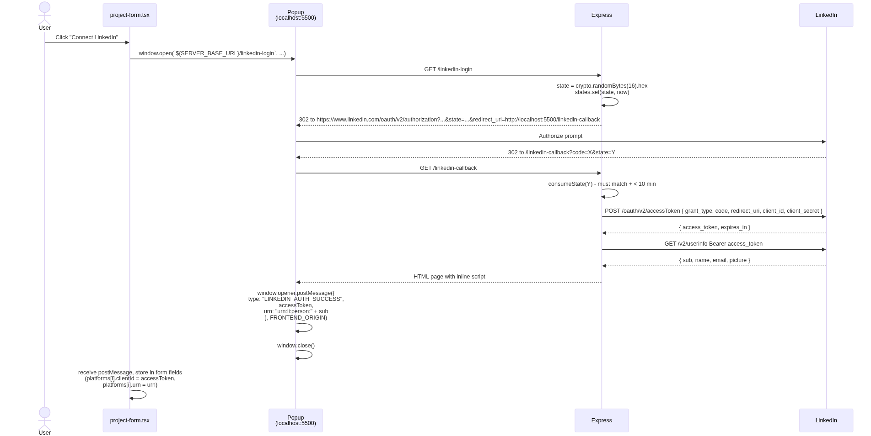
12. Social-Media OAuth & Posting — diagram

Slide 45
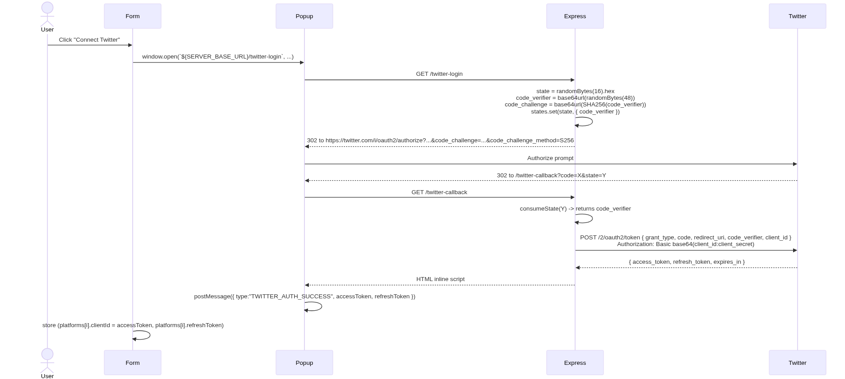
12. Social-Media OAuth & Posting — diagram

Slide 46
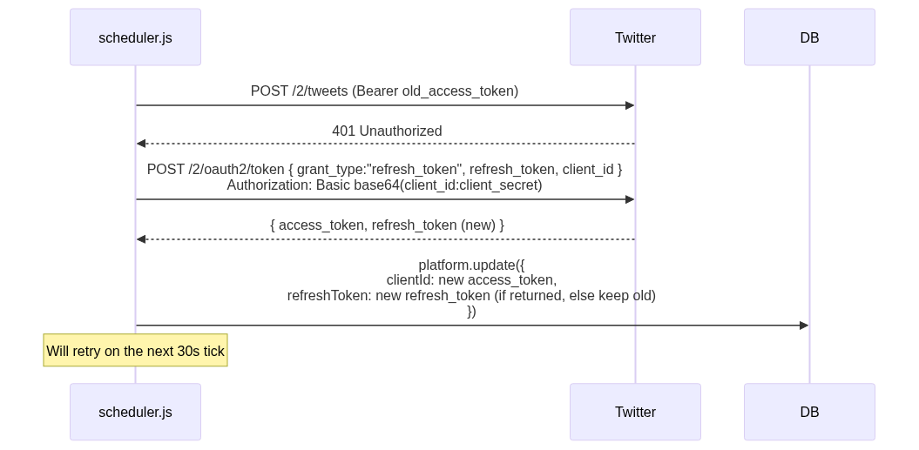
12. Social-Media OAuth & Posting — diagram

Slide 47
12. Social-Media OAuth & Posting
▸ LinkedIn — popup OAuth
▸ Twitter — OAuth 2.0 + PKCE
▸ Posting (LinkedIn)
publishToLinkedIn({ text, accessToken, urn }) in deal-ai-server/src/lib/social.js:
▸ Posting (Twitter)
publishToTwitter({ text, accessToken }):
▸ Token refresh (Twitter only)
POST https://api.linkedin.com/v2/ugcPosts
Authorization: Bearer ${accessToken}
X-Restli-Protocol-Version: 2.0.0
Content-Type: application/json
{
"author": "<urn>",
"lifecycleState": "PUBLISHED",
"specificContent": {
"com.linkedin.ugc.ShareContent": {
"shareCommentary": { "text": "<post text>" },
"shareMediaCategory": "NONE"
}
},
"visibility": {
"com.linkedin.ugc.MemberNetworkVisibility": "PUBLIC"
}
}

Slide 48
12. Social-Media OAuth & Posting (cont.)
When the cron publisher gets a 401 from /2/tweets, it auto-refreshes:
Refs: scheduler.js:150-205.

Slide 49
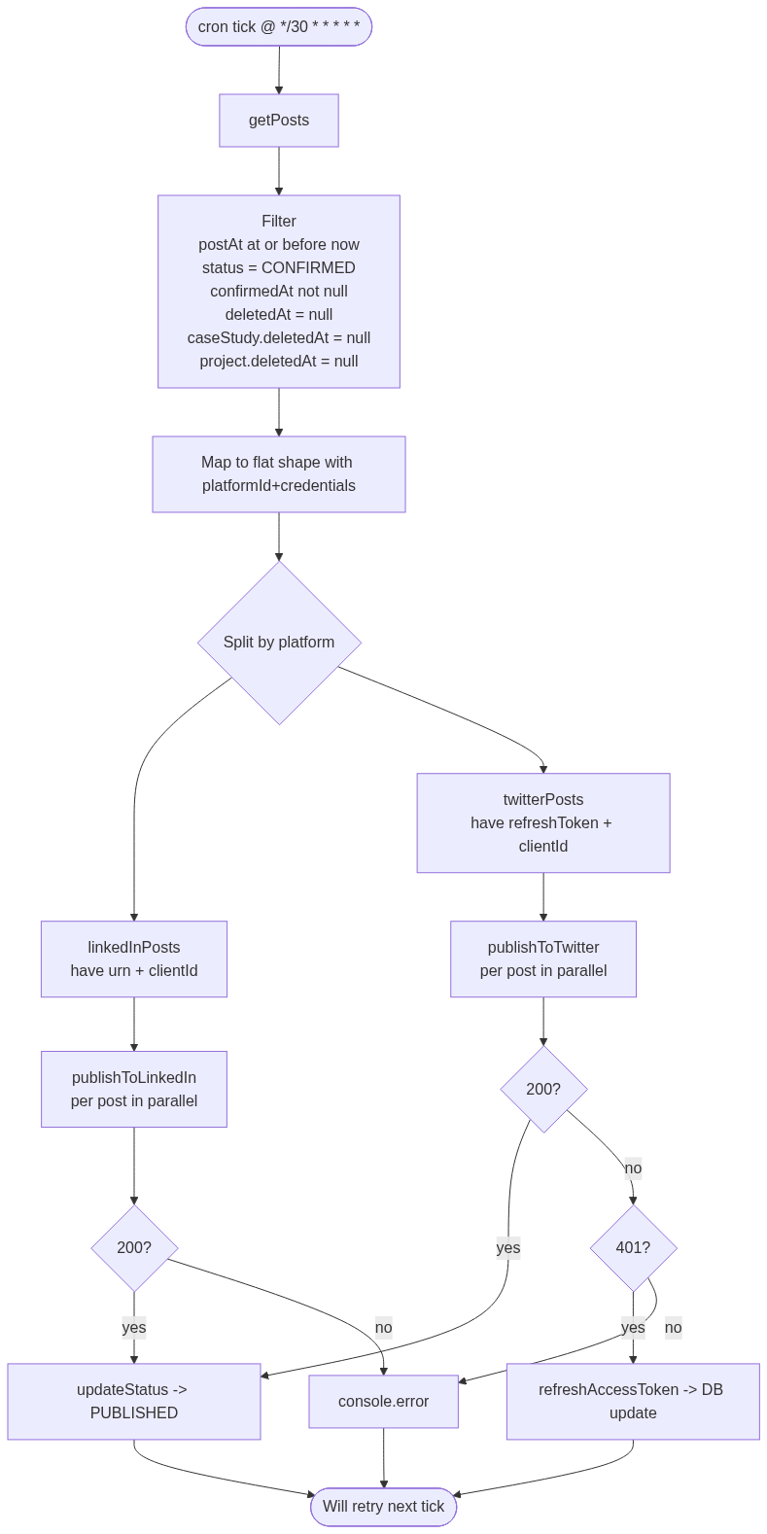
13. Cron Scheduler — diagram

Slide 50
13. Cron Scheduler
Refs: deal-ai-server/src/lib/scheduler.js:1-210; deal-ai-server/src/index.js:45.

Slide 51
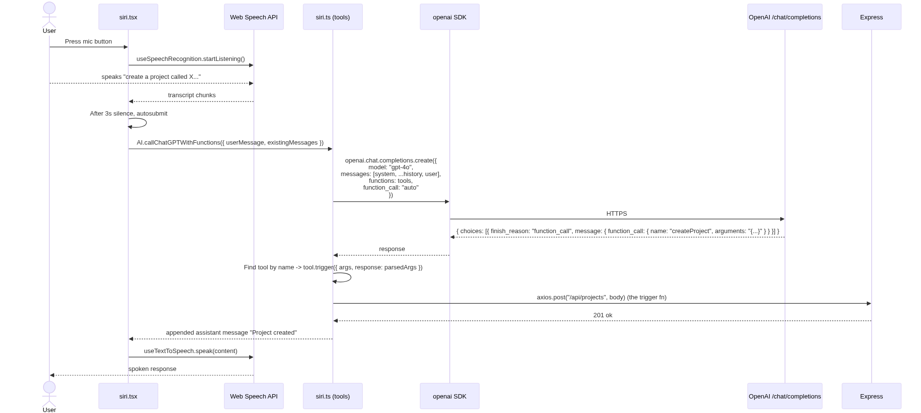
14. Voice Assistant ("Siri") — diagram

Slide 52
14. Voice Assistant ("Siri")
▸ Tools defined in `src/lib/siri.ts`
Table: Tool / Effect
• `createProject` | POST `/api/projects` with structured fields
• `deleteProject` | List user projects, find by title, DELETE
• `addPropertyTypes` | POST `/api/properties` (bulk)
• `deleteProperty` | Find + DELETE property
• ... +4 more rows

Slide 53
14. Voice Assistant ("Siri") (cont.)
Each tool exposes a JSON-schema for its arguments and a trigger(data) async fn that performs the side effect.
Wake-word: "hello" (line 110-121 in siri.tsx) — listened for in continuous mode; once heard, subsequent transcripts populate the message.
Refs: deal-ai/src/lib/siri.ts, deal-ai/src/components/siri.tsx, deal-ai/src/lib/openai.ts.

Slide 54
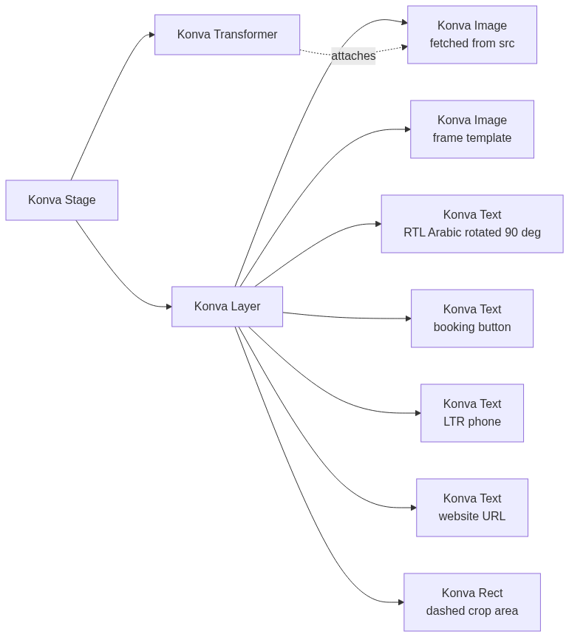
15. Image Editor (Konva) — diagram

Slide 55
15. Image Editor (Konva)
Entry: /[lang]/editors/images/:img-id opens ImageEditor which instantiates a PhotoEditor Konva wrapper.
PhotoEditor public methods (src/lib/konva.ts):
Table: Method / Purpose
• `addPhoto(src)` | Load image from URL; scale-fit into crop area
• `addBase64(b64)` | Same with base64 string
• `addFrame(frameId)` | Load from `public/frames/frame-XX.png` (regular and filled variants)
• `addText(opts)` | Add RTL/LTR text node with `lang` parameter

Slide 56
15. Image Editor (Konva) (cont.)
• ... +3 more rows
Frame templates: public/frames/frame-01.png … frame-05.png (and filled/ variants). Each has its own applyFrame* constant in src/lib/constants.ts that places the title, CTA, phone, and URL at frame-...

Slide 57
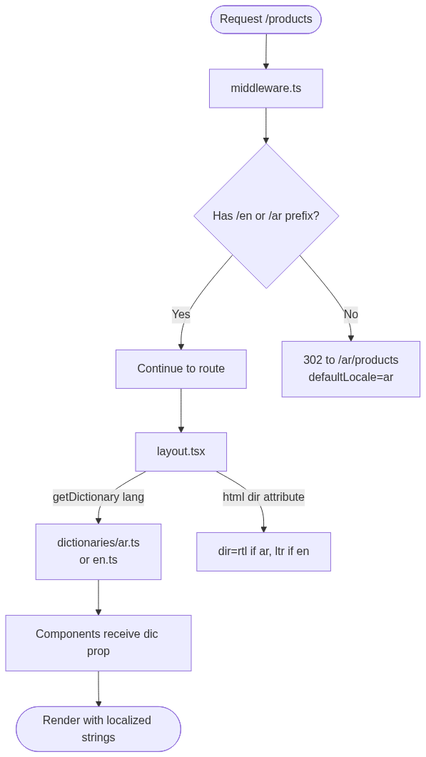
16. Localization — diagram

Slide 58
16. Localization
▸ Files
• src/middleware.ts — locale routing
• src/lib/locale.ts — i18n config, getDictionary(), t(value, { from, to })
• src/dictionaries/en.ts, src/dictionaries/ar.ts — full UI strings (≈47 KB + 39 KB)
• src/app/[lang]/layout.tsx:62 — <html dir={lang === "ar" ? "rtl" : "ltr"}>
▸ Dynamic translation
Anything outside the static dictionaries is run through the translate npm package (Google Translate under the hood) at request time via t(text, { from: "en", to: locale }). Used for backend error m...

Slide 59
16. Localization (cont.)
▸ Backend i18n
Express has its own src/lib/locale.js mirror that reads the locale request header and provides c?.["error key"] lookups for translated error messages. Same dictionary files duplicated server-side.

Slide 60
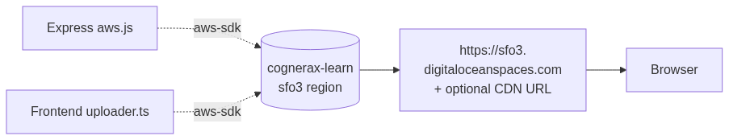
17. Storage — diagram

Slide 61
17. Storage
▸ DigitalOcean Spaces
▸ Upload prefixes
Table: `name` arg / Final key / Used by
• `"projects"` | `imgs/projects_<timestamp>` | Project logos
• `"cases"` | `imgs/cases_<timestamp>` | Study-case ref images, PDF page images
• `"posts"` | `imgs/posts_<timestamp>` | Post images (DALL-E generated)
ACL is always public-read; Content-Type defaults to image/png. The S3 client uses s3ForcePathStyle: true (DO Spaces requirement).

Slide 62
17. Storage (cont.)
▸ Allowed Next.js remote image hosts
next.config.mjs:12-52:
• cognerax-learn.sfo3.digitaloceanspaces.com
• sfo3.digitaloceanspaces.com
• cognerax-learn.sfo3.cdn.digitaloceanspaces.com
• takamolspace.lon1.digitaloceanspaces.com (legacy)
• lon1.digitaloceanspaces.com (legacy)

Slide 63
17. Storage (cont.)
• oaidalleapiprodscus.blob.core.windows.net (DALL-E temp URLs)
• ideogram.ai (legacy)
• images.unsplash.com, plus.unsplash.com, source.boringavatars.com

Slide 64
18. Frontend API Reference
▸ Pages (App Router)
Table: Path / Purpose / Auth
• `/` | Landing → redirect to login if unauth
• `/[lang]/login` | Email/password + Google OAuth | Public
• `/[lang]/register` | Email/password sign-up | Public
• `/[lang]/dashboard` | Overview | Required
• ... +12 more rows

Slide 65
18. Frontend API Reference (cont.)
▸ Server Actions (`src/actions/users.ts`)
Table: Action / Purpose
• `signUpWithPassword({ name, email, password })` | Create user, hash, session
• `signInWithPassword({ email, password })` | Verify, session
• `signInWithGoogle()` | Generate state/codeVerifier, set cookies, redirect to Google
• `logout()` | Invalidate session, clear cookie, redirect
• ... +2 more rows

Slide 66
18. Frontend API Reference (cont.)
▸ Frontend env vars (consumed in `src/`)
Table: Variable / Used by / Purpose
• `NEXT_PUBLIC_BASE_URL` | `lib/auth.ts:40` | Google OAuth redirect URI base
• `NEXT_PUBLIC_SERVER_BASE_URL` | `lib/axios.ts:7`, `scheduler.tsx`, `project-form.tsx` | Express backend base URL
• `NEXT_PUBLIC_AI_API` | `project-form.tsx:207` | Python AI service base (PDF extractor only on FE)
• `NEXT_PUBLIC_OPENAI_API_KEY` | `lib/openai.ts:14` | Voice assistant LLM
• ... +5 more rows

Slide 67
19. Backend API Reference
▸ Server config (`src/index.js`)
Table: Setting / Value
• Port | `process.env.PORT ?? 8080` (production .env sets 5500)
• Body limit | 100 MB JSON / 100 MB urlencoded
• CORS origins | `http://localhost:3000`, `https://urchin-app-6wl4t.ondigitalocean.app`
• CORS headers | `Content-Type`, `locale`, `user`
• ... +2 more rows

Slide 68
19. Backend API Reference (cont.)
▸ Endpoints
Table: Method / Path / Purpose / Auth
• GET | `/` | Health
• GET | `/api/projects` | List projects
• POST | `/api/projects` | Create project + properties + platforms
• PATCH | `/api/projects/:id` | Update project
• ... +27 more rows

Slide 69
19. Backend API Reference (cont.)
▸ Backend env vars
Table: Variable / Required / Purpose
• `PORT` | no | Server port (default 8080; set to 5500)
• `NODE_ENV` | no | Stack-trace toggling
• `DATABASE_URL` | yes | MongoDB connection string
• `NEXT_PUBLIC_AI_API` | yes | Python AI service base URL
• ... +5 more rows

Slide 70
20. Python AI Service Reference
Bootstrap: app.py:53-78. Local-dev: python app.py → 127.0.0.1:5000. Prod: gunicorn -w 4 -b :$PORT app:app.
▸ Endpoint catalog
Table: Method / Path / Purpose / Helper / model
• `POST /ar/pdf-data-extractor` | Vision-extract project metadata from PDF page images | `pdf_extractor` / **gpt-4o-mini** vision
• `POST /shortcontent` | Short / Medium / Long copy variants | `short_content_generator` / gpt-4o-mini
• `POST /en/chat/casestudy` | Case study EN | `case_study_ai` / gpt-4o-mini
• `POST /ar/chat/casestudy` | Case study AR | same

Slide 71
20. Python AI Service Reference (cont.)
• ... +51 more rows
❝ **Note**: The Python service's OAuth + posting endpoints are legacy and overlap with the Express backend's implementation. The Express versions (`deal-ai-server/src/routes/{link... ❞
▸ Models in use (Python service)
Table: Model / Where / Role
• `gpt-4o-mini` | most text + vision endpoints | Default workhorse
• `gpt-4o` | `/analyze-map` only | Higher-quality vision
• `dall-e-2` | `/image`, `/image2` | Quick generation

Slide 72
20. Python AI Service Reference (cont.)
• `dall-e-3` | `investment_image_creator` (semaphore=5) | High-quality investment images
• ... +1 more rows
▸ Concurrency primitives
• task_queue = Queue() (app.py:75) for async image-gen tasks.
• semaphore = threading.Semaphore(5) (app.py:77) caps concurrent image generation.
• concurrent.futures.ThreadPoolExecutor (app.py:1580) parallelizes the four marketing-analysis sub-calls.
▸ Python env vars

Slide 73
20. Python AI Service Reference (cont.)
Table: Variable / Purpose
• `OPENAI_API_KEY` | OpenAI auth (chat + image)
• `IDEOGRAM_API_KEY` | Ideogram auth
• `TWITTER_CLIENT_ID` / `TWITTER_CLIENT_SECRET` | (legacy) Twitter OAuth
• `LINKEDIN_CLIENT_ID` / `LINKEDIN_CLIENT_SECRET` | (legacy) LinkedIn OAuth
• ... +2 more rows

Slide 74
21. Configuration / Environment Variables
▸ Frontend `.env`
▸ Backend `.env`
▸ Python `.env`
NEXT_PUBLIC_BASE_URL=http://localhost:3000
NEXT_PUBLIC_SERVER_BASE_URL=http://localhost:5500
NEXT_PUBLIC_AI_API=http://localhost:5000
DATABASE_URL=mongodb+srv://...
GOOGLE_CLIENT_ID=...
GOOGLE_CLIENT_SECRET=...
NEXT_PUBLIC_GOOGLE_MAPS_API_KEY=...
DO_SPACE_URL=https://sfo3.digitaloceanspaces.com
DO_SPACE_REGION=sfo3
DO_SPACE_ID=...
DO_SPACE_SECRET=...
DO_SPACE_BUCKET=cognerax-learn
NEXT_PUBLIC_OPENAI_API_KEY=sk-...

Slide 75
22. Deployment
▸ Local dev
▸ Production targets (current)
Table: Service / Platform / Build/run
• Frontend (`deal-ai`) | Vercel | `next build` then static + serverless
• Backend (`deal-ai-server`) | DigitalOcean App Platform | `node src/index.js`
• Python AI (`TakamolAdvancedAI`) | Vercel (`vercel.json`) or Railway (`railway.json`) | `gunicorn -w 4 -b :$PORT app:app`
• MongoDB | MongoDB Atlas | managed
# Terminal 1: MongoDB Atlas — already remote, nothing to do
# Terminal 2: Python AI service
cd "TakamolAdvancedAI"
.venv\Scripts\python.exe app.py
# → http://127.0.0.1:5000
# Terminal 3: Express backend
cd "deal-ai-server"
yarn dev
# → http://localhost:5500
# Terminal 4: Next.js frontend
cd "deal-ai"
yarn dev
# → http://localhost:3000

Slide 76
22. Deployment (cont.)
• ... +1 more rows
No Dockerfile in any repo; all platforms use buildpacks / runtime detection.

Slide 77
23. Appendix A — Key Prompts
▸ A.1 PDF data extractor (`app.py:131-163`)
❝ you will be provided some images and you have to understand it and reply with the data you understood from these images. Your response must be in Arabic. Guidance: - If there ar... ❞
▸ A.2 Investment selector (`openai_api_requests.py:153-178`)
▸ A.3 Land best-use conclusion (`openai_api_requests.py:762-785`)
▸ A.4 Property-type recommendation (`openai_api_requests.py:597-657`)
System prompt frames the model as an "expert real estate analyst" and provides the available property types (13: residential, commercial, mixed, towers, villas, compounds, hotels, etc.). Instructs ...
*End of document.*
أنت أداة استكشاف نوع العقار الذي يريده العميل.
العميل سوف يرسل لك برومبت مثل هذه:
كومباوند عمارات سكنية في حي الياسمين في الرياض.
عليك أن تفهم نوع العقار الذي يريده العميل و ردك يجب أن يكون بصيغة JSON كالتالي:
{
"مبنى_سكني":"False",
"مبنى_تجاري":"False",
...
"كومباوند_سكني":"True",
...
}
إرشادات:
الفلل لا تعني فيلا.
النوع الصحيح للعقار يجب أن يحمل قيمة True و الباقي يجب أن يحمل قيمة False.
يجب أن يكون اختيار واحد فقط هو الذي يحمل قيمة True.

Slide 78
23. Appendix A — Key Prompts (cont.)
❝ **Generated**: April 2026.
**Source repos** (now under `Bits-Solutions-co`):
- `Bits-Solutions-co/deal-ai`
- `Bits-Solutions-co/deal-ai-server`
- `Bits-Solutions-co/TakamolAdvan... ❞

Slide 79
End of deck
For full text including Mermaid diagrams, prompts, and the complete
endpoint catalog, see DEAL_AI_FUNCTIONAL_DOCUMENTATION.md.
Repos (Bits-Solutions-co):
• deal-ai
• deal-ai-server
• TakamolAdvancedAI

