Slide 1
Large Language Models

Slide 2
Large Language Models
A large language model (LLM) is a type of machine learning model that can perform a variety of natural language processing (NLP) tasks such as generating and classifying text, answering questions in a conversational manner, and translating text from one language to another.

Slide 3
Large Language Models
Large language models use transformer models and are trained using massive datasets — hence, large.
This enables them to recognize, translate, predict, or generate text or other content.
Transformer models are neural network architectures that consist of an encoder and a decoder.
They process data by tokenizing the input, then simultaneously conducting mathematical equations to discover relationships between tokens.
This enables the computer to see the patterns a human would see were it given the same query.

Slide 4
Large Language Models
Large language models also have large numbers of parameters, which are akin to memories the model collects as it learns from training.
Think of these parameters as the model’s knowledge bank.
The more parameters a model has, the more powerful and versatile it is.
For example, GPT-3, one of the most famous large language models, has 175 billion parameters and can perform tasks such as writing essays, composing emails, creating chatbots, and coding programs.

Slide 5
Large Language Models
Large language models are also referred to as neural networks (NNs), which are computing systems inspired by the human brain.
These neural networks work using a network of nodes that are layered, much like neurons. In addition to teaching human languages to artificial intelligence (AI) applications, large language models can also be trained to perform a variety of tasks like understanding protein structures, writing software code, and more.

Slide 6
Large Language Models
Like the human brain, large language models must be pre-trained and then fine-tuned so that they can solve text classification, question answering, document summarization, and text generation problems.
Their problem-solving capabilities can be applied to fields like healthcare, finance, and entertainment where large language models serve a variety of NLP applications, such as translation, chatbots, AI assistants, and so on.

Slide 7
Training Large Language Models

Slide 8
Training Large Language Models
Training a large language model is not a trivial task.
It requires a lot of computational resources, data, and time.
In this section, we will explain the main steps involved in training a large language model, and some of the tools and techniques that can help you achieve this goal.

Slide 9
Prepare Your Dataset
The first step is to prepare your dataset.
You need a large and diverse corpus of text that covers your target domain or task.
For example, if you want to train a large language model for code generation, you need a dataset of source code files in different programming languages.
You can use existing datasets, such as those available on Hugging Face, or create your own by scraping the web or using other sources of data.
You also need to preprocess your data, such as tokenizing, cleaning, and splitting it into train, validation, and test sets.

Slide 10
Configure The Training Parameters
The second step is to configure the training parameters.
You need to decide on the architecture, size, and hyperparameters of your large language model.
You can use a pre-trained model, such as GPT-3 or BERT, and fine-tune it on your custom dataset, or train a model from scratch.
You also need to choose the optimizer, learning rate, batch size, and other settings that affect the training process.
You can use libraries like Hugging Face Transformers or PyTorch to easily access and modify these parameters.

Slide 11
Set Up The Training Environment
The third step is to set up the training environment.
You need a powerful machine or a cluster of machines that can handle the large amount of data and computation required for training a large language model.
You can use cloud services, such as AWS, Google Cloud, or Azure, to rent GPU or TPU instances, or use your own hardware if you have access to it.
You also need to install and run the necessary software, such as Python, PyTorch, and the libraries mentioned above.

Slide 12
Fine-tune Or Train The Model
The fourth step is to fine-tune or train the model.
You need to feed your data to the model and update its weights based on the loss function and the optimizer.
You can use a training loop, such as the one provided by Hugging Face Trainer, or write your own using PyTorch.
You also need to monitor the training progress, such as the loss, accuracy, and perplexity, and save the checkpoints of the model at regular intervals.

Slide 13
Evaluate The Fine-tuned Or Trained Model
The fifth step is to evaluate the fine-tuned or trained model.
You need to test the model on the validation and test sets, and measure its performance on the target task or domain.
You can use metrics, such as BLEU, ROUGE, or F1-score, depending on the type of task.
You can also use qualitative methods, such as human evaluation or examples, to assess the quality and diversity of the model’s outputs.

Slide 14
Use The Fine-tuned Or Trained Model
The sixth step is to save and use the fine-tuned or trained model.
You need to export the model and its tokenizer to a file or a repository, such as Hugging Face Model Hub, where you can share it with others or use it for your own applications.
You can also deploy the model to a web service or an API, where you can access it from any device or platform.

Slide 15
Training Large Language Models
These are the main steps involved in training a large language model.
Of course, there are many more details and challenges that you may encounter along the way, such as data quality, model size, memory consumption, scalability, robustness, and ethics.

Slide 16
Applications of Large Language Models
Large language models have many applications in various domains and tasks that require natural language understanding and generation.
Text Generation
Text Summarization
Question Answering
Text Classification
Text Translation

Slide 17
Challenges and Risks of Large Language Models
Large language models are impressive and powerful, but they also come with some challenges and risks that need to be addressed and mitigated
Computational Cost
Data Quality
Generalization Ability
Social Impact

Slide 18
What is BERT
BERT is a neural network architecture that can learn from both left and right context of a given word, sentence, or document.
BERT stands for Bidirectional Encoder Representations from Transformers, which means that it uses a bidirectional encoder to encode the input text, and a transformer to learn the relationships between the tokens.
A transformer is a type of neural network that uses attention mechanisms to encode and decode sequences of words or tokens.

Slide 19
BERT - Usage
BERT can be used for pretraining and fine-tuning language models on various natural language processing (NLP) tasks, such as text classification, question answering, sentiment analysis, named entity recognition, and more.
Pretraining is the process of training a language model on a large corpus of unlabeled text data, such as Wikipedia or books, to learn general linguistic features and representations.
Fine-tuning is the process of adapting a pretrained language model to a specific downstream task, such as answering questions or recognizing entities, by adding a task-specific layer and training it on a smaller labeled dataset.

Slide 20
BERT - components
BERT has two main components: the BERT encoder and the BERT model.
The BERT encoder is a stack of transformer encoder layers that takes a sequence of tokens as input and outputs a sequence of hidden states, which are vector representations of the tokens.
The BERT model is a combination of the BERT encoder and a task-specific layer, such as a classifier or a span predictor, that takes the hidden states as input and outputs the predictions for the task.

Slide 21
GPT: Generative Pre-trained Transformers
GPT stands for Generative Pre-trained Transformer, which is a type of neural network architecture that can generate natural language texts.
GPT is based on the idea of pre-training a large language model on a massive amount of text data, and then fine-tuning it on specific tasks, such as text summarization, translation, question answering, and more. By pre-training on a large and diverse corpus of text, GPT can learn general linguistic patterns and knowledge, and then adapt to different domains and tasks with minimal data and computational resources.

Slide 22
GPT
GPT is a type of neural network architecture that can generate natural language texts.
Neural networks are computational models that can learn from data and perform various tasks, such as image recognition, speech synthesis, and natural language processing.
Neural networks are composed of layers of units called neurons, which can process information and pass it to the next layer.
The output of the final layer is the result of the task.

Slide 23
GPT
GPT is a generative pre-trained transformer that can generate natural language texts from scratch or from a given prompt.
GPT uses self-attention and sampling to learn the dependencies between the tokens and to introduce some randomness and creativity into the text generation process.
GPT is trained on a large and diverse corpus of text data, which enables it to learn general linguistic patterns and knowledge, as well as specific facts and information.
GPT is one of the most advanced and powerful language models in the field of natural language processing.

Slide 24
Claude AI
Claude, developed by Anthropic AI, is both an AI chatbot and the name for the underlying Large Language Models (LLMs) that power it.
Claude is trained to have natural, text-based conversations, and it excels in tasks like summarization, editing, Q&A, decision-making, code-writing, and more.
Claude models are generative pre-trained transformers. They have been pre-trained to predict the next word in large amounts of text.

Slide 25
Llama (language model)
Llama (acronym for Large Language Model Meta AI, and formerly stylized as LLaMA) is a family of autoregressive large language models (LLMs) released by Meta AI starting in February 2023.

Slide 26
Microsoft Copilot
Microsoft Copilot is a generative artificial intelligence chatbot developed by Microsoft.
Based on a large language model, it was launched in February 2023 as Microsoft's primary replacement for the discontinued Cortana.

Slide 27
Codeium
Codeium offers best in class AI code completion, search, and chat

Slide 28
LLM Use Cases And Applications
Audio data analysis
Content creation
Customer support
Language translation and localization
Customer sentiment analysis
Education and training
Product development
Supply chain management
Chatbots and virtual assistants. Chatbots and virtual assistants use large language models to provide quality service to customers. ...
Content writing. ...
Talent acquisition and recruiting. ...
Targeted advertising. ...
Social media. ...
Classifying text. ...
Translation. ...
Fraud detection.

Slide 29
Best practices for LLM optimization
Prompt engineering: optimize the number of prompts and context window size
Prompt design: ensure appropriate directness, or indirectness, of language in the prompts
Pre-processing of input text: implement speaker diarization and labelling in call transcript texts to help better signal to the models
Test Retrieval Augmented Generation (RAG): breaking text into smaller chunks to optimize queries and costs
Fine-tune models on labelled data sets that identify examples of compliant and non-compliant conversations.

Slide 30
LLM Security
LLM security involves practices and technologies that protect LLMs and their associated infrastructure from unauthorized access, misuse, and other security threats.
This includes safeguarding the data they use, ensuring the integrity and confidentiality of their outputs, and preventing malicious exploitation.
Effective LLM security measures address vulnerabilities inherent in the development, deployment, and operational phases of these models.

Slide 31
LLM Security
Security in LLMs is crucial due to their ability to process and generate large volumes of sensitive information, making them targets for various cyber threats.
These models, which range from text generators to advanced decision-making systems, are integral to numerous applications across industries.
Therefore, maintaining their security ensures they operate as intended and continue to be reliable assets in automated and assistive technologies.

Slide 32
Importance of Security in LLM Usage
Data Breaches
Model Exploitation
Misinformation
Ethical and Legal Risks

Slide 33
Cyber Security Risks for LLM Applications
Prompt Injection
Insecure Output Handling
Training Data Poisoning
Model Denial of Service
Supply Chain Vulnerabilities
Sensitive Information Disclosure
Overreliance
Model Theft

Slide 34
LLM Cybersecurity Best Practices
Encrypt Data In Transit and at Rest
Implement Strict Access Controls
When Training LLMs, Anonymize Data to Protect User Privacy
Manage and Control Training Data Sources

Slide 35
Hallucinations
Hallucinations are false perceptions of sensory experiences

Slide 36
What is AI Hallucination?
AI hallucination is a phenomenon where a language model generates factually incorrect or misleading content.
This occurs due to limitations in the training data or the model's inability to distinguish between reliable and unreliable sources.
Such hallucinations often manifest as confidently presented but incorrect facts, nonsensical responses, or fictional scenarios.
This issue warns about the importance of evaluating AI-generated content to improve their responses' reliability.

Slide 37
How AI and LLM hallucinations happen
To understand why AI and LLM hallucinations occur, we first need to understand how language models generally work.
These models perceive words not with human-like understanding but as sequences of letters.
Similarly, sentences are seen as sequences of words.
The model's "knowledge" comes from its training data – vast collections of text it has been fed.
Now, the model uses statistical patterns from this data to predict what word or phrase might logically come next in a sentence.
It's a bit like a highly advanced pattern recognition system.
However, since it's not truly “understanding” the content but rather relying on statistical likelihoods, it can sometimes make mistakes.

Slide 38
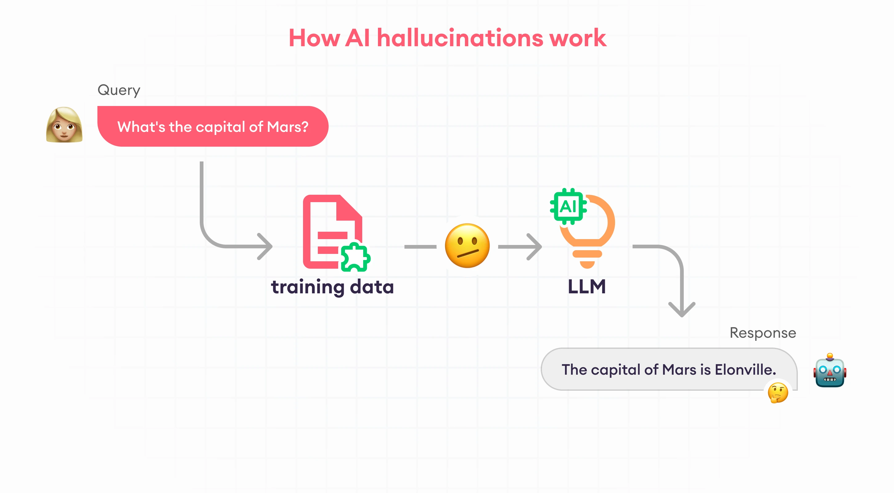
How AI and LLM hallucinations happen
These mistakes, or "hallucinations," occur when the model confidently generates information that is either incorrect or nonsensical.
This is often because it's drawing from patterns it has seen in the training data, which might not always align with real-world accuracy or logic.
In trying to construct a plausible response based on its training, the model may create a reasonable response but is actually disconnected from factual or logical consistency.

Slide 39
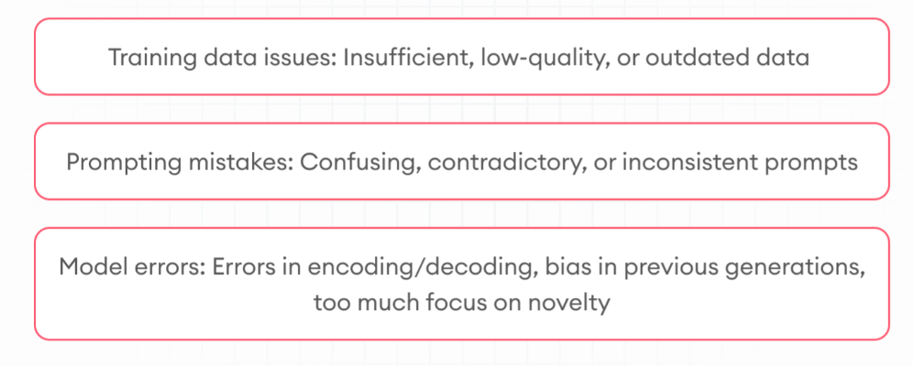
Why LLM hallucinates
LLM hallucinations occur for multiple reasons.
Training data issues
Insufficient training data
Low-quality training data
Outdated training data
Prompting mistakes
Confusing prompts
Inconsistent or contradictory prompts
Adversarial attacks
Model errors
Errors in encoding-decoding
Bias in previous generations

Slide 40
Types and real-world examples of AI hallucinations
Hallucinations in GenAI can be categorized in different ways.
There are three distinct types of chatbot hallucinations that not only confuse people but possess serious problems.

Slide 41
Factual errors
A common type of LLM hallucination is generating the wrong content. Again, the model may sound confident and generate plausible-sounding answer while telling the most nonsensical lies.
An example is Google Bard's hallucination about the James Webb space telescope. According to Bard, Webb took the first images of an exoplanet. Nasa, however, claims that the first exoplanet images (2021) came long before Webb's launch (2004).

Slide 42
Fabricated information
This is also very dangerous. Earlier in 2023, a client suing an airline submitted a legal brief written by ChatGPT to a Manhattan federal judge. The chatbot fabricated information, included fake quotes, and cited non-existent court cases. A New York federal judge sanctioned lawyers who submitted the brief. This is vivid proof that ChatGPT hallucinations are real and should be very carefully avoided.

Slide 43
Harmful information
A famous case happened in April 2023, when ChatGPT hallucinated that a university professor had made sexually suggestive comments and attempted to touch a student while on a class trip to Alaska, citing a March 2018 article in The Washington Post as the source of the information. The problem is that no such article existed, there's never been a class trip to Alaska, and the professor has never been accused of harassing a student.
In the same month, ChatGPT hallucinated that Brian Hood, Mayor of Hepburn Shire Council, was imprisoned for bribery while working for a subsidiary of Australia's national bank. In fact, Mr Hood was a whistleblower and was never charged with a crime.

Slide 44
Prevent AI hallucinations
Prompt engineering and model refinement are two major ways to prevent AI hallucinations

Slide 45
Prompt Engineering
Prompt engineering is a great technique to reduce hallucinations.
The most notable prompting tips to prevent hallucinations are:
Use clear prompts : Be as clear as you can be. Moreover, restrict the model so that it has fewer possible outcomes to generate.
Provide relevant information : Techniques like in-context learning and few-shot learning will significantly help you get your desired output from the model. Just show it an example of what you expect it to return.
Give a role to the model : Assigning a role like a teacher, friend, or expert can help the model fit its responses to fit the chosen persona, providing more contextually appropriate and engaging interactions.

Slide 46
Model refinement
Use diverse and relevant data : When the AI model is trained on various topics and sources, it gets exposure to more robust knowledge and constructs more accurate and nuanced responses. Hallucination becomes much less possible if the model is fluent in the specific area.
Experiment with temperature : LLM temperature is a parameter that affects the predictability of the model's possible outputs. Experimenting with temperature is about adjusting the level of randomness in the models's responses. A lower temperature results in more conservative and expected outcomes, while a higher temperature encourages creativity and variability in the responses. And hallucinations sometimes come with creativity. By fine-tuning this parameter, developers can balance between novel content generated and accuracy. Building a model that is both truthful and creative requires good care.

