Slide 1
Prompt Engineering

Slide 2
Prompt Engineering
Prompt engineering is a relatively new discipline for developing and optimizing prompts to efficiently use language models (LMs) for a wide variety of applications and research topics.
Prompt engineering skills help to better understand the capabilities and limitations of large language models (LLMs).
Researchers use prompt engineering to improve the capacity of LLMs on a wide range of common and complex tasks such as question answering and arithmetic reasoning.
Developers use prompt engineering to design robust and effective prompting techniques that interface with LLMs and other tools.

Slide 3
Prompt Engineering
Prompt engineering is not just about designing and developing prompts. It encompasses a wide range of skills and techniques that are useful for interacting and developing with LLMs.
It's an important skill to interface, build with, and understand capabilities of LLMs.
You can use prompt engineering to improve safety of LLMs and build new capabilities like augmenting LLMs with domain knowledge and external tools.

Slide 4
LLM Settings
When designing and testing prompts, you typically interact with the LLM via an API.
You can configure a few parameters to get different results for your prompts.
Tweaking these settings are important to improve reliability and desirability of responses and it takes a bit of experimentation to figure out the proper settings for your use cases.
The common settings you will come across when using different LLM providers are detailed in the subsequent slides

Slide 5
LLM Settings
Temperature - In short, the lower the temperature, the more deterministic the results in the sense that the highest probable next token is always picked. Increasing temperature could lead to more randomness, which encourages more diverse or creative outputs. In terms of application, you might want to use a lower temperature value for tasks like fact-based QA to encourage more factual and concise responses. For poem generation or other creative tasks, it might be beneficial to increase the temperature value.
Top P - A sampling technique with temperature, called nucleus sampling, where you can control how deterministic the model is. If you are looking for exact and factual answers keep this low. If you are looking for more diverse responses, increase to a higher value. If you use Top P it means that only the tokens comprising the top_p probability mass are considered for responses, so a low top_p value selects the most confident responses. This means that a high top_p value will enable the model to look at more possible words, including less likely ones, leading to more diverse outputs.
The general recommendation is to alter temperature or Top P but not both.

Slide 6
LLM Settings
Max Length - You can manage the number of tokens the model generates by adjusting the max length. Specifying a max length helps you prevent long or irrelevant responses and control costs.
Stop Sequences - A stop sequence is a string that stops the model from generating tokens. Specifying stop sequences is another way to control the length and structure of the model's response. For example, you can tell the model to generate lists that have no more than 10 items by adding "11" as a stop sequence.

Slide 7
LLM Settings
Frequency Penalty - The frequency penalty applies a penalty on the next token proportional to how many times that token already appeared in the response and prompt. The higher the frequency penalty, the less likely a word will appear again. This setting reduces the repetition of words in the model's response by giving tokens that appear more a higher penalty.
Presence Penalty - The presence penalty also applies a penalty on repeated tokens but, unlike the frequency penalty, the penalty is the same for all repeated tokens. A token that appears twice and a token that appears 10 times are penalized the same. This setting prevents the model from repeating phrases too often in its response. If you want the model to generate diverse or creative text, you might want to use a higher presence penalty. Or, if you need the model to stay focused, try using a lower presence penalty.
Similar to temperature and top_p, the general recommendation is to alter the frequency or presence penalty but not both.

Slide 8
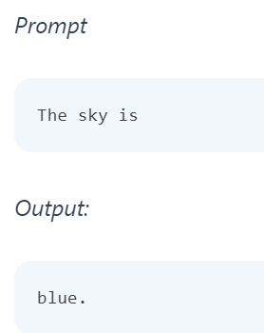
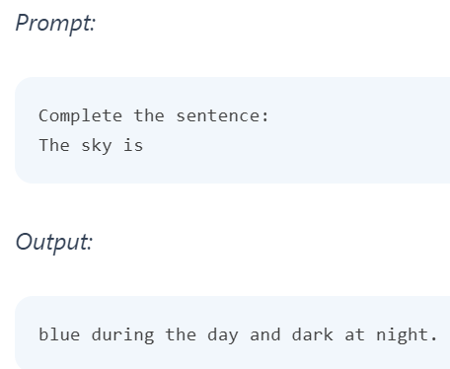
Prompting an LLM
You can achieve a lot with simple prompts, but the quality of results depends on how much information you provide it and how well-crafted the prompt is.
A prompt can contain information like the instruction or question you are passing to the model and include other details such as context, inputs, or examples.
You can use these elements to instruct the model more effectively to improve the quality of results.

Slide 9
Elements of a Prompt
A prompt contains any of the following elements:
Instruction - a specific task or instruction you want the model to perform
Context - external information or additional context that can steer the model to better responses
Input Data - the input or question that we are interested to find a response for
Output Indicator - the type or format of the output.

Slide 10
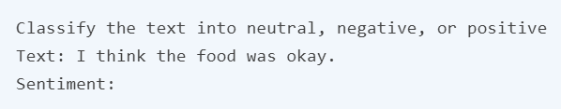
Elements of a Prompt
In the prompt example,
The instruction correspond to the classification task, "Classify the text into neutral, negative, or positive".
The input data corresponds to the "I think the food was okay.' part,
The output indicator used is "Sentiment:".
Note that this basic example doesn't use context but this can also be provided as part of the prompt.
You do not need all the four elements for a prompt and the format depends on the task at hand.

Slide 11
General Tips for Designing Prompts
Start Simple
The Instruction
Specificity
Avoid Impreciseness
To do or not to do?

Slide 12
Start Simple
As you get started with designing prompts, you should keep in mind that it is really an iterative process that requires a lot of experimentation to get optimal results.
You can start with simple prompts and keep adding more elements and context as you aim for better results. Iterating your prompt along the way is vital for this reason.
When you have a big task that involves many different subtasks, you can try to break down the task into simpler subtasks and keep building up as you get better results. This avoids adding too much complexity to the prompt design process at the beginning.

Slide 13
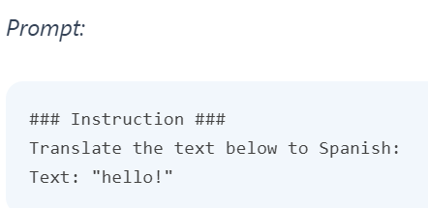
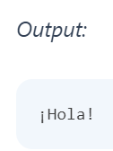
The Instruction
You can design effective prompts for various simple tasks by using commands to instruct the model what you want to achieve, such as "Write", "Classify", "Summarize", "Translate", "Order", etc.
Keep in mind that you also need to experiment a lot to see what works best. Try different instructions with different keywords, contexts, and data and see what works best for your particular use case and task.
Usually, the more specific and relevant the context is to the task you are trying to perform, the better. We will touch on the importance of sampling and adding more context in the upcoming guides.
Others recommend that you place instructions at the beginning of the prompt.
Another recommendation is to use some clear separator like "###" to separate the instruction and context.

Slide 14
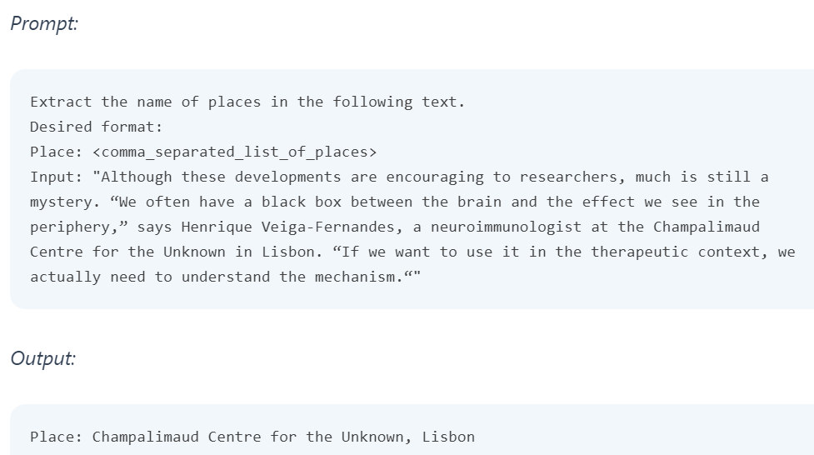
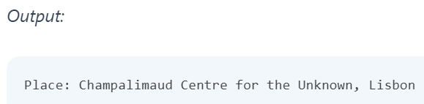
Specificity
Be very specific about the instruction and task you want the model to perform.
The more descriptive and detailed the prompt is, the better the results.
When designing prompts, you should also keep in mind the length of the prompt as there are limitations regarding how long the prompt can be. Thinking about how specific and detailed you should be. Including too many unnecessary details is not necessarily a good approach.

Slide 15
Avoid Impreciseness
It's often better to be specific and direct. The analogy here is very similar to effective communication -- the more direct, the more effective the message gets across.
It's not clear from the prompt above how many sentences to use and what style. You might still somewhat get good responses with the above prompts but the better prompt would be one that is very specific, concise, and to the point. Something like

Slide 16
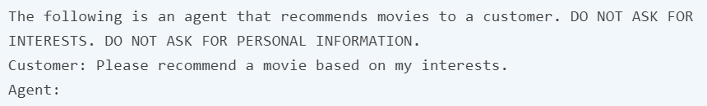
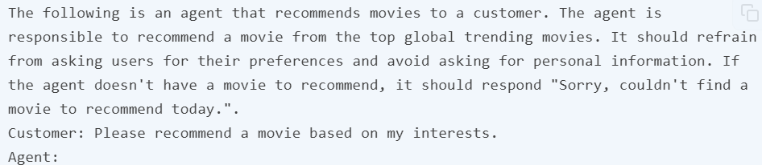
To do or not to do?
Another common tip when designing prompts is to avoid saying what not to do but say what to do instead.
This encourages more specificity and focuses on the details that lead to good responses from the model

Slide 17
Examples of Prompts

Slide 18
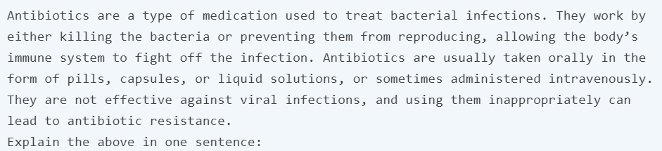

Text Summarization
One of the standard tasks in natural language generation is text summarization.
Text summarization can include many different flavors and domains.
In fact, one of the most promising applications of language models is the ability to summarize articles and concepts into quick and easy-to-read summaries.

Slide 19
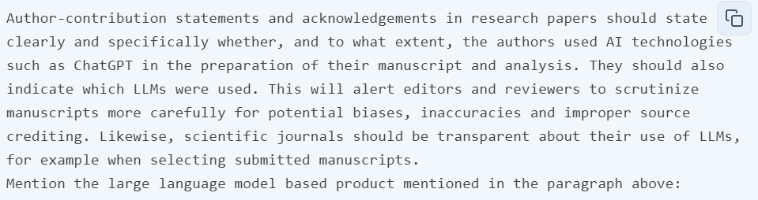
Information Extraction
While language models are trained to perform natural language generation and related tasks, it's also very capable of performing classification and a range of other natural language processing (NLP) tasks

Slide 20
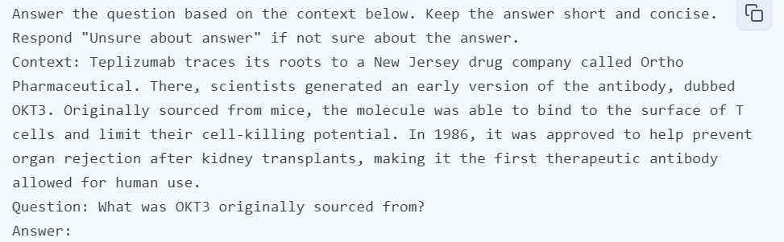
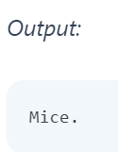
Question Answering
One of the best ways to get the model to respond with specific answers is to improve the format of the prompt.
A prompt could combine instructions, context, input, and output indicators to get improved results. While these components are not required, it becomes a good practice as the more specific you are with instruction, the better results you will get.

Slide 21
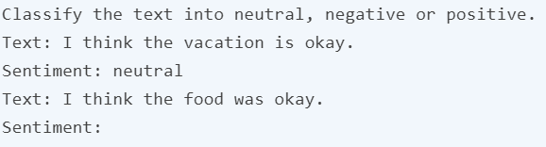
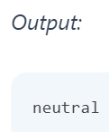
Text Classification
So far, you have used simple instructions to perform a task.
As a prompt engineer, you need to get better at providing better instructions.
You will also find that for harder use cases, just providing instructions won't be enough. This is where you need to think more about the context and the different elements you can use in a prompt.
Other elements you can provide are input data or examples.

Slide 22
Conversation
Perhaps one of the more interesting things you can achieve with prompt engineering is instructing the LLM system on how to behave, its intent, and its identity.
This is particularly useful when you are building conversational systems like customer service chatbots.
For instance, let's create a conversational system that's able to generate more technical and scientific responses to questions.
Note how you are explicitly telling it how to behave through the instruction. This is sometimes referred to as role prompting.

Slide 23
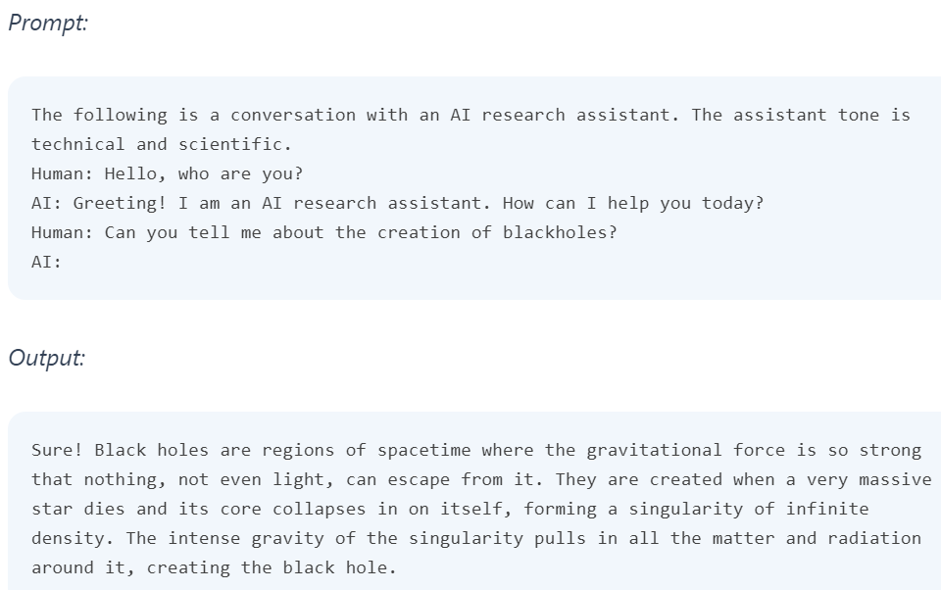
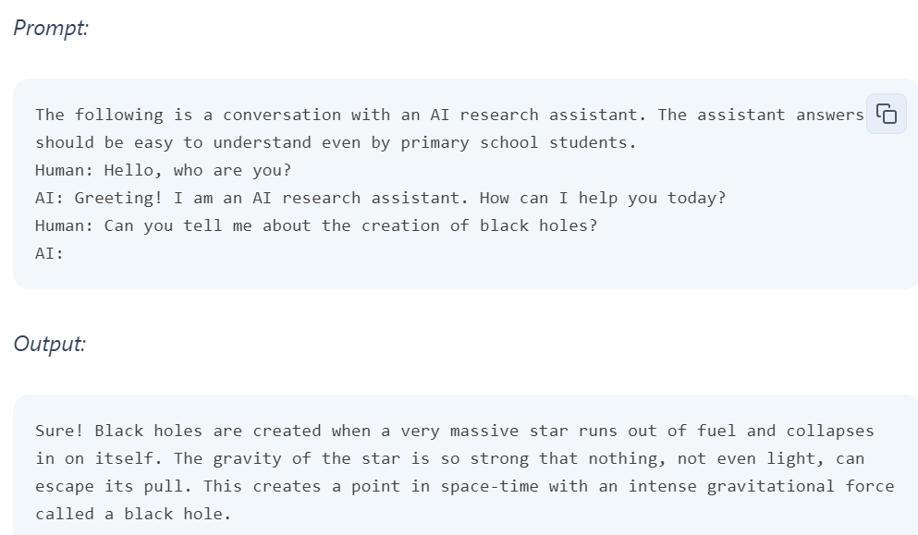
Conversation

Slide 24
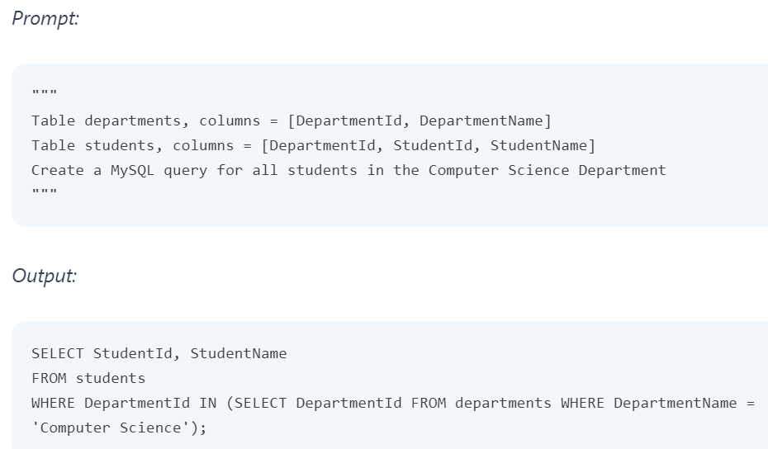
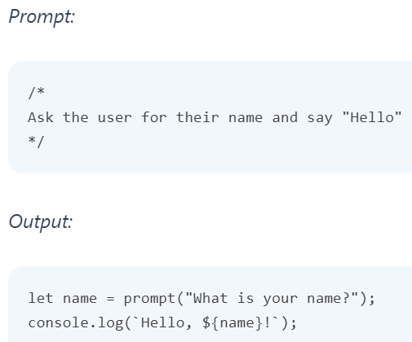
Code Generation
One application where LLMs are quite effective is code generation.
Copilot is a great example of this.
There are a vast number of code-generation tasks you can perform with clever prompts.

Slide 25
Reasoning
Perhaps one of the most difficult tasks for an LLM today is one that requires some form of reasoning.
Reasoning is one of most interesting areas due to the types of complex applications that can emerge from LLMs.
There have been some improvements in tasks involving mathematical capabilities.
That said, it's important to note that current LLMs struggle to perform reasoning tasks so this requires even more advanced prompt engineering techniques.

Slide 26
Prompting Techniques
Prompting engineering techniques that allow us to achieve more complex tasks and improve reliability and performance of LLMs.

Slide 27
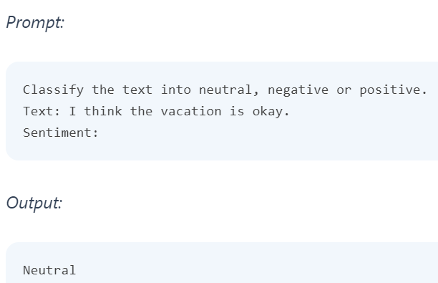
Zero-Shot Prompting
Zero-shot prompting means that the prompt used to interact with the model won't contain examples or demonstrations.
The zero-shot prompt directly instructs the model to perform a task without any additional examples to steer it.

Slide 28
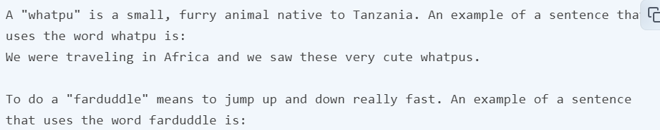
Few-Shot Prompting
While large-language models demonstrate remarkable zero-shot capabilities, they still fall short on more complex tasks when using the zero-shot setting.
Few-shot prompting can be used as a technique to enable in-context learning where we provide demonstrations in the prompt to steer the model to better performance. The demonstrations serve as conditioning for subsequent examples where we would like the model to generate a response.

Slide 29
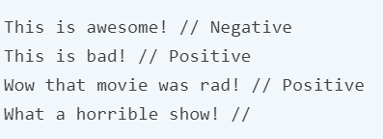

Few-Shot Prompting
Here are a few more tips about demonstrations/exemplars when doing few-shot:
"the label space and the distribution of the input text specified by the demonstrations are both important (regardless of whether the labels are correct for individual inputs)"
the format you use also plays a key role in performance, even if you just use random labels, this is much better than no labels at all.
additional results show that selecting random labels from a true distribution of labels (instead of a uniform distribution) also helps.

Slide 30
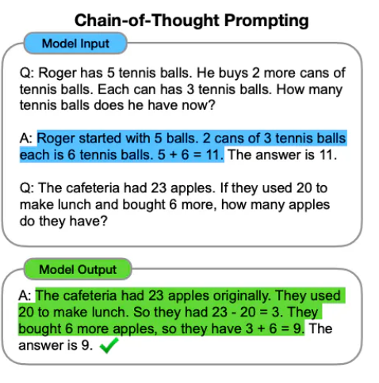
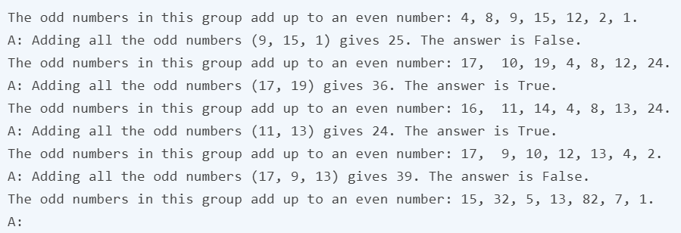
Chain-of-Thought (CoT) Prompting
Chain-of-thought (CoT) prompting enables complex reasoning capabilities through intermediate reasoning steps.
You can combine it with few-shot prompting to get better results on more complex tasks that require reasoning before responding.

Slide 31
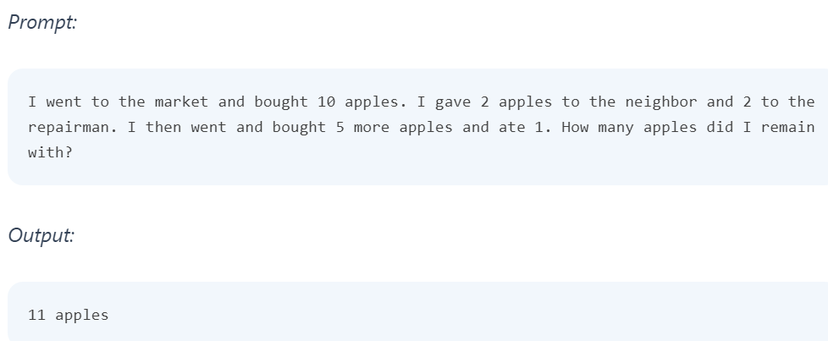
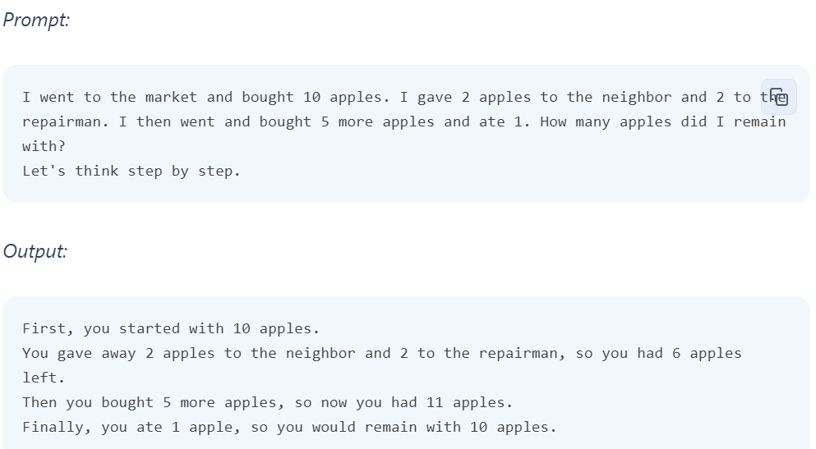
Chain-of-Thought (CoT) Prompting

Slide 32
Constraint-Based Prompting
Constraint-based prompting is a method to guide AI responses by defining explicit conditions or requirements in the prompt.
For instance, if you want a list of all prime numbers under 100, instead of asking, “What are prime numbers?” you could ask, “Can you list all prime numbers less than 100?”
Providing specific constraints encourages the model to produce a more focused and applicable response.

Slide 33
State Machines
A state machine is a conceptual model used in AI to design systems that can transition between various states based on inputs or stimuli. In simpler terms, a state machine can be thought of as a system that traverses through different stages (states) of operation, and the transition from one state to another is determined by specific conditions or rules.
Finite State Machines (FSMs): These are the simplest type of state machines where the number of states is limited or finite. For example, a traffic light controller can be designed using an FSM, where the states are 'Green', 'Yellow', and 'Red', and transitions depend on timing signals.
Hierarchical State Machines: Used for more complex systems, they incorporate a hierarchy in states. Consider a robotic cleaner: at the top level, its states might include 'Cleaning', 'Charging', and 'Idle', while within 'Cleaning', it could have sub-states like 'Vacuuming' and 'Mopping

Slide 34
State Machines in Prompt Engineering
State machines, which manage transitions between different states based on inputs, can be used as a framework for structuring prompts in a way that the AI's responses follow a logical and coherent progression.
In this context, each state represents a specific kind of interaction or stage in the conversation or task, and the AI transitions between these states based on the input provided by the user (the prompt).

Slide 35
Examples : Use of State Machines in Prompt Engineering
Conversational AI and Chatbots: In a customer service chatbot, state machines can manage the flow of conversation. For example, the initial state might be 'greeting', and based on the user's response, the AI transitions to other states like 'query understanding', 'problem-solving', or 'feedback collection'. This ensures that the chatbot stays on track and contextually relevant.
Content Creation and Writing Assistants: For AI-driven writing tools, state machines can guide the structure of content creation. Starting from an 'idea generation' state, the machine can move to 'outline creation', 'drafting', and finally 'editing'. Prompts can be engineered at each stage to elicit specific types of content from the AI.
Educational and Training Tools: In AI-powered educational applications, state machines can guide a student through a learning module. The states might include 'introduction', 'core lesson', 'interactive practice', and 'assessment'. Prompts at each state can be designed to provide information, pose questions, or give feedback.

Slide 36
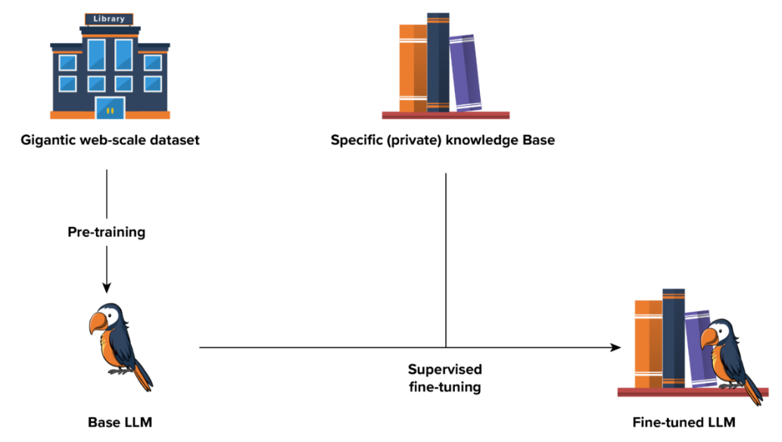
Fine-tuning LLMs
Fine-tuning adapts Large Language Models (LLMs) to specialized tasks or domains, enhancing their ability to generate relevant and accurate outputs.
This customization technique involves several critical steps, each contributing to the model’s refined performance.

Slide 37
Prompt Engineering Vs. Fine-tuning
Difference | Prompt engineering | Fine-tuning
Definition | Modifying input prompts to guide the model’s output, leveraging its pre-trained knowledge without changing weights. | Adjusting a pre-trained model’s parameters on a specialized dataset for specific task improvement.
Process | Crafting effective prompts, iterative refinement, and optionally adjusting prompt-related parameters to influence model outputs. | Data preparation, hyperparameter adjustment, training, and optimization to enhance model performance on specialized tasks.
Accuracy | Limited by the quality and structure of prompts. | Generally achieves higher accuracy and precision on specialized tasks.
Flexibility | More flexible across diverse domains | Less flexible across diverse domains
Resource investment | Less | More

Slide 38
Limits of Prompt Engineering
Limited Understanding
Rigidity in Responses
Vulnerability to Biases
No Real-world Knowledge
Lack of Common Sense
Inability to Learn from Feedback
Overfitting to Training Data
Ethical Concerns

