Slide 1
Java Server Pages (JSP)
JSP technology is used to create web application just like Servlet technology.

Slide 2
Java Server Pages (JSP)
JSP technology is used to create web application just like Servlet technology.
It can be thought of as an extension to Servlet because it provides more functionality than servlet such as expression language, JSTL, etc.
A JSP page consists of HTML tags and JSP tags.
The JSP pages are easier to maintain than Servlet because we can separate designing and development.
It provides some additional features such as Expression Language, Custom Tags, etc.

Slide 3
Advantages of JSP over Servlet
Extension to Servlet : JSP technology is the extension to Servlet technology. We can use all the features of the Servlet in JSP. In addition to, we can use implicit objects, predefined tags, expression language and Custom tags in JSP, that makes JSP development easy.
Easy to maintain : JSP can be easily managed because we can easily separate our business logic with presentation logic. In Servlet technology, we mix our business logic with the presentation logic.
Fast Development: No need to recompile and redeploy. If JSP page is modified, we don't need to recompile and redeploy the project. The Servlet code needs to be updated and recompiled if we have to change the look and feel of the application.
Less code than Servlet : In JSP, we can use many tags such as action tags, JSTL, custom tags, etc. that reduces the code. Moreover, we can use EL, implicit objects, etc.

Slide 4
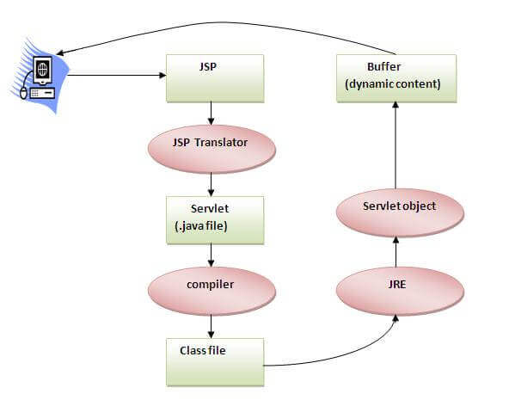
The Lifecycle of a JSP Page
Translation of JSP Page
Compilation of JSP Page
Classloading (the classloader loads class file)
Instantiation (Object of the Generated Servlet is created).
Initialization ( the container invokes jspInit() method).
Request processing ( the container invokes _jspService() method).
Destroy ( the container invokes jspDestroy() method).

Slide 5
JSP Scripting elements
The scripting elements provides the ability to insert java code inside the jsp.
There are three types of scripting elements:
scriptlet tag
expression tag
declaration tag

Slide 6
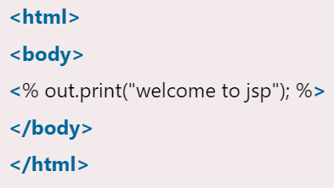
JSP scriptlet tag
A scriptlet tag is used to execute java source code in JSP.
<% java source code %>

Slide 7
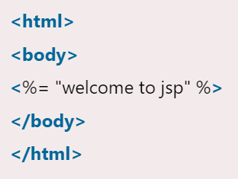
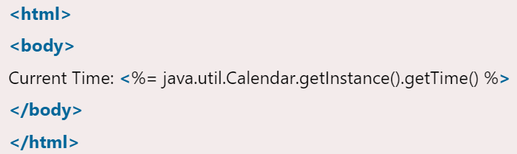
JSP expression tag
The code placed within JSP expression tag is written to the output stream of the response.
So you need not write out.print() to write data.
It is mainly used to print the values of variable or method.
<%= statement %>

Slide 8
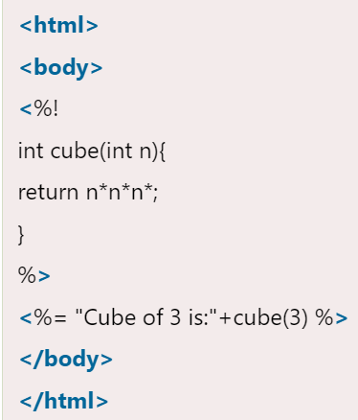
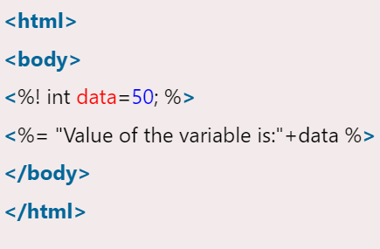
JSP Declaration Tag
The JSP declaration tag is used to declare fields and methods.
The code written inside the jsp declaration tag is placed outside the service() method of auto generated servlet.
So it doesn't get memory at each request.
<%! field or method declaration %>

Slide 9
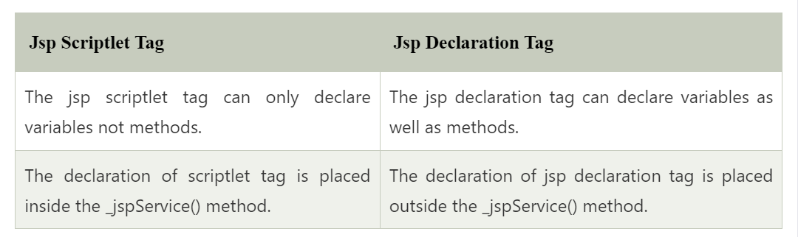
Difference between JSP Scriptlet tag and Declaration tag

Slide 10
JSP Implicit Objects

Slide 11
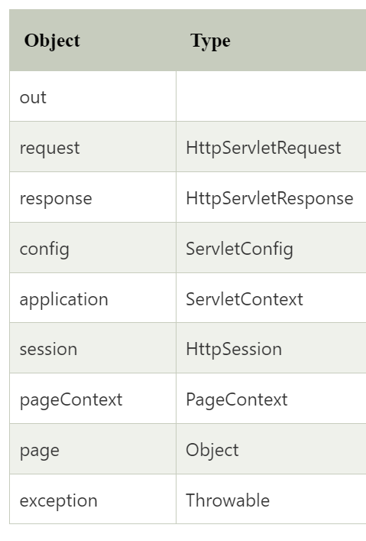
JSP Implicit Objects
There are 9 jsp implicit objects.
These objects are created by the web container that are available to all the jsp pages.

Slide 12
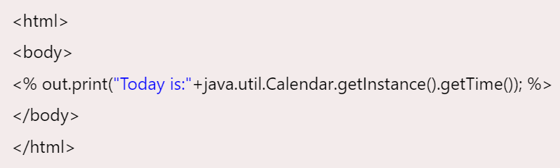
JSP out implicit object
For writing any data to the buffer, JSP provides an implicit object named out.
It is the object of JspWriter.
In case of servlet you need to write PrintWriter out=response.getWriter();
But in JSP, you don't need to write this code.

Slide 13
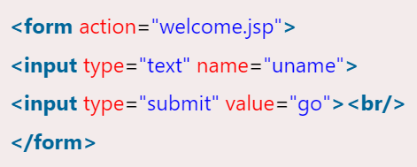
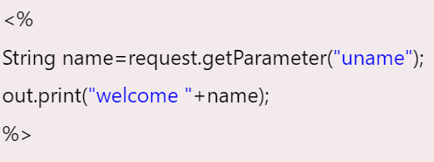
JSP request implicit object
The JSP request is an implicit object of type HttpServletRequest i.e. created for each jsp request by the web container.
It can be used to get request information such as parameter, header information, remote address, server name, server port, content type, character encoding etc.
It can also be used to set, get and remove attributes from the jsp request scope.

Slide 14
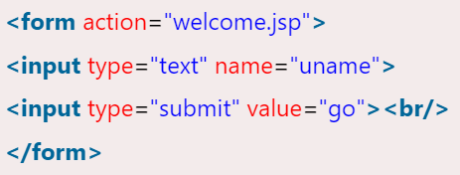
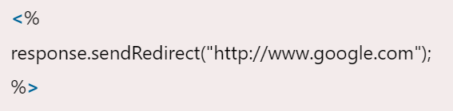
JSP response implicit object
In JSP, response is an implicit object of type HttpServletResponse.
The instance of HttpServletResponse is created by the web container for each jsp request.
It can be used to add or manipulate response such as redirect response to another resource, send error etc.

Slide 15
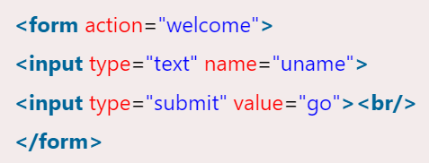
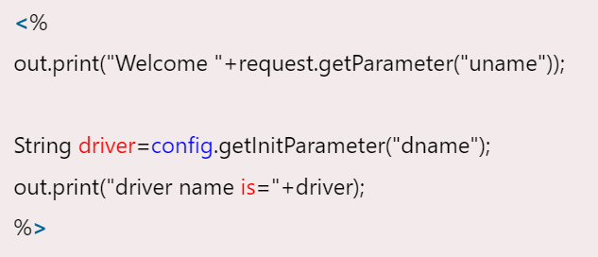
JSP config implicit object
In JSP, config is an implicit object of type ServletConfig.
This object can be used to get initialization parameter for a particular JSP page.
The config object is created by the web container for each jsp page.

Slide 16
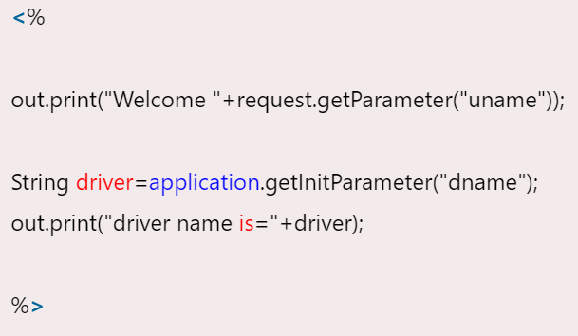
JSP application implicit object
In JSP, application is an implicit object of type ServletContext.
The instance of ServletContext is created only once by the web container when application or project is deployed on the server.
This object can be used to get initialization parameter from configuaration file (web.xml). It can also be used to get, set or remove attribute from the application scope.

Slide 17
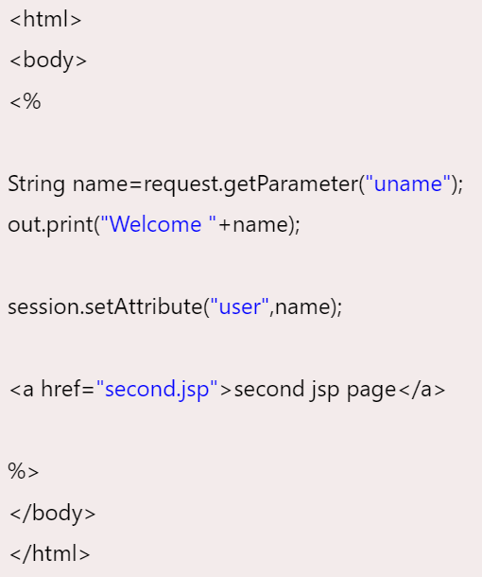
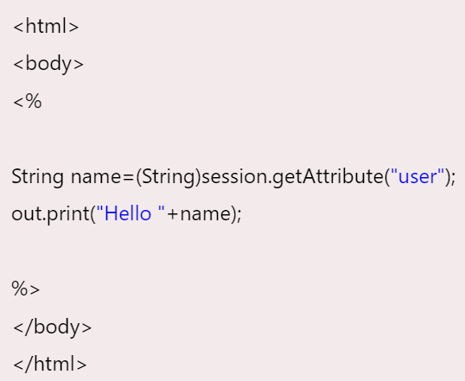
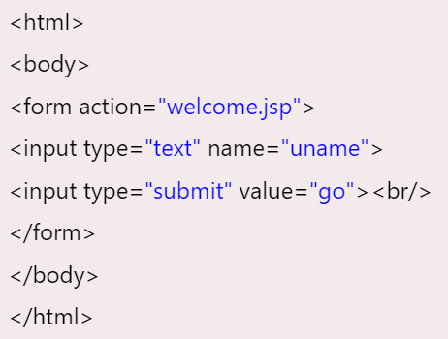
session implicit object
In JSP, session is an implicit object of type HttpSession.
The Java developer can use this object to set,get or remove attribute or to get session information.

Slide 18
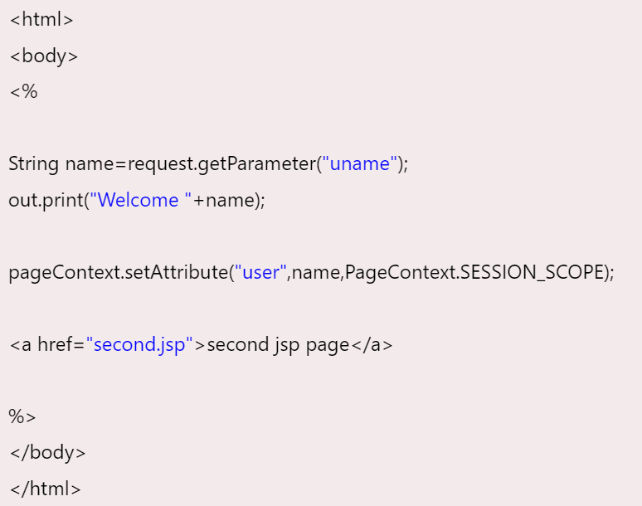
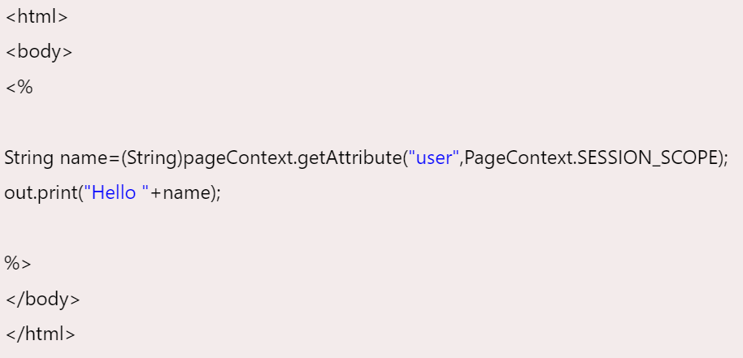
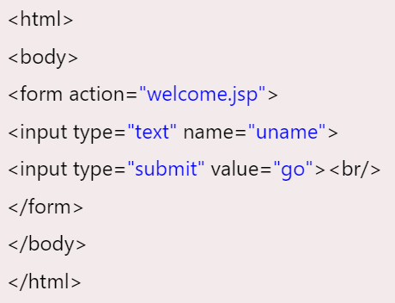
pageContext implicit object
In JSP, pageContext is an implicit object of type PageContext class.
The pageContext object can be used to set,get or remove attribute from one of the following scopes:
page
request
session
application

Slide 19
page implicit object
In JSP, page is an implicit object of type Object class.
This object is assigned to the reference of auto generated servlet class.

Slide 20
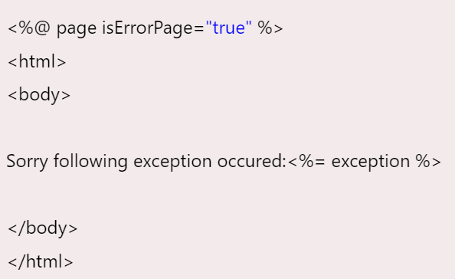
exception implicit object
In JSP, exception is an implicit object of type java.lang.Throwable class.
This object can be used to print the exception.
But it can only be used in error pages.

Slide 21
JSP directives

Slide 22

JSP directives
The jsp directives are messages that tells the web container how to translate a JSP page into the corresponding servlet.
There are three types of directives:
page directive
include directive
taglib directive

Slide 23

JSP page directive
The page directive defines attributes that apply to an entire JSP page.

Slide 24
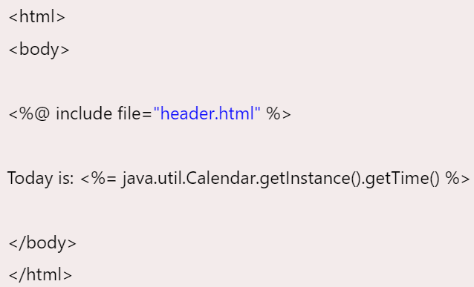
Jsp Include Directive
The include directive is used to include the contents of any resource it may be jsp file, html file or text file.
The include directive includes the original content of the included resource at page translation time (the jsp page is translated only once so it will be better to include static resource).

Slide 25
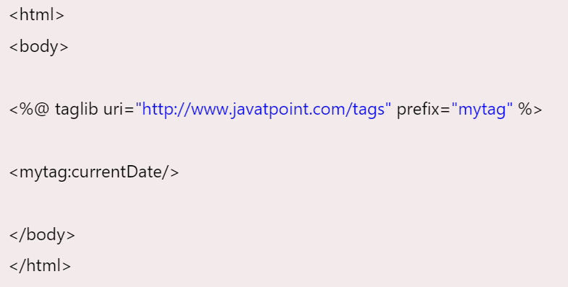
JSP Taglib directive
The JSP taglib directive is used to define a tag library that defines many tags.
We use the TLD (Tag Library Descriptor) file to define the tags.

Slide 26
Exception Handling in JSP
The exception is normally an object that is thrown at runtime.
Exception Handling is the process to handle the runtime errors.
There may occur exception any time in your web application.
So handling exceptions is a safer side for the web developer.
In JSP, there are two ways to perform exception handling:
By errorPage and isErrorPage attributes of page directive
By <error-page> element in web.xml file

Slide 27
JSP Action Tags
The action tags are used to control the flow between pages and to use Java Bean.
Each JSP action tag is used to perform some specific tasks.

Slide 28
JSP Action Tags
JSP Action Tags | Description
jsp:forward | forwards the request and response to another resource.
jsp:include | includes another resource.
jsp:useBean | creates or locates bean object.
jsp:setProperty | sets the value of property in bean object.
jsp:getProperty | prints the value of property of the bean.
jsp:plugin | embeds another component such as applet.
jsp:param | sets the parameter value. It is used in forward and include mostly.
jsp:fallback | can be used to print the message if plugin is working. It is used in jsp:plugin.

Slide 29
Expression Language (EL) in JSP
The Expression Language (EL) simplifies the accessibility of data stored in the Java Bean component, and other objects like request, session, application etc.
There are many implicit objects, operators and reserve words in EL.
${ expression }

Slide 30
Implicit Objects in Expression Language (EL)
Implicit Objects | Usage
pageScope | it maps the given attribute name with the value set in the page scope
requestScope | it maps the given attribute name with the value set in the request scope
sessionScope | it maps the given attribute name with the value set in the session scope
applicationScope | it maps the given attribute name with the value set in the application scope
param | it maps the request parameter to the single value
paramValues | it maps the request parameter to an array of values
header | it maps the request header name to the single value
headerValues | it maps the request header name to an array of values
cookie | it maps the given cookie name to the cookie value
initParam | it maps the initialization parameter
pageContext | it provides access to many objects request, session etc.

Slide 31
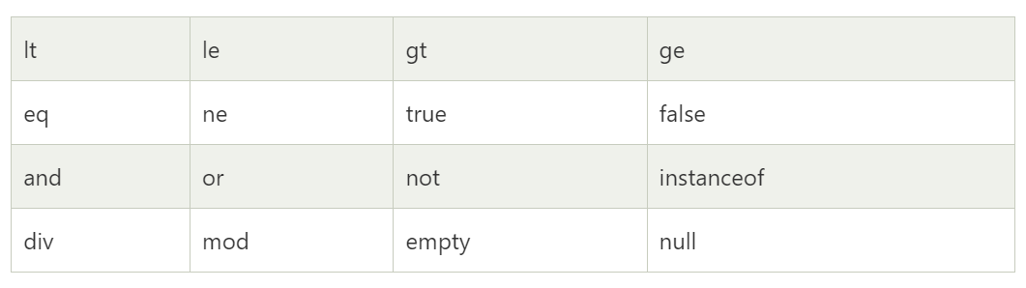
Reserve words in EL

