Slide 1
Validation and Hibernate Exceptions

Slide 2
Data Validation
Data validation is needed in systems that receive input from the user.
Each framework implements a proprietary mechanism to validate the information, which created incompatibility problems and was harder to integrate.
Java has a standard Bean Validation API
Defines a metadata model and API for entity validation
Not tied to either the web tier or the persistence tier
Available for server-side apps and also client-side JavaFX/Swing apps

Slide 3
The Need for Validation
Check the user input form for
required fields
valid numbers in a range
valid format (postal code)
custom business rule

Slide 4
Bean Validation Features
Validation Feature
required
validate length
validate numbers
validate with regular expressions
custom validation

Slide 5
JSR 303
JSR 303 has established a standard API for validation, which is flexible enough to be used for many different types of frameworks.
In addition, the Bean Validation API provides data validation classes in the application domain, which is simpler than when the process is done by layer.
The JSR 303 implementation reference is the Hibernate Validator

Slide 6
Validations
When you need to add validation constraints in the code, this is done through the use of annotations.
Hibernate Validator comes with a set of annotations for common validations, although the API allows the programmer to make customizations.
All elements of the Hibernate Validator (classes, interfaces, annotations, etc..) used by your code belong to the package javax.validation.

Slide 7
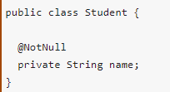
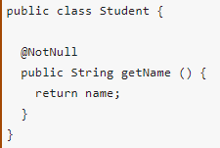
Validations
There are two places where constraints may apply.
The first is directly in the class attribute.
In this case the Java directly accesses the attribute thru reflection in order to do the validation.
The second form of implementation of constraints can be used when the class follows the specification of a JavaBean.

Slide 8
Validations
In addition to the annotation @NotNull shown in the example, which verifies that the data is not null, there are other important annotations included in Hibernate Validator.

Slide 9
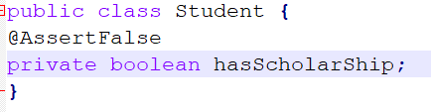
@AssertFalse and @AssertTrue
These annotations validate if the data is true or false, respectively.
Should be implemented in Boolean data (the primitive type Boolean and Boolean class are supported)

Slide 10
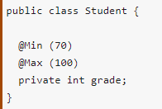
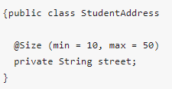
@Max and @Min and @Size
These annotations validate if in a given numeric data has a minimum or maximum value, respectively.
Are applied to data types BigDecimal, BigInteger, String, byte, short, long, and their corresponding classes wrappers.
@Size
Validate if the data size is between the values ​​specified in the attributes min and max (including).
This annotation can be applied to String objects, arrays and objects of type Collection and Map.

Slide 11
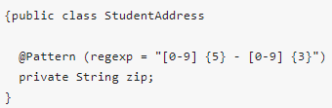
@Pattern
This annotation allows data validation according to a regular expression, which is specified by the regexp attribute.
Works with String data type.

Slide 12
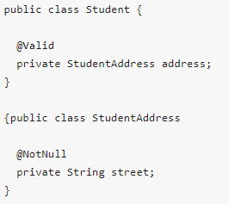
@Valid
It is quite common to find classes that have attributes that reference other classes.
In these situations, it is often interesting to validate not only a specific object, but also all the objects referenced by it.
This is the role of the @Valid annotation.
When it is present, Hibernate Validator performs the necessary validations on the object being referenced.

Slide 13
Invoking the validation process
After the constraints definition in the form of annotations, the next step is to invoke the code that will actually do the data validation in accordance with the rules that were established.
For this, the first required object is an instance of ValidatorFactory, which will be used to construct an object of type Validator.
Having a reference to a validator object allows to invoke the validation.

Slide 14
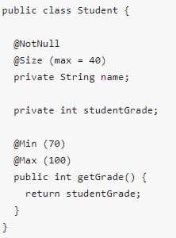
Invoking the validation process
Restrictions defined in the class Student.

Slide 15
Invoking the validation process
The first option to invoke the validation process is to call the validate() method that receives as parameter the object to be validated.
For an object student from the class Student, the call validator.validate(student) performs validation on the object in accordance with all constraints set.

Slide 16
Invoking the validation process
The second option is to use the method validateProperty().
Unlike the validate() method, it allows to invoke the validation on only one object property.
The property name provided is the name of the attribute or the name that follows the specification of a JavaBean
By invoking the method validator.validateProperty(student, "name"), the validation will be invoked directly in the attribute name.
But if invoked the method validator.validateProperty (student, "grade"), it will be invoked in the method getGrade().

Slide 17
Invoking the validation process
The third and final option is to make a validation simulation using the method validateValue().
This way you can verify that the validation work for a property where a given value was attributed to it.
To check whether the grade property of the student class could take the value 60,
for example, simply invoke validator.validateValue (Student.class, "grade", 60).

Slide 18
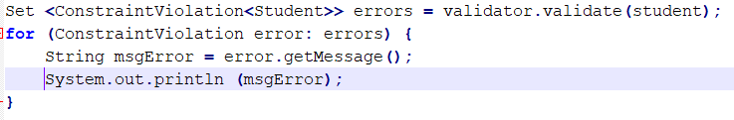
Invoking the validation process
The three methods explained above (validate(), validateProperty() and validateValue()) returns a Set < >.
Through this collection you can see if there were validation problems and identify them.
When there is none, Set returns empty.
if one or more errors occur, each item stored on Set represents a validation error.
The getMessage() method is used to return the error message.

Slide 19
Hibernate Exceptions

Slide 20
Hibernate Exception Handling
An exception is kind of error generated during the execution of a program.
It interrupts the normal flow of the program and there are many reasons of exceptions, like:
Entered invalid data
A File that you want to fetch is not found
Some network problem or Out of Memory run

Slide 21
Hibernate Exception Handling
Entity Manager handle exceptions as by calling the EntityManager.close() method which discard the changes and rollback the database transaction.
In general, EntityManager handle Hibernate core exception. Some of them are:
IllegalArgumentException: Wrong argument or fail to recognized, or having the incorrect format etc.
EntityNotFoundException: An Entity was expected but did not match the requirement
TransactionRequiredException: This operation has to be in a Transaction object
IllegalStateException: Wrong way of using the Entity Manager

Slide 22
Hibernate Exception Handling
Hibernate works with most of unchecked Hibernate persistence layer exceptions.
HibernateException : The base Throwable type for Hibernate.
When Hibernate interacts with the database it throws SQLException.
Hibernate provides better handle than the JDBCException.
All SQLExceptions will be wrapped in some form of JDBCException.
Any exceptions thrown by the Hibernate framework are FATAL, hence developers have to roll-back the transaction and close the current session object immediately.

Slide 23
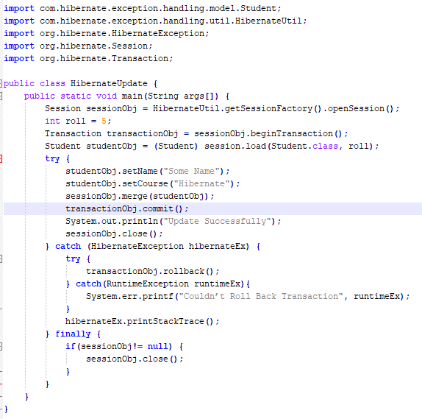
Hibernate Exception Handling

Slide 24
Common Hibernate Exceptions
Query-Related Exceptions
NonUniqueResultException
QuerySyntaxException
SQLGrammarException
LazyInitializationException
MultipleBagFetchException
Mapping-Related Exceptions
MappingException
Update-Related Exceptions
OptimisticLockException
PersistentObjectException: Detached Entity Passed to Persist

