Slide 1
Caching in Hibernate

Slide 2
Exploring Hibernate Architecture(Contd.)
Caching
Caching is a mechanism to enhance the performance of a system. It is a buffer memory that lies between the application and the database. Cache memory stores recently used data items in order to reduce the number of database hits as much as possible

Slide 3
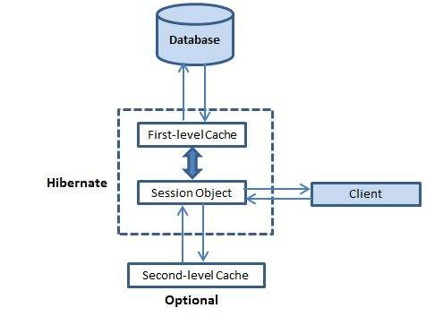
Caching(Contd.)

Slide 4
First-level Cache
The first-level cache is the Session cache and is a mandatory cache through which all requests must pass. The Session object keeps an object under its own power before committing it to the database.
If you issue multiple updates to an object, Hibernate tries to delay doing the update as long as possible to reduce the number of update SQL statements issued. If you close the session, all the objects being cached are lost and either persisted or updated in the database.

Slide 5
Second-level Cache
Second level cache is an optional cache and first-level cache will always be consulted before any attempt is made to locate an object in the second-level cache. The second level cache can be configured on a per-class and per-collection basis and mainly responsible for caching objects across sessions.
Any third-party cache can be used with Hibernate. An org.hibernate.cache.CacheProvider interface is provided, which must be implemented to provide Hibernate with a handle to the cache implementation.

Slide 6
Query-level Cache
Hibernate also implements a cache for query resultsets that integrates closely with the second-level cache.
This is an optional feature and requires two additional physical cache regions that hold the cached query results and the timestamps when a table was last updated. This is only useful for queries that are run frequently with the same parameters.

Slide 7
Concurrency Strategies
A concurrency strategy is a mediator, which is responsible for storing items of data in the cache and retrieving them from the cache. If you are going to enable a second-level cache, you will have to decide, for each persistent class and collection, which cache concurrency strategy to use.
Transactional − Use this strategy for read-mostly data where it is critical to prevent stale data in concurrent transactions, in the rare case of an update.
Read-write − Again use this strategy for read-mostly data where it is critical to prevent stale data in concurrent transactions, in the rare case of an update.
Nonstrict-read-write − This strategy makes no guarantee of consistency between the cache and the database. Use this strategy if data hardly ever changes and a small likelihood of stale data is not of critical concern.
Read-only − A concurrency strategy suitable for data, which never changes. Use it for reference data only.

Slide 8
If we are going to use second-level caching for our Employee class, let us add the mapping element required to tell Hibernate to cache Employee instances using read-write strategy.
<?xml version = "1.0" encoding = "utf-8"?>
<!DOCTYPE hibernate-mapping PUBLIC
"-//Hibernate/Hibernate Mapping DTD//EN"
"http://www.hibernate.org/dtd/hibernate-mapping-3.0.dtd">
<hibernate-mapping>
<class name = "Employee" table = "EMPLOYEE">
<meta attribute = "class-description">
This class contains the employee detail.
</meta>
<cache usage = "read-write"/>
<id name = "id" type = "int" column = "id">
<generator class="native"/>
</id>
<property name = "firstName" column = "first_name" type = "string"/>
<property name = "lastName" column = "last_name" type = "string"/>
<property name = "salary" column = "salary" type = "int"/>
</class>
</hibernate-mapping>

Slide 9
Cache Provider
EHCache
It can cache in memory or on disk and clustered caching and it supports the optional Hibernate query result cache.
OSCache
Supports caching to memory and disk in a single JVM with a rich set of expiration policies and query cache support.
swarmCache
A cluster cache based on JGroups. It uses clustered invalidation, but doesn't support the Hibernate query cache.
JBoss Cache
A fully transactional replicated clustered cache also based on the JGroups multicast library. It supports replication or invalidation, synchronous or asynchronous communication, and optimistic and pessimistic locking. The Hibernate query cache is supported.

Slide 10
Compatibility Matrix
Strategy/Provider | Read-only | Nonstrictread-write | Read-write | Transactional
EHCache | X | X | X
OSCache | X | X | X
SwarmCache | X | X
JBoss Cache | X |  |  | X

