Slide 1
Hibernate Architecture

Slide 2
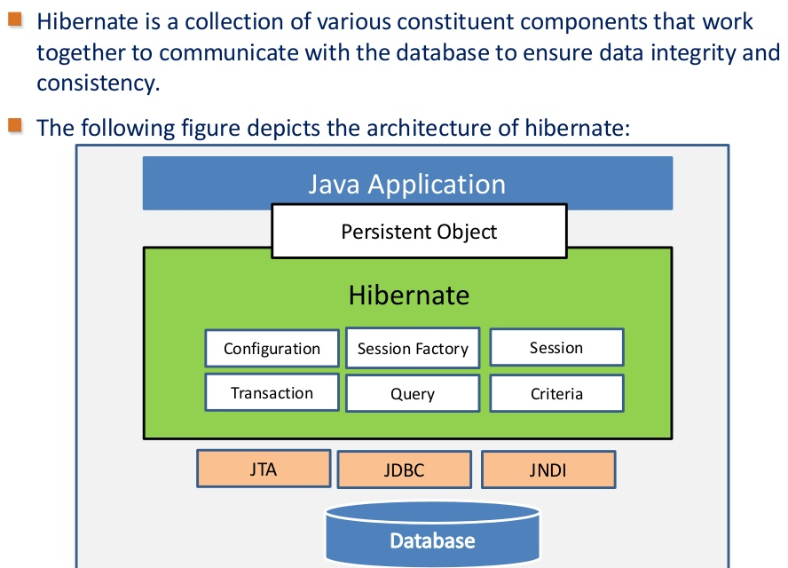
Exploring Hibernate Architecture

Slide 3
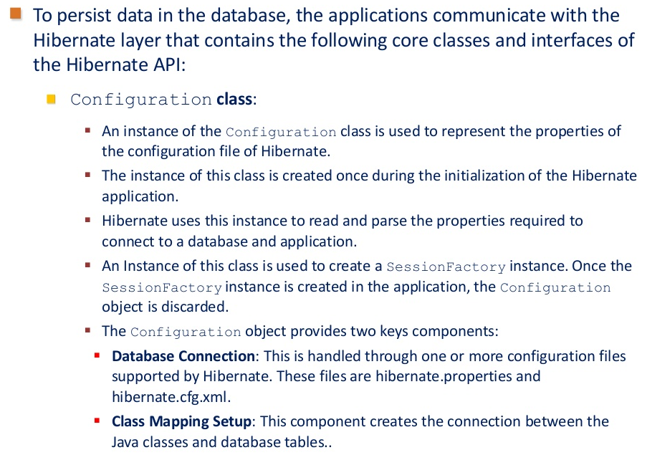
Exploring Hibernate Architecture(Contd.)

Slide 4
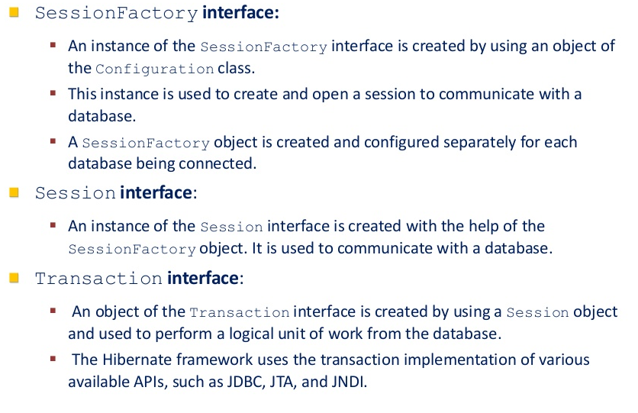
Exploring Hibernate Architecture(Contd.)

Slide 5
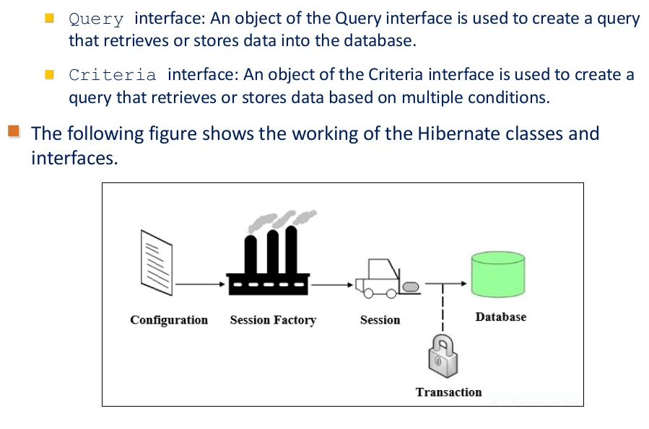
Exploring Hibernate Architecture(Contd.)

