Slide 1
Jenkins

Slide 2
What is Jenkins?
Jenkins is an open-source automation server that facilitates software projects’ continuous integration and delivery (CI/CD).
It provides a framework for automating applications’ building, testing, and deployment, enabling teams to streamline their software development processes.
With Jenkins, developers can set up a pipeline defining the steps required to build, test, and deploy their applications.
These steps can include tasks like compiling source code, running unit tests, packaging the application, deploying it to a staging environment for further testing, and finally deploying it to production.

Slide 3
What is Jenkins?
Jenkins supports integration with various version control systems, such as Git, Subversion, and Mercurial, allowing it to automatically trigger builds and tests whenever changes are pushed to the repository.
It also integrates with a wide range of tools and technologies, including build tools, testing frameworks, and deployment platforms.
Jenkins provides a web-based interface that allows users to configure and manage their build pipelines and monitor the status of builds.
It offers a vast ecosystem of plugins, which extend its functionality and allow integration with additional tools and services.

Slide 4
Why we used Jenkins?
Continuous Integration (CI): Jenkins facilitates continuous integration by automatically building and testing software whenever changes are made to the codebase. It helps identify issues and conflicts early in the development process, leading to faster feedback and easier bug resolution.
Automated Testing: Jenkins allows the integration of automated testing frameworks into the build process. It can execute unit tests, integration tests, and other types of tests to ensure that the software functions as expected and meets the defined quality criteria.

Slide 5
Why we used Jenkins?
Continuous Delivery and Deployment (CD): Jenkins enables continuous delivery and deployment by automating the steps involved in packaging, deploying, and releasing software. It streamlines the release process, reduces human error, and allows for frequent and reliable software deployments.
Build and Release Management: Jenkins provides a centralized platform for managing build configurations, artifacts, and release versions. It tracks changes, manages dependencies, and ensures consistency across different builds and environments.

Slide 6
Why we used Jenkins?
Scalability and Flexibility: Jenkins is highly scalable and can support projects of various sizes and complexities. It can handle multiple builds concurrently and distribute work across multiple nodes for faster execution. Jenkins also offers extensive plugin support, allowing integration with a wide range of tools and technologies.
Community and Ecosystem: Jenkins has a large and active community of users and contributors. This vibrant ecosystem offers a vast array of plugins, documentation, and community support, making it easier to extend Jenkins’ functionality and find solutions to common challenges.

Slide 7
Why we used Jenkins?
Open Source and Cost-Effective: Jenkins is an open-source tool, which means it is freely available for use and can be customized as per project requirements. This makes it a cost-effective choice compared to commercial alternatives.
Jenkins is used to automate build, test, and deployment processes, improve software quality, enable continuous integration and delivery, and provide a flexible and scalable platform for managing software development projects.

Slide 8
Jenkins Workflow
Developers modify the source code, committing changes to the repository, and Jenkins creates a new build in order to handle the new Git commit.
Jenkins can work in “push” or “pull” mode. The Jenkins CI server is either triggered by an event such as a code commit, or it can regularly check the repository for changes.
The build server builds the code and generates an artifact. If the build fails, the developer receives an alert.
Jenkins deploys the built application/executable to the test server, which can execute continuous, automated tests. Developers receive alerts if their changes impact functionality.
Jenkins optionally deploys the changes to the production server if the code has no issues.

Slide 9
Jenkins Jobs
Jenkins Jobs are a given set of tasks that runs sequentially as defined by the user.
Any automation implemented in Jenkins is a Jenkins Job.
These jobs are a significant part of Jenkins's build process.
We can create and build Jenkins jobs to test our application or project.
With a Jenkins Job, you can clone source code from version control like Git, compile the code, and run unit tests based on your requirements.

Slide 10
Types Of Jenkins Jobs
There are different Jenkins Job types available intended for different purposes.
Based on the complexity and nature of your project, you can choose the one that best suits your needs.

Slide 11
Types Of Jenkins Jobs
Job Type | Description
Freestyle Project | This is the central and the most widely used feature in Jenkins. It is an available Jenkins build job offering multiple operations. Using this option, you can build and run pipelines or scripts seamlessly.
Maven Project | If your work involves managing and building projects containing POM files, you prefer using Maven Project to build jobs in Jenkins. On choosing this option, Jenkins, by default, will pick the POM files, make configurations, and run builds.
Pipeline | Freestyle Project is often not a good option to create Jenkins Jobs. Therefore, Pipeline is the best option. Use the option Pipeline for creating Jenkins Jobs, especially when working on long-running activities.
Multi-configuration Project | If you are working on a project requiring multiple configurations, you prefer to use the Multi-configuration Project option. This option allows for making multiple configurations for testing in multiple environments.
GitHub Organization | If you click on this option, it scans the User's GitHub account for all repositories. And then, it matches markers as defined.

Slide 12
Jenkins Pipeline

Slide 13
Jenkins Pipeline
Jenkins Pipeline is a mixture of plugins that helps the combination and implementation of non-stop transport pipelines.
It has an extensible automation server to create easy and complicated transport pipelines as code through pipeline DSL.
A Pipeline is a collection of occasions interlinked with every difference in a sequence.

Slide 14

How do Continuous Delivery Pipelines work?
Each task or event in a Jenkins pipeline depends in some way on at least one or more other jobs or events.
A continuous delivery pipeline in Jenkins is shown in the image below. It has four states: build, deploy, test, and release.
These things are related to one another.
Each state has its events, which follow a continuous supply pipeline.

Slide 15
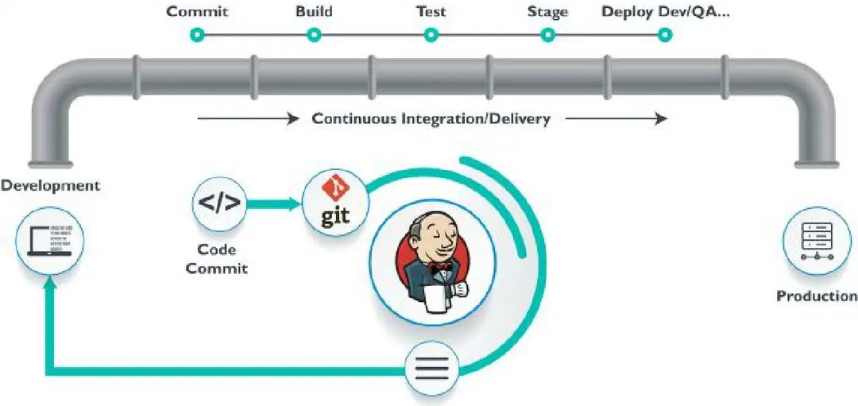
Why Pipelines
Jenkins pipeline is developed using code, allowing numerous people to change and run the pipeline process.
The pipeline will thus be immediately resumed if your server has to restart for some reason.
The pipeline process can be stopped, and you can instruct it to not restart until the user provides input.
Jenkins Pipelines assist with large projects. It's possible to use pipelines in a loop and perform numerous jobs.

Slide 16
Pipeline Concepts

Slide 17

Pipeline
The pipeline is a set of instructions for continuous delivery that are provided as code and contains all the instructions required for the complete construction procedure.
The application may be built, tested, and delivered using the pipeline.

Slide 18

Node
Jenkins runs on a machine known as a node.
The programmed pipeline syntax makes extensive use of node blocks.

Slide 19
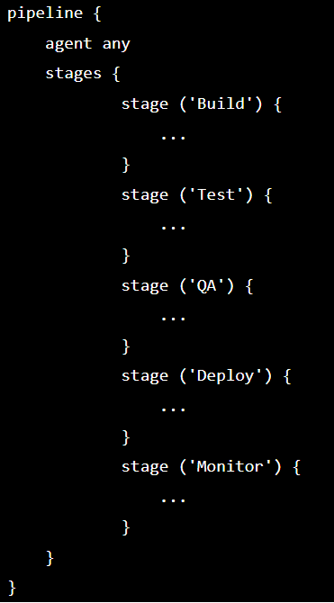
Stage
An assembly of pipeline steps is called a stage block.
In other words, a stage is where the procedures for build, test, and deployment are all together.
In most cases, the Jenkins pipeline process is represented by a stage block.

Slide 20
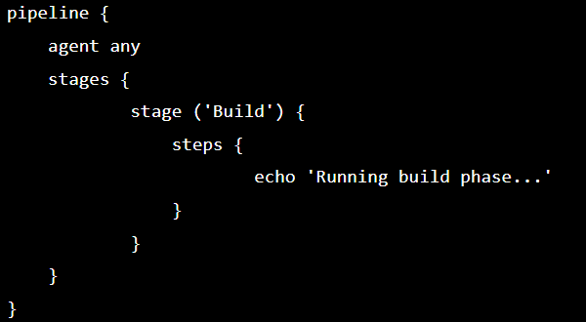
Step
Simply put, a step is a single job that completes a particular procedure at a specific time.
There are several steps in a pipeline.

Slide 21
Pipeline Syntax
Your JenkinsFile can be defined using one of two styles of syntax.
Declarative: A straightforward method for building pipelines is the declarative pipeline syntax. It has a preconfigured hierarchy that is used to build Jenkins pipelines. It gives you the capacity to easily and plainly handle every facet of a pipeline action.
Scripted: A lightweight executor helps the Jenkins master run scripted Jenkins pipeline syntax. The pipeline is transformed into atomic commands with a minimal number of resources.
Declarative and Scripted syntax are completely distinct from one another and are defined differently.

Slide 22
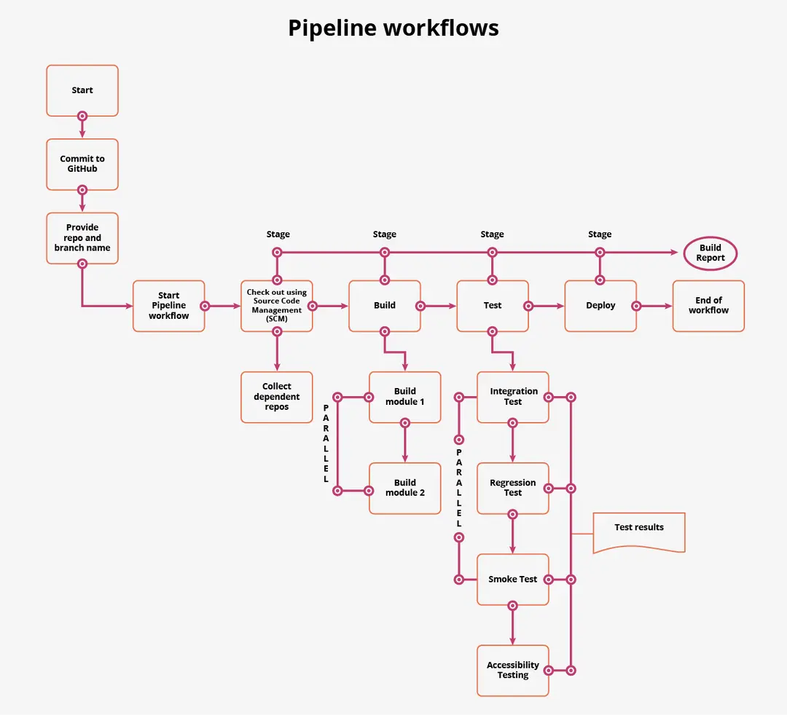
Pipeline Example

Slide 23
The Jenkinsfile
Pipeline as code is based on the idea of being able to add the pipeline script to a code repository for source control and versioning.
The text file containing the code of your pipeline is also known as a Jenkinsfile.
Writing your pipeline into a Jenkins file and make it part of your application repository for source control has several advantages: it can be reviewed/edited by other team members and the file can be versioned and included with your application builds.
Your Jenkinsfile can be edited through the Jenkins web interface or with a text editor, and you can also edit it with your prefered IDE, thus making it part of your project. Then, you can configure Jenkins to automatically poll your repo, while triggering new builds when updates to it are detected.

Slide 24
Scripted Pipeline vs. Declarative Pipeline
One of the latest Pipeline improvements is the Jenkins Declarative Pipeline, which is a bit different than the Scripted Pipeline that we have been discussing.
Both are implementations of the pipeline as code, but the Declarative way is designed to make it easier to develop and maintain your code by providing a more meaningful syntax.
These two enhancements are achieved by adding syntax elements allowing you to define a different pipeline skeleton

Slide 25
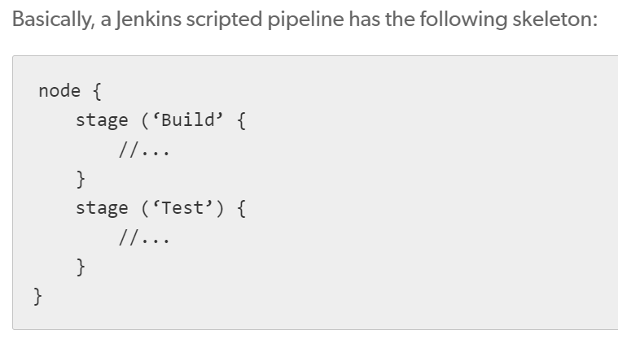
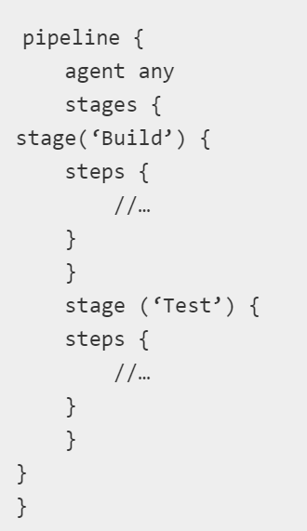
Scripted Pipeline vs. Declarative Pipeline
Declarative Pipeline

Slide 26
Scripted Pipeline vs. Declarative Pipeline
The script has the elements “pipeline”, “agent” and “steps” which are specific to Declarative Pipeline syntax; “stage” is common to both Declarative and Scripted; and finally, node” is specific for the Scripted one.
“Pipeline” defines the block that will contain all the script content.
“Agent” defines where the pipeline will be run, similar to the “node” for the scripted one.
“Stages” contains all of the stages

