Slide 1
GENERICS
TypeScript generics allow you to write the reusable and generalized form of functions, classes, and interfaces.

Slide 2
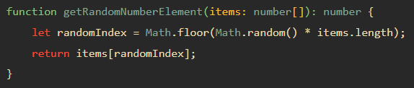

TypeScript Generics
Suppose you need to develop a function that returns a random element in an array of numbers.
The following getRandomNumberElement() function takes an array of numbers as its parameter and returns a random element from the array:
To get a random element of an array, you need to:
Find the random index first.
Get the random element based on the random index.
Assuming that you need to get a random element from an array of strings.

Slide 3
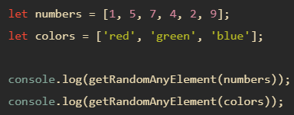
TypeScript Generics
Using the any type
One solution for this issue is to set the type of the array argument as any[].
By doing this, you need to write just one function that works with an array of any type.

Slide 4
TypeScript Generics
This solution works fine. However, it has a drawback.
It doesn’t allow you to enforce the type of the returned element. In other words, it isn’t type-safe.
A better solution to avoid code duplication while preserving the type is to use generics.

Slide 5
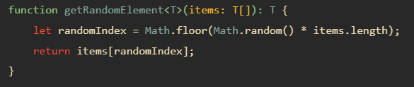
TypeScript Generics come to rescue
The following shows a generic function that returns the random element from an array of type T
This function uses type variable T. The T allows you to capture the type that is provided at the time of calling the function. Also, the function uses the T type variable as its return type.
This getRandomElement() function is generic because it can work with any data type including string, number, objects,…
By convention, we use the letter T as the type variable. However, you can freely use other letters such as A, B C, …

Slide 6

Calling a generic function
The following shows how to use the getRandomElement() with an array of numbers:
In practice, you’ll use type inference for the argument. It means that you let the TypeScript compiler set the value of T automatically based on the type of argument that you pass into, like this:
let numbers = [1, 5, 7, 4, 2, 9];
let randomEle = getRandomElement(numbers);
console.log(randomEle);
In this example, we didn’t pass the number type to the getRandomElement() explicitly. The compiler just looks at the argument and sets T to its type.

Slide 7
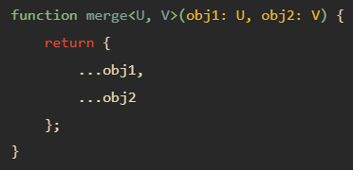
Generic functions with multiple types
The following illustrates how to develop a generic function with two type variables U and V:

Slide 8


TypeScript Generic Classes
A generic class has a generic type parameter list in an angle brackets <> that follows the name of the class:
TypeScript allows you to have multiple generic types in the type parameter list.

Slide 9


TypeScript Generic Interfaces
Like classes, interfaces also can be generic. A generic interface has generic type parameter list in an angle brackets <> following the name of the interface
This make the type parameter T visible to all members of the interface.
The type parameter list can have one or multiple types.

Slide 10
TypeScript Modules

Slide 11
TypeScript Modules
A TypeScript module can contain both declarations and code.
A module executes within its own scope, not in the global scope.
It means that when you declare variables, functions, classes, interfaces, etc., in a module, they are not visible outside the module unless you explicitly export them using export statement.
On the other hand, if you want to access variables, functions, classes, etc., from a module, you need to import them using the import statement.

Slide 12

Creating a new module
The following creates a new module called Validator.ts and declares an interface named Validator
In this module, we place the export keyword before the interface keyword to expose it to other modules.
In other words, if you do not use the export keyword, the Validator interface is private in the Validator.ts module, therefore, it cannot be used by other modules.

Slide 13
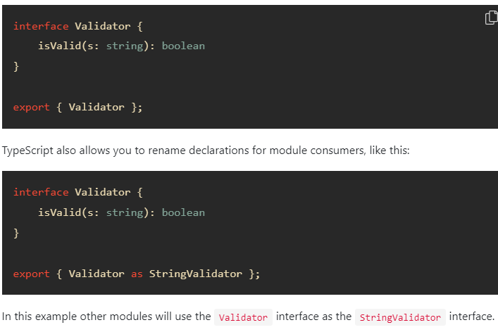
Export statements
Another way to export a declaration from a module is to use the export statement

Slide 14
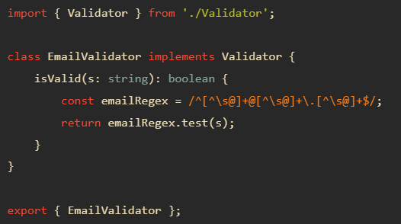

Importing a new module
To consume a module, you use the import statement.
The following creates a new module EmailValidator.ts that uses the Validator.ts module

