Slide 1
Introducing ORM

Slide 2
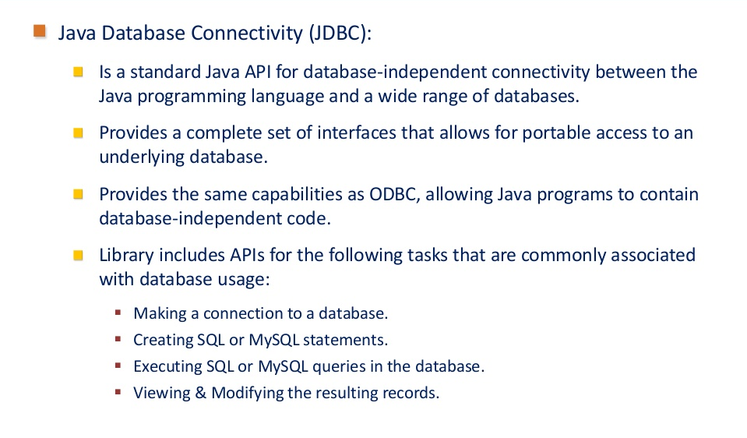
Reviewing JDBC

Slide 3
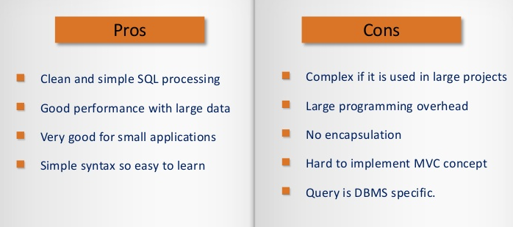
Reviewing JDBC(Contd.)

Slide 4
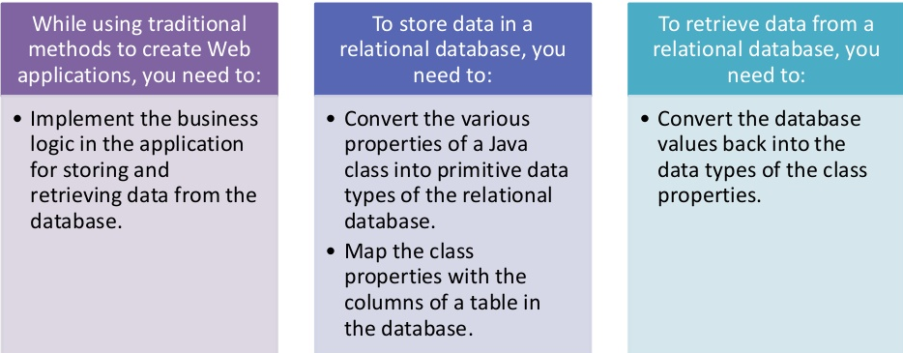
Identifying the Need of Hibernate

Slide 5
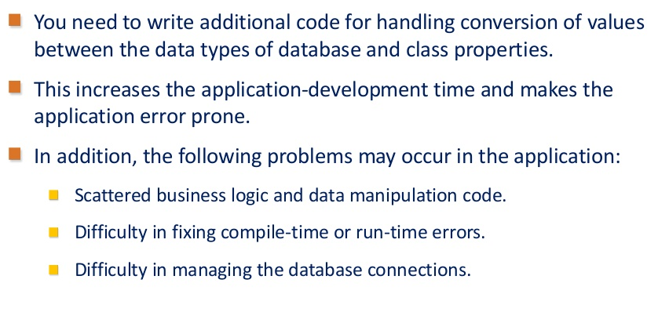
Identifying the Need of Hibernate(Contd.)

Slide 6
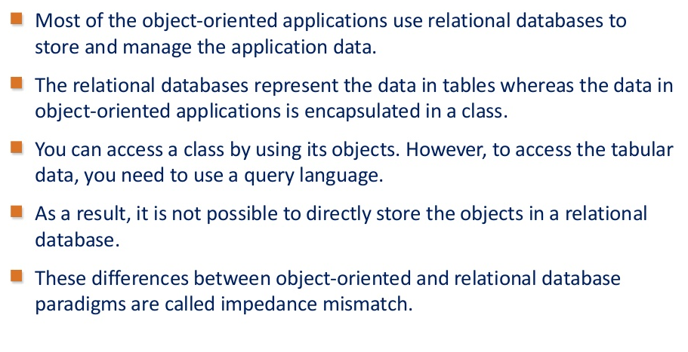
Introducing ORM

Slide 7
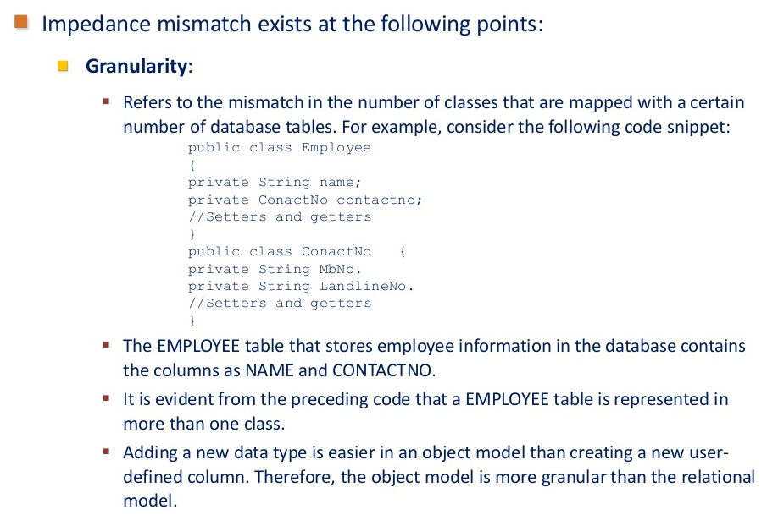
Introducing ORM(Contd.)

Slide 8
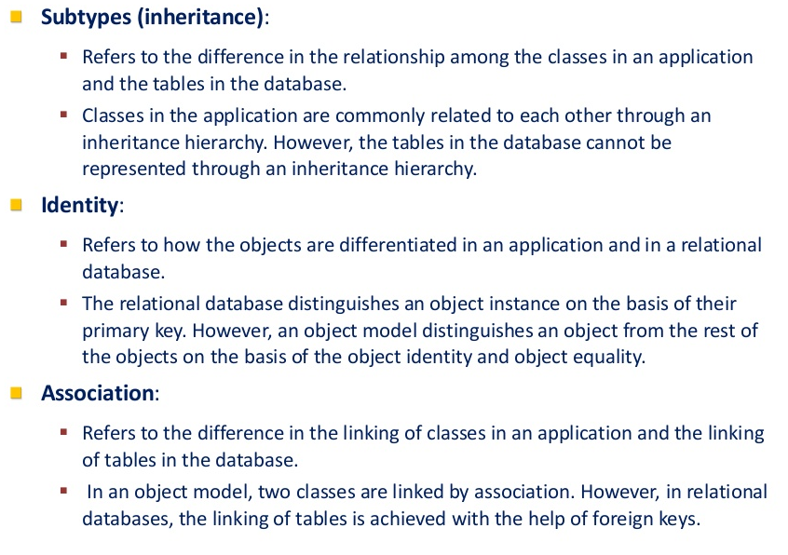
Introducing ORM(Contd.)

Slide 9
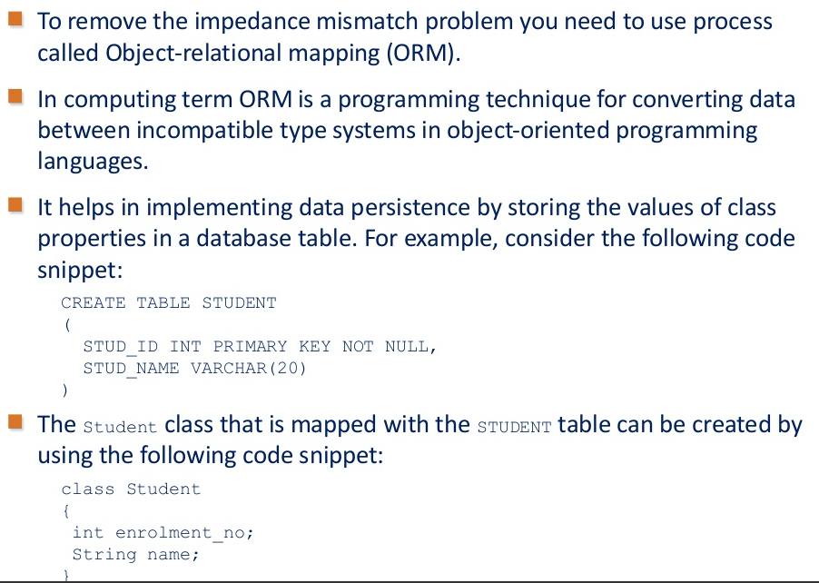
Introducing ORM(Contd.)

Slide 10
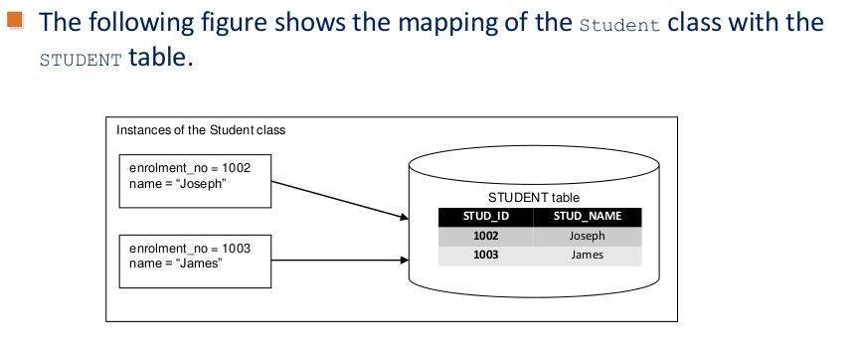
Introducing ORM(Contd.)

Slide 11
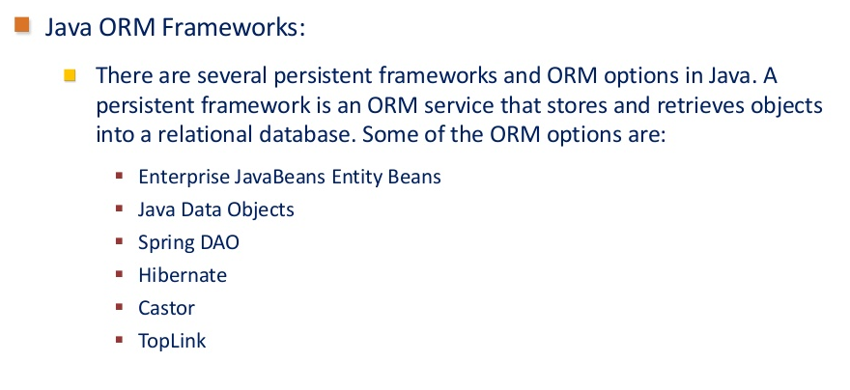
Introducing ORM(Contd.)

