Slide 1
Introduction to Hibernate

Slide 2
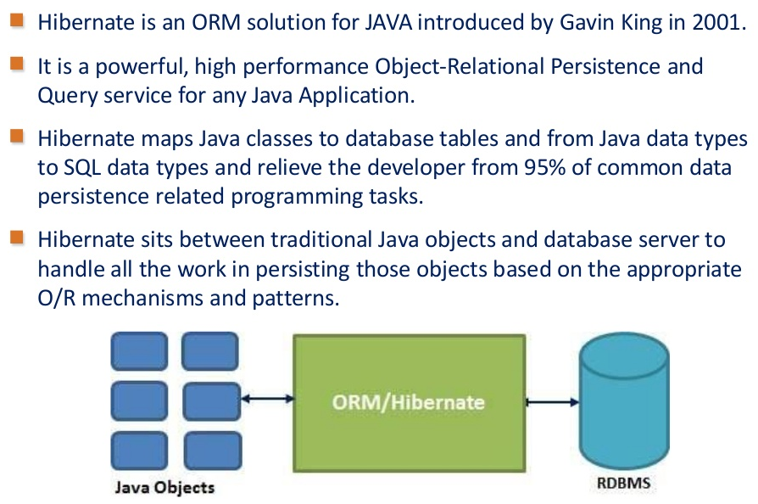
Identifying Hibernate

Slide 3
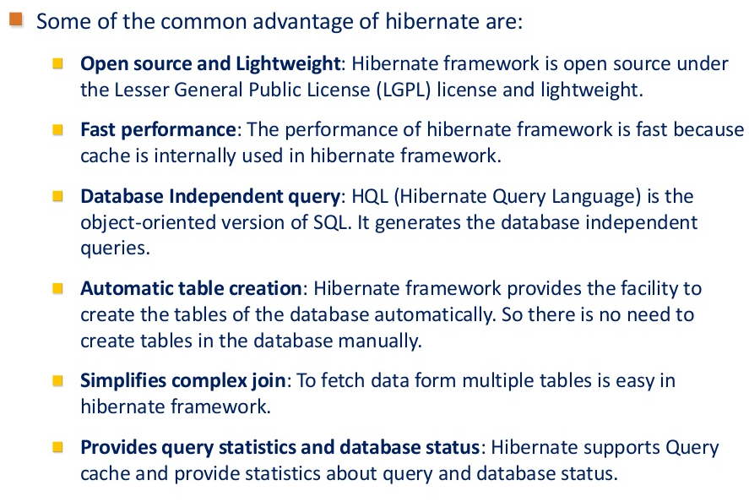
Advantages of Hibernate

Slide 4
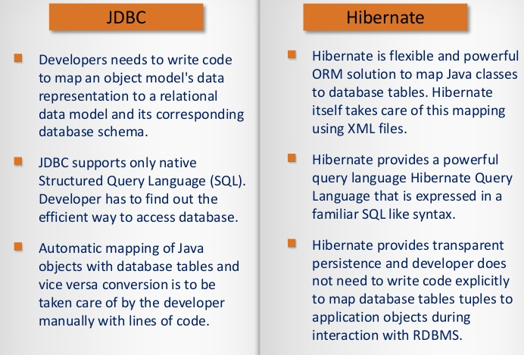
Difference between JDBC and Hibernate

