Slide 1
CSS Selectors

Slide 2
CSS Selectors
CSS selectors are used for selecting the content/text you want to style in our site.
Selectors are the part of CSS ruleset.
CSS selectors select the HTML elements according to its id, class, type, attribute, etc.

Slide 3
CSS Selectors
There are several different types of selectors in CSS, some of them are listed below
Element Selector
Id Selector
Class Selector
Universal Selector
Attribute selectors
Grouping Selector
Child and descendent selectors
General and adjacent sibling selectors
Pseudo-element and pseudo-class selectors

Slide 4
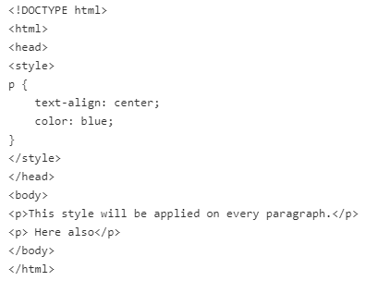
Element Selector
The element selector selects HTML elements by their name / tag name like a, h1, div, p etc.

Slide 5
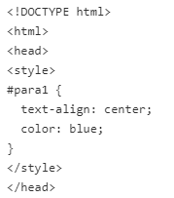
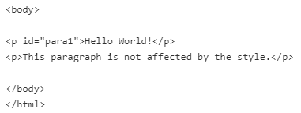
ID Selector
In the CSS, the ID selector is a name preceded by a hash character (“#”).
It uses the id attribute of an HTML element to match the specific HTML element.
The id of an element should be unique within a page, so the id selector is used to select one unique element.

Slide 6
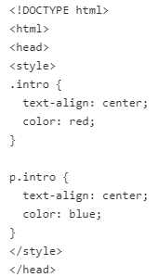
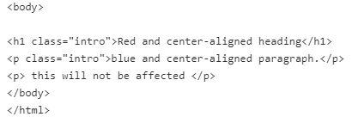
Class Selector
In the CSS, the class selector is a name preceded by a period (“.”).
It uses the class attribute of an HTML element to match the specific HTML element.
We can have a Class selector specific to an HTML element like we have p.class in the below example.

Slide 7
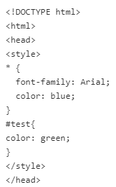
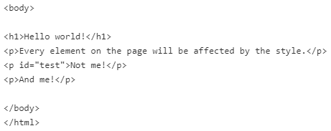
Universal Selector
The universal selector denoted by an asterisk (*), matches all the elements on the page.
If any other specific selector exists on the element, then the universal selector will be omitted.

Slide 8
Attribute Selector
An attribute selector selects the HTML elements that has a specific attribute or attribute with a specified value.
You can create an attribute selector by having the attribute in a pair of square brackets [attribute].
The most commonly used attribute selectors are listed below:
[attribute] Selector - applies the style rule for all the element which has a specified attribute.
[attribute="value"] Selector - uses the = operator to select the element whose attribute value is exactly equal to the given value.
[attribute~="value"] Selector - uses the ~= operator to select elements that have the specified attribute with a value containing a given word, delimited by spaces.

Slide 9
Attribute Selector
[attribute|="value"] Selector - uses the |= operator to select elements that have the specified attribute with a value either equal to a given string or starting with that string followed by a hyphen (-).
[attribute^="value"] Selector - uses the ^= operator to select elements that have the specified attribute with a value beginning exactly with a given string.
[attribute$="value"] Selector uses the $= operator to select elements that have the specified attribute with a value ending exactly with a given string. The comparison is case sensitive.
[attribute*="value"] Selector - uses the *= operator to select elements that have the specified attribute with a value containing a given substring.

Slide 10
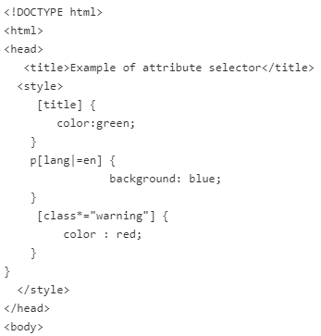
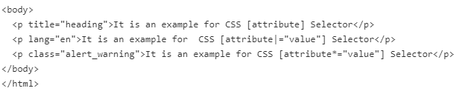
Attribute Selector

Slide 11
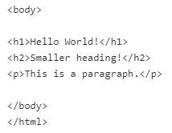
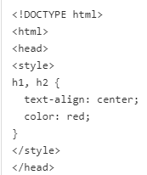
Grouping Selector
The CSS grouping selector is used to apply a common style for the number of elements on the page.
You can group the selector using comma (,) separator.
It allows you to specify the same properties and rules for more than one element at the same time.
This reduces the code and extra effort to declare common styles for each element.

Slide 12
Child selectors
Child Selector selects all the elements that are the children of a specified element.
The Syntax of Child Selector is element > element { property: value;} which selects those elements which are the children of specific parent.
The left side of > is a parent element and on the right is the children element.

Slide 13
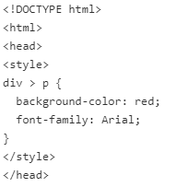
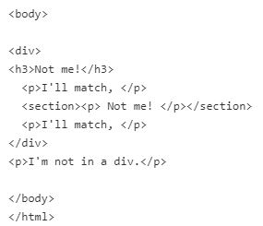
Child selectors

Slide 14
Descendent selectors
The descendant selector selects all the elements which are a child of the element.
It allows you to limit the targeted elements to the ones who are descendants of another element.
The syntax is element { property: value; } you simply write the parent(s), separate with space, and then the actual element you want to target.

Slide 15
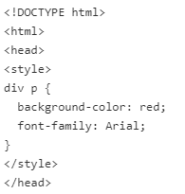
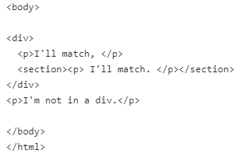
Descendent selectors

Slide 16
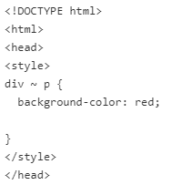
General Sibling Selector
The General Sibling selector selects all the elements which are siblings of a specified element.
The syntax is element ~ element { property: value; }, which selects all the sibling elements that are in same hierarchy level

Slide 17
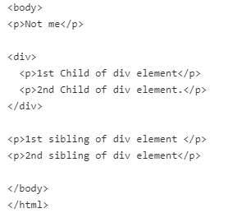
General Sibling Selector

Slide 18
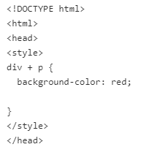
Adjacent Sibling Selector
The Adjacent Sibling selector selects the element that are the adjacent sibling of a specified element.
The syntax is element + element { property: value; }, which selects the second one, if it immediately follows the first one in order of appearance in an HTML page.

Slide 19
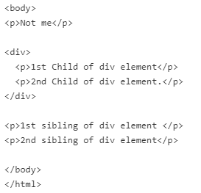
Adjacent Sibling Selector

