Slide 1
Servlet Introduction & Architecture

Slide 2

Client and Server Architecture
A client-server architecture is a networking model in which the server provides services to clients to perform user-based tasks.
A client and a server are two pieces of software that might be on the same computer, or two different computers that might be separated by miles but connected by the Internet.
Server - A server is software designed to process requests and deliver responses to another computer over the internet.
Client - A client is a program that runs on a local machine requesting service from the server.

Slide 3
Client and Server Architecture
A Client and a Server establish a connection according to a set of rules called a protocol.
There are quite a few protocols for different purposes, but one of the most popular is the HTTP protocol.
Once the connection is established, the Client sends HTTP Requests to the server in the form of XML or JSON, which both entities (Client and Server) understand.
After parsing the request, the Server responds with appropriate data by sending back an HTTP Response.

Slide 4
Types of Client-Server Architecture
2 tier architecture - The user interface stored at the client machine and the database stored on the server. If Business Logic & Data Logic collected at a client-side, then it is known as a fat client thin server architecture. If Business Logic & Data Logic handled on the server, then it is known as a thin client fat server architecture. 2 tier architecture has some limitations in performance, security, and portability.
3 tier architecture - Three-tier architecture has a middleware between the user interface and database. The 3 tiers are named the presentation tier, application tier, and data tier. The presentation tier is the front end layer and consists of the user interface. The application tier contains the functional business logic which drives an application’s core capabilities. The data tier consists of a database system and the data access layer.
n-tier architecture - In n-tier architecture, there are multiple Business Logic & Data Logic layers. It increases the flexibility and reusability of applications but can be difficult to implement.

Slide 5
Servlets
A website can consist of both static and dynamic webpages.
A static webpage is a pre-built HTML page with the content explicitly written into the code, and stored in the webserver.
Static web pages display the same content each time we visit. A dynamic webpage loads dynamic content such as stock prices, weather information, news, and sports updates at different points of time.
In Java, there exists a way to generate static webpages with dynamic data, and that's with Java Servlets.

Slide 6
Servlets
A Servlet is a Java class that takes incoming requests, processes them, and generates a response to send back to the user.
For example, an HttpServlet takes an HTTP request, processes its headers and content, and uses that information to write HTML, CSS, and JavaScript code into an HTTP response that can be sent back to the user's browser.
The Servlet container is the component of an application server that interacts with Java servlets and is responsible for managing the execution of servlets and JSP pages for Java applications.

Slide 7
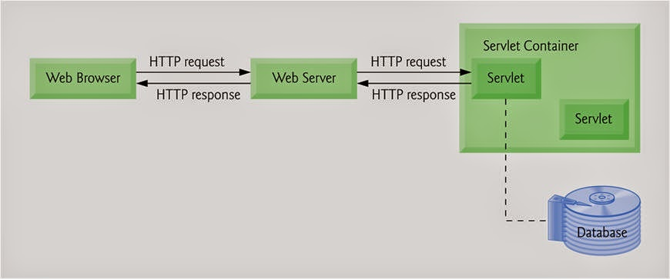
How do servlets work?
When a client sends a request to the application server, the application server receives and passes the request to the appropriate servlet.
The servlet processes the request, generates the response, and sends the response back to the application server.
The application server sends the response back to the client.
Most servlets are HTTPServlets, which receive HTTP requests and generate HTTP Responses out of HTML, CSS, and JavaScript code.

Slide 8
Web Servers / HTTP Servers
A web server is used to handle HTTP requests sent by a client, and return HTTP responses. They are designed to serve static files from a website (HTML files, images, etc).

Slide 9
Application Servers / App Servers
An application server can also handle HTTP requests, but they are not limited to just HTTP.
They can be support other protocols such as RMI/RPC. Application servers typically pass incoming requests to one of the applications running on them, using metadata in the request to decide which application will handle it.
Most application servers can double as Web Servers.

Slide 10
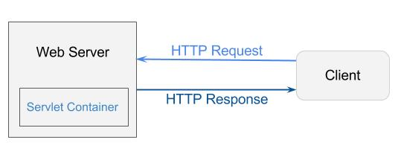
Servlet Container
A servlet container is a component of some application servers that can interact with Java servlets.
It is responsible for managing the life-cycle of servlets, mapping a URL to a particular servlet, and ensuring that the URL requester has the correct access rights and many more such services.
The application server receives HTTP requests and forwards the request to the servlet container.
The servlet container determines which servlet is able to service this request.
Then the container invokes the servlet, which reads data in the request and formulates a response.
Then the application server returns the dynamically generated response to the Client.

Slide 11
Life Cycle of a Servlet
A servlet container manages the life cycle of a servlet.
Servlet is an interface defined in jakarta.servlet package.
A servlet container uses the Servlet interface to understand a specific Servlet object and manage it.
There are three life cycle methods of a Servlet
init()
service()
destroy()

Slide 12
Life Cycle of a Servlet
Step-1 : Loading of Servlet
When the application server (e.g. Apache Tomcat) starts up, the servlet container deploys and loads all the servlet classes.
Step-2 : Creating an instance of Servlet
Once all the Servlet classes are loaded, the servlet container creates only one instance for each servlet class. All requests to the servlet are executed on that same servlet instance. Some application servers can create multiple instances of a servlet to handle a high volume of incoming requests, but that is not the default behavior.

Slide 13
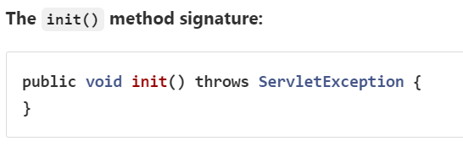
Life Cycle of a Servlet
Step-3 : Invoke init() method once
Once all the servlet classes are instantiated, the init() method is invoked for each instantiated servlet. The init() method is used to initialize the servlet. The init() method is called only once.

Slide 14
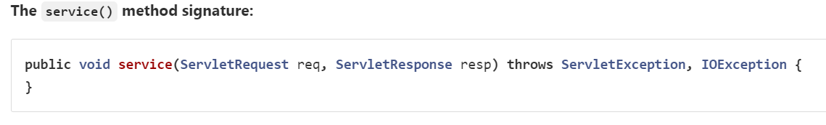
Life Cycle of a Servlet
Step-4 : Invoke service() method repeatedly for each client request
The servlet container calls the service method each time a request for the servlet is received. The service() method determines the type of Http request (GET, POST, PUT, DELETE, etc.) also calls doGet(), doPost(), doPut(), doDelete(), etc. methods as appropriate.

Slide 15
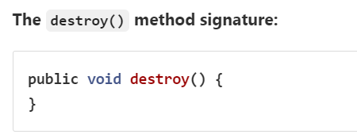
Life Cycle of a Servlet
Step-5 : Invoke destroy() method once
The destroy() method is called only once at the end of the a servlet's life. The servlet container calls this method before removing the servlet instance from the service.

Slide 16
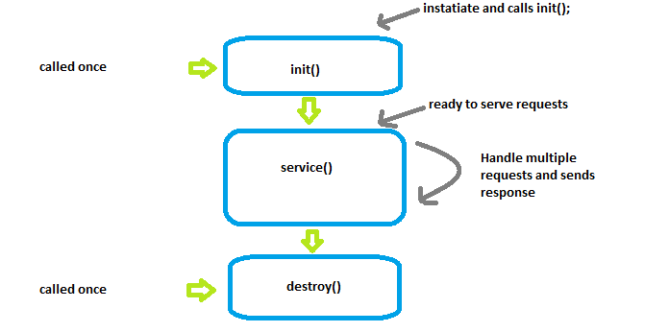
Life Cycle of a Servlet

Slide 17
Servlet API
The Servlet API provides interfaces and classes that are required to build servlets.
These interfaces and classes represented in two packages:
jakarta.servlet package - used by the servlet or web container.
jakarta.servlet.http package - used for handling http requests.

Slide 18
Servlet Class Hierarchy
The Servlet interface is the root interface of the servlet class hierarchy.
The GenericServlet class implements Servlet, ServletConfig, and Serializable interfaces.
The HttpServlet class extends the GenericServlet class and implements the Serializable interface.
It provides HTTP methods such as doGet, doPost, doHead, doTrace, etc.
The user defined servlet class is created by implementing the Servlet interface, usually by extending the GenericServlet class or (more commonly) the HttpServlet class.

Slide 19
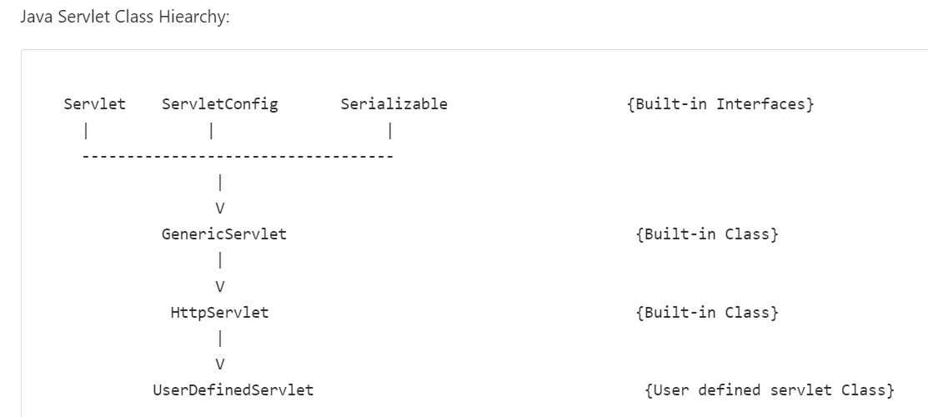
Servlet Class Hierarchy

Slide 20
Servlet Class Hierarchy
In order to initialize a Servlet, a server application loads the user-defined servlet class and creates an instance.
Then it calls the Servlet’s init (ServletConfig config) method. Since the init() method is run once, it stores the initial parameters or configuration information in the ServletConfig object.
This information can be retrieved later by calling the Servlet’s getServletConfig() method. This is implemented in the GenericServlet class definition.
The ServletConfig object contains Servlet parameters and a reference to the Servlet’s ServletContext.
The ServletContext is an interface which helps to communicate with other servlets.
Then, the service (ServletRequest request, ServletResponse response) method is called for every request to the Servlet.
When the Servlet needs to be unloaded the destroy() method is called.

Slide 21
Creating a Custom Servlet

