Slide 1
Servlet Configuration

Slide 2
Deployment descriptor
Java web applications use a deployment descriptor file to define the URLs that map to servlets, and to determine which URLs require authentication and additional information.
A deployment descriptor file specifies the classes, resources, and configuration of the application and how the web server uses them to serve HTTP requests.

Slide 3
Deployment descriptor
The deployment descriptor is a file named web.xml.
It resides within the app's WAR beneath the WEB-INF/ directory.
The root element of the web.xml file is <web-app>.
The web.xml file defines mappings between URL paths and the servlets that will handle requests with those paths.
The application server uses this configuration to find the servlet that handles a given request, and calls the servlet method that corresponds to the HTTP request method used.
To map a URL to a servlet, you declare the servlet with the <servlet> element, then define a mapping from a URL path to a servlet declaration with the <servlet-mapping> element.

Slide 4
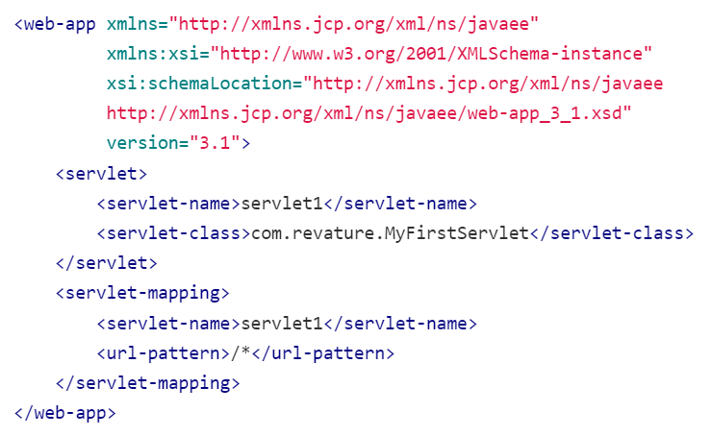
Deployment descriptor

Slide 5
Declaring and mapping servlets
To configure a servlet in the web.xml file,
Configure the servlet using the <servlet> element.
Map the servlet to a URL or URL pattern using the <servlet-mapping> element.
The <servlet> element is used to declare the servlet name, the fully-qualified class name of the servlet, and any initialization parameters.
The name for every servlet must be unique across the deployment descriptor.The <servlet-mapping> element is used to specify a URL pattern, and the name of the servlet which handles requests whose URL matches the given pattern.
The URL pattern uses an asterisk (*) at the beginning or end of the pattern to indicate zero or more of any character.

Slide 6
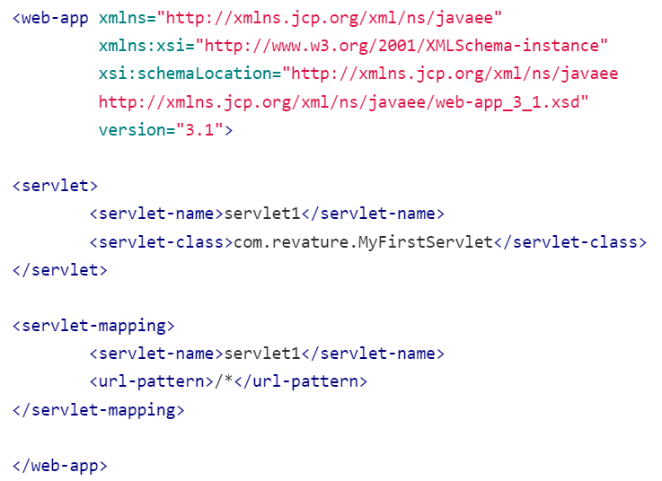
Declaring and mapping servlets

Slide 7
ServletConfig
ServletConfig is an object created by the Servlet Container, used to pass initial parameters or configuration information to a particular servlet during initialization.
The <servlet> XML element in the deployment descriptor (web.xml) has a subelement called <init-param> used to pass parameters to a servlet from the web.xml file.
The ServletConfig object is returned by the getServletConfig() method of HttpServlet, and so the XML properties added to ServletConfig are only shared with the single servlet indicated.

Slide 8
ServletContext
ServletContext is the object created by the Servlet Container to share initial parameters or configuration information to all servlets and other components.
The <context-param> element used to declare the parameters of ServletContext.
It present outside the <servlet> element and inside the <web-app> element.
This object is returned by the getServletContext() method of HttpServlet.
The <param-name> and <param-value> used to declare the parameter name and its value.

Slide 9
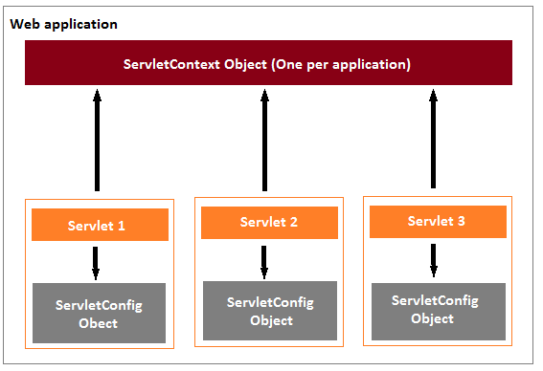
ServletConfig vs ServletContext

Slide 10
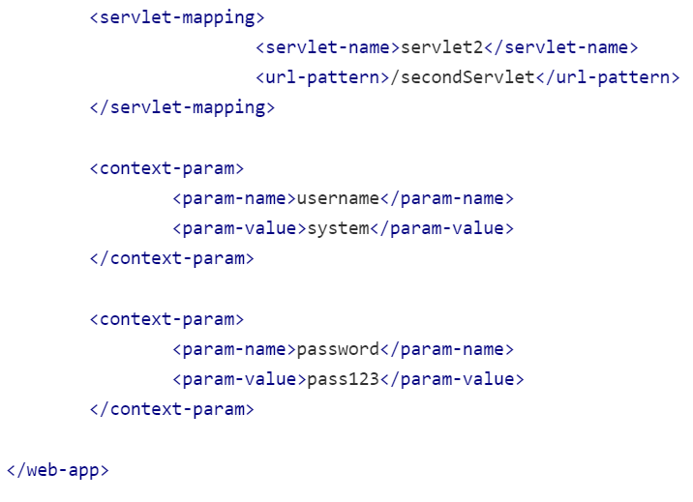
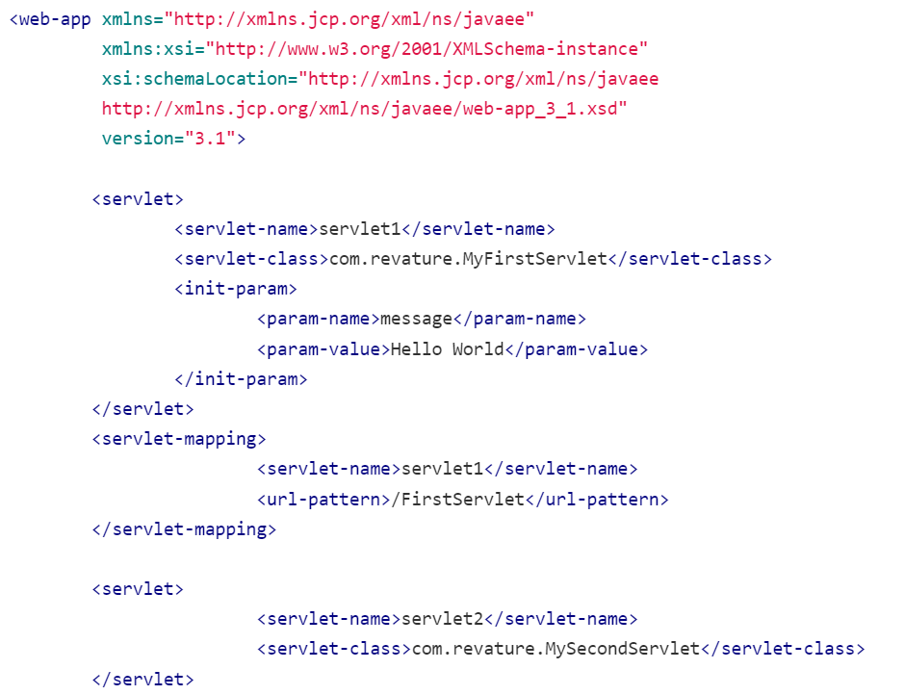

Slide 11
Filters
Servlet Filters are used to intercept a request and conduct pre-processing or post-processing on that request.
They can be used to perform tasks such as logging, authentication and authorization, encryption or decryption, and formatting the request header or body before sending it to the servlet.
Filters are configured in the deployment descriptor of a web application and then map to either servlet names or URL patterns in your application's deployment descriptor.
Servlet filters are pluggable, i.e. Servlets and filters both are unaware of each other and we can add or remove a servlet filter just by editing web.xml.

Slide 12
How do Filters work?
When the application starts up, the Servlet Container creates an instance of each filter that is declared in the deployment descriptor.
When a request reaches the Servlet Container, it checks if any filter has the same URL pattern as a requested URL.
If any filter has a matching URL pattern, then its code gets executed.
If the filter executes successfully without any errors, then the filtered request passes to the target servlet.
The servlet processes the filtered request and returns the response.
The response also passes through the filter.
At last, the filtered response passed to the Servlet Container which passes it to the client.

Slide 13
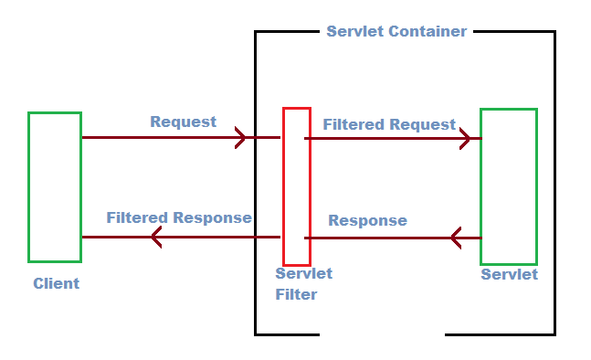
How do Filters work?

Slide 14
Filter API
Filter API is a part of servlet API and defined inside javax.servlet package.
The Filter API has three Interfaces - Filter, FilterChain, and FilterConfig.
We create filters by implementing the Filter Interface, which provides the life cycle methods for a filter.
Filters perform filtering in the doFilter() method.
Every Filter has access to a FilterConfig object that contains its initialization parameters.
We can create multiple filters for a single resource, which is known as a Filter Chain.
The FilterChain object used to call the next filter or resource in the chain.

Slide 15
Filter API
The life cycle methods provided by the Filter interface are listed below, and all these methods are invoked by the servlet container.
init( FilterConfig config ) – This method called only once and used to initialize the filter
doFilter(HttpServletRequest request,HttpServletResponse response, FilterChain chain) - This method gets invoked whenever the filter has to filter a request. All the filter actions on the request can be implemented here. The FilterChain parameter can be used to implement the next filter in the filter chain.
destroy() - This method is called only once when the filter is taken out of service.
In Java Servlet API 4.0 (the latest version), we'll override only the doFilter() method because the Filter interface implements the init() and destroy() as default methods.

Slide 16
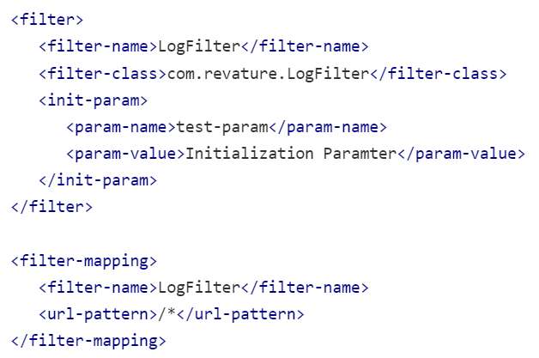
Configuring the Servlet Filter in web.xml
Filters are defined and then mapped to a URL or Servlet, in much the same way as Servlet is defined and then mapped to a URL pattern.
We use <filter> and <filter-mapping> elements in the web.xml to create a filter and map that to a URL or Servlet.

