Slide 1
Servlet Processing

Slide 2
Request Dispatcher
The Request Dispatcher interface defines an object that passes along the client's request to any other resources (servlet, JSP file, or HTML file) on the server.
The servlet container creates the RequestDispatcher object.
The getRequestDispatcher(String) method of the ServletRequest interface returns the Request Dispatcher object.
RequestDispatcher interface defined in the javax.servlet package provides two methods:

Slide 3
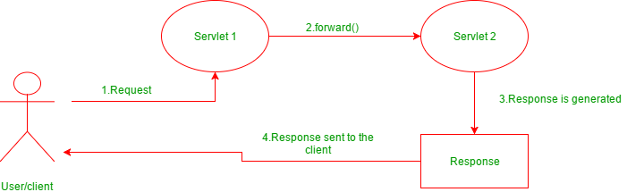
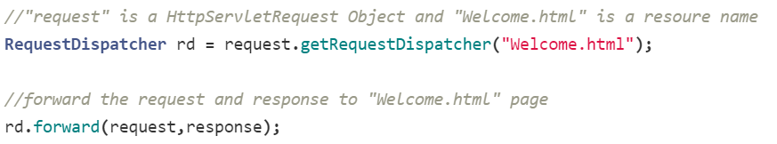
forward(ServletRequest request, ServletResponse response)
forward() passes a request from one servlet to another resource on the server.
The contents of the request and response are preserved and forwarded to the next resource which will process the data and return the response to the client.

Slide 4
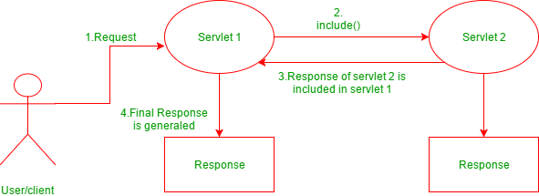
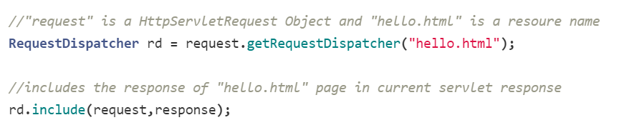
include(ServletRequest request, ServletResponse response)
include() does not entirely transfer control over the request and reponse object to the next resource.
Instead, this method includes the content of the original resource in the reponse returned to the client.
If you include() a servlet or JSP document, the included resource may not change the response code or HTTP headers.

Slide 5
Writing plain text to the response Object
The Servlet API provides HttpServletResponse interface which extends the ServletResponse interface to assist in sending a response to the client.
The Servlet Container informs the client browser about the type of data in the response before sending it.
The Servlet container uses the setContentType() method to set the type of data in the response object.
The response data can be in simple plain text format, HTML format, XML format, an image format, etc.
The setContentType(String type) method sets the content type of the response being sent to the client before sending the response.
The response.getWriter() method returns a PrintWriter object, which sends character text to the client.

Slide 6
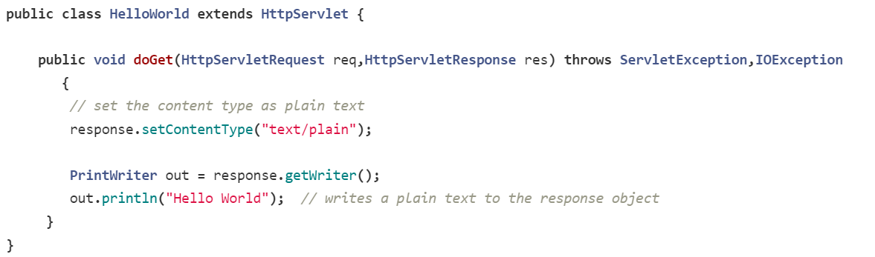
Writing plain text to the response Object

Slide 7

SendRedirect in servlets
sendRedirect(String URL) - This method defined in HttpServletResponse interface and used to redirect a response to another resource.
It uses the URL to make another request.
Therefore, it works at the client-side also can work inside and outside the server.
The RequestDispatcher.forward() method is used to pass the same request to a new destination resource, but the Response.sendRedirect() method is used to send an entirely new request for the destination resource.
Any request attributes or parameters from the original request are lost.

Slide 8
Handling form data from the request
To make the form work with a Java servlet, we need to specify the following attributes for the <form> tag:
method="post" or method="get" : to send the form data as an HTTP POST or HTTP GET request to the server.
action= "URL of the servlet": specifies URL of the servlet which is responsible for handling form data.
The servlet handles GET requests using the doGet() method and POST requests using the doPost() method.

Slide 9
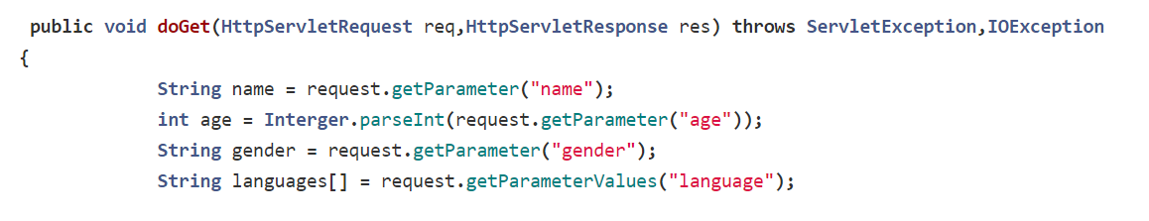
Retrieving request parameters from the request
Servlets use the following methods for retrieving request/form parameters from the HTTP request:
getParameter() method - used to get the value of a specified parameter.
getParameterValues() method - used to get the multiple values of a specified parameter.(for example checkbox)
getParameterNames() method - used to get complete list of all parameters.

Slide 10
Working with Jackson API
The Jackson API is used to convert Java objects into JSON format to send in an HTML response.
The JSON format is commonly used for transmitting data between a server and a client in a web application.

Slide 11
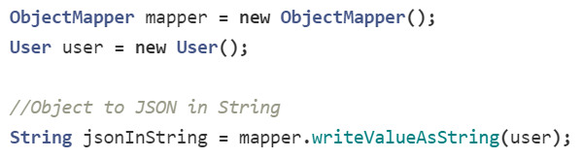
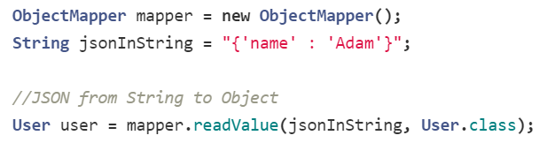
Jackson ObjectMapper
The ObjectMapper API is used for data-binding.
It uses reader/writer methods to perform the conversion between Java objects and JSON.
writeValue() method - used to convert Java object to JSON.
readValue() method - used to convert JSON to Java object.

Slide 12
Exception and Error Handling
The Servlet API allows us to handle exceptions and errors caused during the execution of a servlet and still send a useful response to the user.
The deployment descriptor file just needs to be configured to handle the exceptions/errors thrown by a servlet.
The <error-page> element used to specify the invocation of servlets in response to certain exceptions or HTTP status codes.
The following elements are used within an <error-page> element to handle error or exception:
<error-code> - used to specify a valid HTTP error code. For example, 404, 403, 500, etc.
<exception-type> - used to specify a fully-qualified class name of a Java exception type. For example, javax.servlet.ServletException,java.io.IOException, java.lang.RuntimeException, etc.
<location> - used to specify the location of the resource which is displayed to the user in case of an error. This might be a servlet, an HTML page, a JSP page, or something else.

