Slide 1
Session Management

Slide 2
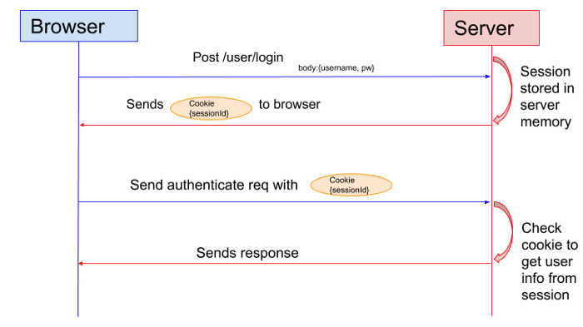
Session Management in servlets
The HTTP protocol is a stateless protocol, which means no client information stored in the server.
The server considers every request form the same client as a new, independent request.
However, this means that a server cannot keep a user "logged in" naturally.
Instead, the client will have to re-identify itself with each request it sends.
One workaround is to have the server create a session for each client request, which the client can re-associate itself with in each request by sending the session ID.

Slide 3
Session Management in servlets
Session tracking is a mechanism that servlets use to maintain state about a series of requests from the same user across a period of time.
A session stores the unique identification information about the client that we can get for all requests that client makes.
There are four different techniques used by the Servlet application for session management.
Cookies
Hidden form fields
URL Rewriting
The HttpSession API

Slide 4
HttpSession API
The Servlet API provides HttpSession Interface, which provides a way to identify a user and to store information about that user.
For the client's first request, the Servlet Container generates a unique session ID and gives it back to the client with a response.
Thereafter, the client sends the session ID with each request to the server.
The getSession() method of the HttpServletRequest object returns a user's session.
Any servlet can access the HttpSession object using getSession() method.

Slide 5
HttpSession API
The commonly used HttpSession Interface methods are listed below
setAttribute(key,object) - used to bind an object to the session, using the key specified.
getAttribute(String) - used to retrieve a specific saved object from the session object, using its key.
removeAttribute(key) - used to remove the object bound with the specified key from the session.
invalidate() - destorys the session.
getId() - returns the unique ID assigned to the session.
getCreationTime()- returns the time when the session was created
getLastAccessedTime() - returns the last time the client sent a request associated with the session
getMaxInactiveInterval() - returns the maximum time interval, in seconds.
setMaxInactiveInterval(int interval) - Specifies the time, in seconds,after servlet container will invalidate the session.

Slide 6
Cookies
A cookie is a key-value pair of information sent by the server to the client, which the client will store.
The client (usually a web browser) can send this cookie in the HTTP request header for all subsequent requests until the cookie becomes invalid.
The Servlet container checks the request header for cookies, most commonly to get the session information from the cookie, which it uses it to retrieve the associated session data stored in the server.

Slide 7
Cookies
We can classify the cookies into two types based on their expiry time:
Non-persistent cookie - Cookie becomes expired when the user closes the browser.
Persistent Cookies - Cookie expires only if the user logs out of the website. The cookie is stored on the browser even the user closes the browser each time.

Slide 8
Creating Cookies with Servlets
To send cookies to the client, we need to create a Cookie object, set the maximum age for the cookie, and place the cookie in the HTTP response header.
The Cookie(String name, String value) constructor defined in the javax.servlet.http.Cookie class can be used to create a cookie with a specified name and value.
We can use the setMaxAge() method to set the maximum age for the particular cookie in seconds.
We can use the response.addCookie() method to place the cookie in the HTTP response header.

Slide 9
Reading Cookies with Servlets
To read cookies, We need to create an array of javax.servlet.http.Cookie objects by calling the getCookies() method of HttpServletRequest.
Then the getName() and getValue() methods used to access each cookie and associated value.

Slide 10
Hidden Form Fields
Hidden fields can be inserted into webpages by the server for session tracking.
These fields are not visible directly to the user but can still be viewed using the view source option from the browser.
Therefore, hidden fields should not be used as a form of security.
Hidden fields may be used to send information that is only pertinent to the server, and not the client.
A web server can send a hidden HTML form field along with a unique session ID:
This hidden field is not displayed on the browser but the value is sent to the server when the parent <form> element is submitted.
The server retrieves this hidden form field value using the request.getParameter("session_id") method in a servlet.

Slide 11
URL Rewriting
URL Rewriting is a process by which a unique session ID gets appended to each request URL, so the server can identify the user session.
URL Rewriting maintains the session and works even the user's browser doesn't support cookies.
This makes it one of the ways in which we can provide a unique id in request and response, alongside implementing the Session Interface and Cookies Management.

