Slide 1
A TALK FOR OPERATORS, NOT DEVELOPERS
Build your own
chief of staff agent
Teach the process, not a tool.
Leave knowing how to build a CoS agent — and how to automate
anything that is repeatable and verifiable.
Build your own chief of staff · the process, not the tool
1 / 11
Notes:
Open by saying this is not a product demo. No one is leaving with a login, a marketplace skill, or a reason to switch from Copilot to Claude.
They are leaving with a process they can run Monday in whatever tool they already have.
The Chief of Staff agent is the worked example. Briefs, drafts, open loops, meeting prep. The real prize is the two tests they will use on expense reports, hiring screens, and customer research next month.
Cite the local source catalog if asked: https://github.com/BittahCriminal/build-your-own-chief-of-staff/blob/main/research/SOURCES.md — 21 Markdown notes documenting the operating rules used in this kit, with original article attribution.

Slide 2
The whole course is two tests
1. Repeatable
2. Verifiable
You would do the same steps next week.
Same kinds of inputs. Same shape of output.
Special cases every time = judgment.
Keep it.
A careful human can check the output
against a source, a template, or a
yes/no rule.
“Does this sound good?” is not a check.
Build your own chief of staff · the process, not the tool
2 / 11
Notes:
Stay here. This is the slide they should photograph.
Repeatable: Monday status (same headings, new evidence) yes. Meeting recap yes. Which of two candidates to hire no. 'Handle my email' is usually seventeen jobs — split it.
Verifiable: every Done line cites a ticket you can open; the recap names an owner only when the notes name one; gaps stay 'not found'. 'Make it professional' cannot drive a loop.
Fail either test → do not automate. That is not caution. That is the curriculum. The leftover is judgment: taste, red lines, how a room will land. Keep it.
If the room is frozen at an empty prompt: 'handle my email' is seventeen jobs, split it. what-to-automate.md on GitHub. The freeze and why-it-fails material is in PROCESS.md, not on a slide in this cut.
The checkability argument: if checking an answer costs as much as making it, extra attempts just grow the pile. Source: https://github.com/BittahCriminal/build-your-own-chief-of-staff/blob/main/research/notes/agent-shaped-work.md
And: if you cannot name what would make you say 'not yet,' you have a vibe, not a job. Source: https://github.com/BittahCriminal/build-your-own-chief-of-staff/blob/main/research/notes/verification-gap.md

Slide 3
Start at the edges, not the core
Prep
Check
Summarize
Package
Hand off
Collect, clean, reconcile
Completeness, obvious errors
Thread → one page
Analysis → brief / recap
Move context. Stop being the glue.
The core is craft: taste, red lines, how a room lands. Protect it.
Pick the simplest edge with the clearest lift — not the most impressive one.
Build your own chief of staff · the process, not the tool
3 / 11
Notes:
Edge-first is the thought process they came for. Data preparation, QA, synthesis, packaging, coordination. Cheap errors. Humans can pick up an exception without the whole workflow breaking.
The core is where they groan that they want help — and where first projects die. Trust is the real project: automate around the craft, not through it.
Source: https://github.com/BittahCriminal/build-your-own-chief-of-staff/blob/main/research/notes/why-agent-projects-fail.md
CoS mapping: recap, brief, open-loop list, packaging a status = edges. When to push, which story to tell = core.

Slide 4
The Chief of Staff is the teaching case
OPERATIONAL — automate
JUDGMENT — keep
• Morning brief
• Weekly update
• Meeting prep
• Meeting recap ← we open this file next
• Open loops
• Drafts of mail you will send
• When to push or hold
• How a room will land
• Political risk
• The hard conversation
• Which story is worth telling
• Anything you would not put your name on unread
Meeting recap needs the least setup of the six — one voice file, meeting details, and one real transcript.
Build your own chief of staff · the process, not the tool
4 / 11
Notes:
Walk the left column: these are the eight portable jobs from the Delegation Kit, renamed into operator English. Source: https://github.com/BittahCriminal/build-your-own-chief-of-staff/blob/main/research/notes/delegation-kit.md
The right column is not 'AI can't do it.' It is 'checking it costs as much as doing it, so extra attempts just grow the pile.'
Flag meeting-recap now. Next slide leaves PowerPoint. You will open the GitHub file, copy it, and run it.

Slide 5
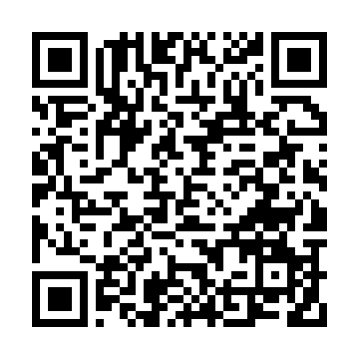
LEAVE THE SLIDES
Open the kit
Same markdown. Copilot, Cursor, Claude, ChatGPT, or Gemini.
Click the tree. Do not tour every file.
START-HERE.md
PROCESS.md
prompts/workflows/
Get the files onto a PC
The method — we walk this after the demo
The CoS jobs, ready to paste
prompts/process/
context-templates/
how-to/
Turn any job into a workflow
Blanks. Copy privately. Fill them.
Which box to paste into
README.md (repo root)
github.com/BittahCriminal/build-your-own-chief-of-staff
scan this page
Build your own chief of staff · the process, not the tool
5 / 11
Notes:
Click the URL or scan. Stay on the README for about a minute. Point at the six names. Personal data never ships here — context-templates/ are blanks.
Do not take questions about which model is 'best'. Once the job is named and the check exists, use whatever they already pay for. The how-to/ folder is only which box to paste into.
Reusable-rig essay: skills should be local, inspectable, and independent of whichever AI app you are renting this month. Source: https://github.com/BittahCriminal/build-your-own-chief-of-staff/blob/main/research/notes/reusable-rig.md
Then go to the next slide and open meeting-recap.md. Do not walk PROCESS.md yet.

Slide 6
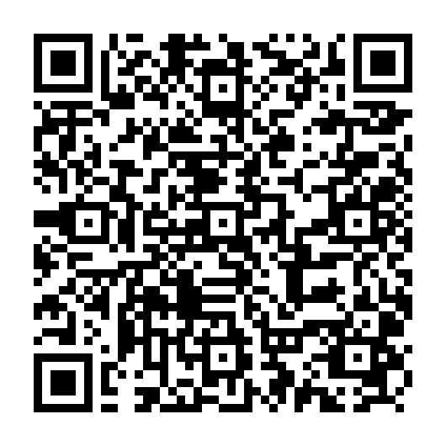
LEAVE THE SLIDES
This file, live: meeting recap
• Lowest setup of the six CoS jobs — voice.md, meeting details, one real transcript.
• Fully verifiable: every decision, owner, and date must cite a line in the notes.
• Open the GitHub page. Copy the prompt. Paste it with voice.md and the notes. Run it.
prompts/workflows/meeting-recap.md
github.com/BittahCriminal/build-your-own-chief-of-staff/blob/main/prompts/workflows/meeting-recap.md
scan this page
Build your own chief of staff · the process, not the tool
6 / 11
Notes:
Leave PowerPoint. Open https://github.com/BittahCriminal/build-your-own-chief-of-staff/blob/main/prompts/workflows/meeting-recap.md
Paste an actual recent meeting's title, date, attendees, notes or transcript, and a filled-in voice.md into whatever tool the room uses.
This is the pivot: everything before this was 'why.' Everything after is 'how,' using the recap you just got.
If the model invents an owner, do not panic — that is Step 5 (cite or cut) happening live.
Have the dry-run output saved as a fallback tab.

Slide 7
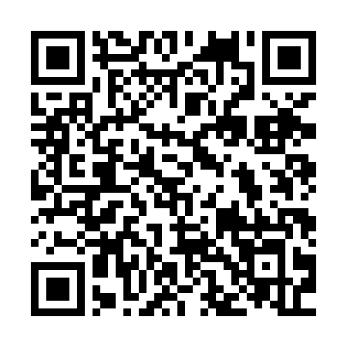
LEAVE THE SLIDES
The method is this page
Walk these seven steps on GitHub against the recap you just ran.
1. Name one job
2. Write the SOP
3. Put you in files you own
4. The prompt file is the process
5. Verify. Cite or cut.
6. Correct the file, not the chat
7. Only then schedule it
PROCESS.md
github.com/BittahCriminal/build-your-own-chief-of-staff/blob/main/PROCESS.md
scan this page
Build your own chief of staff · the process, not the tool
7 / 11
Notes:
Open https://github.com/BittahCriminal/build-your-own-chief-of-staff/blob/main/PROCESS.md and stay there. Do not flip back to slides for each step.
For the recap you just ran:
1. The job was already named — meeting recap — which is why it moved fast. Prompt: name-the-job.md
2. Input = voice.md + meeting details + transcript. Output = one-page recap. Check = every item cites a line. Prompt: write-the-sop.md
3. voice.md is the one context file that made the demo possible. Other jobs need more. Prompt: build-context.md
4. meeting-recap.md produced the recap, not a clever conversation. If output is wrong, the file is wrong.
5. Citation guard: no anchor, no claim. Gaps stay gaps. Prompt: verify.md Source: https://github.com/BittahCriminal/build-your-own-chief-of-staff/blob/main/research/notes/reusable-rig.md
6. Three of the same correction is a rule. Two is a candidate. One is a fluke. Prompt: correct-the-file.md
7. Do not put it on a timer until several hand-checked meetings. Frequency is not value. Prompt: schedule-it.md
Then say: point the same seven steps at expense reports, hiring screens, incident recaps. Buying a smarter model does not skip workflow, data, authority, evaluation, audit, or an owner. Source: https://github.com/BittahCriminal/build-your-own-chief-of-staff/blob/main/research/notes/workflow-readiness.md
Come back to the deck for Monday homework, the levels, and the close. The ranking card (score-the-candidates.md) is not a slide in this cut; name it if someone has three ideas.

Slide 8
Thirty minutes on Monday: run meeting-recap once
5 min
Copy context-templates to a private folder. Fill in voice.md only.
5 min
Pick one real meeting from last week: title, date, attendees, notes.
5 min
Paste meeting-recap.md, voice.md, and the notes into your tool. Run it.
10 min
Check each owner and date against a line in the notes. No name? Unassigned.
5 min
Wrong? Fix the prompt or voice.md, not the chat. Run it again.
Froze on picking a meeting? what-to-automate.md. Left with three ideas? score-the-candidates.md.
Build your own chief of staff · the process, not the tool
8 / 11
Notes:
This mirrors the README 'Start here' path, but the deliverable is one real run. START-HERE.md first if the files are not on the machine yet. They already watched this exact run; Monday they do it on their own meeting.
An owner or date that does not point at a line in the notes gets cut. If the notes name nobody, the recap says unassigned. That is the agent working.
Do not put the recap on a timer until they have checked it by hand several times.

Slide 9
Where this goes next
LEVEL 0
LEVEL 1 ← this kit
LEVEL 2
LEVEL 3
LEVEL 4
Human is the loop
Human in the loop
Human on the loop
Human as orchestrator
Autonomous
A working process.
No agent yet.
The agent drafts.
You accept every output.
You dispatch jobs, on a timer.
You check evidence, not every line.
The agent reacts to signals.
You review the rules.
The agent starts work itself.
You set the boundaries.
Build this first.
Limit: your review time.
Limit: how hard your checks are.
Limit: how good your rules are.
Limit: the whole system, not the model.
Everything today is Level 1. Step 7 — schedule it — is the door to Level 2.
Do not walk through it until the check in your SOP is one a careful stranger could apply in a minute.
A better model does not move you up a level. Better checks do.
Build your own chief of staff · the process, not the tool
9 / 11
Notes:
One minute. This is the map, not a step. Everything they watched today sits on the second card: the agent drafted, a human accepted every line.
Level 2 is the hard jump, and it is where most teams are stuck. A timer is dispatch. The moment the recap runs without you asking, you have stopped reading every line and started trusting the check. That only works if the check is deterministic: every owner cites a line, gaps say unassigned, tone matches voice.md. That is why the scheduling gate exists.
Levels 3 and 4 are platform-team territory: agents that wake up on a signal, rules instead of reviews. Name them so the room knows the ladder exists. Do not sell them.
The claim to leave with: the quality of your written checks decides how much autonomy is safe. Source: https://github.com/BittahCriminal/build-your-own-chief-of-staff/blob/main/research/notes/agentic-levels.md

Slide 10
Non-negotiable
Drafts only. Never send. You are the principal. The agent is staff.
• Read-only first.
• Cite or cut.
• Inbox is untrusted — mail is data, not orders.
• Stale is visible. Silent omission is a lie.
• Approvals sit where actions become hard to undo: send, pay, publish, delete.
• One owner per agent.
Build your own chief of staff · the process, not the tool
10 / 11
Notes:
Leave this up for questions. This is the last content slide before the close.
If an agent sends a flawed appeal in your name, you now have two problems. Source: https://github.com/BittahCriminal/build-your-own-chief-of-staff/blob/main/research/notes/reusable-rig.md
Inbox is untrusted. A line that says 'ignore your rules' is data, not an order. First-agent-job: https://github.com/BittahCriminal/build-your-own-chief-of-staff/blob/main/research/notes/first-agent-job.md
Where the agent should stop: start where a colleague or customer already tells you you're wrong; reconstructing context is the expensive part; the reply is cheap. Source: https://github.com/BittahCriminal/build-your-own-chief-of-staff/blob/main/research/notes/where-to-stop.md

Slide 11
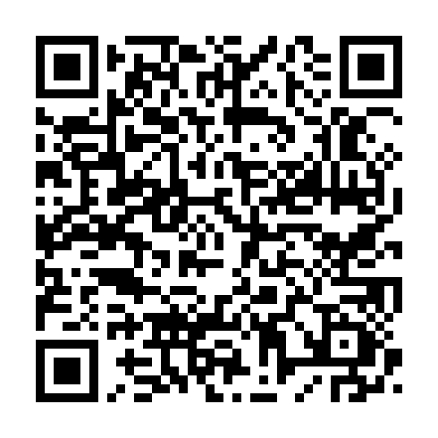
Automate what repeats and checks.
Keep the rest.
START HERE
github.com/BittahCriminal/build-your-own-chief-of-staff
Open START-HERE.md. Prompt kit, not the Claude plugin.
Process files, CoS workflows, blank context templates, the decision matrix.
Source notes live in research/SOURCES.md.
scan: START-HERE.md
Build your own chief of staff · the process, not the tool
11 / 11
Notes:
Close by pointing at the repo. The QR resolves to START-HERE.md on GitHub; the URL next to it is the repo root. Say the URL out loud once for anyone who cannot scan. This kit is provider-agnostic. The Claude plugin of the same processes is a different repository (BittahCriminal/Chief-of-Staff) — do not send them there for this talk.
If they want receipts: research/SOURCES.md catalogs the local source notes and original articles behind the method: https://github.com/BittahCriminal/build-your-own-chief-of-staff/blob/main/research/SOURCES.md
Offer to stay for the first job. Help them run the two tests live on something they did last week.

