Slide 1
Generative Models
Part 9

Slide 2
Outline of the Lecture
Generative Models – Why do we need them ?
Generative Adversarial Networks (GANs)
How to build a GAN
Applications of GANs
Useful online resources

Slide 3
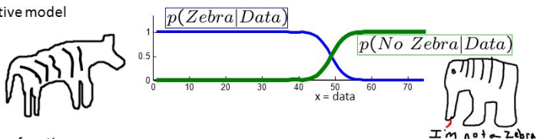
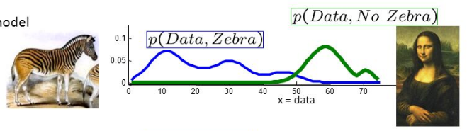
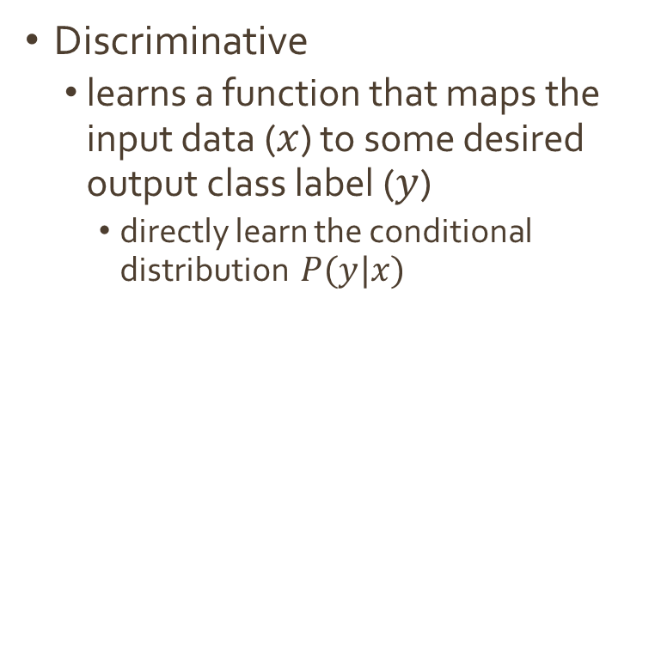
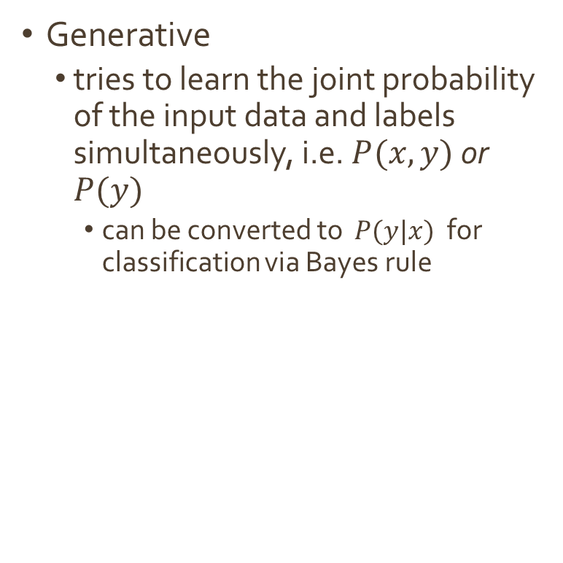
Recap: Discriminative vs Generative Models
Discriminative
learns a function that maps the input data ($x$) to some desired output class label ($y$)
directly learn the conditional distribution $P(y|x)$
Generative
tries to learn the joint probability of the input data and labels simultaneously, i.e. $P(x,y)$ or $P(y)$
can be converted to $P(y|x)$ for classification via Bayes rule
Advantage: generative models have the potential to understand and explain the underlying structure of the input data even when there are no labels
Notes:
A generative algorithm models how the data was generated in order to categorize a signal. It asks the question: based on my generation assumptions, which category is most likely to generate this signal? A discriminative algorithm does not care about how the data was generated, it simply categorizes a given signal.
There are number of advantages of generative models depending on the application. They are typically specified as probabilistic graphical models, which offer rich representation of the independence relations in the data (based on moments – mean and standard deviation for instance, you can make claims about the data). They show how the data is actually generated.
Discriminative models on the other hand, do not offer such clear representations of relations between features and classes in the dataset.
Some, but not all, generative models, provide an estimate of the density function so we can sample from . GANs do not estimate density

Slide 4
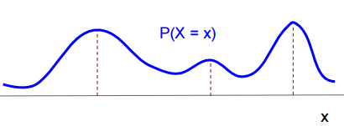
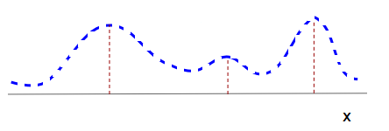



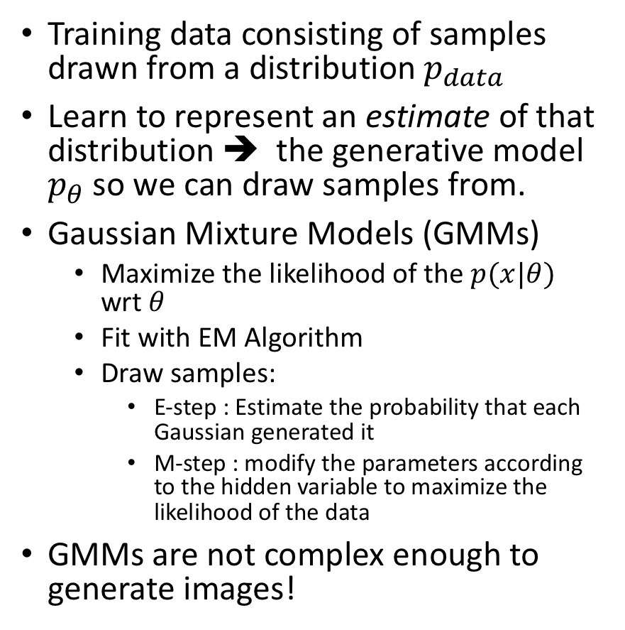
Recap: What is a Generative Model ?
Training data consisting of samples drawn from a distribution $p_{data}$
Learn to represent an estimate of that distribution ➔ the generative model $p_{θ}$ so we can draw samples from.
Gaussian Mixture Models (GMMs)
Maximize the likelihood of the ${p(x|θ)}_{}$ wrt $θ$
Fit with EM Algorithm
Draw samples:
E-step : Estimate the probability that each Gaussian generated it
M-step : modify the parameters according to the hidden variable to maximize the likelihood of the data
GMMs are not complex enough to generate images!
$$𝒩(μ_{1},σ_{1}^{2})$$
$$𝒩(μ_{3},σ_{3}^{2})$$
$$𝒩(μ_{2},σ_{2}^{2})$$
Notes:
You take a large amount of data (p_data) in some domain (millions of images or sentences, etc.) and then train a model to generate data like it p_ ☺
Generative models (e,g, generative classifiers) try to learn the model that generates the data by estimating the assumptions and distributions of the model.
GMM: given a set of data x1… xn drawn from and unknown distribution, estimate the parameters theta of the GMM model that fits the data.
You start with latent components that are indicative of the Gaussians in your data.
GMMs does not know which point come from which component. Iterative algorithms like EMs can help to get around this.
Repeat. This converges to a local optimum.
The problem with such models is that they are not as deep and learns only from the parameters that the user provides.

Slide 5
Recap: Examples: Discriminative vs Generative
Discriminative Models
(learns a hard/soft boundary)
Logistic Regression
Perceptron
SVMs
NNs
RNNs
Generative Models
(learns a distribution)
Naïve Bayes
GMMs
GANs
…

Slide 6
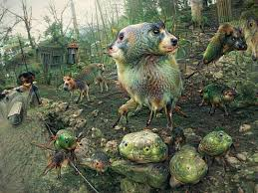
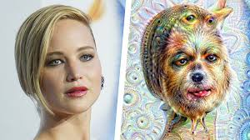
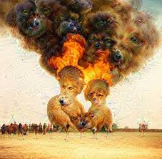
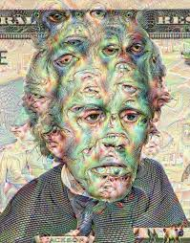
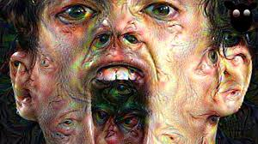
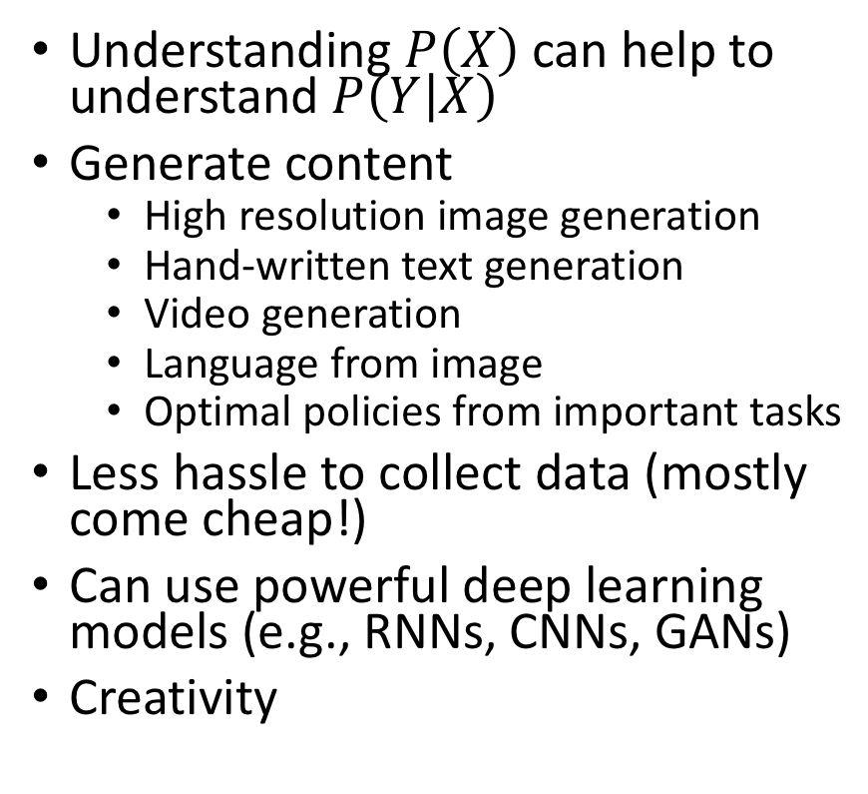
Why are generative models useful?
Understanding $P\left(X\right)$ can help to understand $P\left(Y | X\right)$
Generate content
High resolution image generation
Hand-written text generation
Video generation
Language from image
Optimal policies from important tasks
Less hassle to collect data (mostly come cheap!)
Can use powerful deep learning models (e.g., RNNs, CNNs, GANs)
Creativity
Notes:
The question we would like to ask is in which situation is re-generation useful or necessary in some sense ?

Slide 7
GANs - Generative Adversarial Networks

Slide 8
Generative Adversarial Networks
Relatively new ML architecture (since 2014)
To understand GANs, we need to understand Supervised and Unsupervised Models
GANs and RL can be seen as methods to improve unsupervised learning
Notes:
GAN is a relatively new Machine Learning architecture for neural networks pioneered by Ian Goodfellow and his colleagues at University of Montreal in 2014.
In order to fully understand GANs, one has to understand the difference between Supervised and Unsupervised learning machines.
Supervised machines are trained and tested based on large quantities of “labeled” samples. In other words, they require large datasets containing the “features” or “predictors” as well as its corresponding labels.
The disadvantage of supervised machines is their need for large sums of labeled data. Labeling large number of samples is costly and time consuming. Unsupervised learners don’t have this disadvantage but they tend to be less accurate. Naturally there is a strong motivation to improve the unsupervised machines and to lessen the reliance on the supervised ones. You can view GANs and RLs means of improving unsupervised machines (neural networks).

Slide 9




How do GANs work ?
New method for training deep generative models
IDEA: pit a generator (G) and discriminator (D) against each other (minimax game)
G tries to draw samples from P(X) and D decides if they are fake or real
Real Images
sample
$$x^{t}$$
Real
Loss
Discriminator
Generator
$$x^{f}$$
Fake
$$P(X)$$
$$z$$
Latent Random Variable
Notes:
Discriminator receives xt and xf separately. The target label for xt is 1 and for xf is 0.

Slide 10
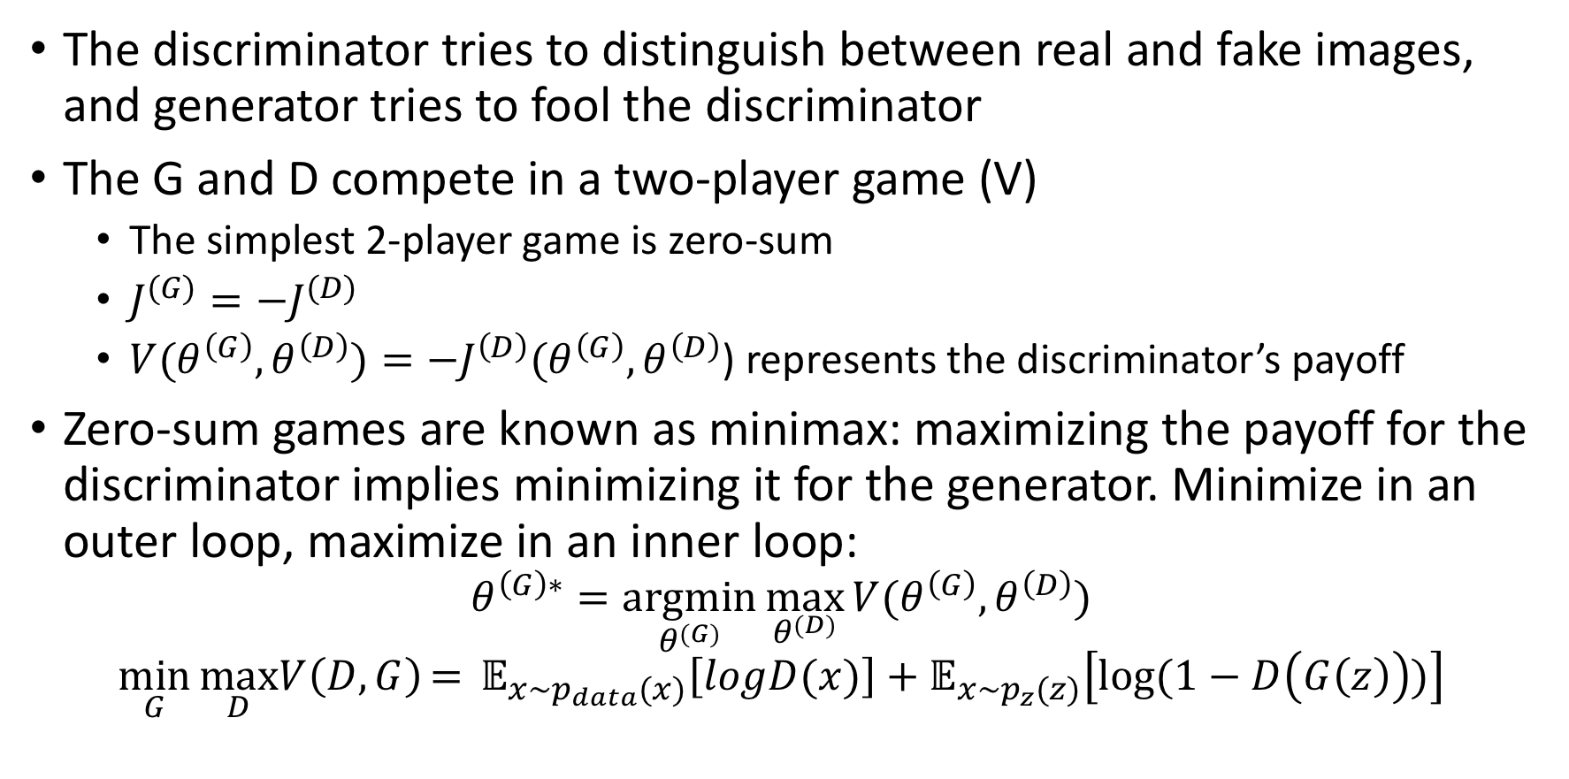
How do GANs work?
The discriminator tries to distinguish between real and fake images, and generator tries to fool the discriminator
The G and D compete in a two-player game (V)
The simplest 2-player game is zero-sum
$J^{(G)}=−J^{(D)}$
$V(θ^{\left(G\right)},θ^{\left(D\right)})=−J^{\left(D\right)}(θ^{\left(G\right)},θ^{\left(D\right)}$) represents the discriminator’s payoff
Zero-sum games are known as minimax: maximizing the payoff for the discriminator implies minimizing it for the generator. Minimize in an outer loop, maximize in an inner loop:
$$θ^{\left(G\right)∗}=\underset{θ^{(G)}}{argmin}{\max_{θ^{(D)}}{V(θ^{\left(G\right)},θ^{\left(D\right)})}}$$
$$\min_{G}{\max_{D}V\left(D,G\right)}={𝔼_{x\sim p_{data}(x)}\left[logD(x)\right]+𝔼_{x\sim p_{z}(z)}\left[log⁡(1−D\left(G\left(z\right)\right))\right]}$$
Log. prob. of D predicting that real data is genuine
Log. prob. of D predicting that G’s data is fake
Notes:
Training GANs requires finding a NASH equilibrium for a non-convex game with continuous high dimensional parameters.
E is expectation = sum(p(x)x)
It needs not be a zero-sum game

Slide 11
Training GANs
GANs are typically trained using SGD and similar techniques
Finding min (log(1-D(G(z))) is expensive. We find max (log(D(G(z))) instead.
Training GANs means finding the Nash equilibrium of the game between G and D
Nash equilibrium is reached when no player can do better by changing its strategy unilaterally (or in this case its parameters)
Equilibrium is reached when G’s output distribution matches that of real data (in theory)
In practice, we approximate:
Train D with G held constant
Train G with D held constant

Slide 12
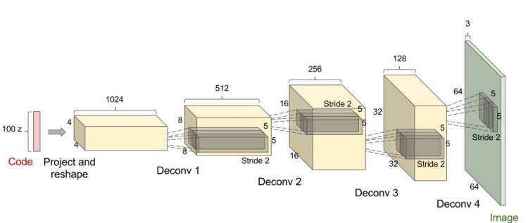
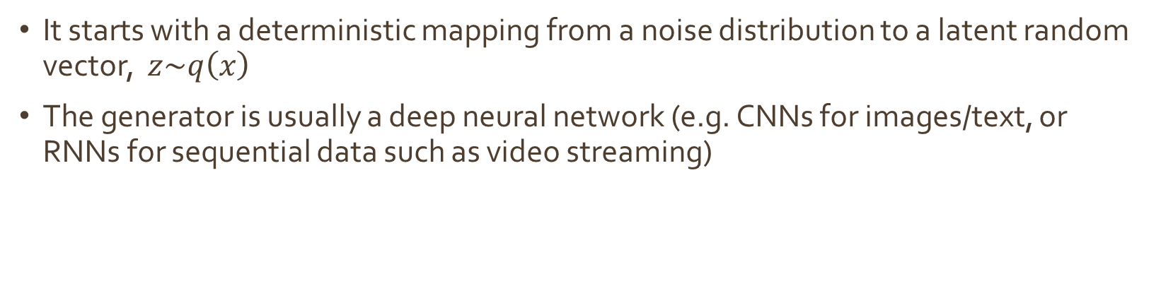
The generator (G)
It starts with a deterministic mapping from a noise distribution to a latent random vector, $z\sim q\left(x\right)$
The generator is usually a deep neural network (e.g. CNNs for images/text, or RNNs for sequential data such as video streaming)
$$\min_{G}{V\left(D,G\right)=}{𝔼_{x\sim p_{z}(z)}\left[log⁡(1−D\left(G\left(z\right)\right))\right] }$$

Slide 13
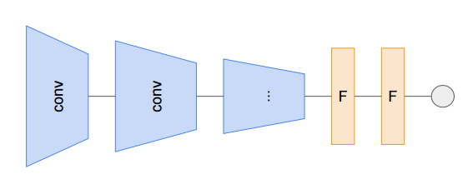
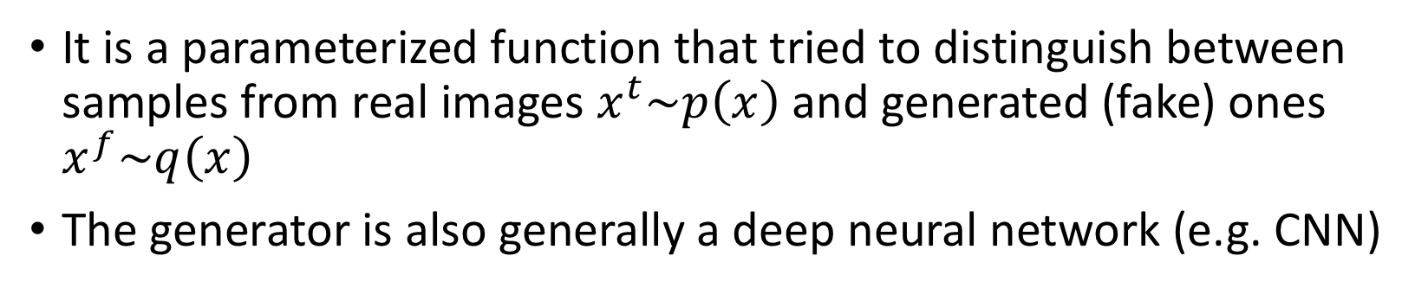
The discriminator (D)
It is a parameterized function that tried to distinguish between samples from real images $x^{t}\sim p\left(x\right)$ and generated (fake) ones $x^{f}\sim q\left(x\right)$
The generator is also generally a deep neural network (e.g. CNN)
$$\max_{D}V\left(D,G\right)={𝔼_{x\sim p_{data}(x)}\left[logD(x)\right]+𝔼_{x\sim p_{z}(z)}\left[log⁡(1−D\left(G\left(z\right)\right))\right] }$$

Slide 14
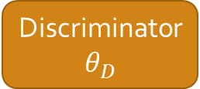



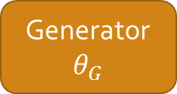
Training GANs : D-Step
Backprop error to update discriminator weights
Alternate between training the discriminator and generator
Fix generator weights, draw samples from both real and generated images
Train discriminator to distinguish between real and generated images.
D tries to force D(G(z)) near 0 (fake) and G tries to force D(G(z)) near 1 (real)
Real Images
sample
$$x^{t}$$
Real
Loss
Discriminator
$$θ_{D}$$
$$x^{f}$$
Generator
$$θ_{G}$$
Fake
Differentiable function
$$z$$
Notes:
you sample random noise, then put it through the generator to produce something (hopefully!) image-like.
Then you take that image and put it through the discriminator. Since you know that it was a fake image, you can tell the discriminator that it was a negative (fake) example. Then you backprop through the discriminator to make it more likely to classify that image as fake.

Slide 15
Training GANs : G-Step
Fix discriminator weights
Sample from generator
Backprop error through discriminator to update generator weights
The gradients “teach” the generator what it needs to improve
Real Images
sample
$$x^{t}$$
Real
Loss
Discriminator
$$θ_{D}$$
$$x^{f}$$
Generator
$$θ_{G}$$
Fake
Backprop error to update generator weights
$$z$$
Notes:
We can use the gradients from the discriminator to train the generator! These gradients tell the generator exactly what it needs to change about this image in order to make it better (that is, to make it more likely to fool the discriminator). Since we're using the discriminator to tell the generator how well it's doing, we call this a discriminative loss function for the generator.

Slide 16
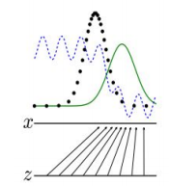
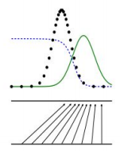
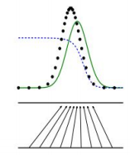
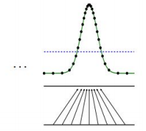
Training GANs
Iterate the D-step and G-step until convergence (which may not happen!)
Note:
Updating the discriminator should make it more robust to discriminating between real images and generated ones (discriminator improves)
Updating the generator makes it better at fooling the current discriminator (generator improves)
With enough training instances and careful selection of parameters and some hand-holding the generator gets so good that it is impossible for the discriminator tot tell the difference between the real and generated images.

Slide 17
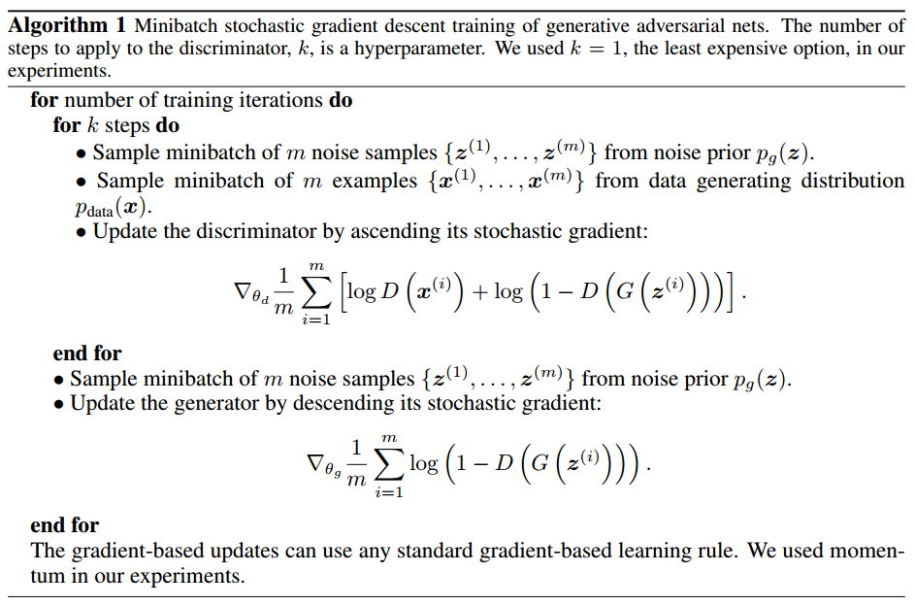
GAN Training Algorithm
Discriminator
Generator
Goodfellow, et al., “Generative adversarial networks,” in NIPS, 2014.
Notes:
We look for a min (descend) for G and and a max (ascend) for D

Slide 18
Possible Issues With Training GANs
Make the generator produce diverse samples.
Generate samples in discrete domains.
Pixel domain : make a pixel just slightly less green – how slightly?
Word domain: make a generator produce a phrase slightly closer to “my fluffy pet kitty” than “my fluffy pet shark”. Embeddings?
Instability of training:
Generator might start out producing random patterns, improve, then become noisy again.
This happens if the G and D start chasing each other again.
Sometime D converges quicker than G, so G gets stuck producing nonsense.
Notes:
Generative modeling is probably the hardest problem in machine learning because the data distribution can be very complex. There are an awful lot of possible images out there and it's hard to even evaluate what fraction of them the model is capturing.

Slide 19
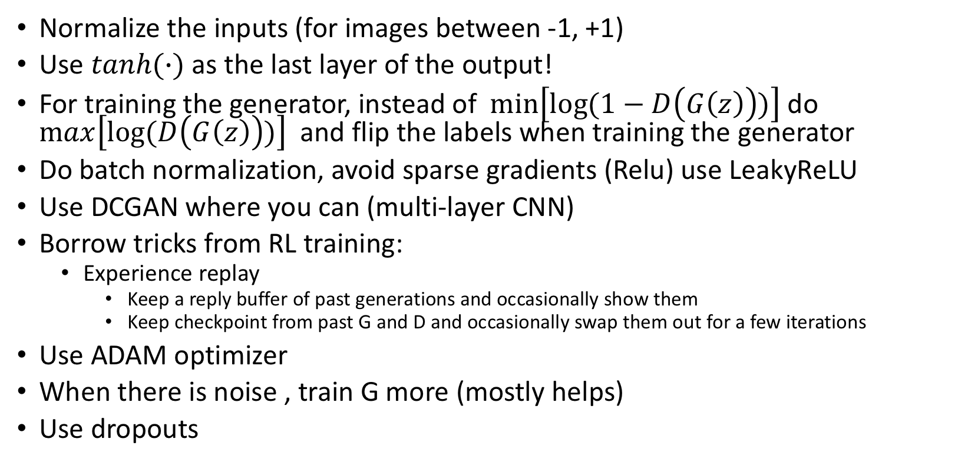
Tips and Tricks to make GANs work
Normalize the inputs (for images between -1, +1)
Use $tanh⁡(∙)$ as the last layer of the output!
For training the generator, instead of $min\left[log⁡(1−D\left(G\left(z\right)\right))\right]$ do $max\left[log⁡(D\left(G\left(z\right)\right))\right]$ and flip the labels when training the generator
Do batch normalization, avoid sparse gradients (Relu) use LeakyReLU
Use DCGAN where you can (multi-layer CNN)
Borrow tricks from RL training:
Experience replay
Keep a reply buffer of past generations and occasionally show them
Keep checkpoint from past G and D and occasionally swap them out for a few iterations
Use ADAM optimizer
When there is noise , train G more (mostly helps)
Use dropouts
Notes:
The fundamental problem is the instability of training
Why use tanh ? This is important because you will work with the gradients over a lot of layers and than provides stronger gradients. For input between [-1,1] the derivatives we have derivates between [0.42,1] whereas for the input between [0,1] the derivatives are between [0.2, 0.25]
Batch normalization provides a layer with inputs of zero mean and 1 variance
Leaky relu is not 0 for x<0 it has a small negative slope instead to provide a small gradient so the neuron does not totally die

Slide 20
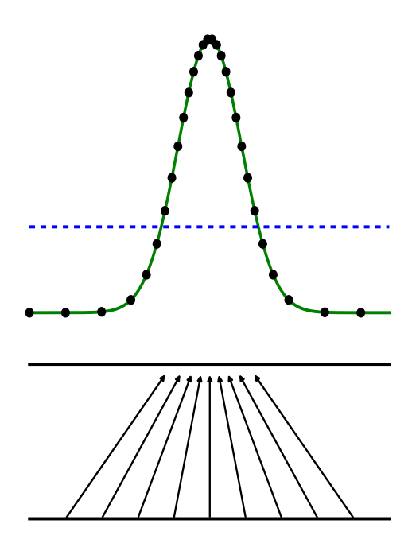
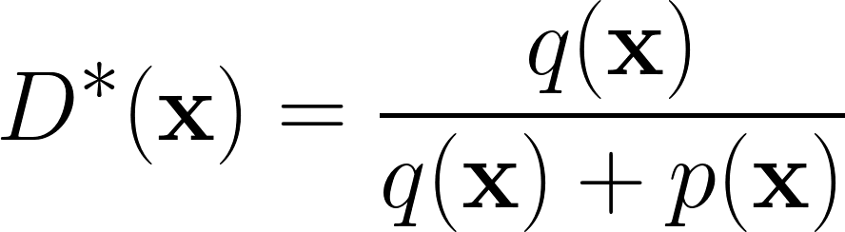
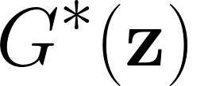
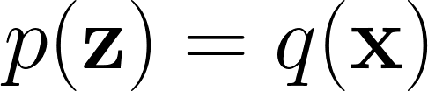
GAN Nash Equilibrium
Global optimality
Discriminator
Generator
D
G
s.t.
Two competing networks are trained towards global optimality
Goodfellow, et al., “Generative adversarial networks,” in NIPS, 2014.

Slide 21
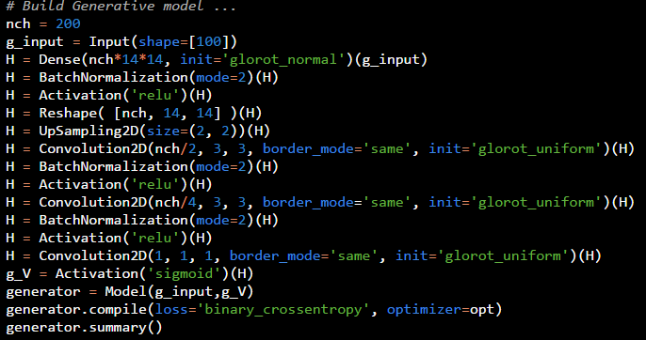
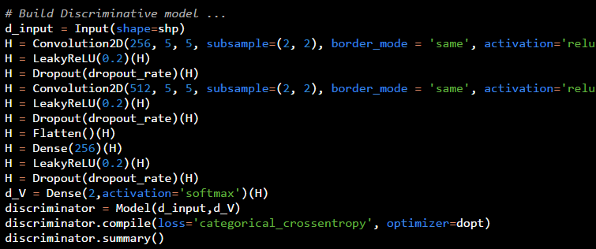
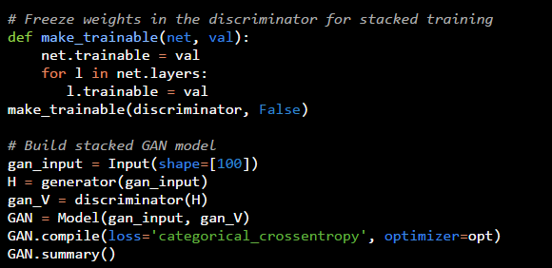
Example GAN training using Tensorflow/Keras
Notes:
GAN is a relatively new Machine Learning architecture for neural networks pioneered by Ian Goodfellow and his colleagues at University of Montreal in 2014.
In order to fully understand GANs, one has to understand the difference between Supervised and Unsupervised learning machines.
Supervised machines are trained and tested based on large quantities of “labeled” samples. In other words, they require large datasets containing the “features” or “predictors” as well as its corresponding labels.
The disadvantage of supervised machines is their need for large sums of labeled data. Labeling large number of samples is costly and time consuming. Unsupervised learners don’t have this disadvantage but they tend to be less accurate. Naturally there is a strong motivation to improve the unsupervised machines and to lessen the reliance on the supervised ones. You can view GANs and RLs means of improving unsupervised machines (neural networks).

Slide 22
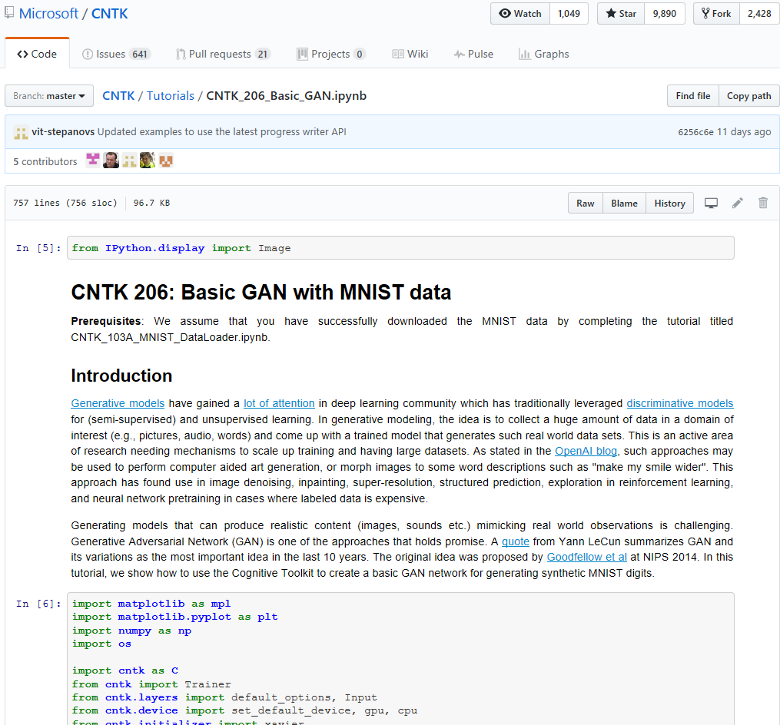
An Example GAN training using CNTK
Notes:
\

Slide 23
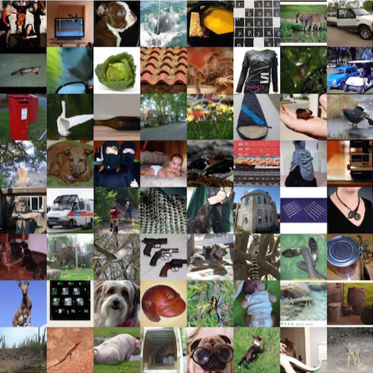
Real World Use Cases for GANs
Image generation
Notes:
Training GANs consists in finding the NASH Equilibrium to a two player non-cooperative game

Slide 24
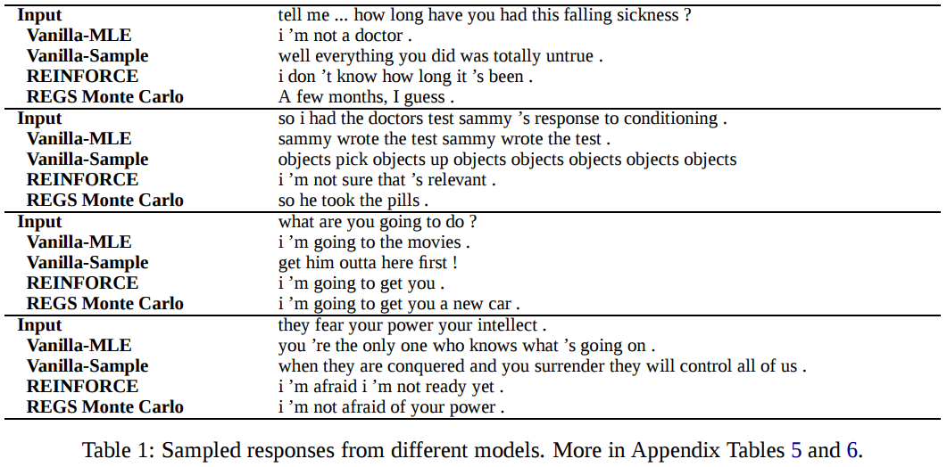
Real World Use Cases for GANs
Image generation
Sentence generation (e.g., dialog modeling response generation)
Generative Model (G)
Generates a response y given dialogue history x.
Standard Seq2Seq model with Attention Mechanism
Discriminative Model (D)
Binary Classifier that takes as input a sequence of dialogue
utterances {x, y} and outputs label indicating whether the
input is generated by human or machines
Hierarchical Encoder + 2 class softmax function -> returns probability of the input dialogue episode being a machine or human generated dialogues.
Notes:
Training GANs consists in finding the NASH Equilibrium to a two player non-cooperative game

Slide 25
Real World Use Cases for GANs
Image generation
Sentence generation (e.g., dialog modeling response generation)
Question generation (e.g., in machine comprehension tasks)
Notes:
Training GANs consists in finding the NASH Equilibrium to a two player non-cooperative game

Slide 26
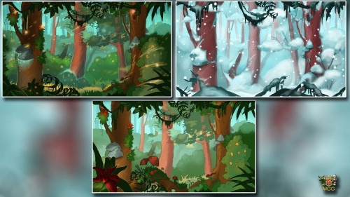
Real World Use Cases for GANs
Image generation
Sentence generation (e.g., dialog modeling response generation)
Question generation (e.g., in machine comprehension tasks)
Background image generation for game developers (to generate background images for moving images, videos)

Slide 27
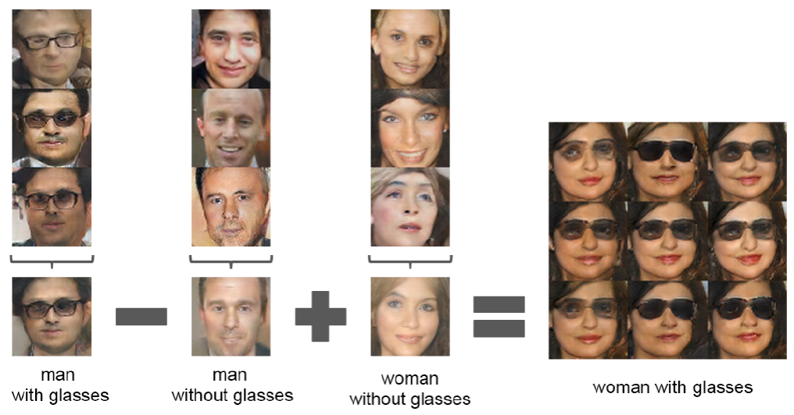
Real World Use Cases for GANs
Image generation
Sentence generation (e.g., dialog modeling response generation)
Question generation (e.g., in machine comprehension tasks)
Background image generation for game developers (to generate background images for moving images, videos)
Creative AI: Interior Design
Notes:
Training GANs consists in finding the NASH Equilibrium to a two player non-cooperative game

Slide 28
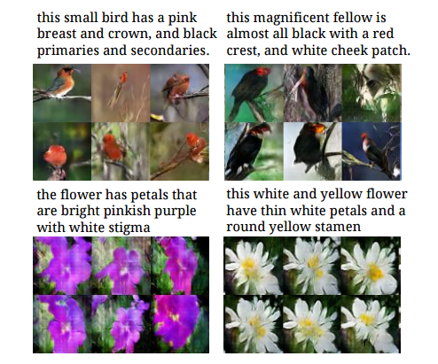
Extending GANs
Text 2 Image Synthesis
Takes a textual description as external information and it generates image based on it.
INFOGAN
generate representations that contain information about the dataset in an unsupervised way
Notes:
The InfoGAN model proposed by OpenAI researchers in August can generate representations that contain information about the dataset in an unsupervised way. For instance, it discovers visual concepts that include hair styles, presence/absence of eyeglasses, and emotions on the CelebA face dataset. when applied to the MNIST dataset it is able to infer the type of number (1, 2, 3, …), the rotation and the width of the generated samples without the need for manually tagged data.
Takes a textual description (encoded as a vector by a character level CNN or LSTM) as external information and it generates image based on it.

Slide 29
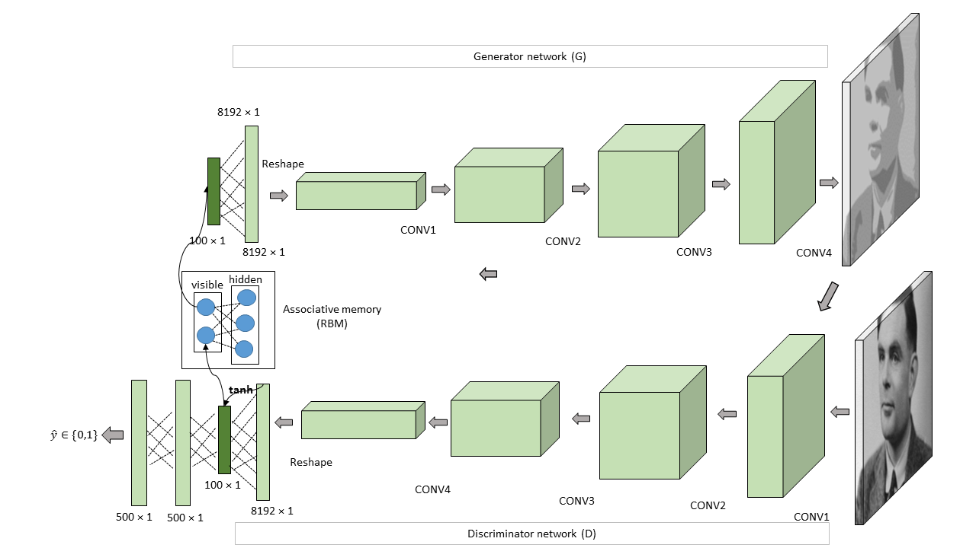
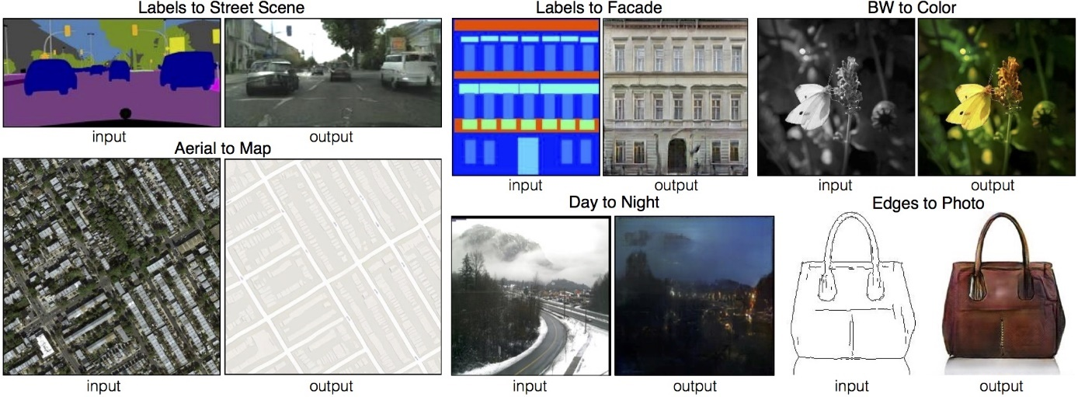
Extending GANs
Image 2 Image
generate representations that contain information about the dataset in an unsupervised way
Associative Adversarial Networks
3rd network that samples features for the generator to sample
Notes:
Maps input image to output image

Slide 30
Useful Links on GANs
Basic GAN with CNTK [link]
Ian Goodfellow’s tutorial:
Slides: http://www.iangoodfellow.com/slides/2016-12-04-NIPS.pdf
Video: [link]
It has 3 exercises with answers to help learn GANs!
OpenAI website on Generative Models:
https://openai.com/blog/generative-models/
Several new advancements of GANs are posted on arxiv.org almost everyday: www.arxiv.org

